Slide 1
CI/CD Intro and Jenkins Pipeline
Neha Sharma

Slide 2
Agenda
Meeting Objective
CI/CD definition and introduction to the pipeline.
Tools and services.
Groovy Scripts(JPaC and GPL) used for the pipeline.
Demo of the pipeline
Q&A
Notes:
Source:
https://codeship.com/continuous-integration-essentials

Slide 3
Continuous Integration
Continuous Integration (CI) is a development practice where developers integrate code into a shared repository frequently, preferably several times a day. Each integration can then be verified by an automated build and automated tests.
One of the key benefits of integrating regularly is that you can detect errors quickly and locate them more easily. As each change introduced is typically small, pinpointing the specific change that introduced a defect can be done quickly.
Notes:
Source:
https://codeship.com/continuous-integration-essentials

Slide 4
Continuous Delivery/Deployment
Continuous Delivery (CD) is the practice of making sure your software is always production ready throughout its entire lifecycle. Beyond making sure your application passes automated tests it has to have, all the configuration necessary to push it into production using a fully automated process in a matter of seconds or minutes
Continuous Deployment (CD) refers to automatically releasing to the production environment if the latest version passes all automated tests.
Notes:
Source:
https://codeship.com/continuous-integration-essentials

Slide 5
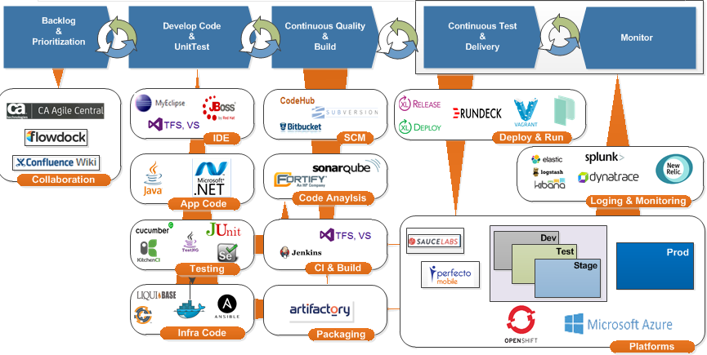
OSAM Continuous Delivery & Quality
source: https://hubconnect.uhg.com/groups/osam-continuous-delivery-quality
Notes:
Source: https://hubconnect.uhg.com/groups/osam-continuous-delivery-quality

Slide 6
Getting Started
1. Source Code Management
Git on CodeHub
2. Build Services
Maven
Maven is a build automation tool used primarily for Java projects. Based on the concept of a project object model (POM)
Jenkins
Open source automation server which supports version control tools, scripts, deployment tools etc. through plugins
Artifactory
Binary repository manager where artifacts are stored
3. Deployment Management
XLDeploy
4. Release Management
XLRelease
5. Deployment Target
Jboss VM/ WAS/
OpenShift Enterprise
6. Code Quality
Sonar and Fortify Scan

Slide 7
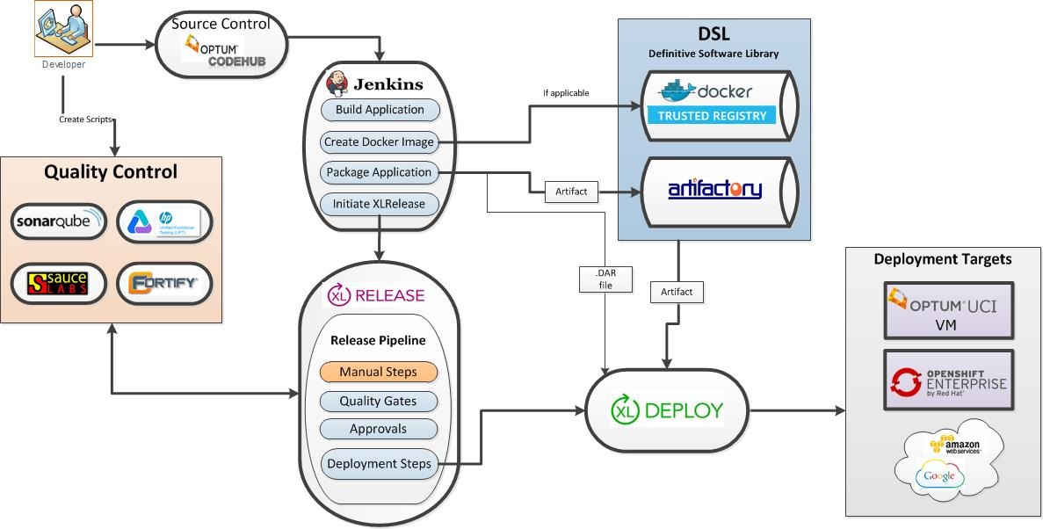
Optum Enterprise Tech CI/CD Services
Notes:
Source: https://hubconnect.uhg.com/docs/DOC-75599

Slide 8
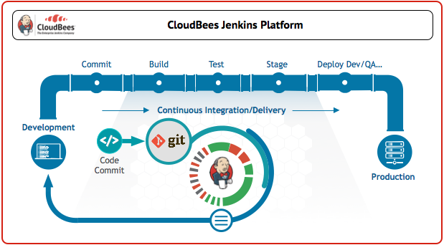
What is a Jenkins Pipeline
Jenkins Pipeline

Slide 9
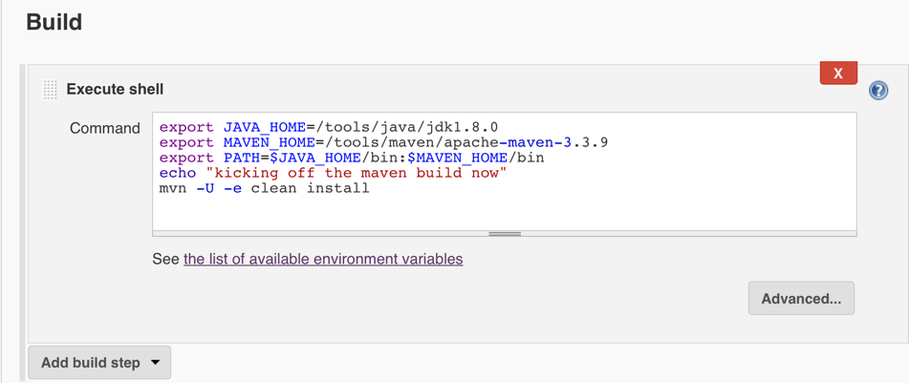
Jenkins UI – Job Config – Build – Execute Shell

Slide 10
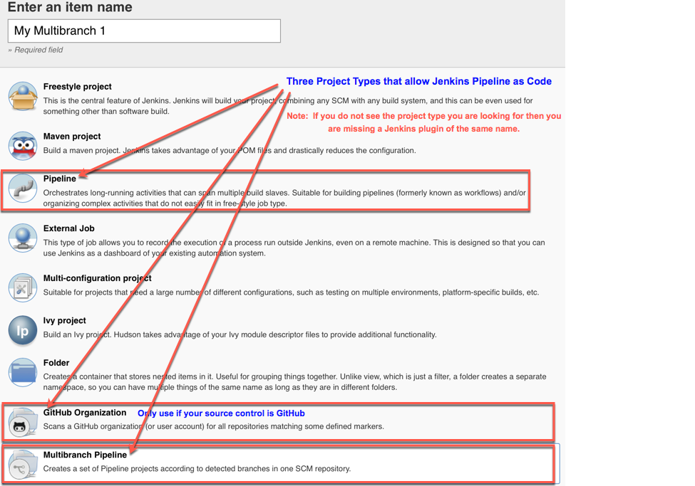
Creating a Jenkins Pipeline as Code Project
Describe Multibranch Pipeline

Slide 11
Jenkins Pipeline as Code
Jenkins Pipeline as Code Benefits
Features Delivered faster
Checked into source control
Versioned
Easily Sharable within an Organization
Support for extending the Domain Specific Language with additional,
organization specific steps, via the "Shared Libraries" feature.(GPL in our case)
More control using groovy DSL to run tests in parallel.
Notes:
350 lines

Slide 12
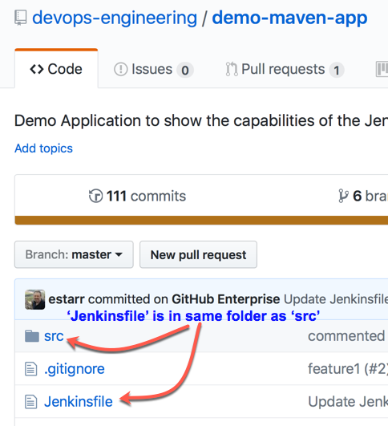
‘Jenkinsfile’ and ‘src’ are in same directory

Slide 13
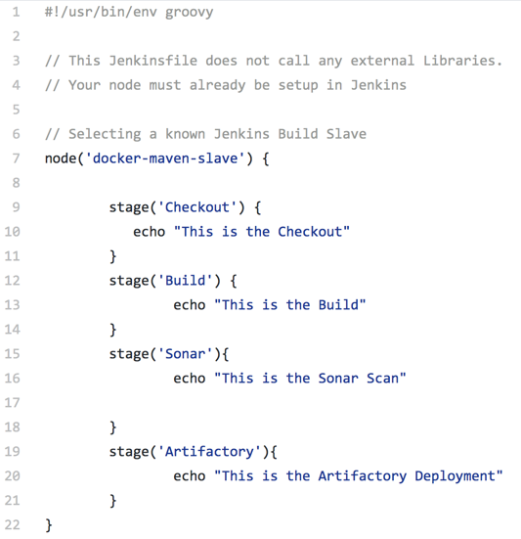
Basic Jenkinsfile Structure - Scripted
https://github.optum.com/devops-engineering/demo-maven-app/blob/master/Jenkinsfile0

Slide 14
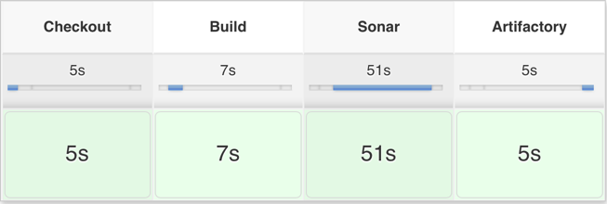
Jenkins Pipeline Stages

Slide 15
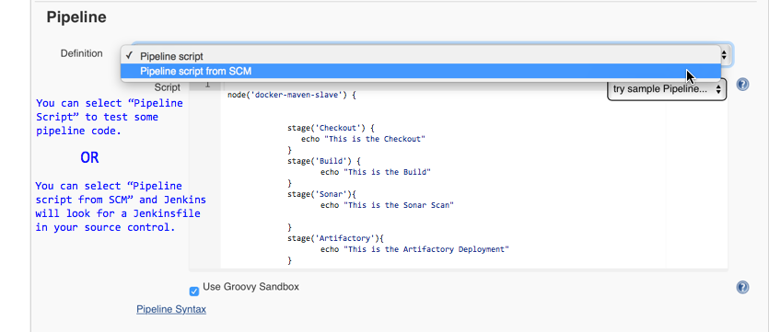
JPaC - Pipeline Job Config

Slide 16
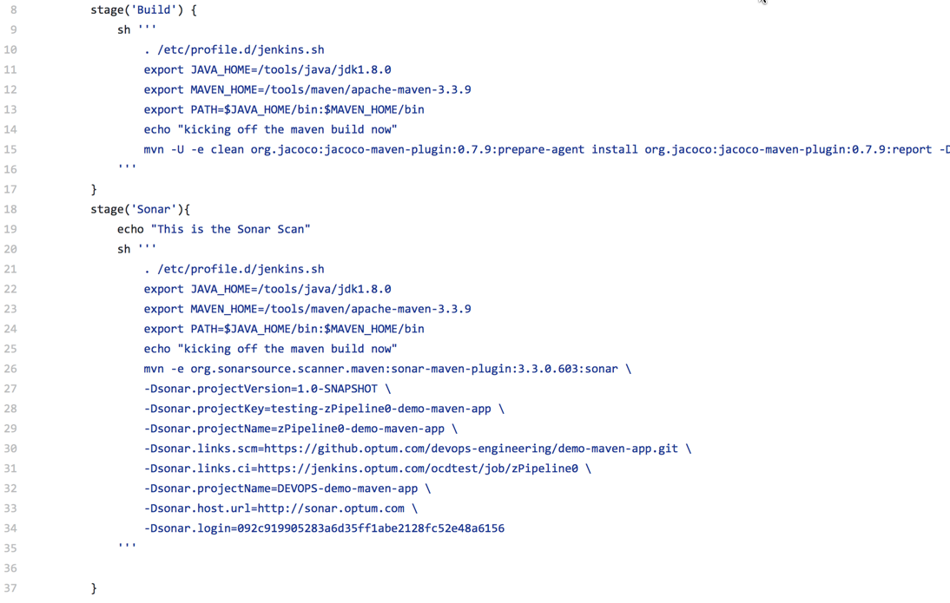
Jenkinsfile with no Global Pipeline Library
https://github.optum.com/devops-engineering/demo-maven-app/blob/master/Jenkinsfile0-Finished

Slide 17
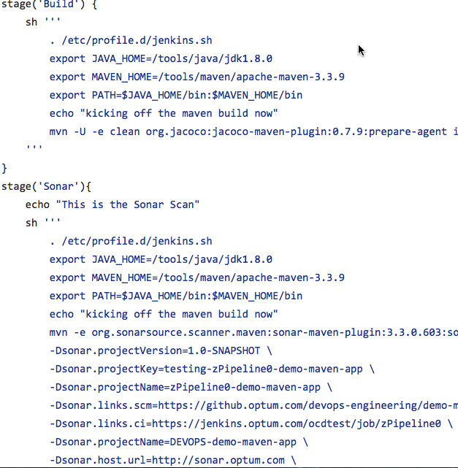
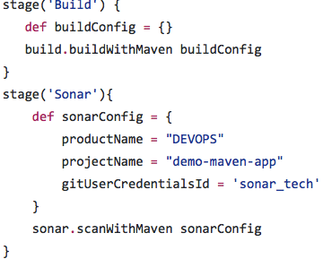
JPaC vs JPaC with GPL Comparison
JPaC with NO GPL
w/ Global Pipeline Library

Slide 18
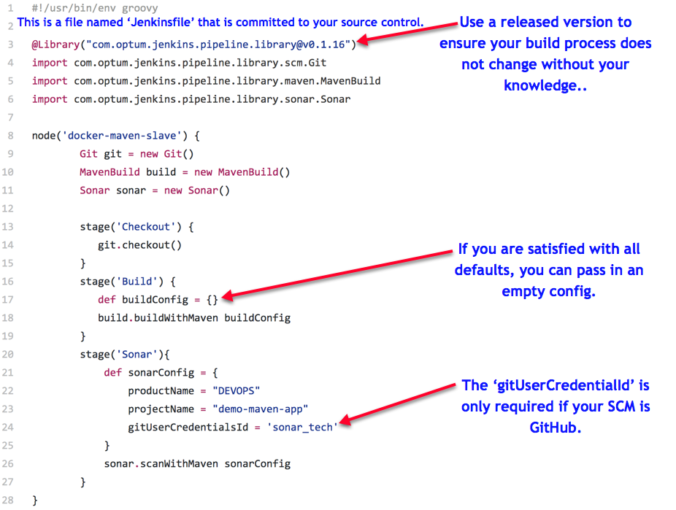
https://github.optum.com/devops-engineering/demo-maven-app/blob/master/Jenkinsfile1-Finished

Slide 19
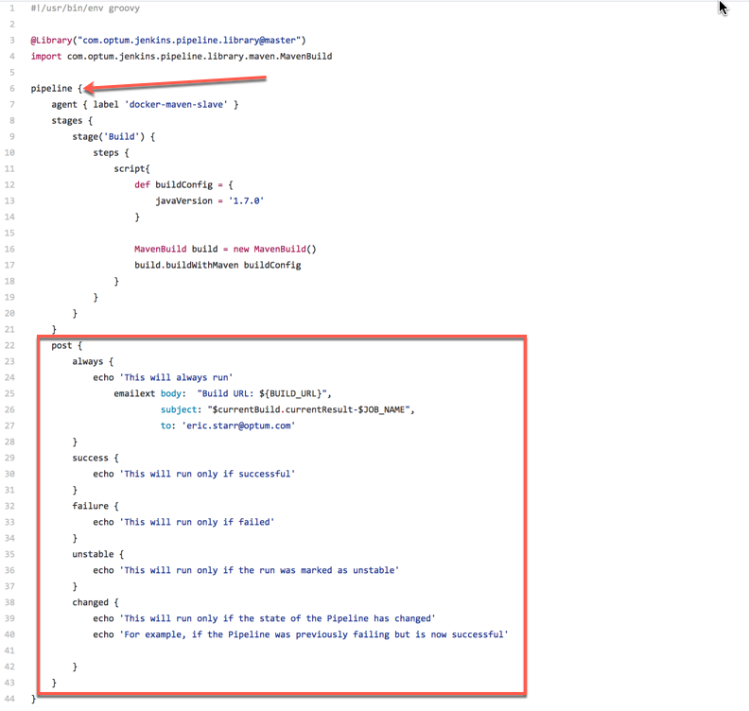
Jenkins Global Pipeline Library and Declarative
More detail
https://github.optum.com/devops-engineering/demo-maven-app/blob/master/Jenkinsfile-declarative

Slide 20
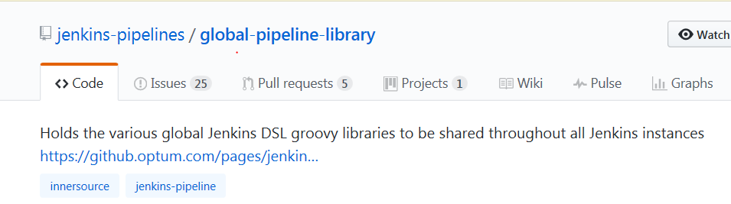
Jenkins Global Pipeline Library
This repository is a collection of shared Groovy classes to extend the functionality
of your Jenkins Pipeline by defining your Jenkins Pipeline in a simple Jenkinsfile.
https://github.optum.com/jenkins-pipelines/global-pipeline-library

Slide 21
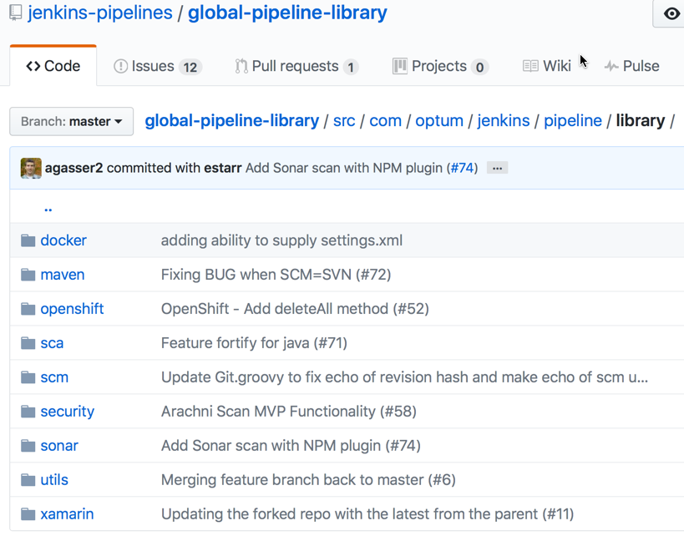
Global Pipeline Library – Directory Structure

Slide 22
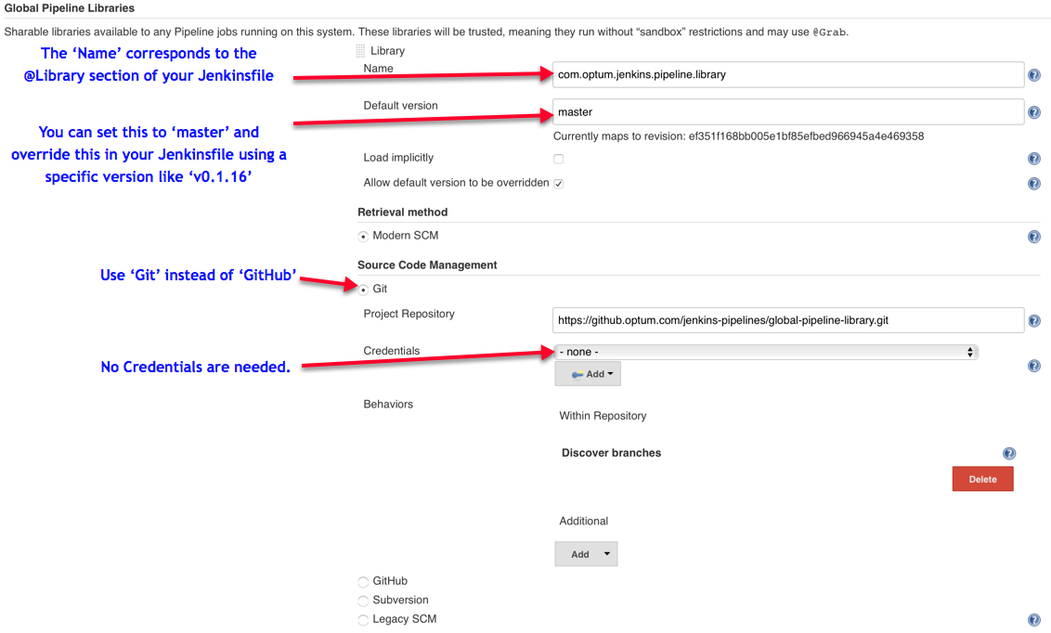
Jenkins -> Manage Jenkins -> Configure System

Slide 23
Global Pipeline Library – Features
Current Features
MavenBuild
Artifactory Deployment
Sonar Scan
Maven, Gradle, Sonar Plugin
Fortify Scan
Artifactory Scan
Docker Image Build, Tag, Push to DTR
OpenShift Deploy
XL-Deploy for VM Deploy

Slide 24

Global Pipeline Library
Global Pipeline Library Benefits
Faster Software Production
Greater Revenue Gains
Better Response to Market Conditions
Exponential Time and Money Savings
Increases Reusability – DRY
Easy to Add Quality Across Enterprise
Lowers Technical Barriers to Get Started
Encourages Inner-sourcing

Slide 25
Where to Get More Help
Optum Resources
HubConnect: JPaC Step-by-Step-Guide
See the JPaC Office Hours info: Every Friday 9-11am ET
HubConnect: Jenkins Build Service (see the Getting Started Guide)
Flowdock: Jenkins Pipeline as Code
Jenkins Sites:
https://jenkins.io
https://jenkins.io/solutions/pipeline/
https://jenkins.io/doc/pipeline/examples/
External Reading
http://martinfowler.com/books/continuousDelivery.html
http://www.martinfowler.com/articles/continuousIntegration.html
http://itrevolution.com/books/phoenix-project-devops-book/

Slide 26


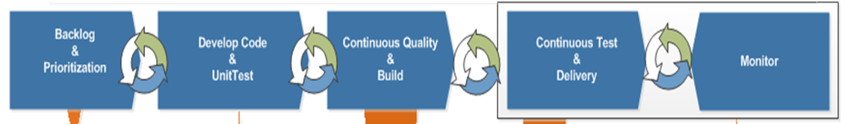
O2M DEVOPS – Selfservice Tools
Are you tired of doing manual deployments and resolving the issues from manual deployments in your application. Implement CI/CD just keep deploying and ease your work
CI/CD
Continuous Integration (CI) is a development practice where developers integrate code into a shared repository frequently, preferably several times a day. Each integration can then be verified by an automated build and automated tests
Continuous Delivery (CD) is the practice of making sure your software is always production ready throughout its entire lifecycle. Beyond making sure your application passes automated tests it has to have, all the configuration necessary to push it into production using a fully automated process in a matter of seconds or minutes
Questions
& Answers
How to implement this? Attend a Demo on 28th Nov to know more. For offshore (4:30 AM CT) For onshore (10 AM CT) | Support: If you have a question, please use the ”Ask O2M-DEVOPS” section of the O2M DevOps Hub Connect site and someone will respond. 1. Click on the link: https://hubconnect.uhg.com/groups/ssmo-devops 2. Type your question under the O2M-DevOps, “Ask your question” 3. Click on the button “Ask It”
Please visit hub connect for more details on O2M-Devops

