Slide 1
Lab Seminar
Jiapeng Huang
28th, Mar ,2014

Slide 2
Outline
Back Scattering Experiment
Single Particle Detection Experiment

Slide 3
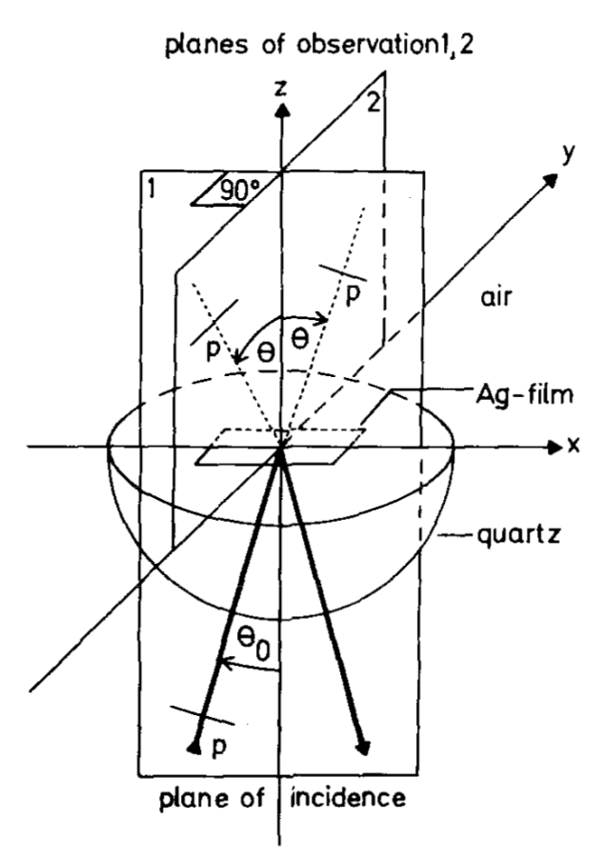
Back Scattering Experiment
From: “Multiple scattering of plasmons at rough surfaces”

Slide 4
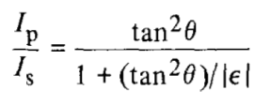
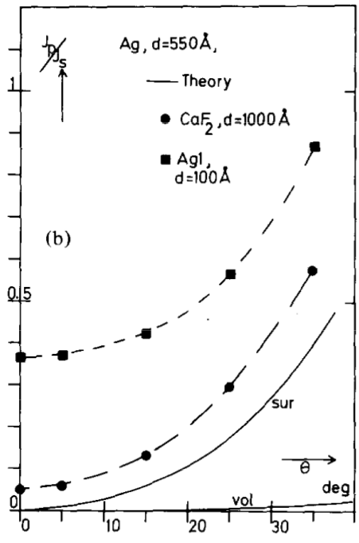
Back Scattering Experiment
For smooth film there is:
In the presence of multiple scattering, at theta 0 degree Ip/Is is not zero.
From: “Multiple scattering of plasmons at rough surfaces”

Slide 5
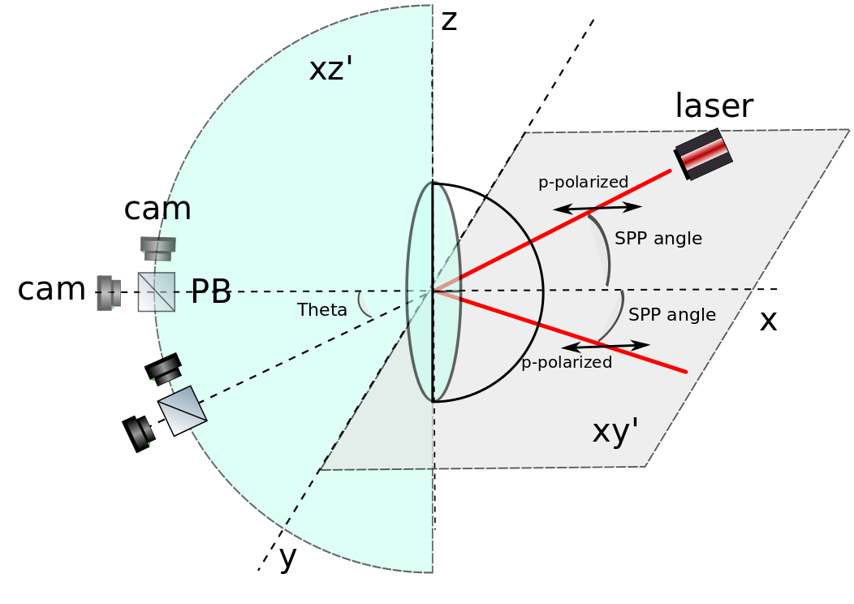
Back Scattering Experiment
Measure s and p polarization lights at the back direction (restlight).
Sputter a 50nm silver layer, with preheating the glass prism to about 300 degree and avoid contacting with metal parts.
xy: plane of incidence
xz: plane of observation

Slide 6
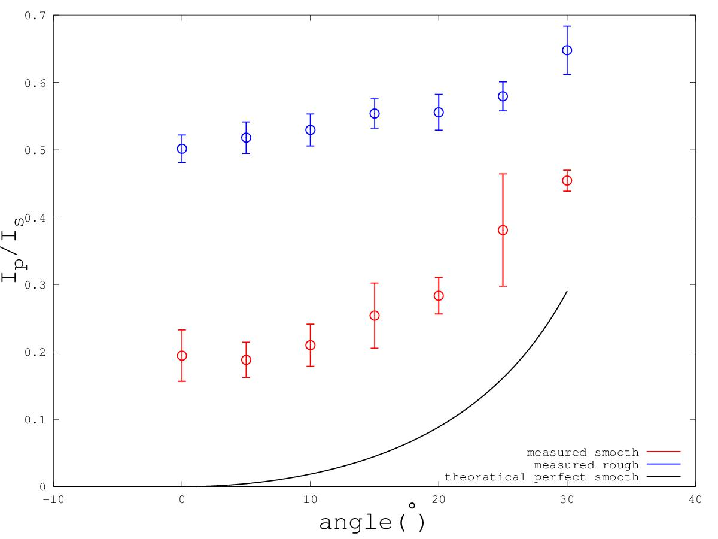
Experimental results
Rough film (preheating)
Less rough film (Plasma treating)

Slide 7
“Single” nano particle detection
DNA binding
Hybridization
High salt environment
ATPMS binding

Slide 8
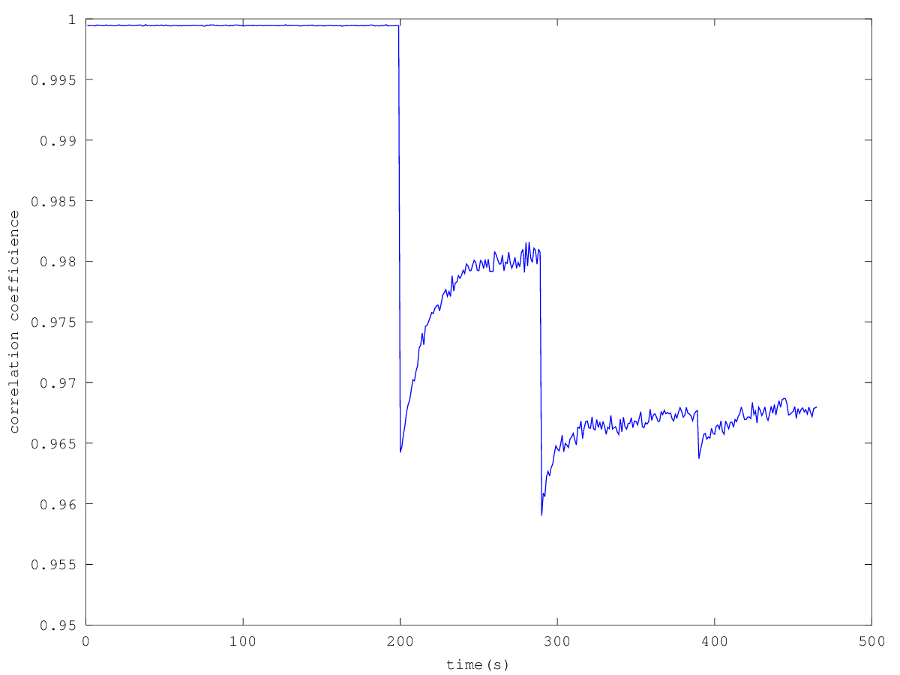
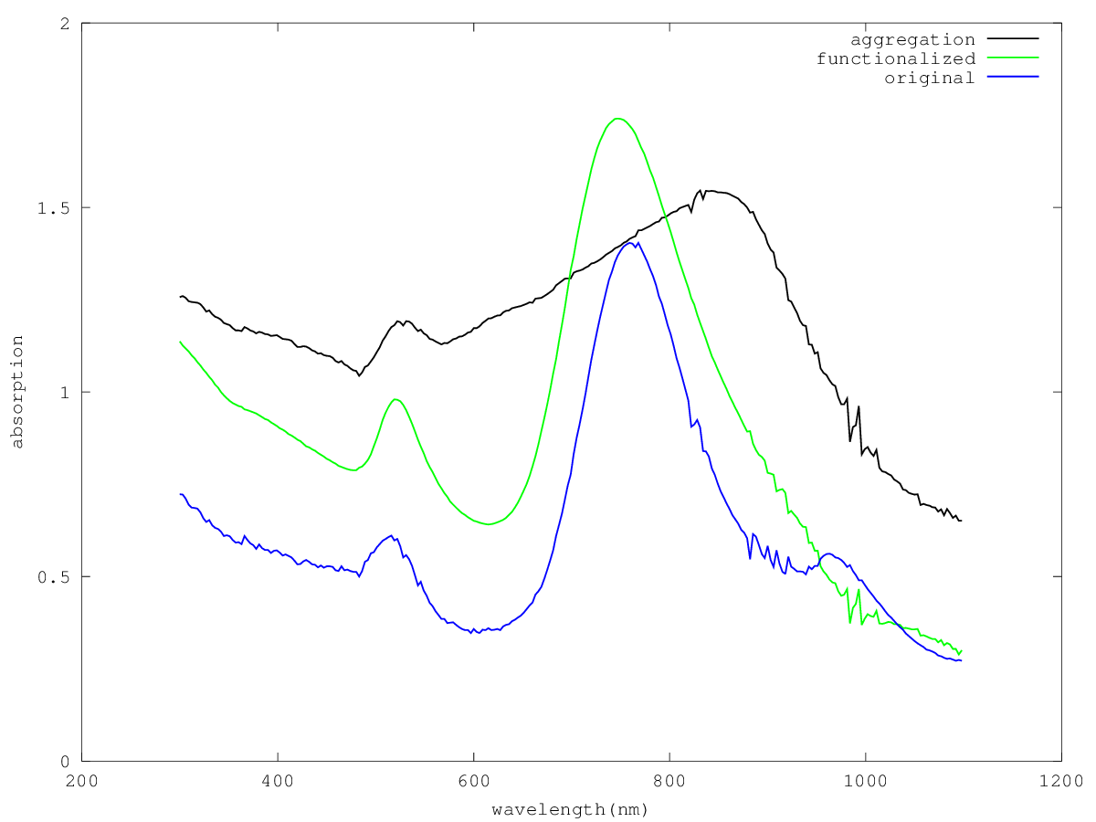
DNA Binding
ph assistant method(in both citrate and TBE buffer)
Both surface and particle can be functionalized

Slide 9
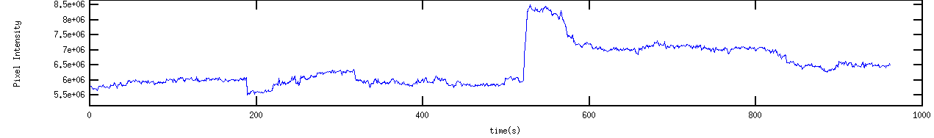
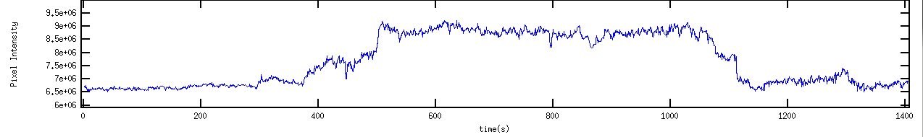
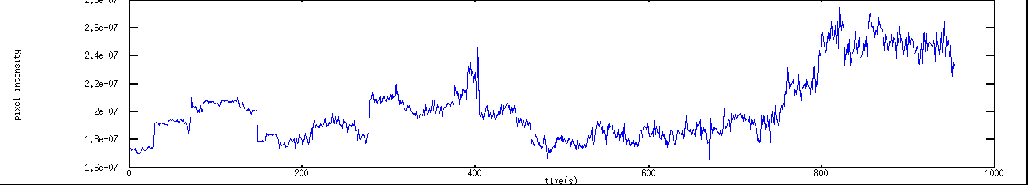
High salt environment
Put NaCl into DNA-functionalized Au NP(57nm) solution to reach about 200mM concentration.

Slide 10
ATPMS binding
Sputtering ~3nm SiO2 on top of gold.
Binding ATPMS on the SiO2 surface.
ATPMS should bind to Au NP
ATPMS should bind to Carboxylic functionalized particles

Slide 11
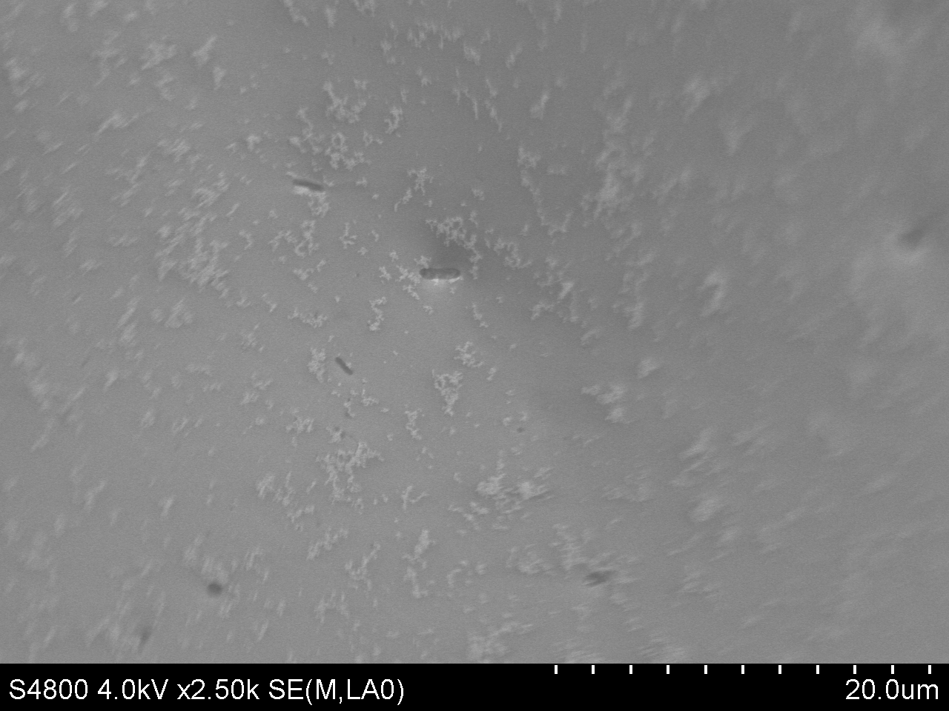
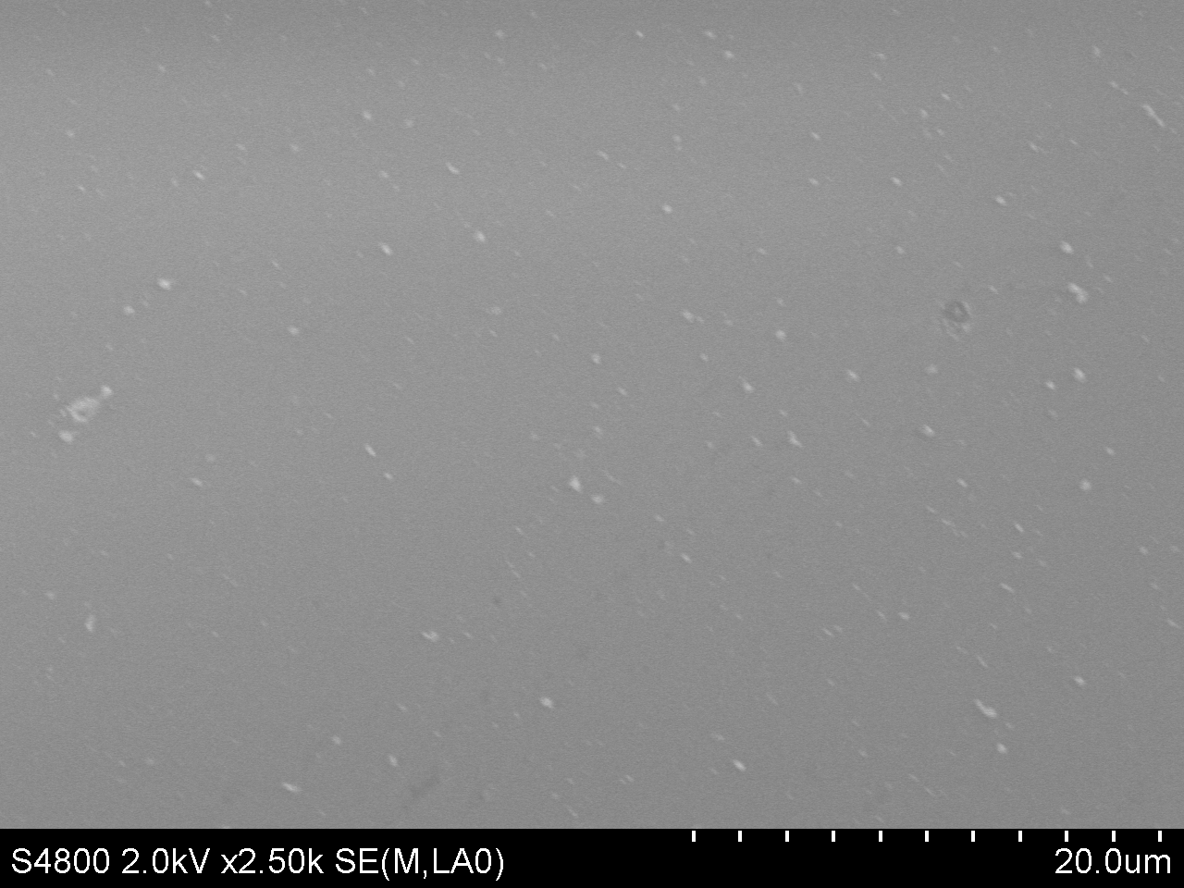
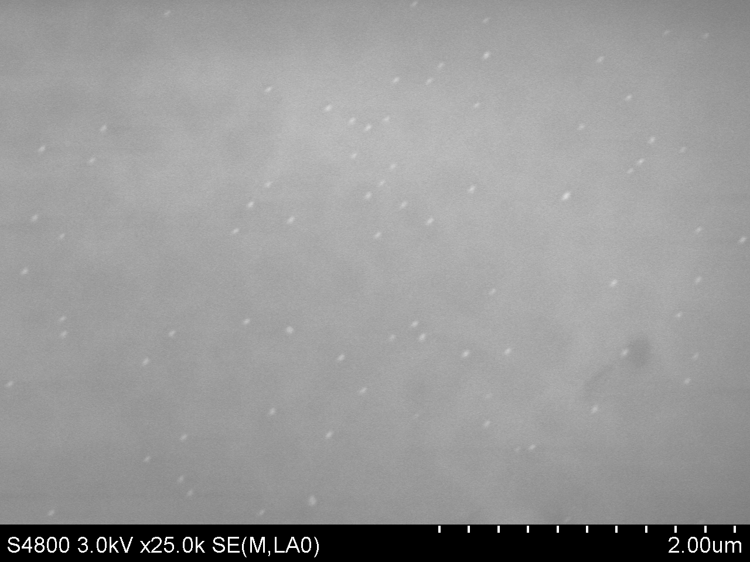
SEM images
Miguel's 50nm Au particle and nanopartz 57nm Au particle

Slide 12
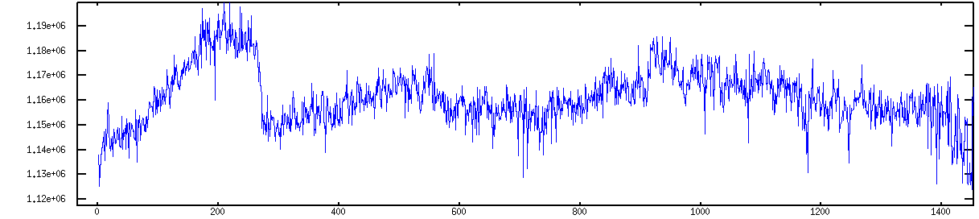
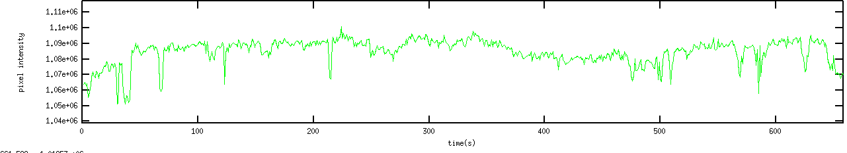
Results
Polymer 0.19 micrometer Carboxylic functionalized
flowing
Not flowing

Slide 13
Thank you!

