Slide 1
NASA LAB 8
電機一 B13901011 吳亞倫

Slide 2
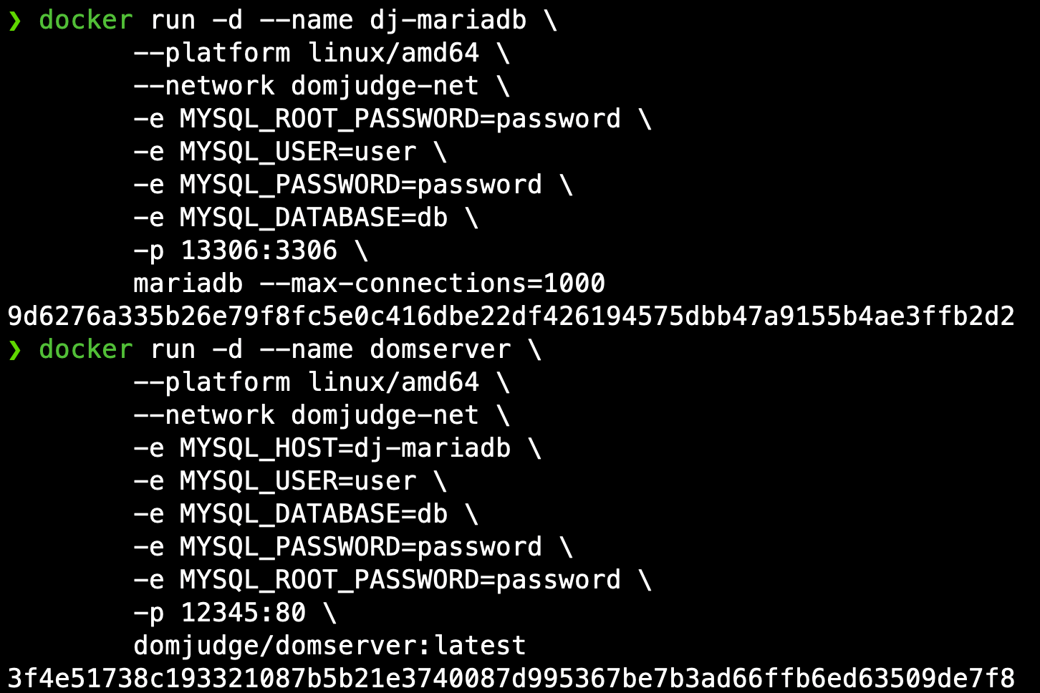
Docker run

Slide 3
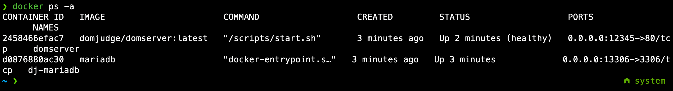
Docker ps -a
Retrieve admin password

Slide 4
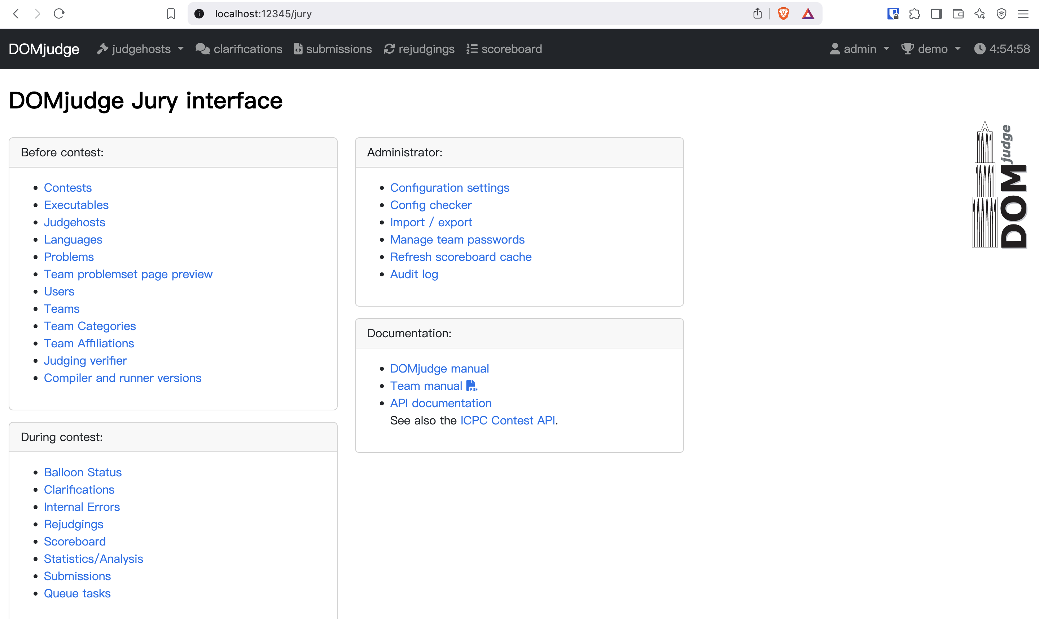
Domjudge login

Slide 5
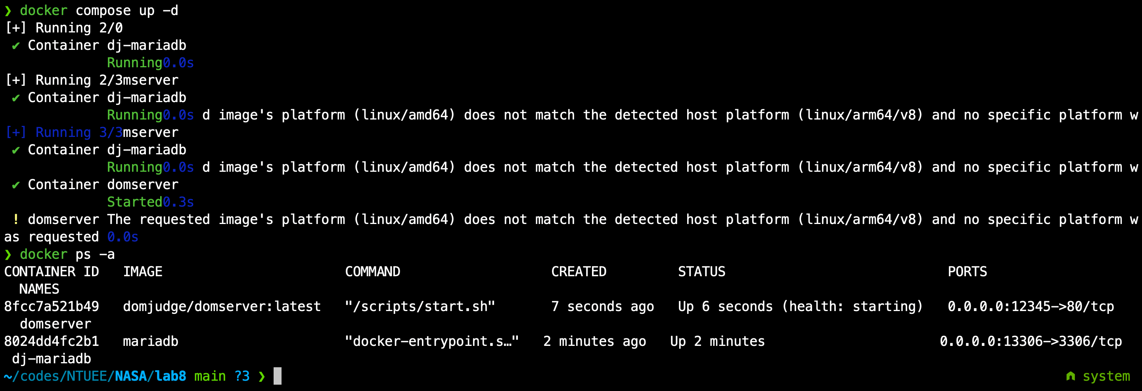
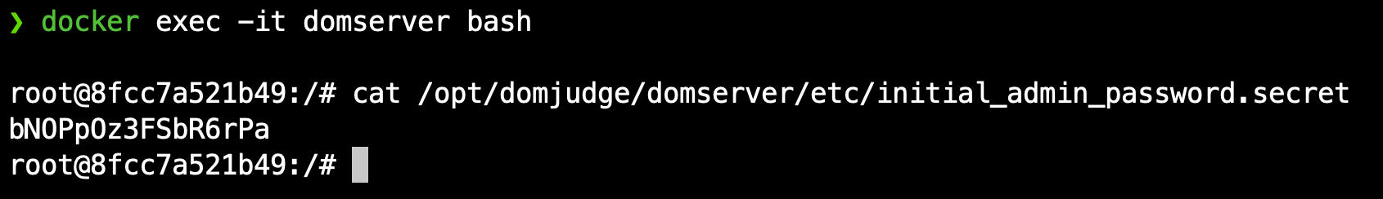
docker compose up – d && docker ps -a
Retrieve admin password

Slide 6
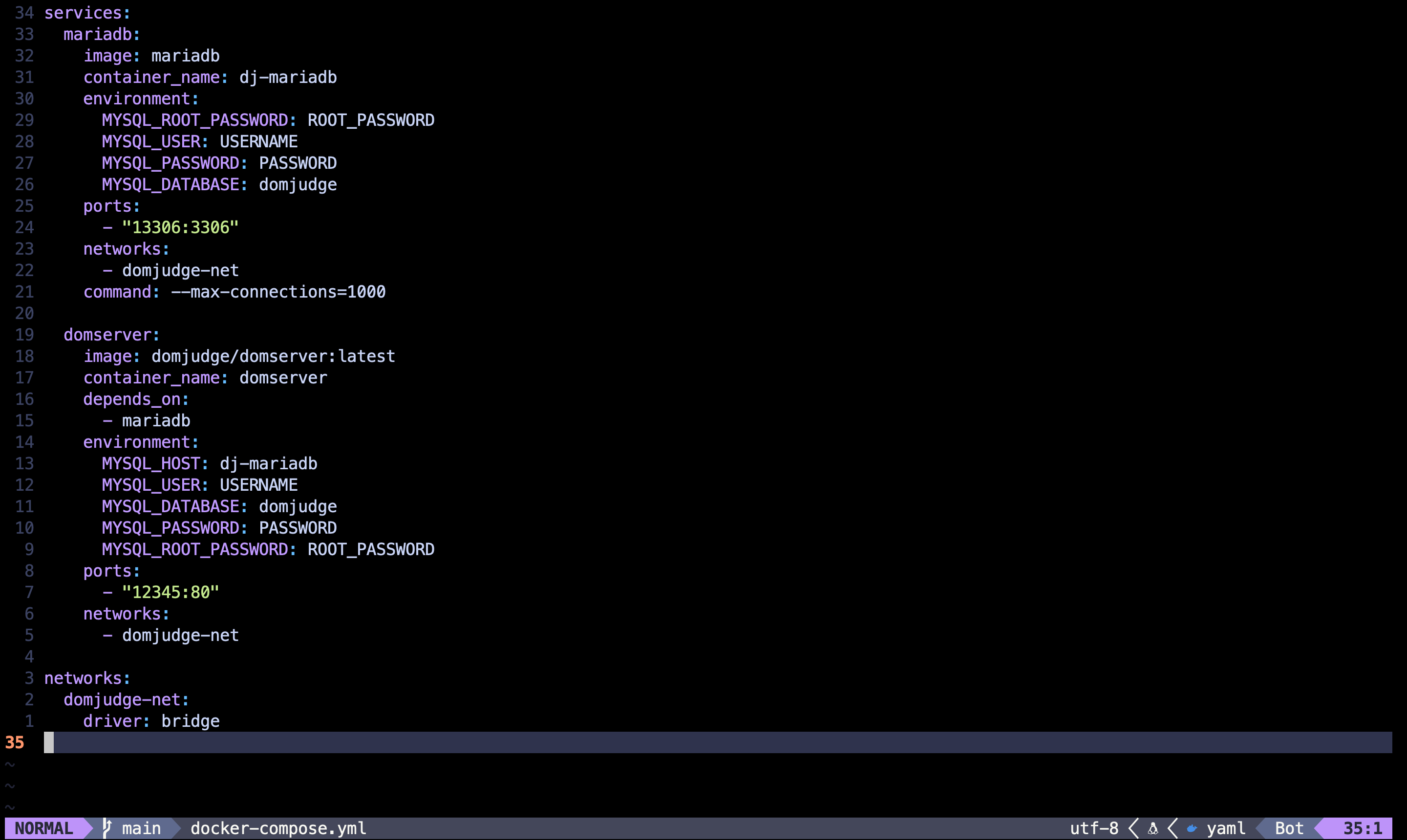
docker-compose.yml

Slide 7

Domjudge login

