Slide 1
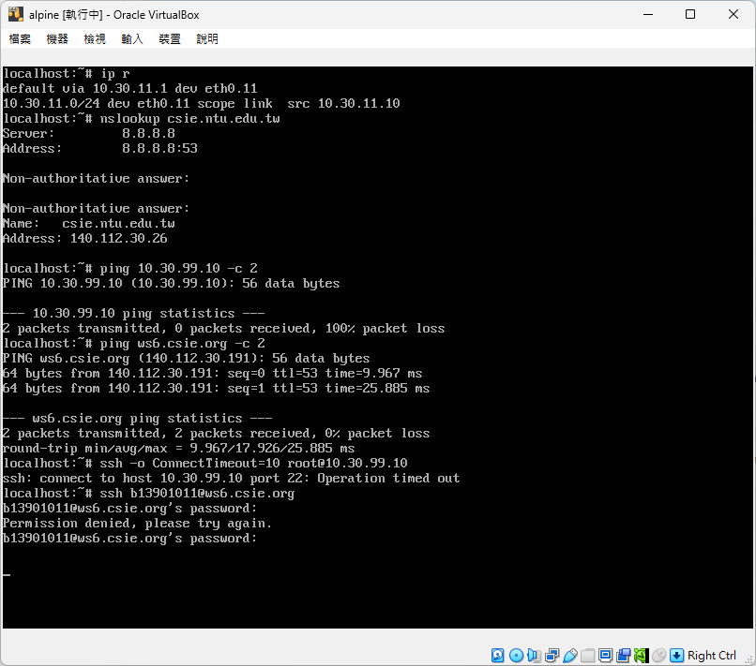
VLAN 11 client

Slide 2
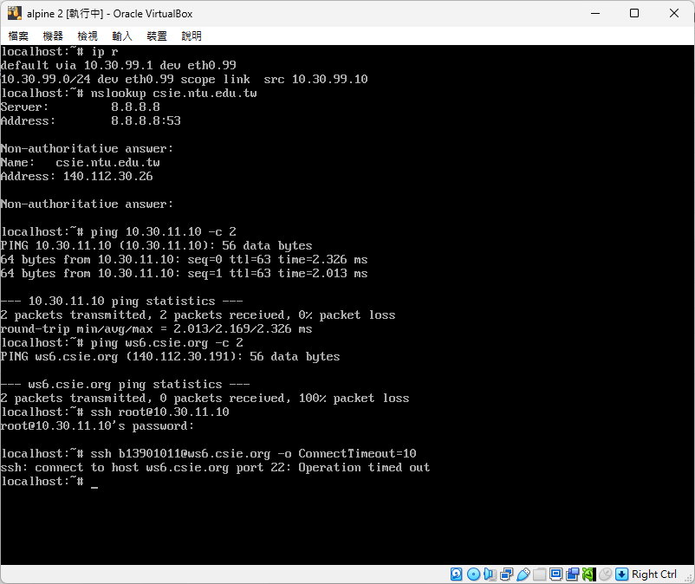
VLAN 99 client

Slide 3
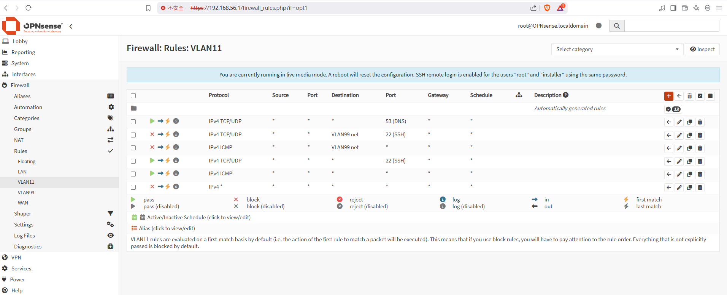
VLAN 11 rules

Slide 4
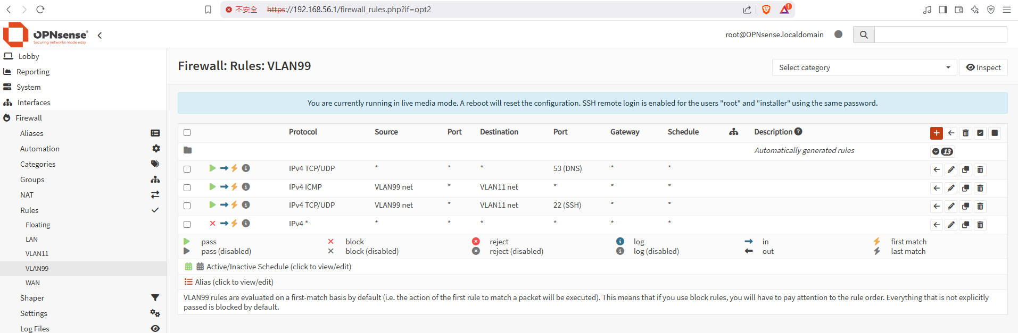
VLAN 99 rules

