Slide 1
Lab 7
B13901011 吳亞倫

Slide 2
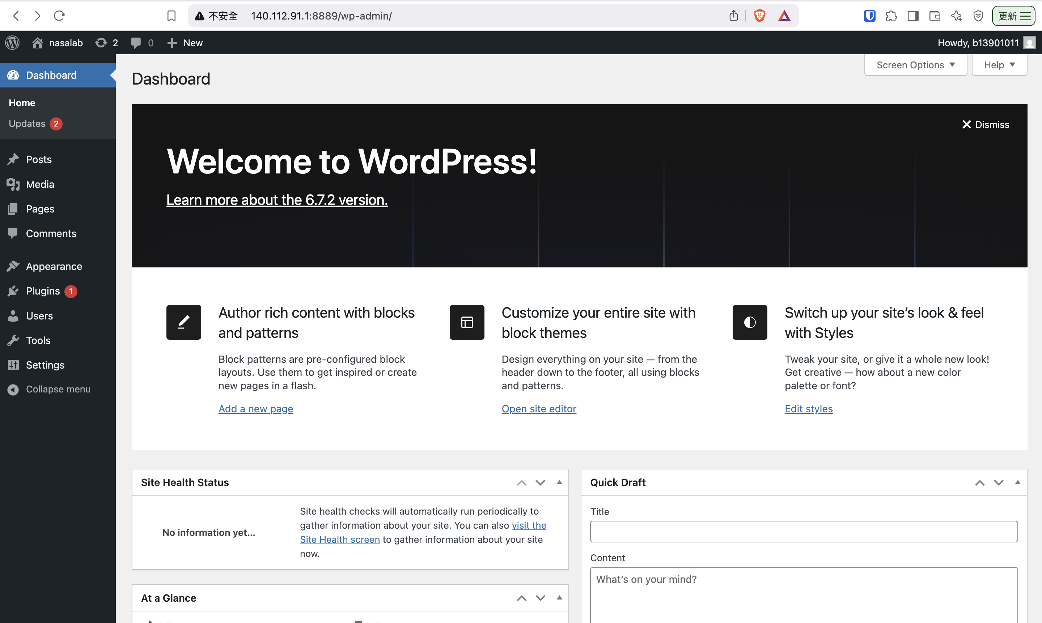
Wordpress Website

Slide 3
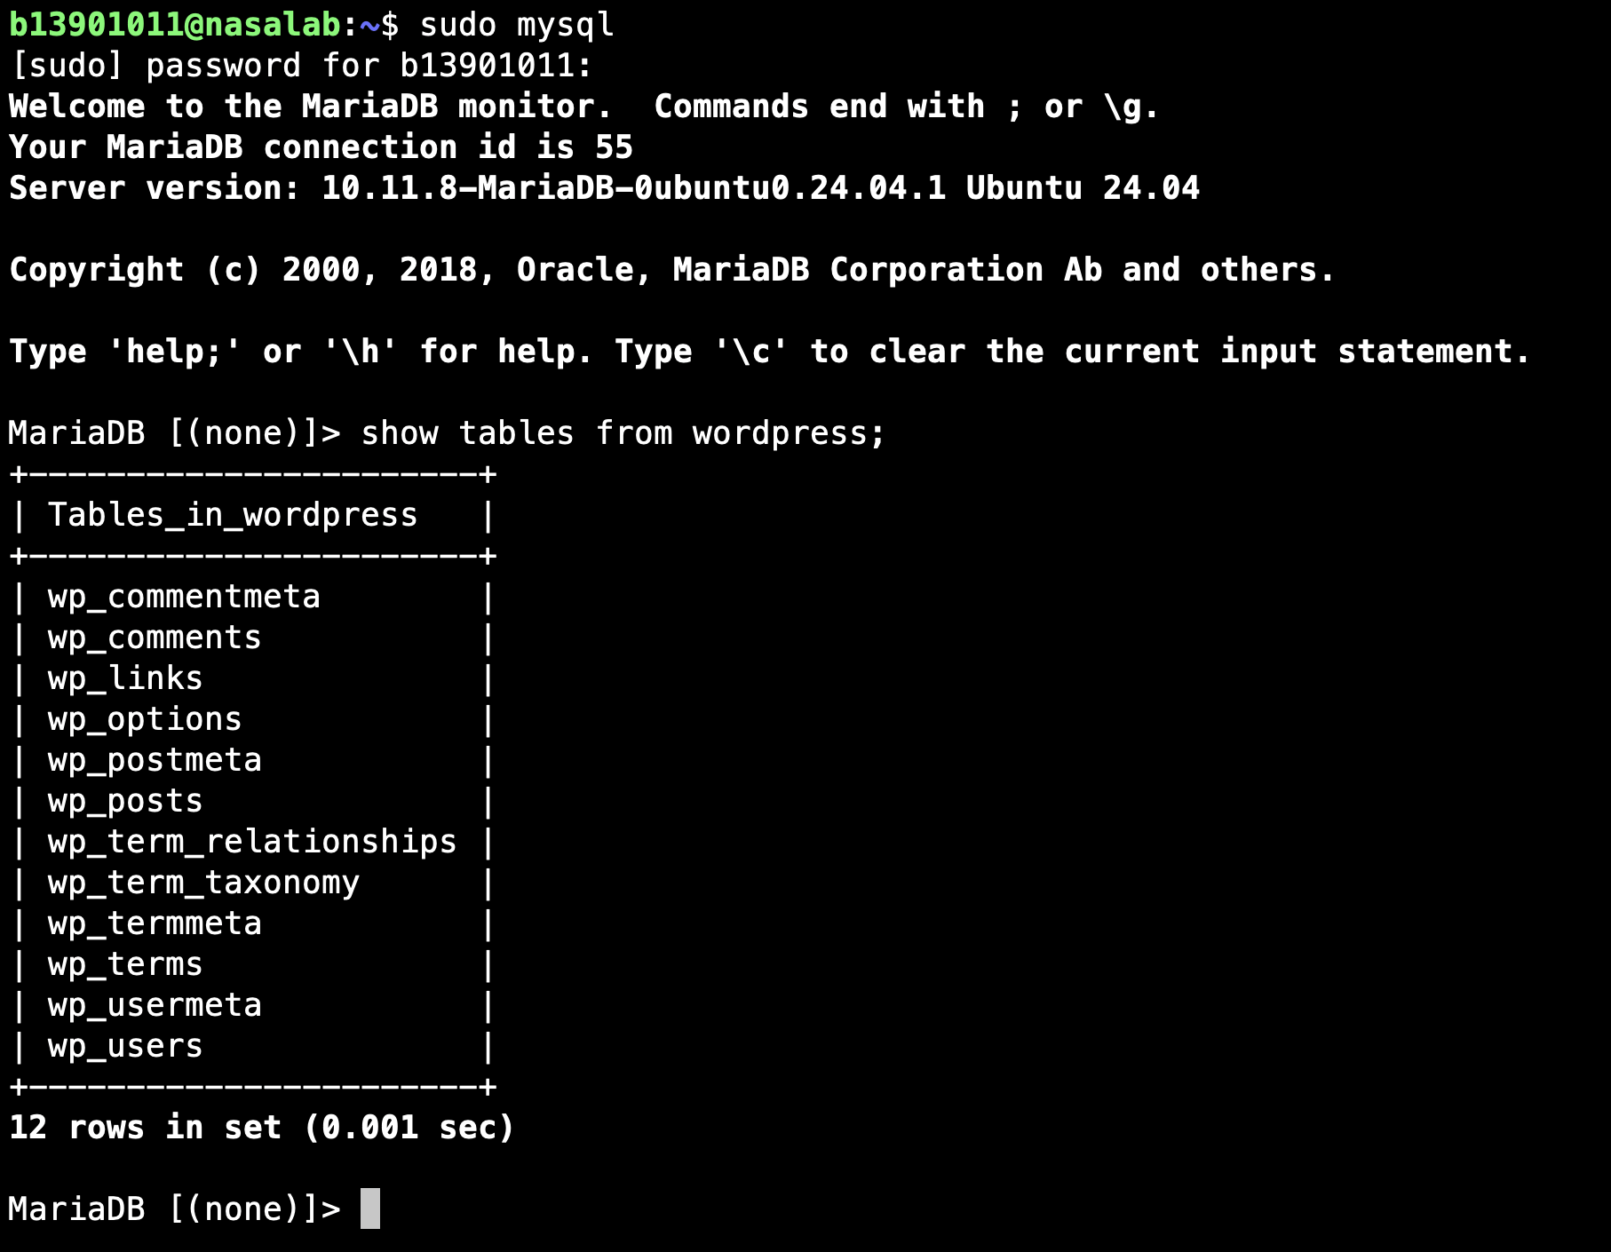
Database

