Slide 1
Ch.11 Requirements Modeling: Behavior, Patterns, and Web/Mobile Apps

Slide 2
Behavioral Modeling
The behavioral model indicates how software will respond to external events or stimuli. To create the model, the analyst must perform the following steps:
  Evaluate all use-cases to fully understand the sequence of interaction within the system.
  Identify events that drive the interaction sequence and understand how these events relate to specific objects.
  Create a sequence for each use-case.
  Build a state diagram for the system.
  Review the behavioral model to verify accuracy and consistency.

Slide 3
The States of a System
state—a set of observable circumstances that characterizes the behavior of a system at a given time
state transition — the movement from one state to another
event—an occurrence that causes the system to exhibit some predictable form of behavior
action—process that occurs as a consequence of making a transition
events
behavior
Outside
world
Application

Slide 4
State Representations
In the context of behavioral modeling, two different characterizations of states must be considered:
  the state of each class as the system performs its function
  the state of the system as observed from the outside as the system performs its function

Slide 5
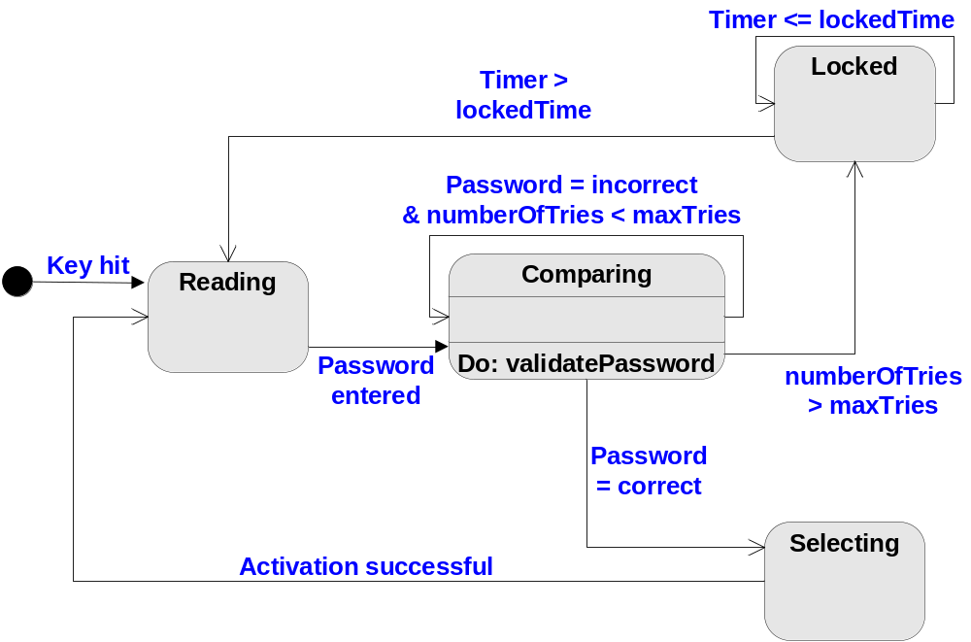
State Diagram for the ControlPanel Class

Slide 6
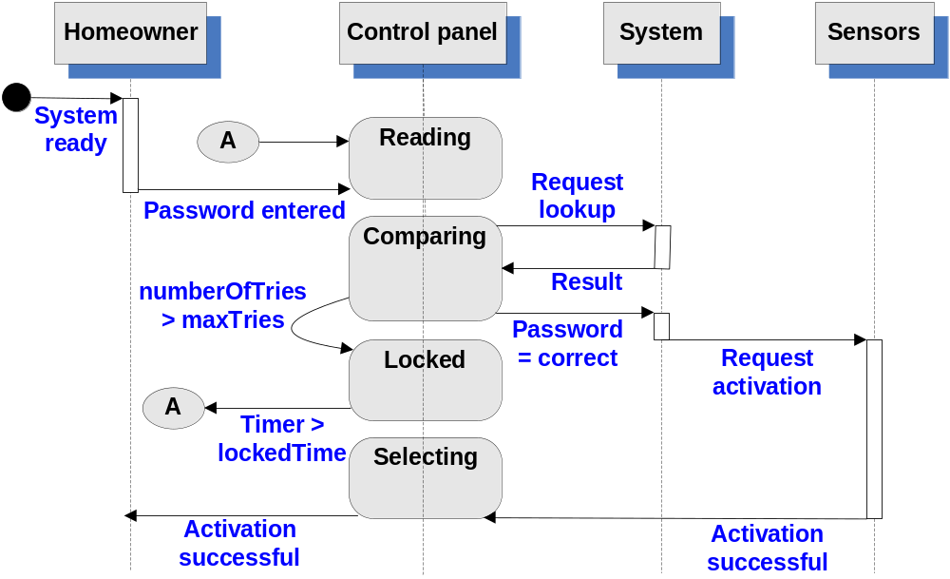
Sequence Diagram

Slide 7
Data Modeling
examines data objects independently of processing
focuses attention on the data domain
creates a model at the customer’s level of abstraction
indicates how data objects relate to one another

Slide 8
What is a Data Object?
Object — something that is described by a set of attributes (data items) and that will be manipulated within the software system
Each instance of an object (e.g., a book) can be identified uniquely (e.g., ISBN#)
Each plays a necessary role in the system i.e., the system could not function without access to instance of the object
Each is described by attributes that are themselves data items

Slide 9
Typical Objects
external entities (printer, user, sensor)
things
(e.g, reports, displays, signals)
occurrences or events (e.g., interrupt, alarm)
roles
(e.g., manager, engineer, salesperson)
organizational units
(e.g., division, team)
places
(e.g., manufacturing floor)
structures (e.g., employee record)

Slide 10
Data Objects and Attributes
A data object contains a set of attributes that act as an aspect, quality, characteristic, or descriptor of the object
object: automobile
attributes:
make
model
body type
price
options code

Slide 11
What is a Relationship?
Relationship — indicates “connectedness”; a "fact" that must be "remembered" by the system and cannot or is not computed or derived mechanically
several instances of a relationship can exist
objects can be related in many different ways

Slide 12
ERD Notation
Cardinality: One-to-one, One-to-many, Many-to-many
Modality: Mandatory, optional
many
one
object₁
relationship
object₂
(0, m)
(1, 1)
optional
mandatory
or
(0,m)
(1,1)
object₁
relationship
object₂
(0, m)

Slide 13
The ERD: An Example
request
for service
Customer
places
(1,1)
(1,m)
(1,1)
standard
task table
(1,n)
work
order
generates
(1,1)
(1,1)
(1,1)
work
tasks
(1,w)
selected
from
consists
of
(1,w)
(1,i)
materials
lists

Slide 14
Flow-Oriented Modeling
Represents how data objects are transformed at they move through the system
A data flow diagram (DFD) is the diagrammatic form that is used
Considered by many to be an ‘old school’ approach, flow-oriented modeling continues to provide a view of the system that is unique — it should be used to supplement other analysis model elements

Slide 15
Data Flow Diagram (DFD)
Every computer-based system is an information transform system
Is a graphical representation that depicts information flow and the transforms that are applied as data move from input to output
Be used to represent a system or software at any level of abstraction
computer
based
system
input
output

Slide 16
Notation of DFD
External entity
Data flow
process
Data storage

Slide 17
External Entity
A producer or consumer of data
Examples: a person, a device, a sensor
Another example: computer-based system
Data must always originate somewhere
and must always be sent to something

Slide 18
Process
A data transformer (changes input
to output)
Examples: compute taxes, determine area, format report, display graph
Data must always be processed in some
way to achieve system function

Slide 19
Data Flow
Data flows through a system, beginning as input and be transformed into output.
base
compute
triangle
area
area
height

Slide 20
Data Stores
Data is often stored for later use.
sensor #
sensor #, type,
location, age
look-up
sensor
data
report required
type,
location, age
sensor number
sensor data

Slide 21
The Data Flow Hierarchy
a
b
x
P
y
level 0
level 1
a
c
p2
f
p1
p4
b
d
5
p3
e
g
f
f1
f2
level 2
P4.1
P4.2
……
P4.5
……
g
e
e1
e2
P4.3
P4.4

Slide 22
DFD Guidelines
always label data flow arrows, and all icons must be labeled with meaningful names
always begin with a context level diagram (also called level 0),and show external entities at level 0
do not represent procedural logic
the DFD evolves through a number of levels of detail, and the information flow continuity must be maintained

Slide 23
Process Specification (PSPEC)
bubble
PSPEC
narrative
pseudocode (PDL)
equations
tables
diagrams and/or charts

Slide 24
Constructing a DFD — I
review the data model to isolate data objects and use a grammatical parse to determine “operations”
determine external entities (producers and consumers of data)
create a level 0 DFD
processing
request
user
requested
video
signal
digital
video
processor
monitor
video
source
NTSC
video signal

Slide 25
Constructing a DFD — II
write a narrative describing the transform
parse to determine next level transforms
“balance” the flow to maintain data flow continuity
develop a level 1 DFD
use a 1:5 (approx.) expansion ratio

Slide 26
Flow Modeling Notes
each bubble is refined until it does just one thing
the expansion ratio decreases as the number of levels increase
most systems require between 3 and 7 levels for an adequate flow model
a single data flow item (arrow) may be expanded as levels increase (data dictionary provides information)

Slide 27
DFDs: A Look Ahead
analysis model
Maps into
design model

Slide 28
Writing the Software Specification
Everyone knew exactly what had to be done until someone wrote it down!

Slide 29
Patterns for Requirements Modeling
Software patterns are a mechanism for capturing domain knowledge in a way that allows it to be reapplied when a new problem is encountered
  domain knowledge can be applied to a new problem within the same application domain
  the domain knowledge captured by a pattern can be applied by analogy to a completely different application domain.
The original author of an analysis pattern does not “create” the pattern, but rather, discovers it as requirements engineering work is being conducted.
Once the pattern has been discovered, it is documented

Slide 30
Discovering Analysis Patterns
The most basic element in the description of a requirements model is the use case.
A coherent set of use cases may serve as the basis for discovering one or more analysis patterns.
A semantic analysis pattern (SAP) “is a pattern that describes a small set of coherent use cases that together describe a basic generic application.” [Fer00]

Slide 31
Requirements Modeling for WebApps
Content Analysis. The full spectrum of content to be provided by the WebApp is identified, including text, graphics and images, video, and audio data. Data modeling can be used to identify and describe each of the data objects.
Interaction Analysis. The manner in which the user interacts with the WebApp is described in detail. Use-cases can be developed to provide detailed descriptions of this interaction.
Functional Analysis. The usage scenarios (use-cases) created as part of interaction analysis define the operations that will be applied to WebApp content and imply other processing functions. All operations and functions are described in detail.
Configuration Analysis. The environment and infrastructure in which the WebApp resides are described in detail.
Navigation Analysis. The organization of web page link.

Slide 32
When Do We Perform Analysis?
In some Web/Mobile App situations, analysis and design is merged. However, an explicit analysis activity occurs when …
  the Web or Mobile App to be built is large and/or complex
  the number of stakeholders is large
  the number of developers is large
  the development team members have not worked together before
  the success of the app will have a strong bearing on the success of the business

Slide 33
The Content Model
Content objects are extracted from use-cases
  examine the scenario description for direct and indirect references to content
Attributes of each content object are identified
The relationships among content objects and/or the hierarchy of content maintained by a WebApp
  Relationships—entity-relationship diagram or UML
  Hierarchy—data tree or UML

Slide 34
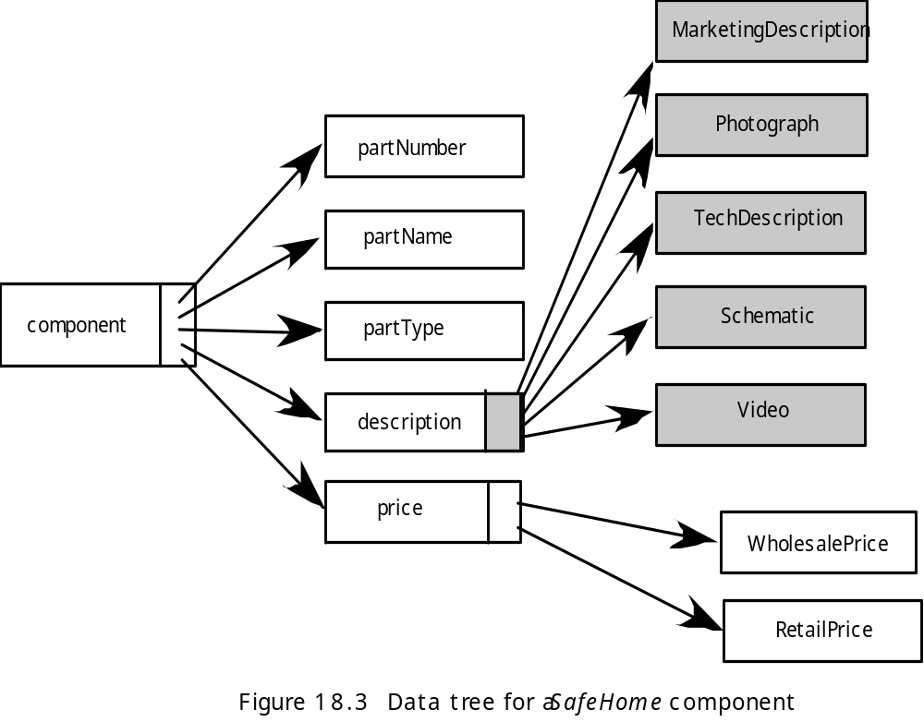
Data Tree

Slide 35
The Interaction Model
Composed of four elements:
  use-cases
  sequence diagrams
  state diagrams
  a user interface prototype
Each of these is an important UML notation and is described in Appendix I

Slide 36
The Functional Model
The functional model addresses two processing elements of the WebApp
  user observable functionality that is delivered by the WebApp to end-users
  the operations contained within analysis classes that implement behaviors associated with the class.
An activity diagram can be used to represent processing flow

Slide 37
The Configuration Model
Server-side
  Server hardware and operating system environment must be specified
  Interoperability considerations on the server-side must be considered
  Appropriate interfaces, communication protocols and related collaborative information must be specified
Client-side
  Browser configuration issues must be identified
  Testing requirements should be defined

Slide 38
Navigation Modeling-I
Should certain elements be easier to reach (require fewer navigation steps) than others? What is the priority for presentation?
Should certain elements be emphasized to force users to navigate in their direction?
How should navigation errors be handled?
Should navigation to related groups of elements be given priority over navigation to a specific element.
Should navigation be accomplished via links, via search-based access, or by some other means?
Should certain elements be presented to users based on the context of previous navigation actions?
Should a navigation log be maintained for users?

Slide 39
Navigation Modeling-II
Should a full navigation map or menu (as opposed to a single “back” link or directed pointer) be available at every point in a user’s interaction?
Should navigation design be driven by the most commonly expected user behaviors or by the perceived importance of the defined WebApp elements?
Can a user “store” his previous navigation through the WebApp to expedite future usage?
For which user category should optimal navigation be designed?
How should links external to the WebApp be handled? overlaying the existing browser window? as a new browser window? as a separate frame?

Slide 40
《Software Requirements Specification》+《Software Plan》
(2 Speaker: 10-minute presentation + 5-minute Q&A )
Note: Word doc (Chinese or English) can be used for Presentation, Ppt slide isn’t required.
Due: on the head of May, 2020
Site：曹东502
Grading Policy: Each group will evaluate the other groups’ performances and fill in the grading table.

