Slide 1
Ch.13 Architectural Design

Slide 2
Why Architecture?
The architecture is not the operational software. Rather, it is a representation that enables a software engineer to:
  (1) analyze the effectiveness of the design in meeting its stated requirements,
  (2) consider architectural alternatives at a stage when making design changes is still relatively easy, and
  (3) reduce the risks associated with the construction of the software.

Slide 3
Why is Architecture Important?
Representations of software architecture are an enabler for communication between all parties (stakeholders) interested in the development of a computer-based system. 沟通工具
The architecture highlights early design decisions that will have a profound impact on all software engineering work that follows and, as important, on the ultimate success of the system as an operational entity. 影响重大
Architecture “constitutes a relatively small, intellectually graspable mode of how the system is structured and how its components work together” [BAS03].方便理解

Slide 4
Architectural Descriptions
The IEEE Computer Society has proposed IEEE-Std-1471-2000, Recommended Practice for Architectural Description of Software-Intensive System, [IEE00]
  to establish a conceptual framework and vocabulary for use during the design of software architecture,
  to provide detailed guidelines for representing an architectural description, and
  to encourage sound architectural design practices.
The IEEE Standard defines an architectural description (AD) as a “a collection of products to document an architecture.”
  The description itself is represented using multiple views, where each view is “a representation of a whole system from the perspective of a related set of [stakeholder] concerns.”

Slide 5
Architectural Genres
Genre implies a specific category within the overall software domain.
Within each category, you encounter a number of subcategories.
  For example, within the genre of buildings, you would encounter the following general styles: houses, condos, apartment buildings, office buildings, industrial building, warehouses, and so on.
  Within each general style, more specific styles might apply. Each style would have a structure that can be described using a set of predictable patterns.

Slide 6
Architectural Styles
Each style describes a system category that encompasses: (1) a set of components (e.g., a database, computational modules) that perform a function required by a system, (2) a set of connectors that enable “communication, coordination and cooperation” among components, (3) constraints that define how components can be integrated to form the system, and (4) semantic models that enable a designer to understand the overall properties of a system by analyzing the known properties of its constituent parts.
  Data-centered architectures
  Data flow architectures
  Call and return architectures
  Object-oriented architectures
  Layered architectures

Slide 7
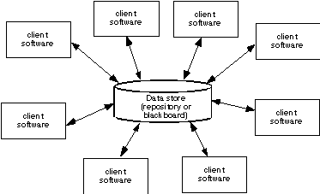
Data-Centered Architecture

Slide 8
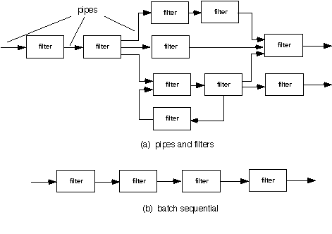
Data Flow Architecture

Slide 9
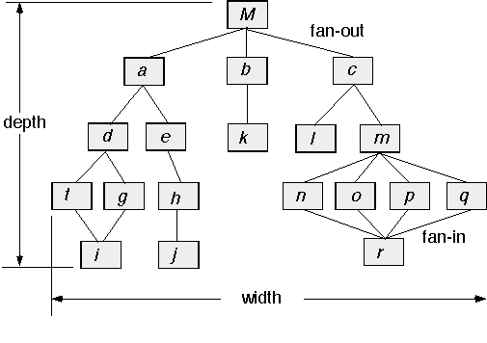
Call and Return Architecture

Slide 10


Object-oriented Architecture
流程
定义库
工艺更改
制定计划
设计更改
专家咨询
流程启动
Task Manager
Task Manager
Task Manager
Task
Task
Task
WorkList
Process Instance
Task Manager
WorkList
Task Manager
Task Manager
Task Manager
WorkList
Task
Task
Task
Process Instance
Task Manager
WorkList

Slide 11
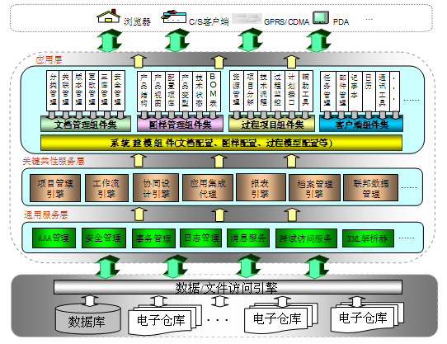
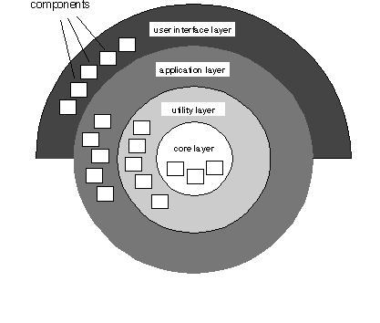
Layered Architecture

Slide 12
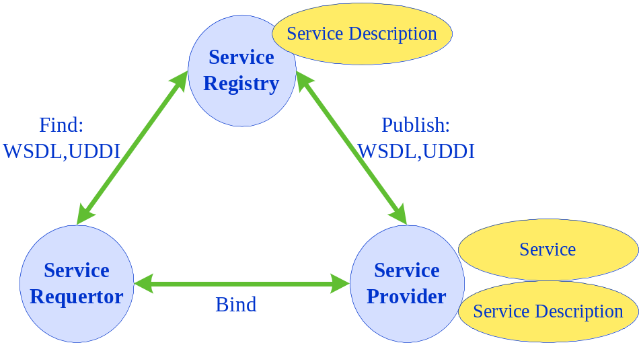
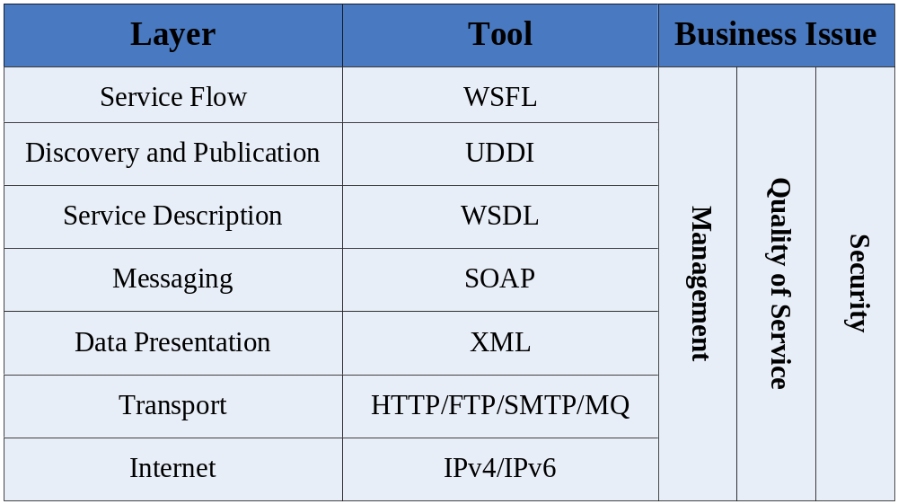
Service-oriented Architecture

Slide 13
Architectural Patterns
Concurrency—applications must handle multiple tasks in a manner that simulates parallelism
  operating system process management pattern
  task scheduler pattern
Persistence—Data persists if it survives past the execution of the process that created it. Two patterns are common:
  a database management system pattern that applies the storage and retrieval capability of a DBMS to the application architecture
  an application level persistence pattern that builds persistence features into the application architecture
Distribution— the manner in which systems or components within systems communicate with one another in a distributed environment
  A broker acts as a ‘middle-man’ between the client component and a server component.

Slide 14
Architectural Design
The software must be placed into context
  the design should define the external entities (other systems, devices, people) that the software interacts with and the nature of the interaction
A set of architectural archetypes should be identified
  An archetype is an abstraction (similar to a class) that represents one element of system behavior
The designer specifies the structure of the system by defining and refining software components that implement each archetype

Slide 15
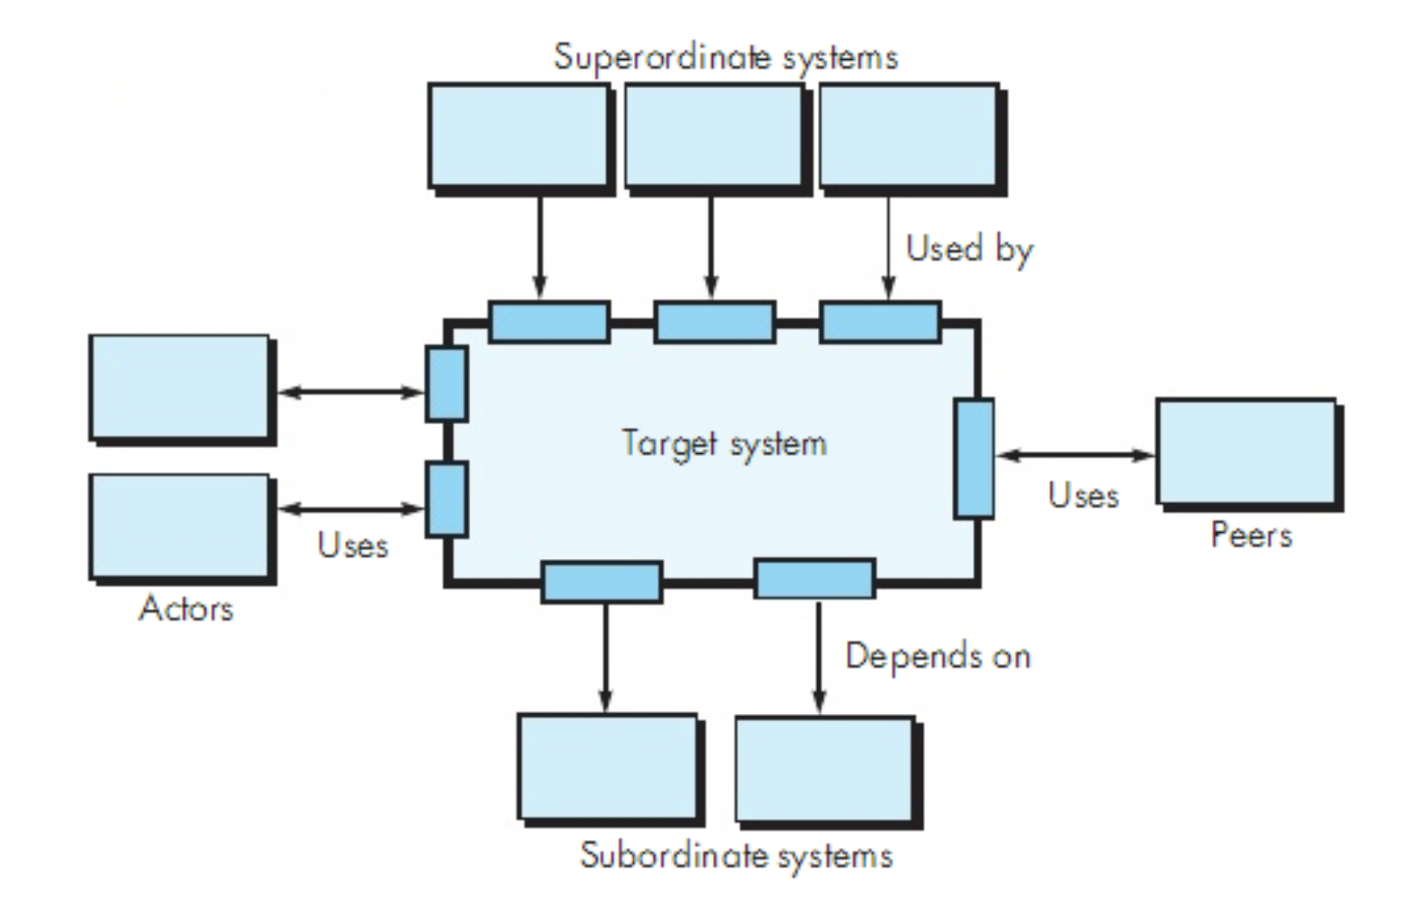
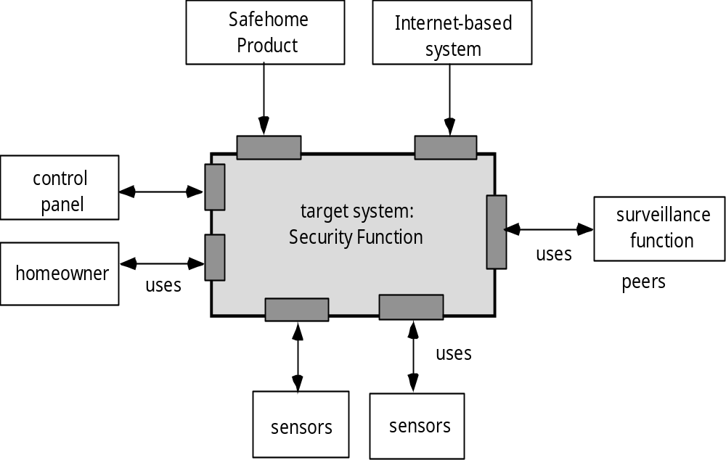
Architectural Context

Slide 16
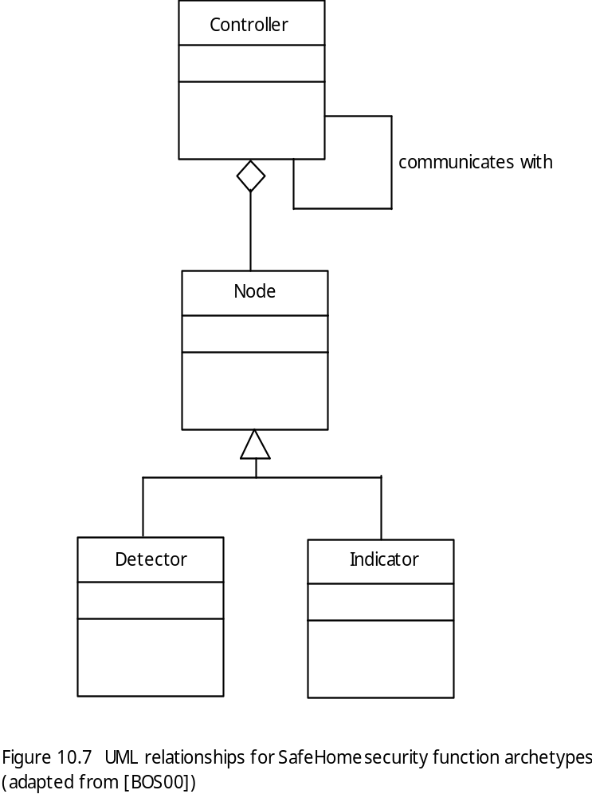
Archetypes

Slide 17
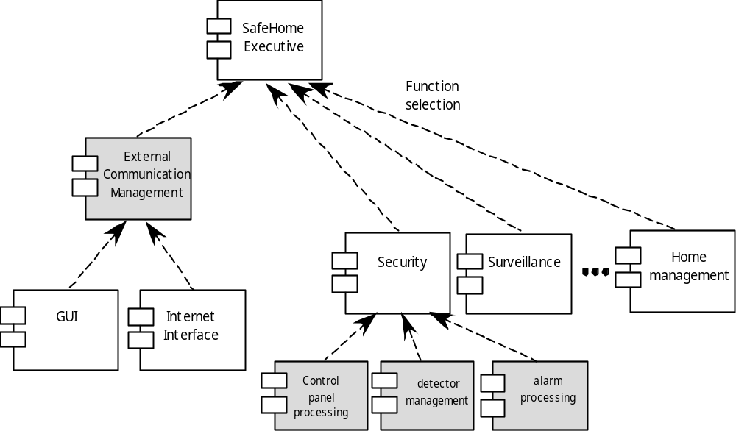
Component Structure

Slide 18
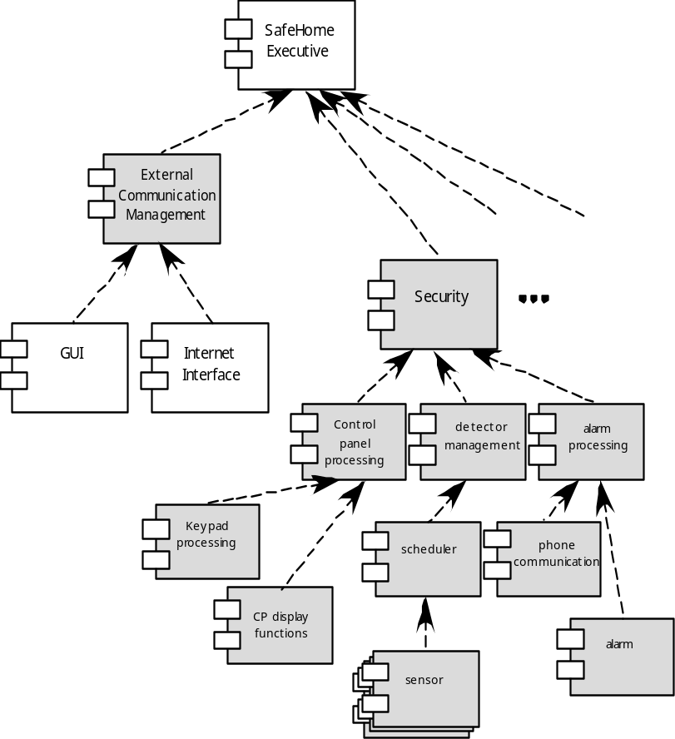
Refined Component Structure

Slide 19
Architectural Considerations
Economy – The best software is uncluttered and relies on abstraction to reduce unnecessary detail.
Visibility – Architectural decisions and the reasons for them should be obvious to software engineers who examine the model at a later time.
Spacing – Separation of concerns in a design without introducing hidden dependencies.
Symmetry – Architectural symmetry implies that a system is consistent and balanced in its attributes.
Emergence – Emergent, self-organized behavior and control.

Slide 20
Architectural Tradeoff Analysis
Collect scenarios.
Elicit requirements, constraints, and environment description.
Describe the architectural styles/patterns that have been chosen to address the scenarios and requirements:
  module view
  process view
  data flow view
Evaluate quality attributes by considered each attribute in isolation.
Identify the sensitivity of quality attributes to various architectural attributes for a specific architectural style.
Critique candidate architectures (developed in step 3) using the sensitivity analysis conducted in step 5.

Slide 21
Architectural Complexity
the overall complexity of a proposed architecture is assessed by considering the dependencies between components within the architecture [Zha98]
  Sharing dependencies represent dependence relationships among consumers who use the same resource or producers who produce for the same consumers.
  Flow dependencies represent dependence relationships between producers and consumers of resources.
  Constrained dependencies represent constraints on the relative flow of control among a set of activities.

Slide 22
ADL
Architectural description language (ADL) provides a semantics and syntax for describing a software architecture
Provide the designer with the ability to:
  decompose architectural components
  compose individual components into larger architectural blocks and
  represent interfaces (connection mechanisms) between components.

Slide 23
Architecture Reviews
Assess the ability of the software architecture to meet the systems quality requirements and identify potential risks；
Have the potential to reduce project costs by detecting design problems early；
Often make use of experience-based reviews, prototype evaluation, and scenario reviews, and checklists；

Slide 24
Pattern-Based Architecture Review
Identify and discuss the quality attributes by walking through the use cases.
Discuss a diagram of system’s architecture in relation to its requirements.
Identify the architecture patterns used and match the system’s structure to the patterns’ structure.
Use existing documentation and use cases to determine each pattern’s effect on quality attributes.
Identify all quality issues raised by architecture patterns used in the design.
Develop a short summary of issues uncovered during the meeting and make revisions to the walking skeleton.

Slide 25
Agility and Architecture
To avoid rework, user stories are used to create and evolve an architectural model (walking skeleton) before coding
Hybrid models which allow software architects contributing users stories to the evolving storyboard
Well run agile projects include delivery of work products during each sprint
Reviewing code emerging from the sprint can be a useful form of architectural review

