Slide 1
Ch.10 Requirements Modeling: Class-Based Methods

Slide 2
Requirements Modeling Strategies
One view of requirements modeling, called structured analysis, considers data and the processes that transform the data as separate entities.
  Data objects are modeled in a way that defines their attributes and relationships.
  Processes that manipulate data objects are modeled in a manner that shows how they transform data as data objects flow through the system.
A second approach to analysis modeled, called object-oriented analysis, focuses on
  the definition of classes and
  the manner in which they collaborate with one another to effect customer requirements.

Slide 3
Object-Oriented Concepts
Key concepts:
  Classes and objects
  Attributes and operations
  Encapsulation and instantiation
  Inheritance
Tasks
  Classes (attribute and method) must be identified
  A class hierarchy is defined
  Object relationship should be represented
  Object behavior must be modeled
  Above tasks are reapplied iteratively
Why encapsulation?

Slide 4
Classes
object-oriented thinking begins with the definition of a class, often defined as:
  template
  generalized description
  describing a collection of similar items
a metaclass (also called a superclass) establishes a hierarchy of classes
once a class of items is defined, a specific instance of the class can be identified

Slide 5
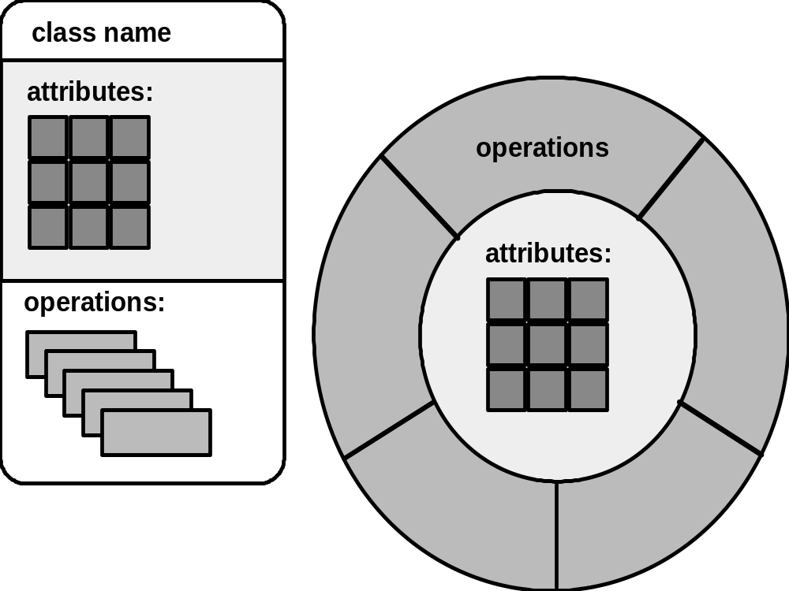
Building a Class

Slide 6
Methods
Also called operations or services. An executable procedure that is encapsulated in a class and is designed to operate on one or more data attributes that are defined as
part of the class. A method
is invoked via message
passing.

Slide 7
Encapsulation/Hiding
The object encapsulates
both data and the logical
procedures required to
manipulate the data
method
# 1
method
# 2
data
method
# 6
method
# 3
method
# 5
method
# 4
Achieves “information hiding”

Slide 8
Class Hierarchy
PieceOfFurniture (superclass)
Table
Chair
Desk
”Chable"
subclasses of the
instances of Chair

Slide 9
Class-Based Modeling
Class-based modeling represents:
  objects that the system will manipulate
  operations (also called methods or services) that will be applied to the objects to effect the manipulation
  relationships (some hierarchical) between the objects
  collaborations that occur between the classes that are defined.

Slide 10
Class-Based Modeling
Identify analysis classes by examining the problem statement
Use a “grammatical parse” to isolate potential classes
Identify the attributes of each class
Identify operations that manipulate the attributes

Slide 11
What is a Class?
occurrences
roles
things
organizational units
places
external entities
structures
class name
attributes:
operations:

Slide 12
Potential Classes
retained information（必要性）
needed services（动态行为）
multiple attributes
common attributes
common operations
essential requirements

Slide 13
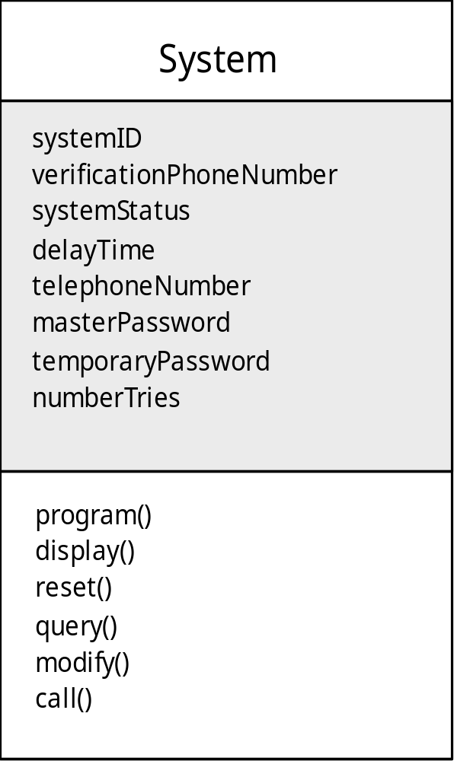
Class Diagram
Class name
attributes
operations

Slide 14
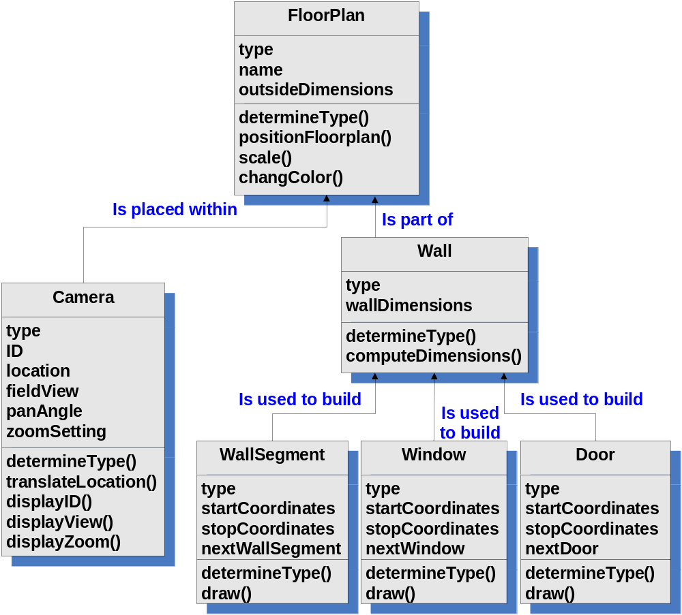
Class
Diagram

Slide 15
Class-Responsibility-Collaborator CRC Modeling
Analysis classes have “responsibilities”
  Responsibilities are the attributes and operations encapsulated by the class
Analysis classes collaborate with one another
  Collaborators are those classes that are required to provide a class with the information needed to complete a responsibility.
  In general, a collaboration implies either a request for information or a request for some action.

Slide 16
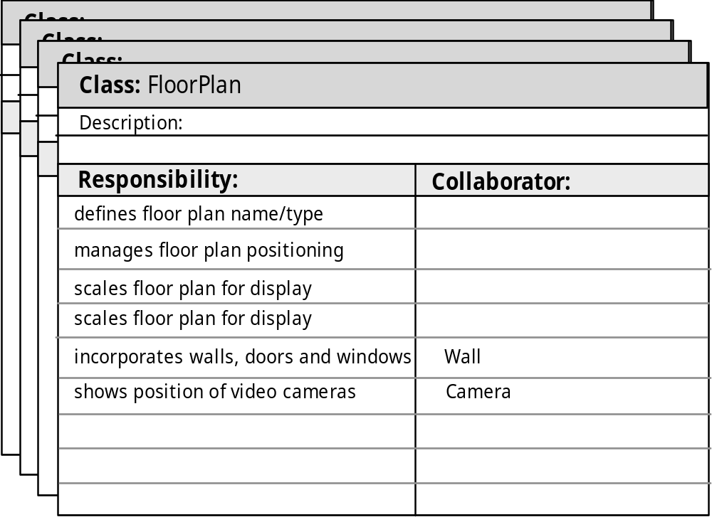
CRC Modeling
Those classes required to provide the info needed to complete a responsibility
Anything the class knows (attributes) or does (operations)

Slide 17
Class Types
Entity classes, also called model or business classes, are extracted directly from the statement of the problem
Boundary classes are used to create the interface (e.g., interactive screen or printed reports) that the user sees and interacts with as the software is used.
Controller classes manage a “unit of work” from start to finish. That is, controller classes can be designed to manage
  the creation or update of entity objects;
  the instantiation of boundary objects as they obtain information from entity objects;
  complex communication between sets of objects;
  validation of data communicated between objects or between the user and the application.

Slide 18
Guidelines for Allocating Responsibilities
System intelligence should be distributed across classes to best address the needs of the problem
Each responsibility should be stated as generally as possible
Information and the behavior related to it should reside within the same class
Information about one thing should be localized with a single class, not distributed across multiple classes.
Responsibilities should be shared among related classes, when appropriate.

Slide 19
Collaborations
Classes fulfill their responsibilities in one of two ways:
  A class can use its own operations to manipulate its own attributes, thereby fulfilling a particular responsibility, or
  a class can collaborate with other classes.
Collaborations identify relationships between classes
three different generic relationships between classes
  the is-part-of relationship
  the has-knowledge-of relationship
  the depends-upon relationship

Slide 20

Composite Aggregate Class

Slide 21
Reviewing the CRC Model
All participants in the review (of the CRC model) are given a subset of the CRC model index cards.
  Cards that collaborate should be separated (i.e., no reviewer should have two cards that collaborate).
All use-case scenarios (and corresponding use-case diagrams) should be organized into categories.
The review leader reads the use-case deliberately.
  As the review leader comes to a named object, she passes a token to the person holding the corresponding class index card.

Slide 22
Reviewing the CRC Model (cont.)
When the token is passed, the holder of the class card is asked to describe the responsibilities noted on the card.
  The group determines whether one (or more) of the responsibilities satisfies the use-case requirement.
If the responsibilities and collaborations noted on the index cards cannot accommodate the use-case, modifications are made to the cards.
  This may include the definition of new classes (and corresponding CRC index cards) or the specification of new or revised responsibilities or collaborations on existing cards.

Slide 23
Associations and Dependencies
Two analysis classes are often related to one another in some fashion
  In UML these relationships are called associations
  Associations can be refined by indicating multiplicity (the term cardinality is used in data modeling
In many instances, a client-server relationship exists between two analysis classes.
  In such cases, a client-class depends on the server-class in some way and a dependency relationship is established

Slide 24
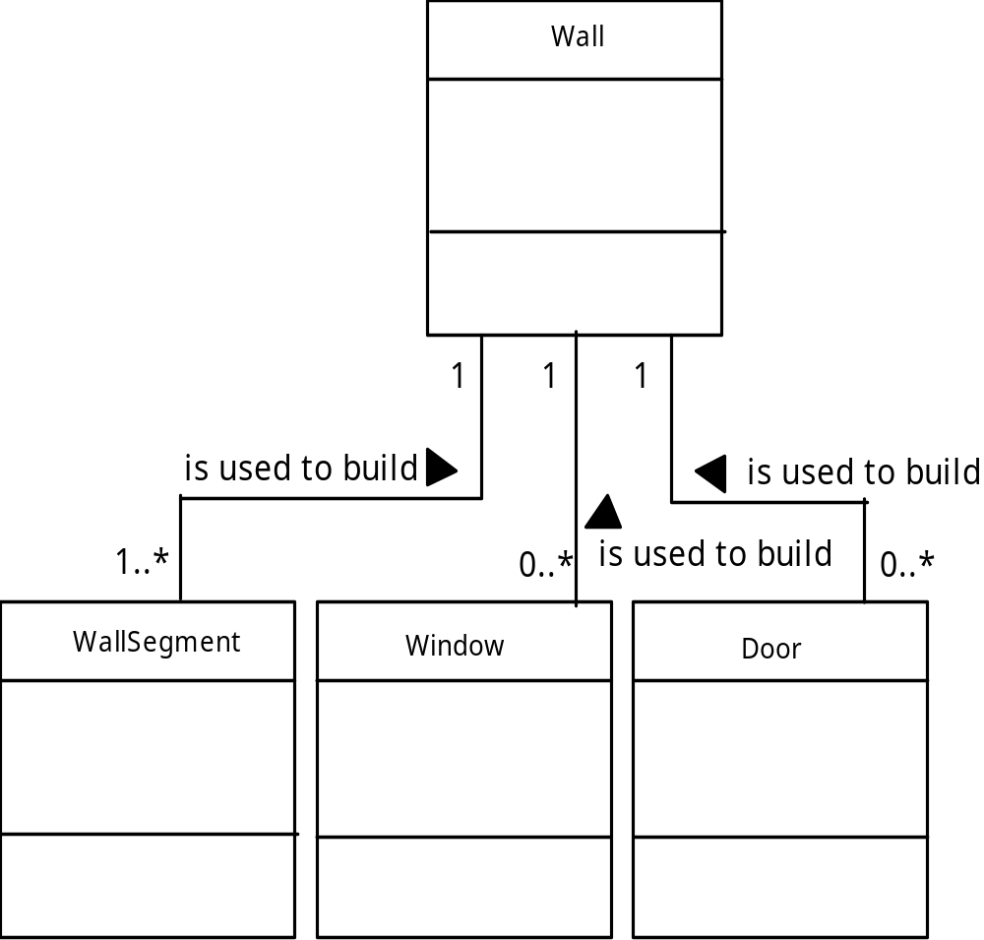
Multiplicity

Slide 25
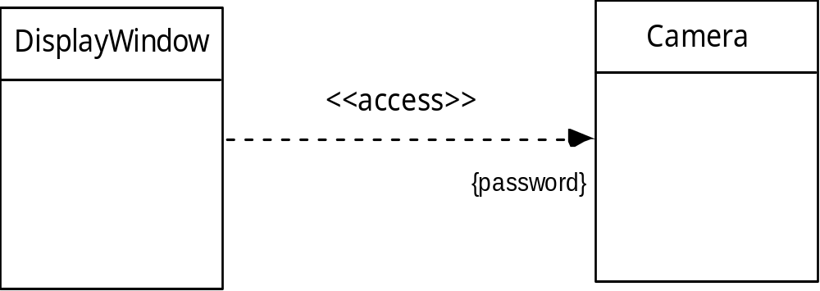
Dependencies

Slide 26
Analysis Packages
Various elements of the analysis model (e.g., use-cases, analysis classes) are categorized in a manner that packages them as a grouping
The plus sign preceding the analysis class name in each package indicates that the classes have public visibility and are therefore accessible from other packages.
Other symbols can precede an element within a package. A minus sign indicates that an element is hidden from all other packages and a # symbol indicates that an element is accessible only to classes contained within a given package.

Slide 27
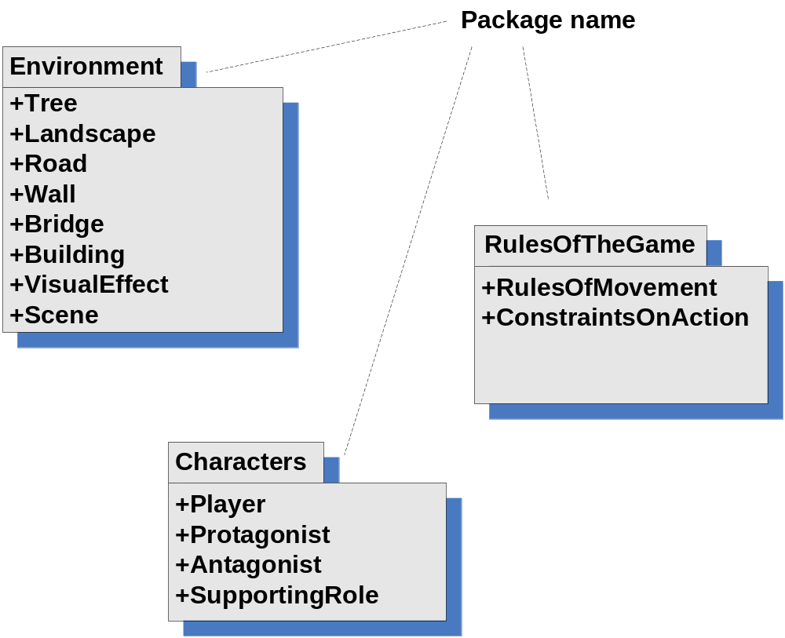
Analysis Packages

