Slide 1
CHAP.16
FLUID DYNAMICS

Slide 2
Fluid Dynamics
Two ways of describing the motion of a fluid:
One is developed by Lagrange (Follow particles):
Solution for the positions and velocities of each particle as function of the time
Another is developed by Euler (Distribution Function):
Specify the density and the velocity of the fluid at each point in space and at each instant of time
zwma@zju.edu.cn

Slide 3



Description of Fluid Flow:
— Variables: Pressure, Density, Velocity
Pressure p(x,y,z,t) , density ρ(x,y,z,t) and velocity v(x,y,z,t) at the point x,y,z in space at a particular time.
Fluid flow
zwma@zju.edu.cn

Slide 4
Characteristics of Fluid Flow:
— Steady or not: Variables change with time?
— Compressible or not
— Viscous or not
— Rotational or irrotational
Ideal fluid is steady, incompressible, nonviscous and irrotational fluid.
zwma@zju.edu.cn

Slide 5
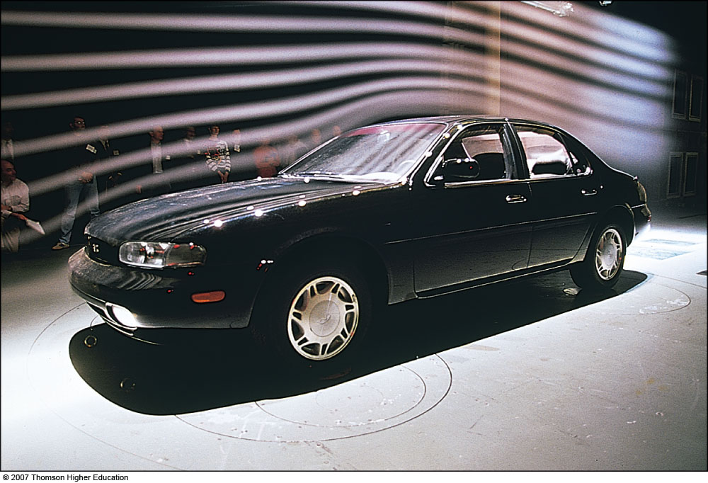
Streamlines and the Equation of Continuity
Streamlines:
zwma@zju.edu.cn

Slide 6
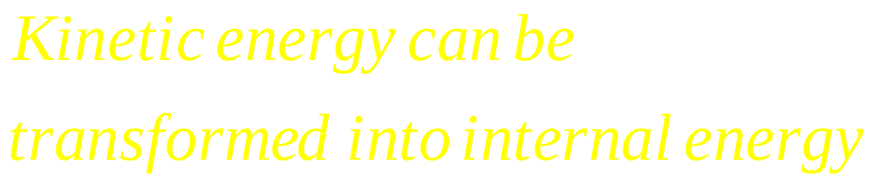
Fluid flow
V₀
zwma@zju.edu.cn

Slide 7
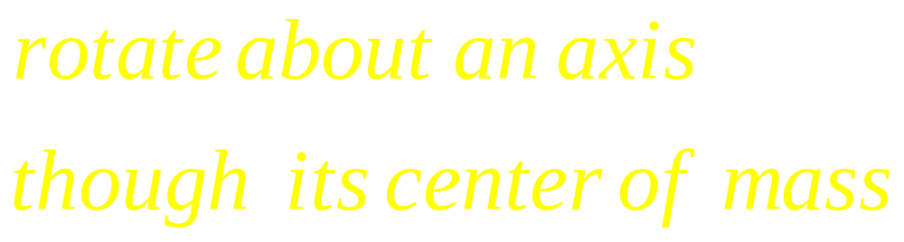
Fluid flow
zwma@zju.edu.cn

Slide 8
Equation of continuity
Fluid flow
(No fluid can cross the boundary of flow tube)
A₁V₁ ρ₁= A₂V₂ρ₂
A₁V₁ = A₂V₂
If ρ₁= ρ₂ (incompressible)
A₂, V₂ , ρ₂
A₁, V₁ , ρ₁
steady
Streamlines
velocity
Direction
A₁>A₂ V₁ < V₂
Density of streamline
Magnitudes
zwma@zju.edu.cn

Slide 9
zwma@zju.edu.cn

Slide 10
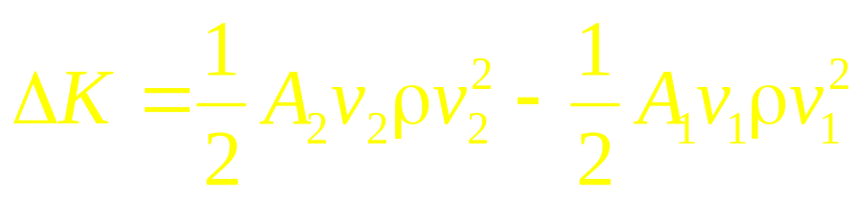
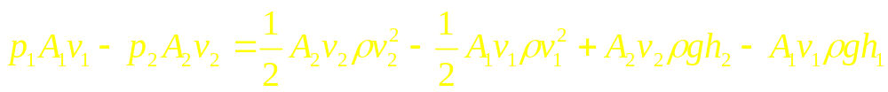


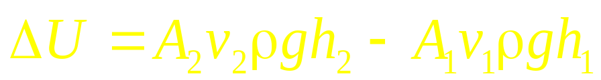

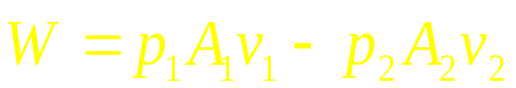
δm
h₂A₂v₂ρ₂
In 1 second
steady
h₁A₁v₁ ρ₁
P₂
P₁
δm
Bernoulli’s Eq.
zwma@zju.edu.cn

Slide 11
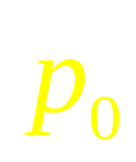
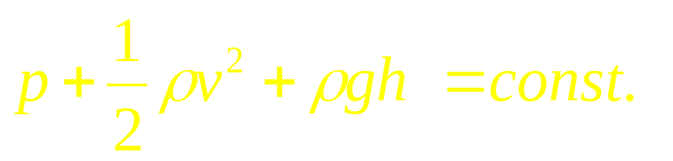
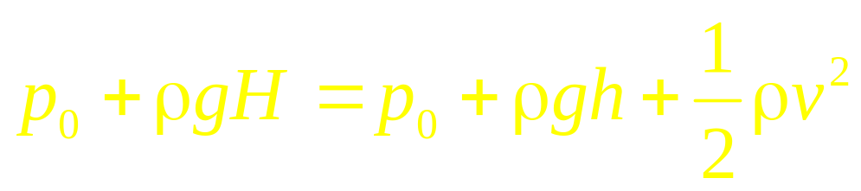
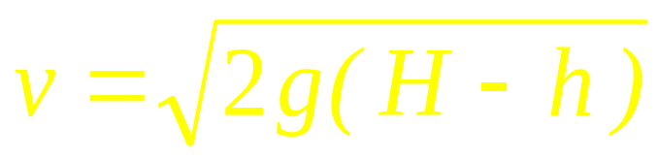
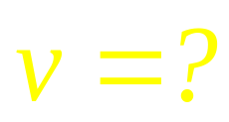
Bernoulli’s Eq.
zwma@zju.edu.cn

Slide 12

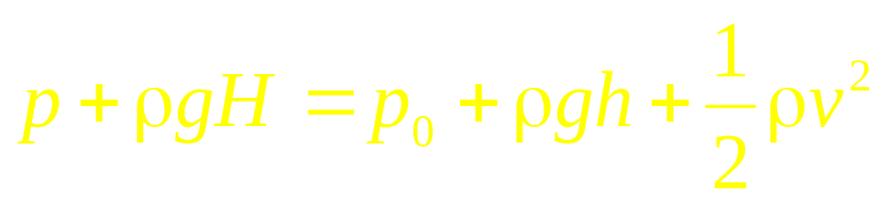
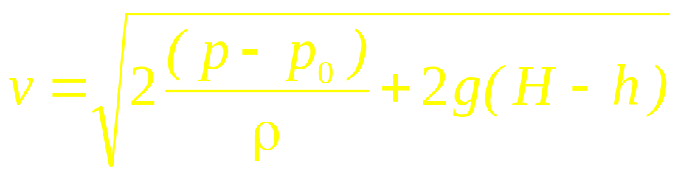

Bernoulli’s Eq.
zwma@zju.edu.cn

Slide 13
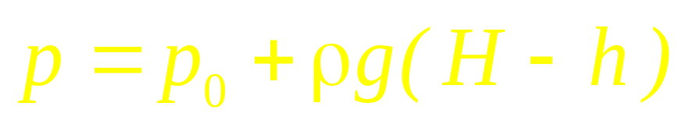

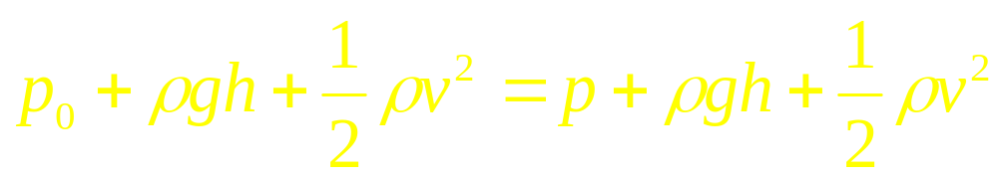
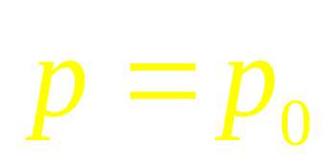
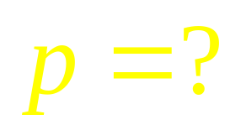

zwma@zju.edu.cn

Slide 14
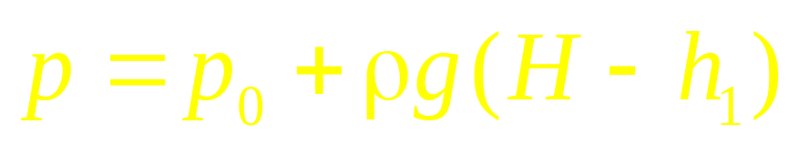
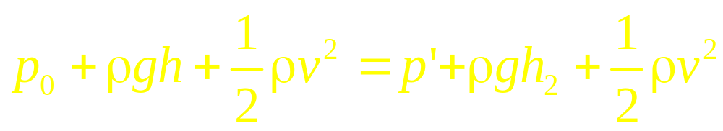
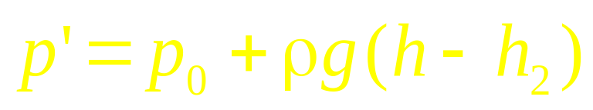
zwma@zju.edu.cn

Slide 15
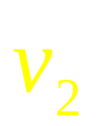
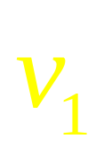
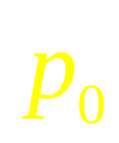

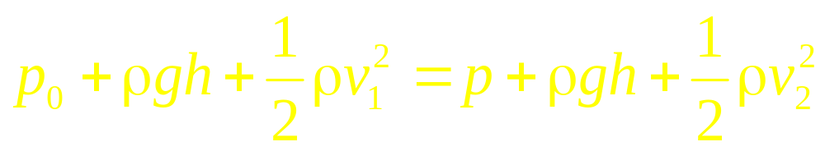
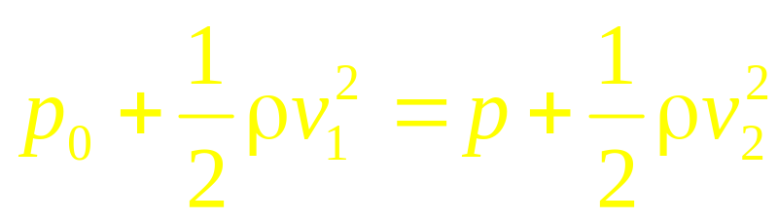
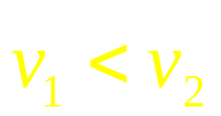
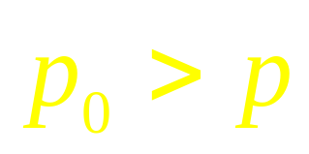
zwma@zju.edu.cn

Slide 16
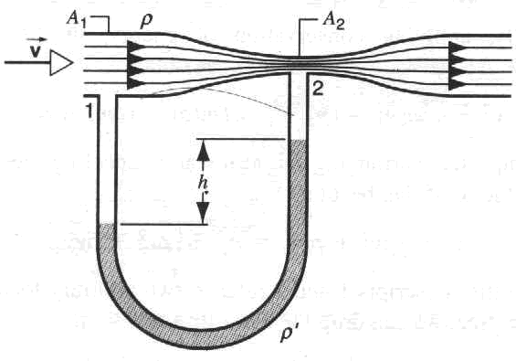
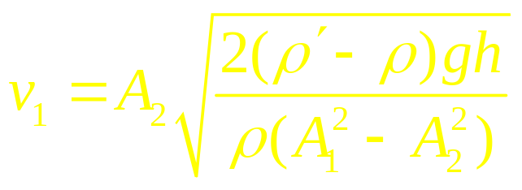
Applications of Bernoulli’s Equation and the Equation of Continuity
1. The Venturi meter
How to get this result?
zwma@zju.edu.cn

Slide 17
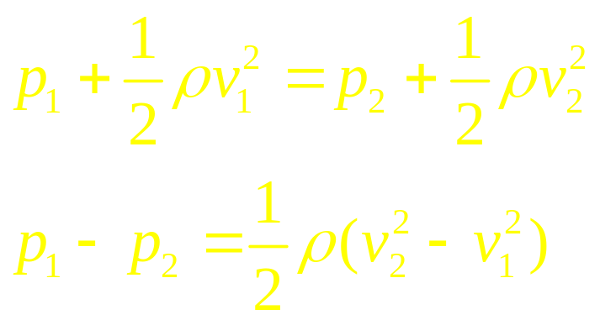
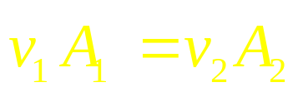
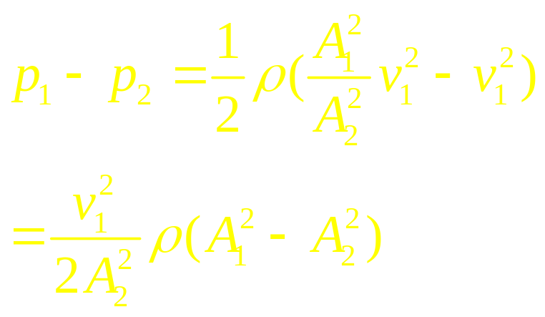
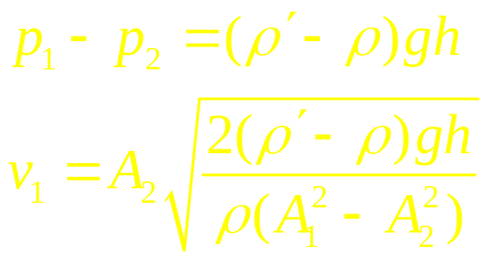
Mass conservation:
zwma@zju.edu.cn

Slide 18
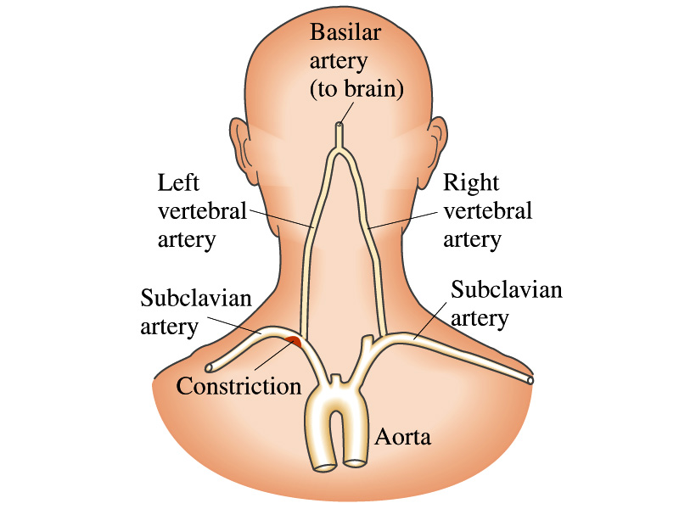
zwma@zju.edu.cn

Slide 19
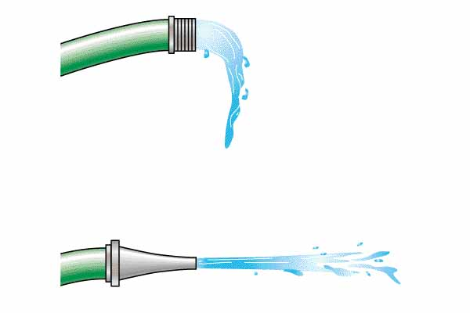
zwma@zju.edu.cn

Slide 20
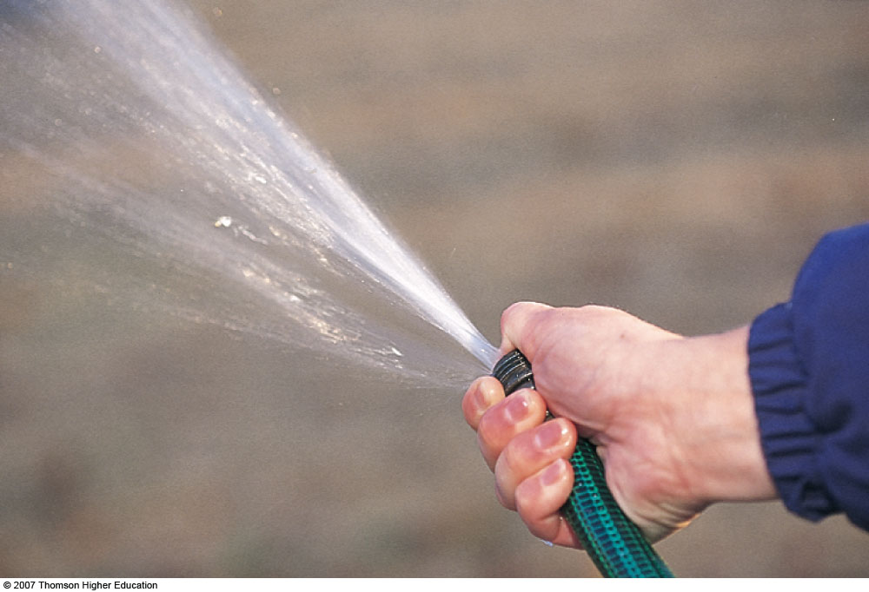
zwma@zju.edu.cn

Slide 21
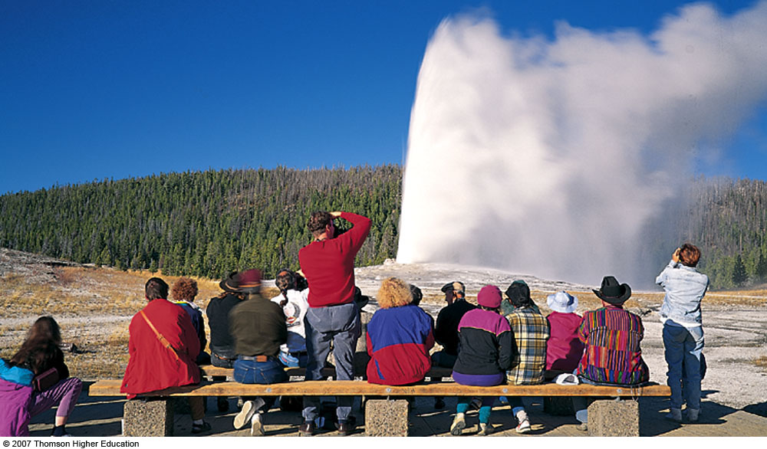
Geiser
zwma@zju.edu.cn

Slide 22
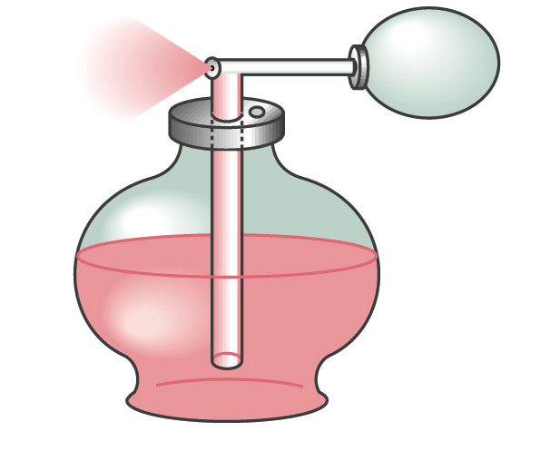
zwma@zju.edu.cn

Slide 23
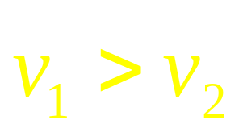
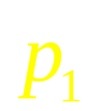
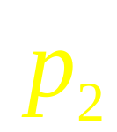
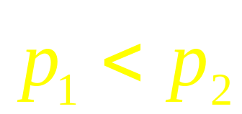
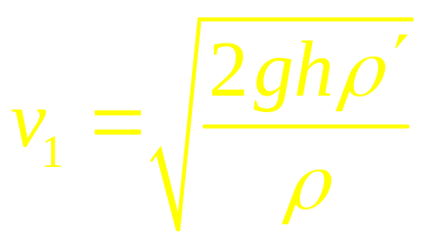
zwma@zju.edu.cn

Slide 24
zwma@zju.edu.cn

Slide 25
zwma@zju.edu.cn

Slide 26
zwma@zju.edu.cn

Slide 27


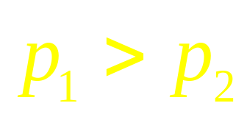
zwma@zju.edu.cn

Slide 28
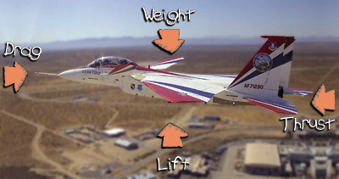
zwma@zju.edu.cn

Slide 29
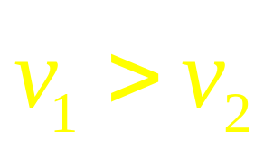
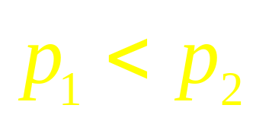
zwma@zju.edu.cn

Slide 30

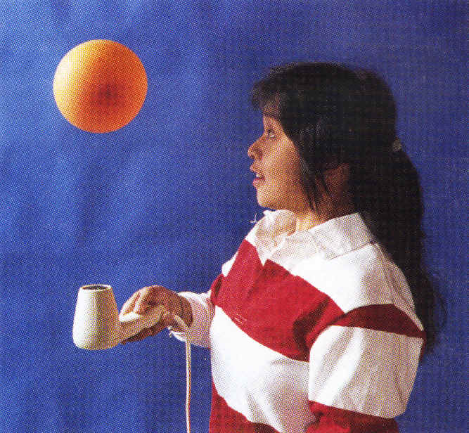
Now, can you explain these phenomena ?
zwma@zju.edu.cn

Slide 31
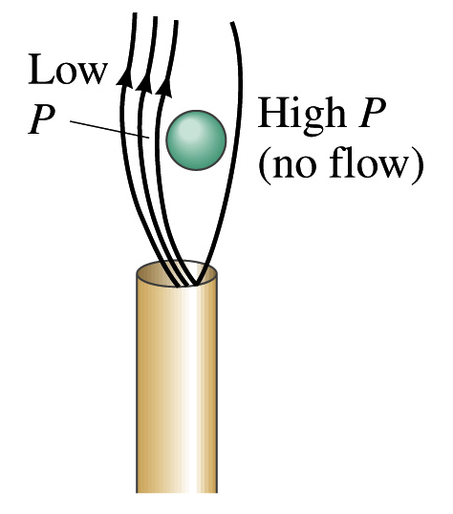
zwma@zju.edu.cn

Slide 32



zwma@zju.edu.cn

Slide 33

Bernoulli’s Eq. cannot be used
zwma@zju.edu.cn

Slide 34
z
viscous
A
F
v
F = A η dv/dZ
A
F
v’
F
V₀
F = 2πrLηdv/dr
F_{ex} = S(p₂-p₁)=πr²Δp
Since F_{ex} =F, we have
dv= (Δp/2Lη)rdr
v =v₀ (1- r²/R²)
where v₀=ΔpR²/4Lη
zwma@zju.edu.cn

Slide 35






V₀
v =v₀ (1- r²/R²)
zwma@zju.edu.cn

Slide 36

Turbulence:
Turbulent (disordered) flow — Chaotic flow
zwma@zju.edu.cn

Slide 37


zwma@zju.edu.cn

Slide 38


phypzq@zj165.com

Slide 39






Turbulence
Critical speed:
R is Reynolds number, D is diameter of a tube
The critical speed for water in the pipe with D~2cm
for our home, R~2000, D=0.02m,
zwma@zju.edu.cn

Slide 40
CHAP.16
Exercises
P367: 7,10,17, 21,23
Problems
P369: 4, 11, 14

