Slide 1

编译原理
陈明帅
m.chen@zju.edu.cn
浙江大学 · 计算机科学与技术学院
Slides partially credited to Peisen Yao

Slide 2
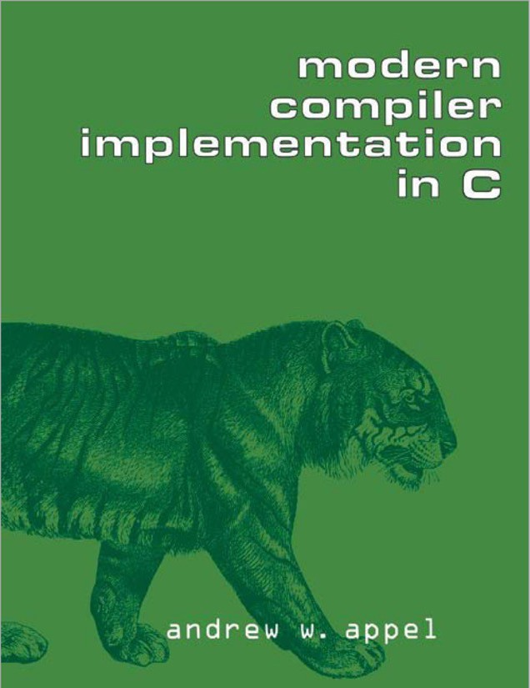
课程信息
主讲老师 | 陈明帅，m.chen@zju.edu.cn
课程助教 | 黄钰，3230105660@zju.edu.cn
时间地点 | 周四（3 - 5节），教4-304
课程网站 | https://fiction-zju.github.io/courses/ 学在浙大
Textbook:
Modern Compiler Implementation in C Andrew W. Appel

Slide 3
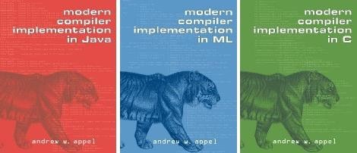
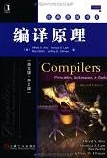

参考书籍 (I)
[虎书] Andrew W. Appel. Modern Compiler Implementation in Java / ML / C
现代编译原理—C语言描述，人民邮电出版社
[龙书] Alfred V. Aho, Monica S. Lam, et al. Compilers: Principles, Techniques, and Tools (2nd Ed.)
编译原理，影印本-2011、译本-2009，机械工业出版社
Keith Cooper & Linda Torczon. Engineering a Compiler
编译器工程，机械工业出版社

Slide 4

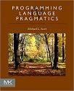

参考书籍 (II)
[鲸书] Steven Muchnick. Advanced Compiler Design and Implementation.
高级编译器设计与实现，影印本-2003, 译本-2005
Michael L. Scott. Programming Language Pragmatics,
程序设计语言：实践之路 (第1-3版)，电子工业出版社
[LCC] Christopher W. Fraser, David R. Hanson. A Retargetable C Compiler.
可变目标C编译器—设计与实现.

Slide 5
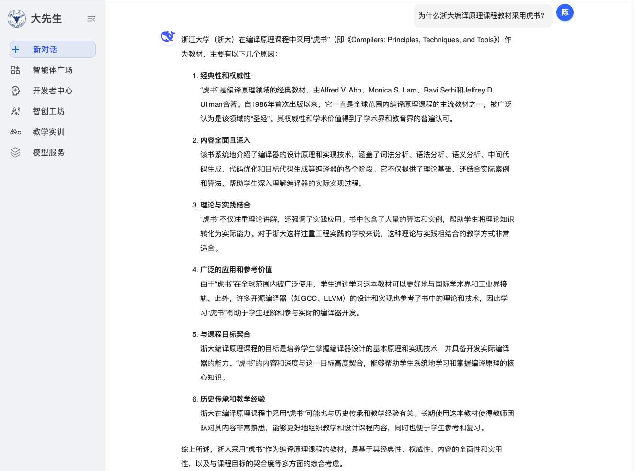
Why the Tiger?

Slide 6
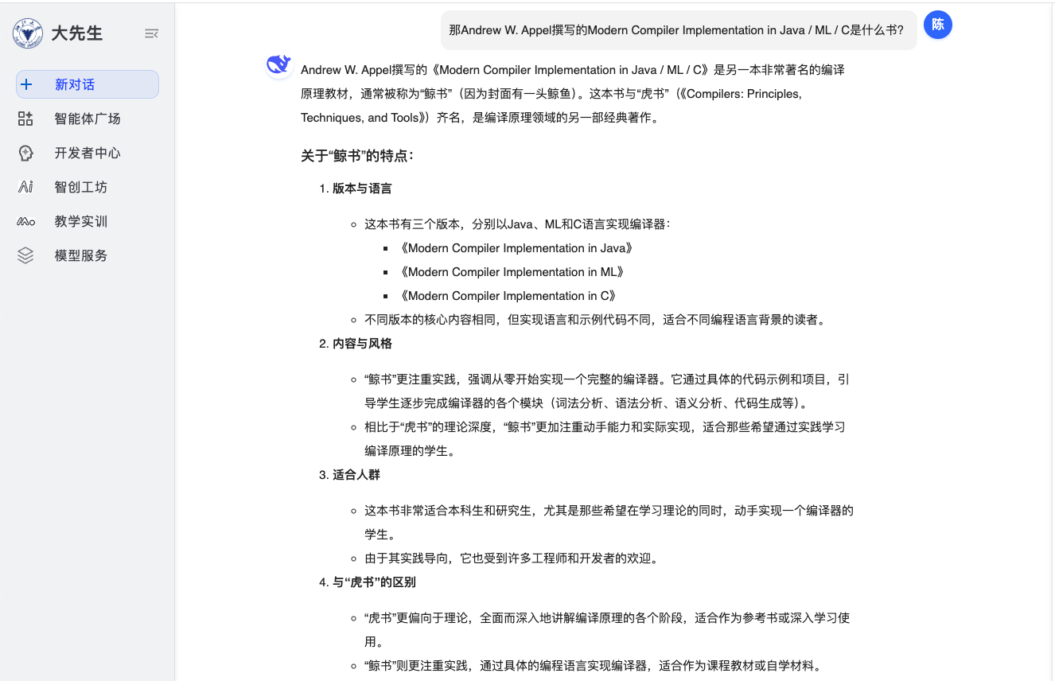
Why the Tiger?

Slide 7
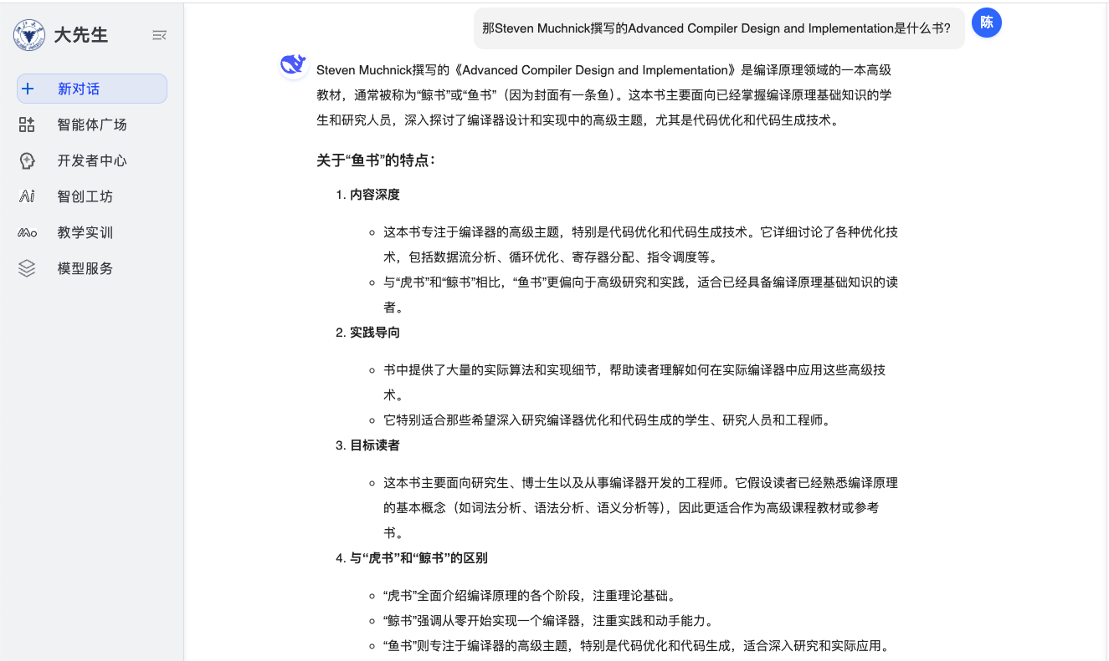
Why the Tiger?

Slide 8
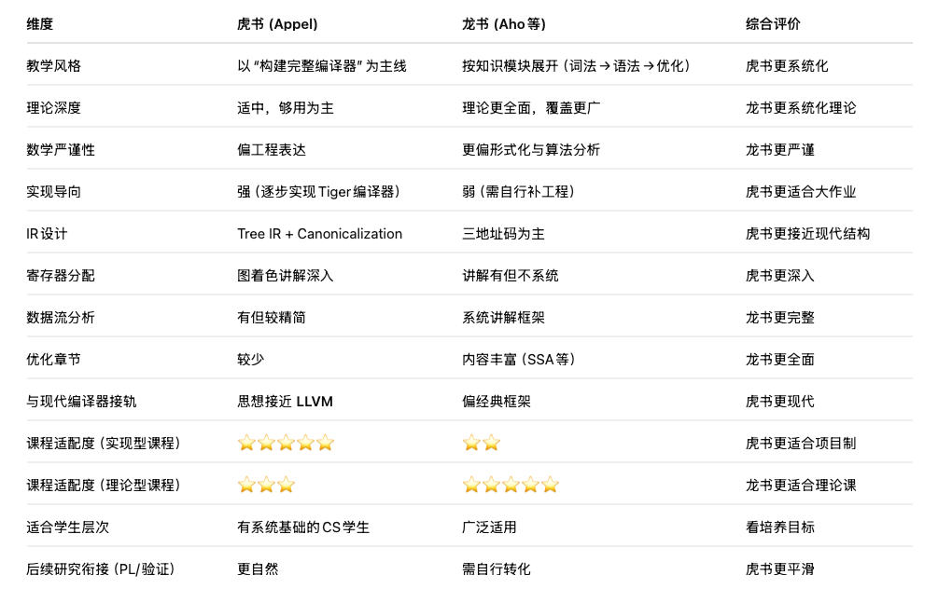
Why the Tiger?

Slide 9
考核方式
课程作业 (课后小型练习题) = 10%
随堂测验 (Quizzes) = 10%
课程设计 (Lab x 5) = 30%
期末考试 = 50%
Note: Final Exam < 40/100 ➔ Final Grade < 60/100

Slide 10
课程内容
1
Introduction
2
3
4
5
6
Lexical Analysis
Parsing
Abstract Syntax
Semantic Analysis
Activation Records
9
8
7
Instruct. Selection
Blocks & Traces
Interm. Code
10
11
Liveness Analysis
Register Allocation
Fundamentals
13
18
14
Garbage Collection
Loop Optimizations
Obj.-Ori. Languages
Advanced Topics

Slide 11
Outline
What, Why and How?
What is a compiler?
Why do we need to learn compilers?
How to learn compilers?
General Workflow of a Compiler
Modules and Interfaces in Tiger

Slide 12
Outline
What, Why and How?
What is a compiler?
Why do we need to learn compilers?
How to learn compilers?
General Workflow of a Compiler
Modules and Interfaces in Tiger

Slide 13
What is a compiler?
What, Why and How?
A compiler is a program to translates one language to another (due to abstraction of computing)
A compiler is a complex program
From 10,000 to 1,000,000 lines of code
gcc has 7.5M lines of code
Source
Program
Target
Program
Compiler

Slide 14
Why should we learn compilers?
What, Why and How?
Compilers are used in almost all forms of computing
The principles and techniques are applicable to so many other domains:
Command interpreters and interface programs
Compiler construction touches upon other fields:
Theoretical CS (automata, fixed-point iteration)
Programing languages (type system, formal semantics)
Machine architecture (memory management, instr. set)
Algorithms (traversal over trees/graphs, dynamic prog.)
“编写编译器的原理和技术具有普遍意义，以至于每个计算机科学家的研究生涯中都会反复用到该原理和技术。”
—— Alfred V. Aho

Slide 15
What, Why and How?
How to learn compilers?
Lectures describe
Techniques
Data structures
Algorithms
Course project aims to implement a compiler
computer programs
executable code

Slide 16
Outline
What, Why and How?
What is a compiler?
Why do we need to learn compilers?
How to learn compilers?
Typical Workflow of a Compiler
Modules and Interfaces in Tiger

Slide 17







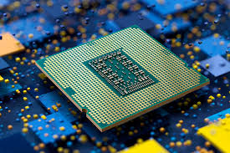
Typical Workflow of a Compiler
词法分析
语 语
法 义
分 分
析 析
前端
指令选择
寄存器分配
指令调度
中间代码生成
机器无关代码优化
程序员编写的源程序
机器硬件上运行的目标代码
中端
后端
记录程序中变量、函数等对象的各种属性
符号表可由编译器的各个步骤使用
语法错误: 如算术表达式的括号不配对
语义错误: 如算符作用于不相容的运算对象
Symbol Table 符号表
Error Handler 错误处理

Slide 18
Typical Workflow of a Compiler
Two Important Concepts
Phases: one or more modules operating on different abstract “languages”
Interfaces: information exchanged between modules of the compiler
词法分析
语 语
法 义
分 分
析 析
前端
指令选择
寄存器分配
指令调度
中间代码生成
机器无关代码优化
程序员编写的源程序
机器硬件上运行的目标代码
中端
后端

Slide 19
Typical Workflow of a Compiler
Why breaking the compiler into multiple phases?
Easier to understand and implement
Allow for reusing the components
changing the source and/or target languages
词法分析
语 语
法 义
分 分
析 析
前端
指令选择
寄存器分配
指令调度
中间代码生成
机器无关代码优化
程序员编写的源程序
机器硬件上运行的目标代码
中端
后端

Slide 20
Think As If You Were a Compiler
x = a * 2 + b * (x * 3)
这行“字符串”是什么含义？这是一个合法的“程序”吗？
我们怎么决定它的含义:
把“字符串”分割成“单词”
“单词”组合成“句子”
解析“句子”的含义

Slide 21
词法分析 (Lexing/Scanning/Lexical Analysis)
string
x = a * 2 + b * (x * 3)
id<x> assign id<a> times int<2> plus id<b> times lparen id<x> times int<3> rparen
词法分析: 将程序字符流分解为记号 (Token) 序列
删除字符串中不必要的部分（如空格）
通常使用正则表达式匹配（DFA 定义）
token sequence
词法分析
语法分析
指令选择
寄存器分配
指令调度
语义分析
中间代码生成
机器无关代码优化

Slide 22
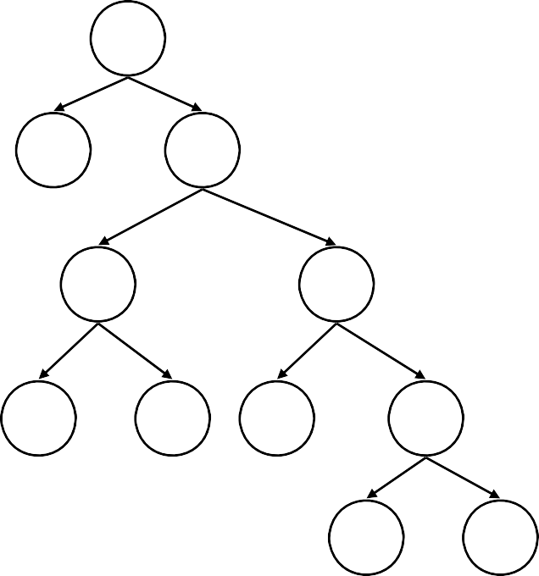
语法分析 (Parsing/Syntactic Analysis)
id<x> assign id<a> times int<2> plus id<b> times lparen id<x> times int<3> rparen
=
语法分析: 将记号序列解析为语法结构
x +
去除不必要的记号（例如括号）
一般使用抽象语法树（AST）定义
*
*
a 2 b
*
x 3
词法分析
语法分析
指令选择
寄存器分配
指令调度
语义分析
中间代码生成
机器无关代码优化

Slide 23
语义分析 (Semantic Analysis)
=
语义分析: 决定语法结构的含义
变量 x, a, b 的类型是什么？
运算符 * 和 + 的含义是什么？
读写变量 x 是合法的吗？
…
x +
*
*
a 2 b
*
x 3
词法分析
语法分析
指令选择
寄存器分配
指令调度
语义分析
中间代码生成
机器无关代码优化

Slide 24
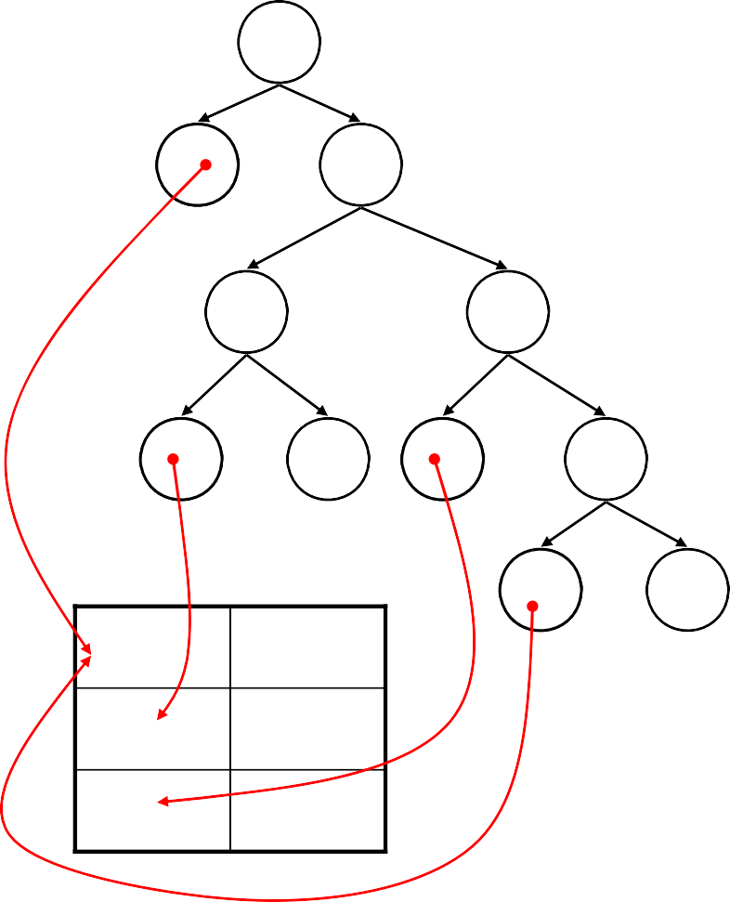
语义分析 (Semantic Analysis)
=
语义分析器
=
x +
x
+
*
*
*
*
a 2 b
*
a 2 b
*
x 3
x 3
x
a b
int
int int
语义分析: 利用属性文法、符号表等

Slide 25
中间代码生成
中间代码/表示 (IR): 源语言与目标语言之间的桥梁
=
t1 = x * 3
t2 = t1 * b
t3 = a * 2
t4 = t2 + t3
x = t4
x +
中间代码生成器
*
*
a 2 b
*
三地址中间代码
x 3
x
a b
int
int int
词法分析
语法分析
指令选择
寄存器分配
指令调度
语义分析
中间代码生成
机器无关代码优化

Slide 26
优化（基于中间表示）
基于中间表示进行分析与变换
降低执行时间，减少资源消耗等
t1 = x * 3
t2 = t1 * b
t3 = a * 2
t4 = t2 + t3
x = t4
t1 = x * 3
t2 = t1 * b
t3 = a << 1
x = t2 + t3
代码优化器
词法分析
语法分析
指令选择
寄存器分配
指令调度
语义分析
中间代码生成
机器无关代码优化

Slide 27
目标代码生成
把中间表示形式翻译到目标语言
指令选择、寄存器分配、指令调度
t1 = x * 3
t2 = t1 * b
t3 = a << 1
x = t2 + t3
muli a0, a0, 3
mul a0, a0, a1
slli a1, a1, 1
add a0, a1, a0
代码生成器
词法分析
语法分析
指令选择
寄存器分配
指令调度
语义分析
中间代码生成
机器无关代码优化

Slide 28
Outline
What, Why and How?
What is a compiler?
Why do we need to learn compilers?
How to learn compilers?
Typical Workflow of a Compiler
Modules and Interfaces in Tiger

Slide 29
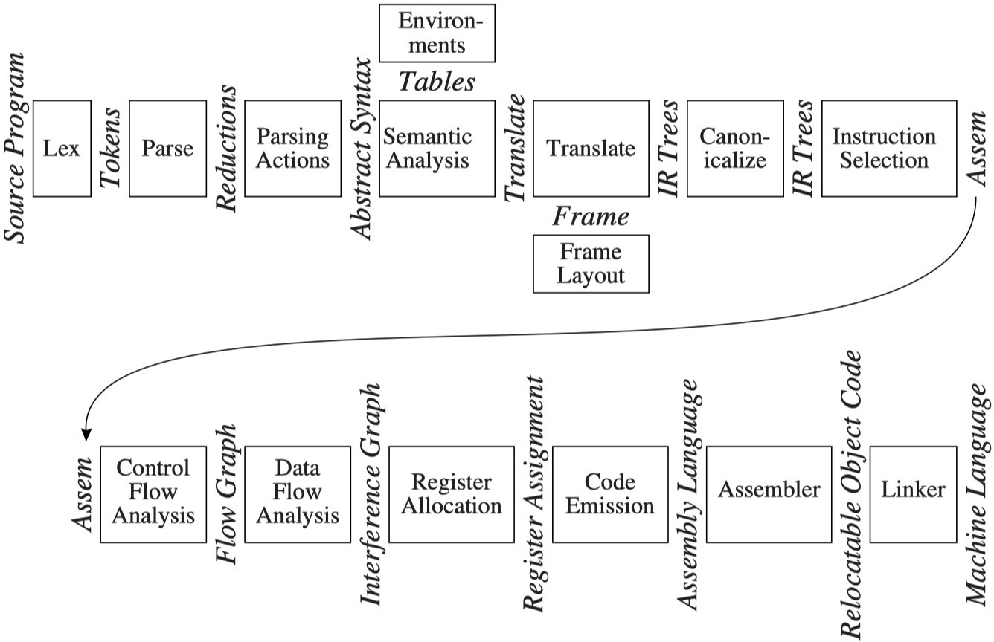
Tiger编译器的流程

Slide 30
Tiger编译器的流程
AST (抽象语法树): 语法分析 +“Parsing Actions”生成
Canoicalized IR Tree
Assem
IR Tree
AST
CFG
Interference Graph

Slide 31
Tiger编译器的流程
IR Tree: 语义分析后按一定规则生成 (树型中间表示)
Canoicalized IR Tree
Assem
IR Tree
AST
CFG
Interference Graph

Slide 32
Tiger编译器的流程
Canonicalized IR Tree: 规范化IR Tree (方便生成汇编)
Canoicalized IR Tree
Assem
IR Tree
AST
CFG
Interference Graph

Slide 33
Tiger编译器的流程
Assem: 指令选择器生成 (一种特殊的抽象汇编)
Canoicalized IR Tree
Assem
IR Tree
AST
CFG
Interference Graph

Slide 34
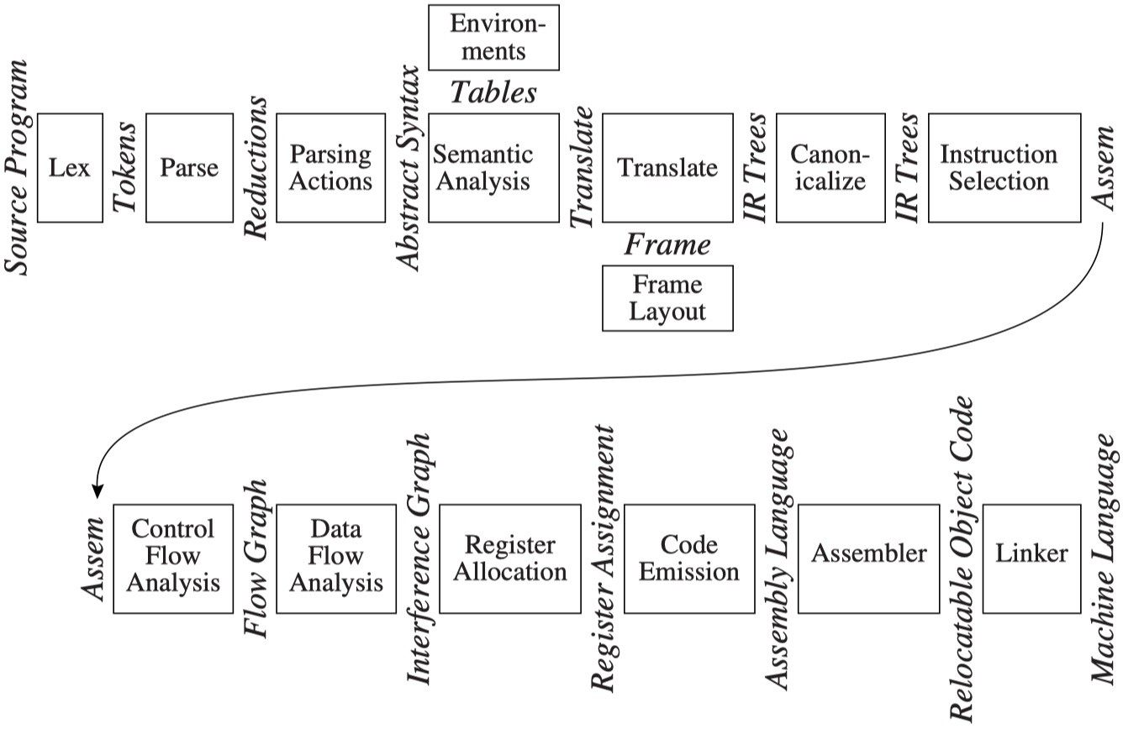
Tiger编译器的流程
CFG (Control Flow Graph) 控制流图: 方便进行数据流分析
– 如活跃变量分析 (Liveness Analysis)
Canoicalized IR Tree
Assem
IR Tree
AST
CFG
Interference Graph

Slide 35
Tiger编译器的流程
Interference Graph (冲突图): 由活跃变量分析结果构造，用于指导寄存器分配
Canoicalized IR Tree
Assem
IR Tree
AST
CFG
Interference Graph

Slide 36
编译器发展简史

Slide 37
编译器的发展
Compiler History
1943: Plankalkül, first high-level language (Konrad Zuse)
1951: Formules, first self-hosting compiler
1952: A-0, term ‘compiler’ (Grace Hopper)
1957: FORTRAN, first commercial compiler (John Backus; 18 PY)
1962: Lisp, self-hosting compiler and GC (Tim Hart and Mike Levin)
Compilers today
Modern compilers are complex (gcc has 7.5M LOC)
There is still a lot of compiler research (LLVM, verified compilation, …)
There is still a lot of compiler development in industry

Slide 38
经典编译器: FORTRAN
1957: The FORTRAN Automatic Coding System
Index Optimiz’n
Code Merge
bookkeeping
Front End
Flow Analysis
Register Allocation
Final Assembly
Front End Back End
Middle End
Six passes in a fixed order
Generated good code
Assumed unlimited index registers
Code motion out of loops, with ifs and gotos Did flow analysis & register allocation

Slide 39
经典编译器: FORTRAN
1969: IBM’s FORTRAN H Compiler
Scan & Parse
Build CFG
&
DOM
Find Busy Vars
Loop
CSE Inv Code Mot’n
Re - assoc
(consts)
Reg. Alloc.
Final Assy.
Copy OSR Elim.
Front Middle End Back End End
Used low-level IR (quads), identified loops with dominators
Focused on optimizing loops (“inside out” order)
Passes are similar to modern compilers
Simple front end, simple back end for IBM 370

Slide 40
经典编译器: PA-RISC
1980: IBM’s PL.8 Compiler
Front End
M
iddle End
Back End
Many passes, one front end, several back ends
Collection of 10 or more passes Repeat some passes and analyses Represent complex operations at 2 levels Below machine-level IR
Multi-level IR has become common wisdom

Slide 41
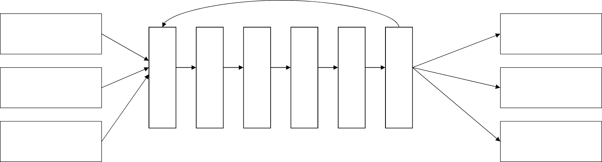
经典编译器: SUIF
1999: The SUIF Compiler System
Fortran 77
C/Fortran
C & C++
Alpha
Java
x86
Front End
Middle End
Back End
SSA construction
Dead code elimination
Another classically-built compiler
3 front ends, 3 back ends
18 passes, configurable order
Constant propagation
Global value numbering
Strength reduction
Reassociation
Instruction scheduling
Two-level IR (High/Low SUIF)
Register allocation
Intended as research infrastructure

Slide 42
The end

Slide 43
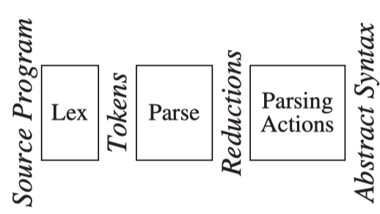
1.1 Modules and Interfaces: Phases
Description of compiler phases
Chapter | Phase | Description
2 | Lex | Break the source file into individual words, or tokens
3 | Parse | Analyze the phrase structure of the program
4 | Parsing Actions | Build a piece of abstract syntax tree corresponding to each phrase

Slide 44
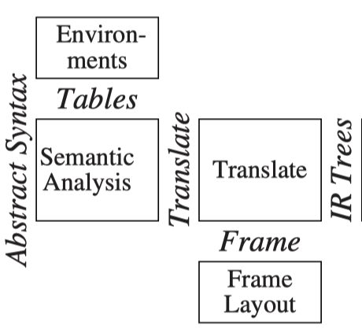
1.1 Modules and Interfaces: Phases
Description of compiler phases
Chapter | Phase | Description
5 | Semantic Analysis | Determine what each phrase means Relate uses of variables to their definitions Check types of expressions Request translation of each phrase
6 | Frame Layout | Place variables, function-parameters, etc. into activation records (stack frames) in a machine-dependent way.
7 | Translate | Produce intermediate representation trees (IR trees) Not tied to any particular source language or target-machine architecture.

Slide 45
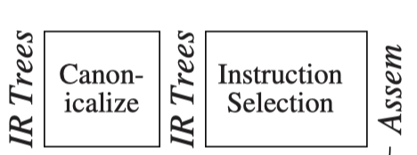

1.1 Modules and Interfaces: Phases
Description of compiler phases
Chapter |  | Phase | Description
8 | Canonicalize |  | Hoist side effects out of expressions Clean up conditional branches for the convenience of the next phases.
9 | Instruction Selection |  | Group the IR-tree nodes into clumps that correspond to the actions of target-machine instructions.
10 | Control Flow Analysis |  | Analyze the sequence of instructions into a control flow graph that shows all the possible flows of control the program might follow when it executes.

Slide 46
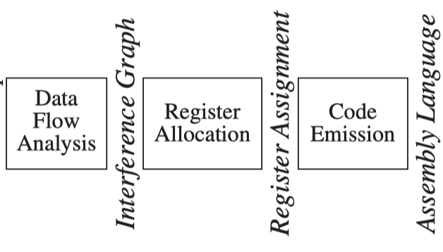
1.1 Modules and Interfaces: phases
Description of compiler phases
Chapter |  | Phase | Description
10 | Dataflow Analysis |  | Gather information about the flow of information through variables of the program For example, liveness analysis calculates the places where each program variable holds a still-needed value (is live)
11 | Register Allocation |  | Choose a register to hold each of the variables and temporary values used by the program; variables not live at the same time can share the same register
12 | Code Emission |  | Replace the temporary names in each machine instruction with machine registers

Slide 47
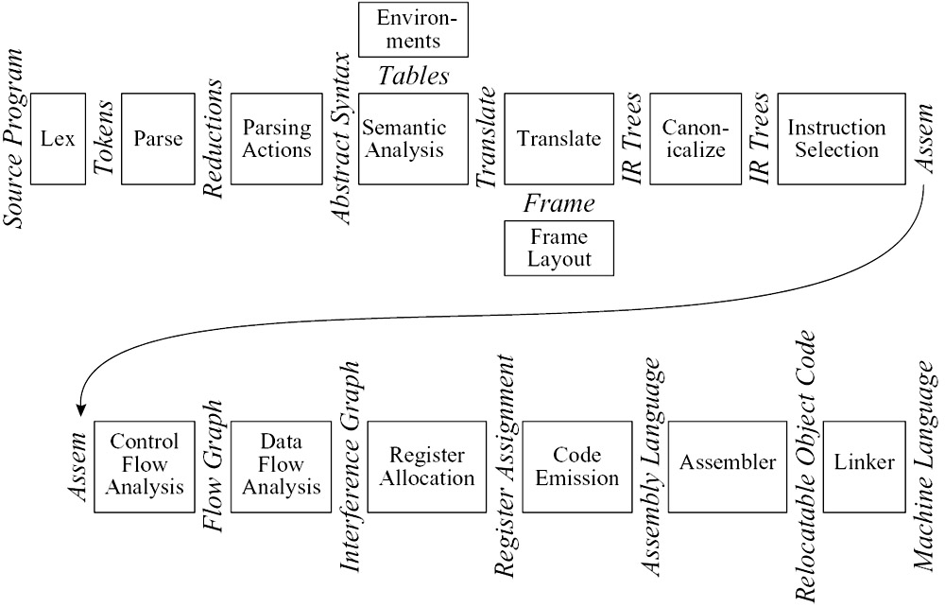
1.1 Modules and Interfaces: Modularization
Several modules maybe combined into one phase: Parse, Semantic Analysis, Translate, Canonicalize
Instruction Selection maybe combined with Code Emission
Simple compilers may omit the Control Flow Analysis, Data Flow Analysis, and Register Allocation phases

Slide 48
1.1 Modules and Interfaces: Interfaces
The data structures: Abstract Syntax, IR Trees and Assem.
A set of functions: The translate interface
A function called by parser: The token interface

Slide 49
1.2 Tools and Software

Slide 50
1.2 Tools and Software
Two of the most useful abstractions:
Regular expressions for lexical analysis.
Context-free grammars for parsing
Two tools for compiling:
(2) Lex converts a declarative specification into a lexical analysis program
(2) Yacc converts a grammar into a parsing program
The programming project in the book can be compiled using any ANSI-standard C compiler, along with Lex and Yacc.

Slide 51
1.3 Data structures for tree languages

Slide 52
1.3 Data Structure For Tree Languages: Concepts
Intermediate representations :
The form of a compiling program
Often takes the form of trees
Trees representation:
The main representation forms
Several node types with different attributes
Described with grammars like programming
languages

Slide 53
1.3 Data Structure For Tree Languages: A grammar
Stm → Stm; Stm | (CompoundStm)
Stm → id := Exp | (AssignStm)
Stm → print (ExpList) | (PrintStm)
Exp → id | (IdExp)
Exp → num | (NumExp)
Exp → Exp Binop Exp | (OpExp)
Exp → (Stm, Exp) | (EseqExp)
ExpList → Exp, ExpList | (PairExpList)
ExpList → Exp | (LastExpList)
Binop →+ | (Plus)
Binop →− | (Minus)
Binop →× | (Times)
Binop → / | (Div)
GRAMMAR 1.3: A straight-line programming language.

Slide 54
1.3 Data Structure For Tree Languages: informal semantics of the language
Stm is a statement
Exp is an expression.
s1; s2 executes statement s1, then statement s2
i :=e evaluates the expression e, then "stores" the result in variable i.
print(e1, e2,…, en) displays the values of all the expressions,
evaluated left to right, separated by spaces,
terminated by a newline.
id yields the current contents of the variable id
number evaluates to the named integer
e1 op e2 evaluates e1, then e2, then applies the given binary operator
(s, e) like the C-language “comma” operator, evaluating the statement
s for side effects before evaluating the expression e.

Slide 55
1.3 Data Structure For Tree Languages: An example
Executing the following program
a := 5+3; b := (print(a, a-1), 10*a); print(b)
prints
8 7
80
How to represent this program inside a compiler?

Slide 56
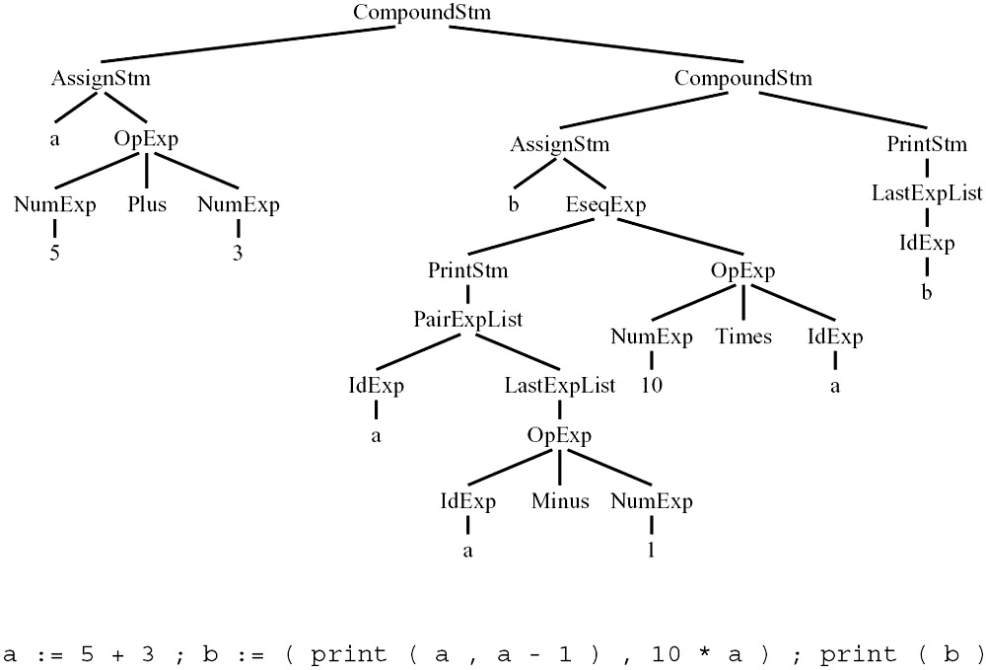
1.3 Data Structure For Tree Languages: Tree representation of a
straight-line program
Exp → Exp Binop Exp | (OpExp)

Slide 57
1.3 Data Structure For Tree Languages: Type define
How to translate the grammar into data structure definitions?
Each grammar symbol can correspond to a typedef in the data structures:
Grammar | Typedef
Stm | A-stm
Exp | A-exp
ExpList | A-expList
id | string
num | int

Slide 58
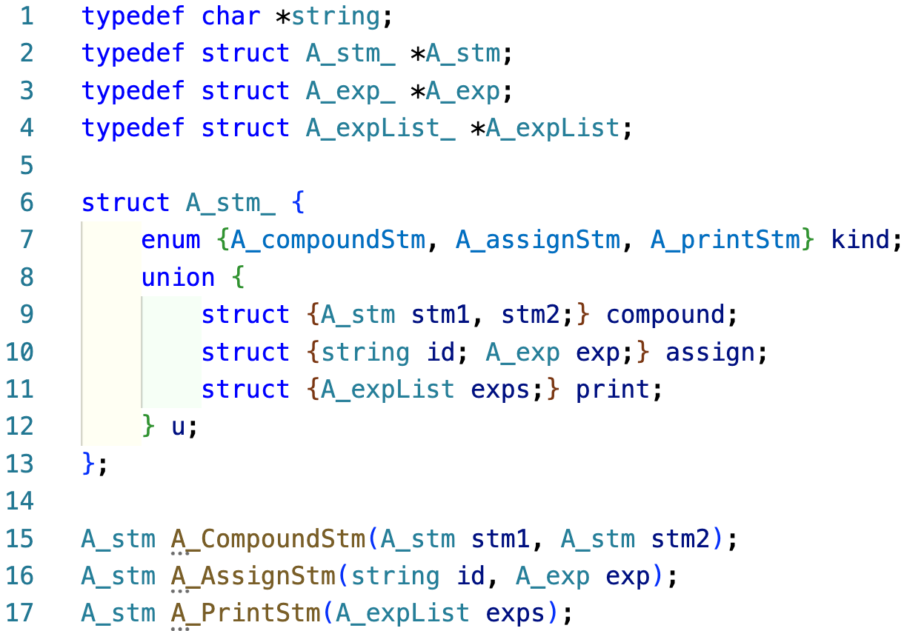
1.3 Data Structure For Tree Languages: Grammar VS
Data structure definiton
Stm → Stm; Stm | (CompoundStm)
Stm → id := Exp | (AssignStm)
Stm → print (ExpList) | (PrintStm)
Constructor function

Slide 59
1.3 Data Structure For Tree Languages: Each grammar rule
One constructor :
belongs to the union for its left-hand-side symbol
The constructor names
indicated on the right-hand side – inside of parentheses
Right-hand-side components
represented in the data structures
{
The CompoundStm has two Stm's on the right- hand side;
Stm → Stm; Stm
The AssignStm has an identifier and an expression;
id := Exp
}
Struct of each grammar symbol:
A union to carry these values, and
A kind field to indicate which variant of the union is valid

Slide 60
1.3 Data Structure For Tree Languages
A constructor function:
Malloc and initialize the data structure
Such as CompoundStm, AssignStm, etc
A_stm A_CompoundStm(A_stm stm1, A_stm stm2) {
A_stm s = checked_malloc(sizeof(*s));
s->kind = A_compoundStm;
s->u.compound.stm1=stm1;
s->u.compound.stm2=stm2;
return s;
}

Slide 61
1.3 Data Structure For Tree Languages
Binop will be simpler.
Binop →+
Binop →−
Binop →×
Binop → /
Making a Binop struct.
struct A_binop {
enum {A_plus,A_minus,A_times,A_div} kind;
}
Overkill：no data need to contain.
Instead, making an enum type A_binop：
typedef enum {A_plus,A_minus,A_times,A_div} A_binop;

Slide 62
1.3 Data Structure For Tree Languages: Programming style :
Several conventions for representing tree data structures in C
Trees are described by a grammar.
A tree is described by one or more typedef, each corresponding to a symbol in the grammar.
Each typedef defines a pointer to a corresponding struct.
The struct name, which ends in an underscore, is never used anywhere except in the declaration of the typedef and the defination of the struct itself.
typedef char *string;
typedef struct A_stm_ *A_stm;
typedef struct A_exp_ *A_exp;
typedef struct A_expList_ *A_expList;

Slide 63
1.3 Data Structure For Tree Languages: Programming style :
Each struct contains a kind fields,
An enum showing different variants, one of each grammar rule; and a u field, which is a union.
There is more than one nontrivial(value-carraying) symbol in the right-hand side of a rule
(example: the rule CompoundStm),
The union has a component that is itself a struct comprising these values
(example: the compound element of the A_stm union).
struct A_stm_ {
enum {A_compoundStm, A_assignStm, A_printStm} kind;
union {
struct {A_stm stm1, stm2;} compound;
struct {string id; A_exp exp;} assign;
struct {A_expList exps;} print;
} u;
};

Slide 64
1.3 Data Structure For Tree Languages: Programming style :
There is only one nontrivial symbol in the right-hand side of a rule,
The union will have a component that is the value
(example: the num field of the A_exp union)
7. Every class will have a constructor function that initializes all the fields.
The malloc function shall never be called directly, except in these constructor functions.
A_stm A_CompoundStm(A_stm stm1, A_stm stm2) {
A_stm s = checked_malloc(sizeof(*s));
s->kind = A_compoundStm;
s->u.compound.stm1=stm1;
s->u.compound.stm2=stm2;
return s;
}

Slide 65
1.3 Data Structure For Tree Languages: Programming style :
8. Each module (head file) shall have a prefix unique to that module (example, A_ in Program 1.5)
9. Typedef names(after the prefix) shall start with lowercase letters;
constructor functions(after the prefix ) with uppercase; enumeration atoms(after the prefix) with lowercase;
and union variants(which have no prefix) with lowercase.

Slide 66
1.3 Data Structure For Tree Languages: Modularity principle
for C programs:
Careful attention to modules and interfaces prevents chaos in a compiler program
Each phase or module of the compiler belongs in its own “.c” file, with a corresponding “.h” file.
Each module shall have a prefix unique to that module.
All global names exported by the module shall start with the prefix
All functions shall have prototype
The C compiler shall be told to warn about uses of functions without prototypes

Slide 67
1.3 Data Structure For Tree Languages: Modularity principle
for C programs:
The inclusion of assert.h encourages the liberal use of assertion by the C programmer
The string type means a heap-allocated string that will not be modified after its initial creation.
6. C’s malloc function returns NULL if there is no memory left.
7. We will never call free.

Slide 68
The end

Slide 69
1.3 Data Structure For Tree Languages: Grammar VS
Data structure definiton
Typedef char *string;
Typedef struct A_stm_ *A_stm;
Typedef struct A_exp_ *A_exp;
Typedef struct A_expList_ *A_expList
Typedef enum {A_plus, A_Minus, A_times, A_div} A_binop
Struct A_stm_ { enum {A_compoundStm, A_assignStm, A_printStm} Kind
union { struct {A_stm stm1, stm2;} compound;
struct {string id; A_exp exp;} assign;
struct {A_expList exps;} print;
} u;
}
A_stm A_CompoundStm(A_stm stm1, A_stm stm2);
A_stm A_AssignStm(string id, A_exp exp;}
A_stm A_PrintStm(A_expList exps);

