Slide 1

Computer Architecture ----A Quantitative Approach
陈文智
浙江大学计算机学院
chenwz@zju.edu.cn

Slide 2
课程简介
《计算机体系结构》是计算机专业的一门重要专业课，从计算机系统角度介绍计算机设计原理和设计方法。课程内容包括：
1）计算机体系结构基本概念、计算机设计生命周期、量化设计原理和计算机性能评价方法；
2）存储体系改进性能的方法，包括cache的提高性能的方法、存储器的性能提升、虚拟存储器和虚拟机；
3）开发指令级并行性提高性能：转移预测、动态调度、猜测执行、多发射处理器等；
4）利用数据级并行性提高性能：向量处理器、SIMD以及GPU；
5）利用线程级并行性提高性能：多处理器结构、Cache一致性以及同步。

Slide 3
课程简介
在学习理论同时，要求在Vivado工具下，用Verilog语言进行硬件设计实现，并在FPGA板上和行为仿真中验证正确性。
实验包括：
实现支持RV32I、forwarding和predict-not-taken的五级流水线CPU
实现精确中断
实现2路组关联Cache并与应用于指令流水线
扩展流水线以支持多周期的复杂操作
实现基于scoreboard算法的动态调度流水线CPU

Slide 4
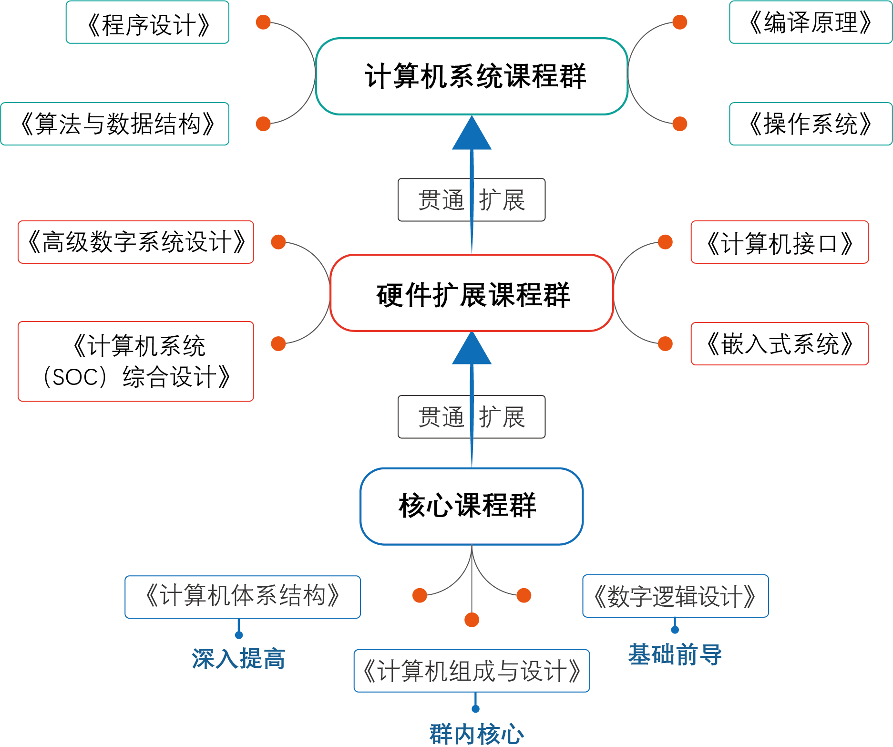
改革中的课程体系
Notes:
逻辑与计算机设计基础，4.0， 3.0-2.0， 二秋冬
计算机组成，4.5，3.5-2.0，二春夏
计算机体系结构，3.5， 2.5-2.0， 三春夏
汇编与接口， 3.0，3.0-0.0，三秋冬
接口实验， 1.5， 0-3.0，三秋冬
编译原理，2.0， 2.0-0， 三春
编译系统设计， 2.0， 1.0-2.0，三夏
操作系统原理，3.0，3.0-0，三秋冬
操作系统实验， 2.0，1-2.0，三冬
Soc／计算机系统设计，3.0， 1.0-4.0， 三夏

Slide 5
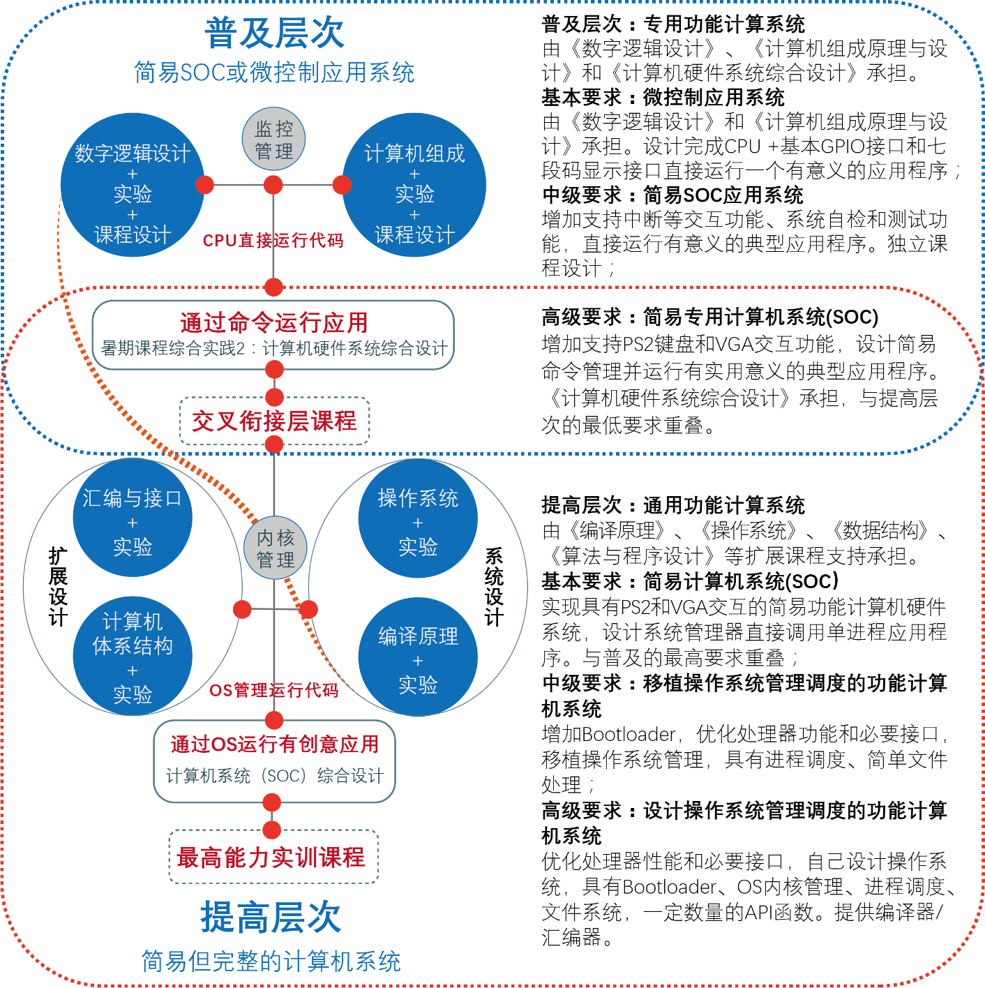
计算机系统能力培养总体思路

Slide 6





改革中的实验体系
自主研发统一的实验平台，建立实验成果库，构建系列化、递进式的实验体系
渐近的计算机硬件系统
Simple but Rich
CACHE
MMU
动态流水
ISA扩展
中断处理
数字逻辑→计算机组成(CPU) →体系结构(流水CPU) →简易计算机系统
高级数字系统设计→计算机接口 →SOC设计→计算机系统设计→多核系统设计
→嵌入式系统设计
操作系统 + 编译系统 + 应用软件

Slide 7
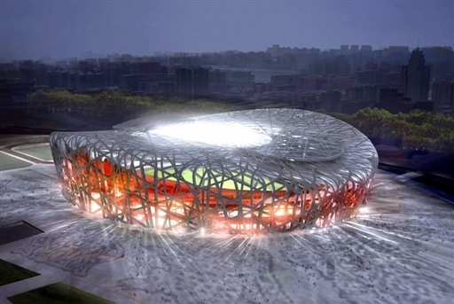
What is Computer Architecture

Slide 8
What is Computer Architecture
Application
Operating
System
Compiler
Firmware
Instruction Set
Architecture
Instr. Set Proc.
I/O system
Datapath & Control
Digital Design
Circuit Design
Layout

Slide 9
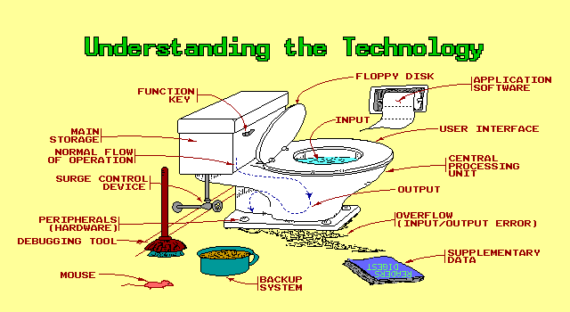
What is Computer Architecture

Slide 10
What is Computer Architecture
Difference with Instruction Set
Difference with Computer Organization
Difference with Computer Implementation
Categories of Computer science

Slide 11
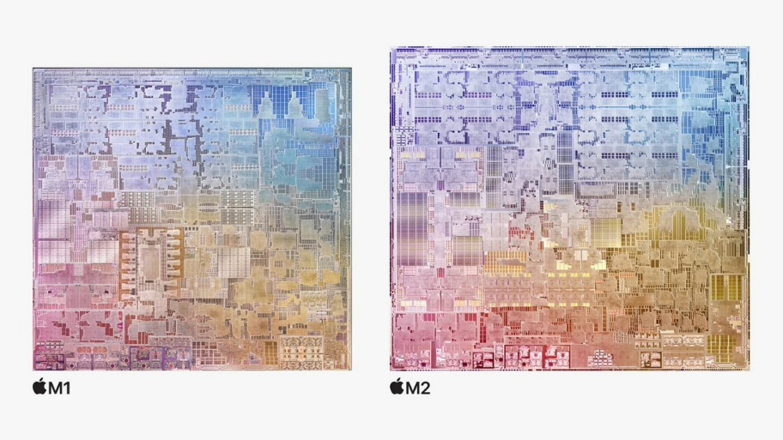
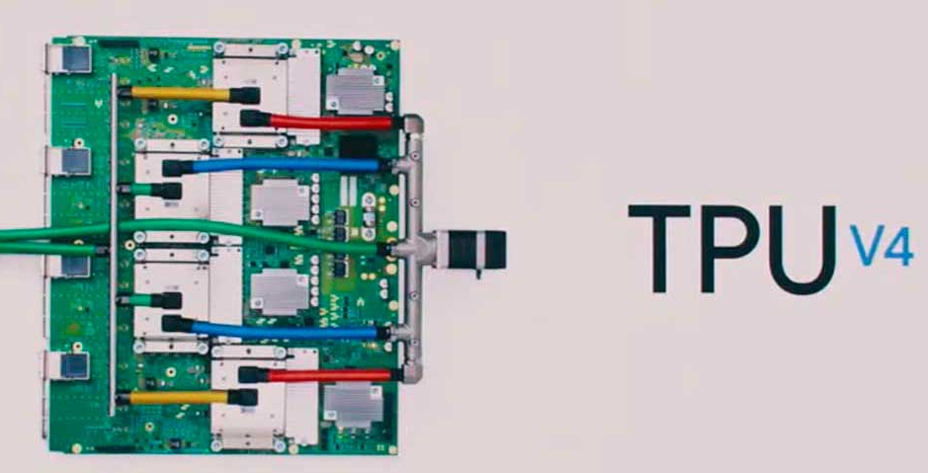
What are the difficult problems?
Develop the performance of single processor
More transistors, less feature size/onechip;
High frequency 2.0-3.5GHz;
Low voltage 0.9-1.2V
Embedded Computer System
Reconfigurable computer Architecture
Power-aware computer Architecture

Slide 12
What are the difficult problems?
Huge hunger for data and new data-intensive applications
Power/energy/thermal constraints
Complexity of design
Difficulties in technology scaling
Memory bottleneck
Reliability problems
Programmability problems
Security and privacy issues

Slide 13
What are the difficult problems?
New apparatus to make processor
Light computer
Molecule computer
DNA computer

Slide 14
TOP 10, 11/2009
1 | Jaguar - Cray XT5-HE Opteron Six Core 2.6 GHz
2 | Roadrunner - BladeCenter QS22/LS21 Cluster, PowerXCell 8i 3.2 Ghz / Opteron DC 1.8 GHz, Voltaire Infiniband
3 | Kraken XT5 - Cray XT5-HE Opteron Six Core 2.6 GHz
4 | JUGENE - Blue Gene/P Solution
5 | Tianhe-1 - NUDT TH-1 Cluster, Xeon E5540/E5450, ATI Radeon HD 4870, Infiniband
6 | Pleiades - SGI Altix ICE 8200EX, Xeon QC 3.0 GHz/Nehalem EP 2.93 Ghz
7 | BlueGene/L - eServer Blue Gene Solution
8 | Blue Gene/P Solution
9 | Ranger - SunBlade x6420, Opteron QC 2.3 Ghz, Infiniband
10 | Red Sky - Sun Blade x6275, Xeon X55xx 2.93 Ghz, Infiniband

Slide 15
TOP 10, 11/2010
1 | Tianhe-1A - NUDT TH MPP, X5670 2.93Ghz 6C, NVIDIA GPU, FT-1000 8C
2 | Jaguar - Cray XT5-HE Opteron 6-core 2.6 GHz
3 | Nebulae - Dawning TC3600 Blade, Intel X5650, NVidia Tesla C2050 GPU
4 | TSUBAME 2.0 - HP ProLiant SL390s G7 Xeon 6C X5670, Nvidia GPU, Linux/Windows
5 | Hopper - Cray XE6 12-core 2.1 GHz
6 | Tera-100 - Bull bullx super-node S6010/S6030
7 | Roadrunner - BladeCenter QS22/LS21 Cluster, PowerXCell 8i 3.2 Ghz / Opteron DC 1.8 GHz, Voltaire Infiniband
8 | Kraken XT5 - Cray XT5-HE Opteron 6-core 2.6 GHz
9 | JUGENE - Blue Gene/P Solution
10 | Cielo - Cray XE6 8-core 2.4 GHz

Slide 16
TOP 10, 11/2011
1 | K computer, SPARC64 VIIIfx 2.0GHz, Tofu interconnect
2 | NUDT YH MPP, Xeon X5670 6C 2.93 GHz, NVIDIA 2050
3 | Cray XT5-HE Opteron 6-core 2.6 GHz
4 | Dawning TC3600 Blade, Intel X5650, NVidia Tesla C2050 GPU
5 | HP ProLiant SL390s G7 Xeon 6C X5670, Nvidia GPU, Linux/Windows
6 | Cray XE6, Opteron 6136 8C 2.40GHz, Custom
7 | SGI Altix ICE 8200EX/8400EX, Xeon HT QC 3.0/Xeon 5570/5670 2.93 Ghz, Infiniband
8 | Cray XE6, Opteron 6172 12C 2.10GHz, Custom
9 | Bull bullx super-node S6010/S6030
10 | BladeCenter QS22/LS21 Cluster, PowerXCell 8i 3.2 Ghz / Opteron DC 1.8 GHz, Voltaire Infiniband

Slide 17
TOP 10, 11/2017
Rank | System | Cores | Rmax (TFlop/s) | Rpeak (TFlop/s) | Power (kW)
1 | Sunway TaihuLight - Sunway MPP, Sunway SW26010 260C 1.45GHz, Sunway , NRCPC | 10,649,600 | 93,014.6 | 125,435.9 | 15,371
2 | Tianhe-2A - TH-IVB-FEP Cluster, Intel Xeon E5-2692 12C 2.200GHz, TH Express-2, Intel Xeon Phi 31S1P , NUDT | 3,120,000 | 33,862.7 | 54,902.4 | 17,808
3 | Piz Daint - Cray XC50, Xeon E5-2690v3 12C 2.6GHz, Aries interconnect , NVIDIA Tesla P100 , Cray Inc. | 361,760 | 19,590.0 | 25,326.3 | 2,272
4 | Gyoukou - ZettaScaler-2.2 HPC system, Xeon D-1571 16C 1.3GHz, Infiniband EDR, PEZY-SC2 700Mhz , ExaScaler | 19,860,000 | 19,135.8 | 28,192.0 | 1,350
5 | Titan - Cray XK7, Opteron 6274 16C 2.200GHz, Cray Gemini interconnect, NVIDIA K20x , Cray Inc. | 560,640 | 17,590.0 | 27,112.5 | 8,209
6 | Sequoia - BlueGene/Q, Power BQC 16C 1.60 GHz, Custom , IBM | 1,572,864 | 17,173.2 | 20,132.7 | 7,890
7 | Trinity - Cray XC40, Intel Xeon Phi 7250 68C 1.4GHz, Aries interconnect , Cray Inc. | 979,968 | 14,137.3 | 43,902.6 | 3,844
8 | Cori - Cray XC40, Intel Xeon Phi 7250 68C 1.4GHz, Aries interconnect , Cray Inc. | 622,336 | 14,014.7 | 27,880.7 | 3,939
9 | Oakforest-PACS - PRIMERGY CX1640 M1, Intel Xeon Phi 7250 68C 1.4GHz, Intel Omni-Path , Fujitsu | 556,104 | 13,554.6 | 24,913.5 | 2,719
10 | K computer, SPARC64 VIIIfx 2.0GHz, Tofu interconnect , Fujitsu | 705,024 | 10,510.0 | 11,280.4 | 12,660

Slide 18
TOP 10, 06/2019
Rank | System | Cores | Rmax (TFlop/s) | Rpeak (TFlop/s) | Power (kW)
1 | Summit - IBM Power System AC922, IBM POWER9 22C 3.07GHz, NVIDIA Volta GV100, Dual-rail Mellanox EDR Infiniband , IBM | 2,414,592 | 148,600.00 | 200,794.90 | 10,096
2 | Sierra - IBM Power System S922LC, IBM POWER9 22C 3.1GHz, NVIDIA Volta GV100, Dual-rail Mellanox EDR Infiniband , IBM / NVIDIA / Mellanox | 1,572,480 | 94,640.00 | 125,712.00 | 7,438
3 | Sunway TaihuLight - Sunway MPP, Sunway SW26010 260C 1.45GHz, Sunway , NRCPC | 10,649,600 | 93,014.60 | 125,435.90 | 15,371
4 | Tianhe-2A - TH-IVB-FEP Cluster, Intel Xeon E5-2692v2 12C 2.2GHz, TH Express-2, Matrix-2000 , NUDT | 4,981,760 | 61,444.50 | 100,678.70 | 18,482
5 | Frontera - Dell C6420, Xeon Platinum 8280 28C 2.7GHz, Mellanox InfiniBand HDR , Dell EMC | 448,448 | 23,516.40 | 38,745.90
6 | Piz Daint - Cray XC50, Xeon E5-2690v3 12C 2.6GHz, Aries interconnect , NVIDIA Tesla P100 , Cray Inc. | 387,872 | 21,230.00 | 27,154.30 | 2,384
7 | Trinity - Cray XC40, Xeon E5-2698v3 16C 2.3GHz, Intel Xeon Phi 7250 68C 1.4GHz, Aries interconnect , Cray Inc. | 979,072 | 20,158.70 | 41,461.20 | 7,578
8 | AI Bridging Cloud Infrastructure (ABCI) - PRIMERGY CX2570 M4, Xeon Gold 6148 20C 2.4GHz, NVIDIA Tesla V100 SXM2, Infiniband EDR , Fujitsu | 391,680 | 19,880.00 | 32,576.60 | 1,649
9 | SuperMUC-NG - ThinkSystem SD650, Xeon Platinum 8174 24C 3.1GHz, Intel Omni-Path , Lenovo | 305,856 | 19,476.60 | 26,873.90
10 | Lassen - IBM Power System S922LC, IBM POWER9 22C 3.1GHz, Dual-rail Mellanox EDR Infiniband, NVIDIA Tesla V100 , IBM / NVIDIA / Mellanox | 288,288 | 18,200.00 | 23,047.20

Slide 19
TOP 10, 06/2021
Rank | System | Cores | Rmax (TFlop/s) | Rpeak (TFlop/s) | Power (kW)
1 | Supercomputer Fugaku - Supercomputer Fugaku, A64FX 48C 2.2GHz, Tofu interconnect D, Fujitsu | 7,630,848 | 442,010.0 | 537,212.0 | 29,899
2 | Summit - IBM Power System AC922, IBM POWER9 22C 3.07GHz, NVIDIA Volta GV100, Dual-rail Mellanox EDR Infiniband, IBM | 2,414,592 | 148,600.0 | 200,794.9 | 10,096
3 | Sierra - IBM Power System AC922, IBM POWER9 22C 3.1GHz, NVIDIA Volta GV100, Dual-rail Mellanox EDR Infiniband, IBM / NVIDIA / Mellanox | 1,572,480 | 94,640.0 | 125,712.0 | 7,438
4 | Sunway TaihuLight - Sunway MPP, Sunway SW26010 260C 1.45GHz, Sunway, NRCPC | 10,649,600 | 93,014.6 | 125,435.9 | 15,371
5 | Perlmutter - HPE Cray EX235n, AMD EPYC 7763 64C 2.45GHz, NVIDIA A100 SXM4 40 GB, Slingshot-10, HPE | 706,304 | 64,590.0 | 89,794.5 | 2,528
6 | Selene - NVIDIA DGX A100, AMD EPYC 7742 64C 2.25GHz, NVIDIA A100, Mellanox HDR Infiniband, Nvidia | 555,520 | 63,460.0 | 79,215.0 | 2,646
7 | Tianhe-2A - TH-IVB-FEP Cluster, Intel Xeon E5-2692v2 12C 2.2GHz, TH Express-2, Matrix-2000, NUDT | 4,981,760 | 61,444.5 | 100,678.7 | 18,482
8 | JUWELS Booster Module - Bull Sequana XH2000 , AMD EPYC 7402 24C 2.8GHz, NVIDIA A100, Mellanox HDR InfiniBand/ParTec ParaStation ClusterSuite, Atos | 449,280 | 44,120.0 | 70,980.0 | 1,764
9 | HPC5 - PowerEdge C4140, Xeon Gold 6252 24C 2.1GHz, NVIDIA Tesla V100, Mellanox HDR Infiniband, Dell EMC | 669,760 | 35,450.0 | 51,720.8 | 2,252
10 | Frontera - Dell C6420, Xeon Platinum 8280 28C 2.7GHz, Mellanox InfiniBand HDR, Dell EMC | 448,448 | 23,516.4 | 38,745.9 | NA

Slide 20
TOP 10, 06/2023
Rank | System | Cores | Rmax (PFlop/s) | Rpeak (PFlop/s) | Power (kW)
1 | Frontier - HPE Cray EX235a, AMD Optimized 3rd Generation EPYC 64C 2GHz, AMD Instinct MI250X, Slingshot-11, HPE | 8,699,904 | 1,194.00 | 1,679.82 | 22,703
2 | Supercomputer Fugaku - Supercomputer Fugaku, A64FX 48C 2.2GHz, Tofu interconnect D, Fujitsu | 7,630,848 | 442.01 | 537.21 | 29,899
3 | LUMI - HPE Cray EX235a, AMD Optimized 3rd Generation EPYC 64C 2GHz, AMD Instinct MI250X, Slingshot-11, HPE | 2,220,288 | 309.10 | 428.70 | 6,016
4 | Leonardo - BullSequana XH2000, Xeon Platinum 8358 32C 2.6GHz, NVIDIA A100 SXM4 64 GB, Quad-rail NVIDIA HDR100 Infiniband, Atos | 1,824,768 | 238.70 | 304.47 | 7,404
5 | Summit - IBM Power System AC922, IBM POWER9 22C 3.07GHz, NVIDIA Volta GV100, Dual-rail Mellanox EDR Infiniband, IBM | 2,414,592 | 148.60 | 200.79 | 10,096
6 | Sierra - IBM Power System AC922, IBM POWER9 22C 3.1GHz, NVIDIA Volta GV100, Dual-rail Mellanox EDR Infiniband, IBM / NVIDIA / Mellanox | 1,572,480 | 94.64 | 125.71 | 7,438
7 | Sunway TaihuLight - Sunway MPP, Sunway SW26010 260C 1.45GHz, Sunway, NRCPC | 10,649,600 | 93.01 | 125.44 | 15,371
8 | Perlmutter - HPE Cray EX235n, AMD EPYC 7763 64C 2.45GHz, NVIDIA A100 SXM4 40 GB, Slingshot-10, HPE | 761,856 | 70.87 | 93.75 | 2,589
9 | Selene - NVIDIA DGX A100, AMD EPYC 7742 64C 2.25GHz, NVIDIA A100, Mellanox HDR Infiniband, Nvidia | 555,520 | 63.46 | 79.22 | 2,646
10 | Tianhe-2A - TH-IVB-FEP Cluster, Intel Xeon E5-2692v2 12C 2.2GHz, TH Express-2, Matrix-2000, NUDT | 4,981,760 | 61.44 | 100.68 | 18,482

Slide 21
Fastest computer in China
2018:
Tianhe-2A 61 petaflop/s
2016:
Sunway TaihuLight 93.01 petaflop/s
2013:
TianHe-2 33.86 petaflop/s
2011:
TianHe-1A 2.57 petaflop/s
2009
TianHe-1
2008 ShuGuang5000A
180.6 TeraFlops
122.88TB RAM, 30720 computing Cell
2004 ShuGuang4000A
11 TeraFLOPS
rank 10 in top 500 in June, 2004
2003 ShenTeng6800
5.324 TeraFLOPS
2002 ShenTeng1800
2.04 TeraFLOPS
2000 YinHe IV
1024 CPU 1 TeraFLOPS
……?

Slide 22
Why?
Where there is a will, there is a way.

Slide 23
Top conference in CA
ISCA: The International Symposium on Computer Architecture
MICRO: Intl Symp on Microarchitecture
OSDI、SOAP、HPCA、ASPLOS……

Slide 24
Eckert-Mauchly Award
2011 Sohi, Gurindar S 2010 Dally, William J 2009 Emer, Joel 2008 Patterson, David 2007 Valero, Mateo 2006 Pomerene, James H 2005 Colwell, Robert P. 2004 Brooks, Frederick P. 2003 Fisher, Joseph A. (Josh) 2002 Rau, B. Ramakrishna (Bob) 2001 Hennessy, John 2000 Davidson, Edward 1999 Smith, James E. 1998 Watanabe, T. 1997 Tomasulo, Robert 1996 Patt, Yale 1995 Crawford, John | 1994 Thornton, James E. 1993 Kuck, David J 1992 Flynn, Michael J. 1991 Smith, Burton J. 1990 Batcher, Kenneth E. 1989 Cray, Seymour 1988 Siewiorek, Daniel P. 1987 Amdahl, Gene M. 1986 Cragon, Harvey G 1985 Cocke, John 1984 Dennis, Jack B. 1983 Kilburn, Tom 1982 Bell, C. Gordon 1981 Clark, Wesley A. 1980 Wilkes, Maurice V. 1979 Barton, Robert S.

Slide 25
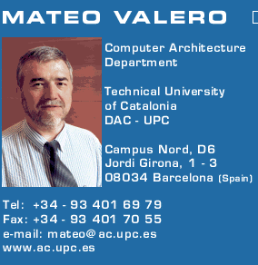
Big Men in Architecture(1)
2007 Mateo Valero
http://personals.ac.upc.edu/mateo/
For important contributions to instruction level parallelism and superscalar processor design.

Slide 26
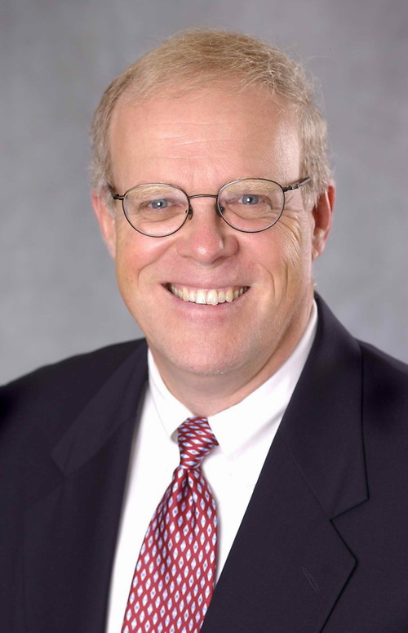
Big Men in Architecture(2)
2001 Hennessy, John
For being the founder and chief architect of the MIPS Computer Systems and contributing to the development of the landmark MIPS R2000 microprocessor.

Slide 27
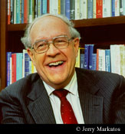
Big Men in Architecture(3)
1999 ACM Turing Award
landmark contributions to computer architecture, operating systems, and software engineering."
2004 Eckert-Mauchly Award
"For the definition of computer architecture and contributions to the concept of computer families and to the principles of instruction set design; for seminal contributions in instruction sequencing, including interrupt systems and execute instructions; and for contributions to the IBM 360 instruction set architecture."
Frederick P. Brooks
http://www.cs.unc.edu/~brooks/

Slide 28
Big Men in Architecture(4)
1997 Robert Tomasulo For the ingenious Tomasulo's algorithm, which enabled out-of-order execution processors to be implemented.

Slide 29
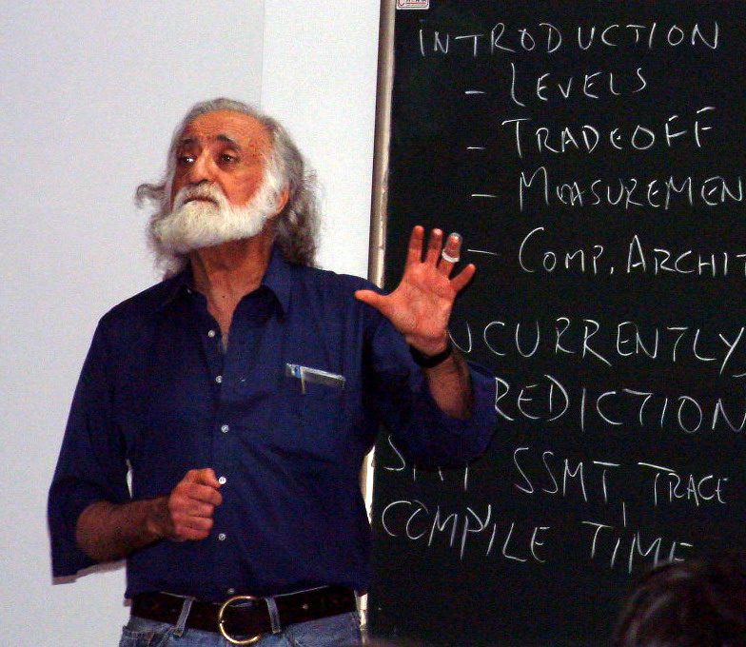
Big Men in Architecture(5)
1996 Yale Patt
For important contributions to instruction level parallelism and superscalar processor design.

Slide 30
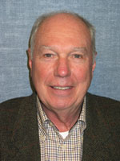
Big Men in Architecture(6)
1992 Michael J. Flynn
http://www.cpe.calpoly.edu/IAB/flynn.html
For his important and seminal contributions to processor organization and classification, computer arithmetic and performance evaluation.

Slide 31
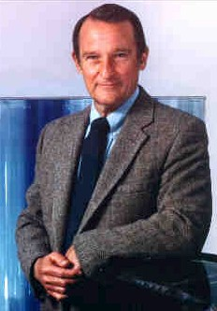
Big Men in Architecture(7)
1989 Cray, Seymour
For a career of achievements that have advanced supercomputing design.

Slide 32
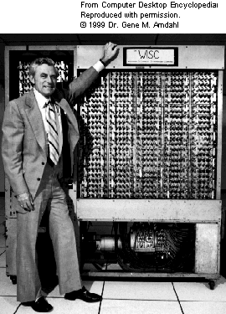
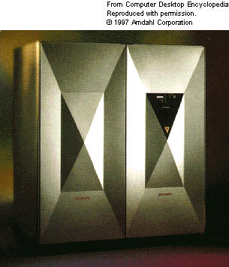
Big Men in Architecture(8)
1987 Amdahl, Gene M. For outstanding innovations in computer architecture, including pipelining, instruction look-ahead, and cache memory.
In 1975, Dr. Amdahl stands beside the Wisconsin Integrally Synchronized Computer (WISC), which he designed in 1950. It was built in 1952. (Image courtesy of Dr. Gene M. Amdahl.)

Slide 33
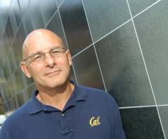
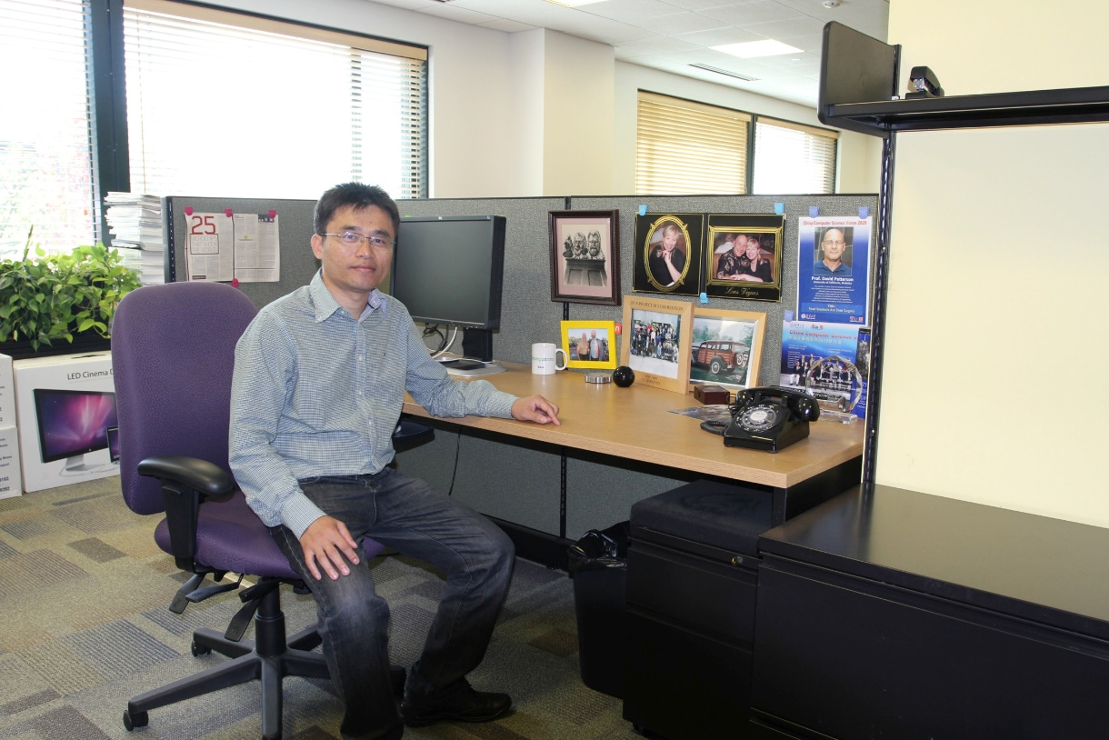
David A. Patterson （UC Berkeley）
He led the design and implementation of RISC I (the foundation of the SPARC architecture )
Leader of RAID
involved in the Network of Workstations (NOW) project
Research Accelerator for Multiple Processors (RAMP)

Slide 34
How ?
Possibility:
standing on the shoulder of giants.
Concepts, Ideas and Principles
Quantitative approaches
Hit the problem and right way to solve problem
As a man sows, so he shall reap.

Slide 35
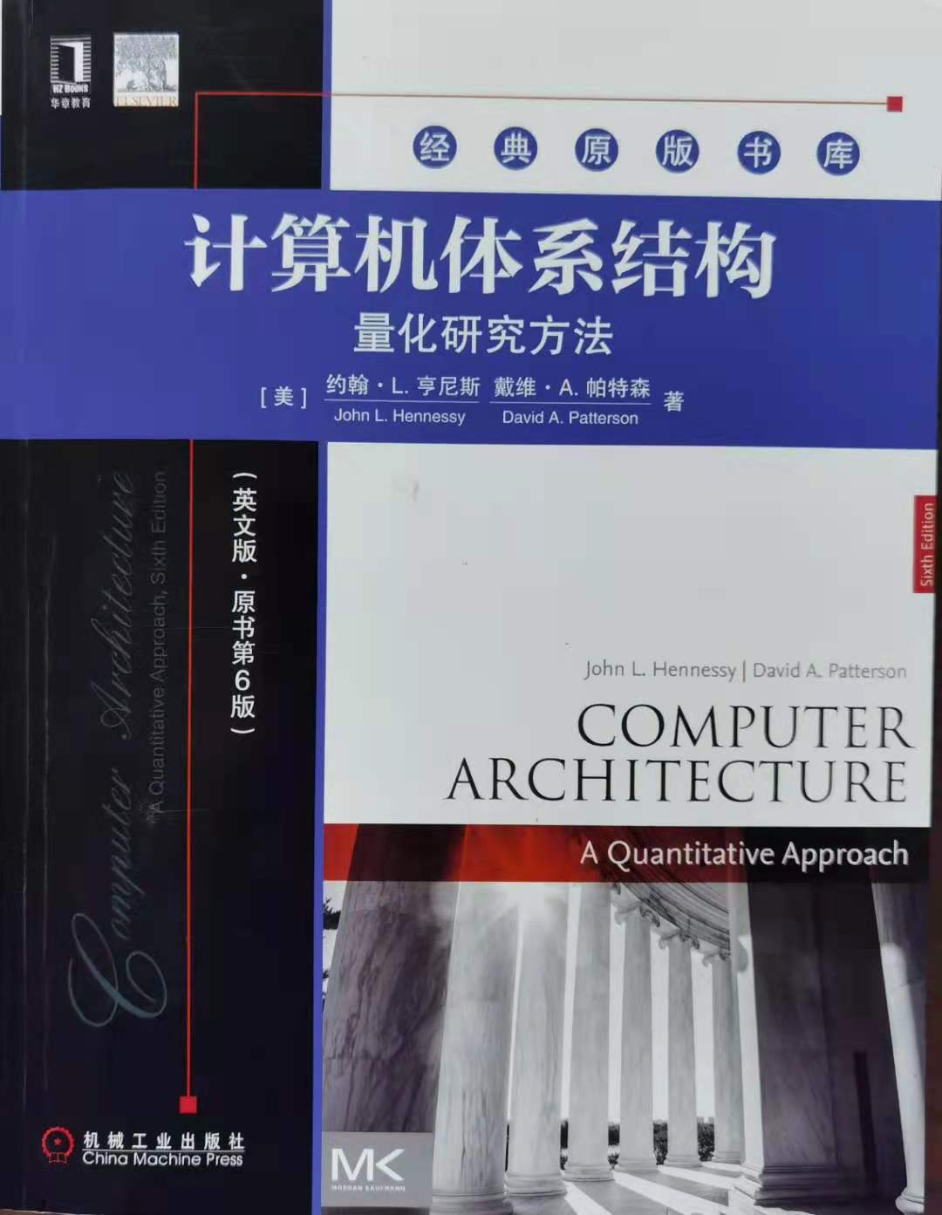
Text Book
Computer Architecture - A quantitative approach
(6th edition)
John L. Hennessy
(Stanford University)
David A. Patterson
(University of California, Berkeley)
China Machine Press

Slide 36
What’s new on this Edition ?
Most significant edition:
1~3 edition focus on ILP(Inst-Level Parallelism)
=>Focus on TLP(Thread-level parallelism) and DLP(Data-level parallelism).
Chapter adjustment:
Changing technology
=>More emphasize on Dependability and topics of Power
Book size limitation:
More contents move to Appendix and CD

Slide 37
Contents
Ch1 Fundamentals of computer design
Ch2 ILP and its exploitation
Ch3 Limits of ILP
Ch4 Multiprocessor and TLP
Ch5 Memory Hierarchy Design
Ch6 Storage Systems
AppA Pipelining: Basic and Intermediate Concepts
AppB Instruction Set Principles and Examples
AppC Review of Memory Hierarchy
AppD Embedded systems
AppE Interconnection Networks
AppF Vector Processors

Slide 38
Topics covered in this class
Ch1 Fundamentals of computer design
AppB Instruction Set Principles and Examples
AppA Pipelining: Basic and Intermediate Concepts
AppC Review of Memory Hierarchy
Ch5 Memory Hierarchy Design
Ch6 Storage Systems
Ch4 Basic concepts of Multiprocessor
AppF Vector Processors

Slide 39
Outlook
Open-source Architecture
RISC-V
Security Risks
Spectre and Meltdown
Intel ME
Security Improvements
Domain Specific Architectures

Slide 40

Open Source Architecture
RISC-V
A completely open ISA based on RISC principles
Freely available to academia and industry
Simple and extendable modular design
A small base integer ISA (RV32I, etc.)
Optional standard extensions
Free implementations & commercial implementations
Free: Rocket, PULPino, Hummingbird “蜂鸟”
Commercial: SiFive
Notes:
https://riscv.org/risc-v-cores/

Slide 41
Security Risks
Spectre & Meltdown
Complicated techniques are widely used on modern processors to improve performance
However, these widely-used techniques may cause security risks
Out-of-order execution
Meltdown
Branch predication & speculative execution
Spectre
Intel Management Engine
Notes:
https://meltdownattack.com/
https://en.wikipedia.org/wiki/Intel_Management_Engine
Intel Management Engine
A ”secret” microprocessor built in all Intel processors since 2008
Runs proprietary firmware while computer is running, asleep or even turned off

Slide 42
Security Improvements
Pointer Authentication
The actual address space of a 64-bit architecture is less than 64-bits.
We can place a “signature” of pointer in unused bits, to prove it comes from a valid operation, rather than a software flaw.
New instructions to sign/authenticate pointers.
Enclave (Intel SGX)
Keeping trusted environment on a untrusted platform is challenging.
Untrusted OS/Malware/Cloud
Root of trust on the CPU
If you trust CPU’s vendor, you can probably trust its enclave

Slide 43
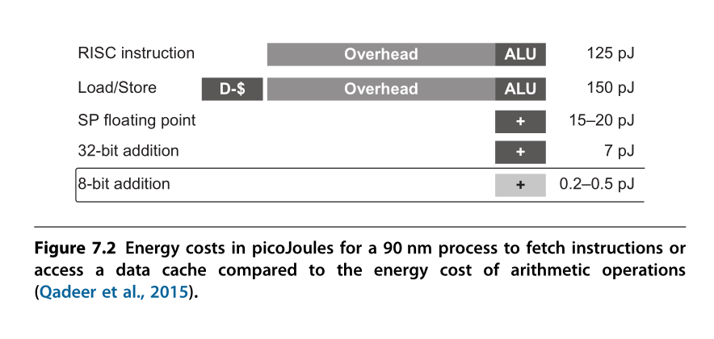
Domain Specific Architectures
General processors are not efficient when solving specific problems
Performance & Energy
To achieve a higher level of efficiency, we need a drastic change in computer architecture from general-purpose cores to domain-specific architectures (DSAs).

Slide 44
Domain Specific Architectures
Domain Specific Architectures
Google TPU
Data Center ASIC
Google Pixel vCore
Mobile Device ASIC
寒武纪 NPU
Mobile/Data center IP

Slide 45
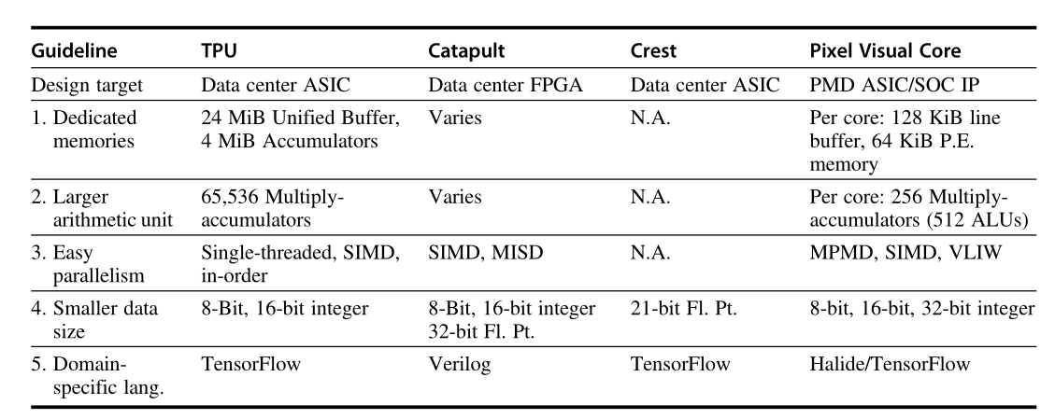
Domain Specific Architectures

Slide 46
Course materials & Readings
WWW Computer Architecture Website:
http://www.cs.wisc.edu/arch/www/
http://www.ece.cmu.edu/~ece347/
RISCV ISA Manual
https://github.com/riscv/riscv-isa-manual

Slide 47
Grading
Final Grade = Performance * 60% + Final exam * 40%
Performance = Labs (80pt) + Class (20~30pt)
Class: Quiz, question, discussion…
Total Performance <= 100pt
Labs = Lab1 (3weeks, 15pt) + Lab2 (3weeks, 15pt) + Lab3 (1weeks, 5pt) + Lab4 (2weeks, 10pt) + Lab5 (2weeks, 10pt) + Lab6 (5weeks, 25pt)
20% delay penalty per day

Slide 48
Important Note about Grading
Don’t ask me for a higher score after the final examination no matter what reason you have !

Slide 49
Assignments and reading
Group work in assignments is permitted
Group discussion is strongly encouraged
Members in one group are no more than 2
Reports need to be submitted in time
The more Late the more discount

Slide 50
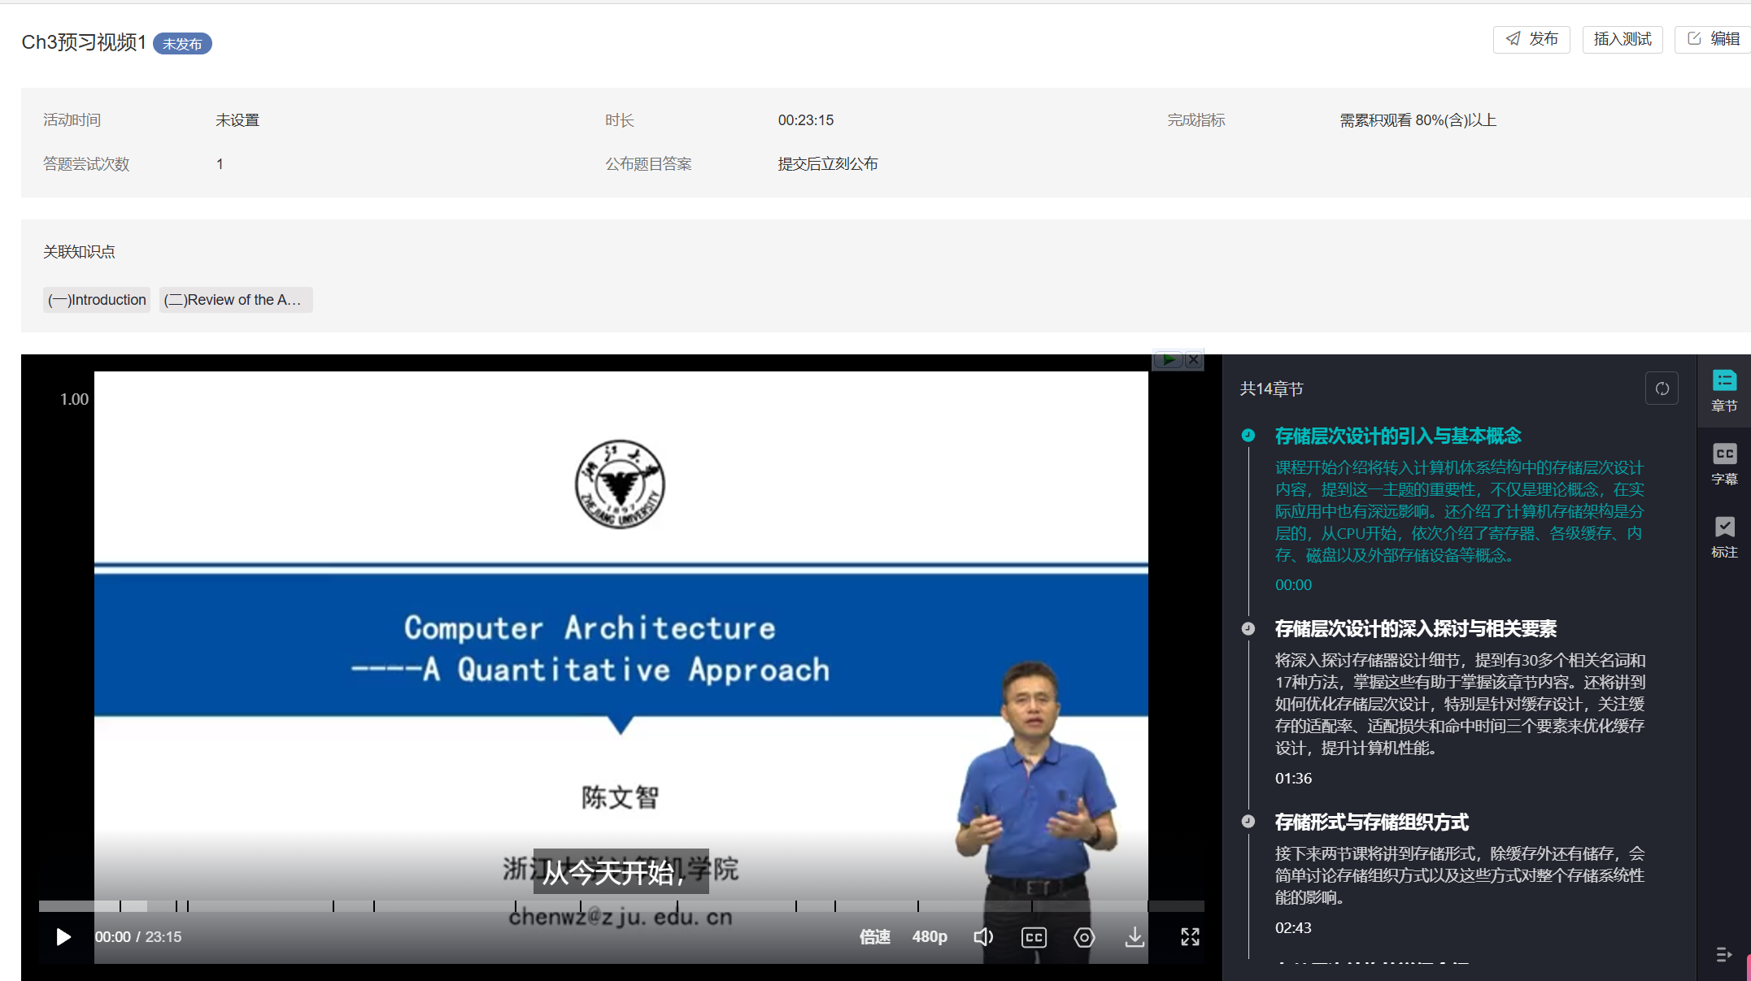
AI赋能课程
数字人预习

Slide 51

AI赋能课程
AI助教

Slide 52
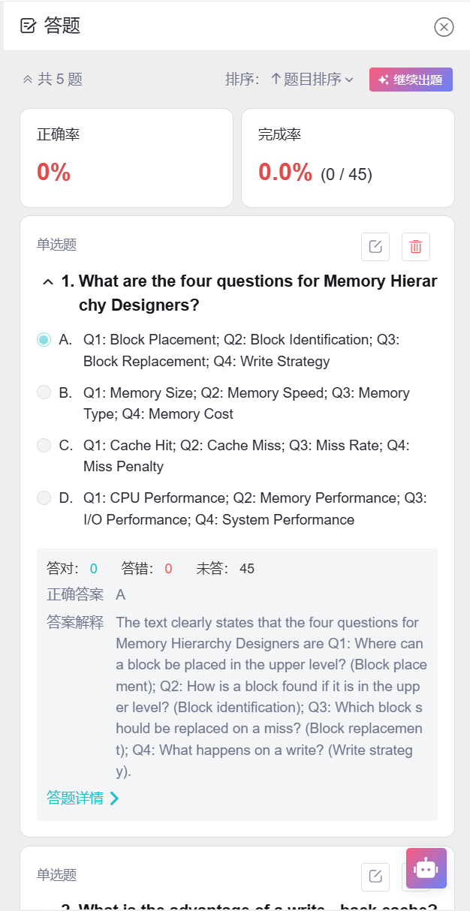
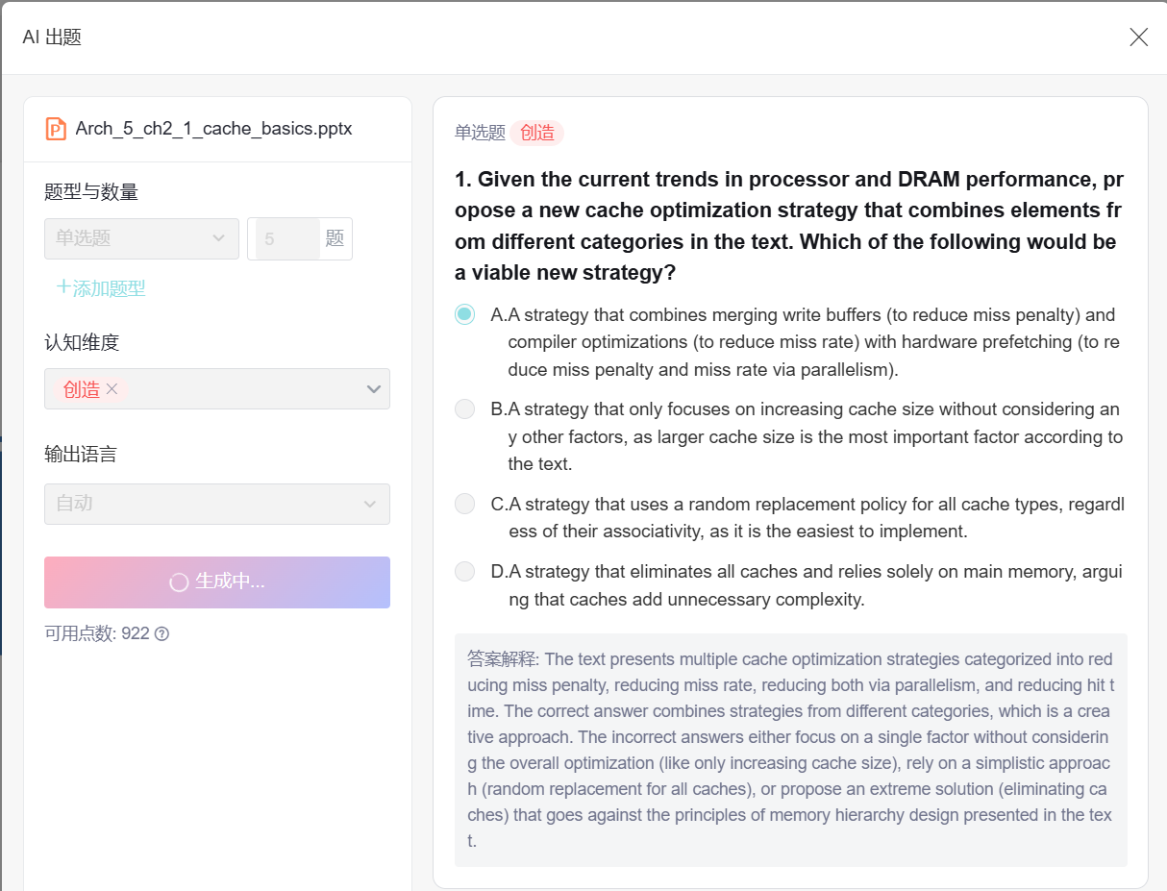
AI赋能课程
AI出题

Slide 53
AI赋能课程
未来更多尝试……
互动教材
AI融入实验课
翻转课堂

Slide 54
生成式人工智能使用规范
本规范中生成式人工智能（Generative AI）指利用人工智能算法生成文本、图像、音频或视频内容的技术。本规范主要针对文本生成式人工智能工具，例如DeepSeek、ChatGPT、Gemini、Kimi、智谱清言、豆包等，适用于其在课程作业中的使用。
学院鼓励学生在遵守学术诚信的前提下，合理使用生成式人工智能工具，以提高学习效率、激发创新思维。学生需明确标注人工智能的使用情况，并对其生成内容负责。

Slide 55
课程作业使用规范
使用范围
允许使用生成式人工智能的场景：文献检索与整理；领域知识入门参考；减少重复性编程和代码调试；学习辅导和解答疑问。
禁止使用生成式人工智能的场景：直接生成课程作业、实验报告；生成实验数据、实验方案等；替代个人思考完成创新性任务。
使用规范
声明义务：学生在提交使用了生成式人工智能的作业时，必须在文件开头或结尾明确声明使用情况，包括使用的工具名称、使用目的和具体内容。
标注要求：对于生成式人工智能产生的内容，应在相应段落或代码块后以方括号标注，如[AI生成，工具名称，具体用途]。
使用比例：直接使用生成式人工智能生成的内容不得超过整体工作的30%，且学生需对AI生成内容进行实质性修改和优化。

Slide 56
评估与监督
学院定期对学生作业进行人工智能生成内容检测，或者组织专家组进行人工审核；检测结果将作为学术诚信评估的依据。
对于违反本规范的行为，将依据学校相关规定，视情节轻重给予以下处理：课程作业：警告、降低成绩、取消成绩。
本规范自发布之日起试行，学院将根据实施情况适时调整和完善。欢迎广大师生提出宝贵意见和建议。

Slide 57

学在浙大
https://courses.zju.edu.cn

Slide 58
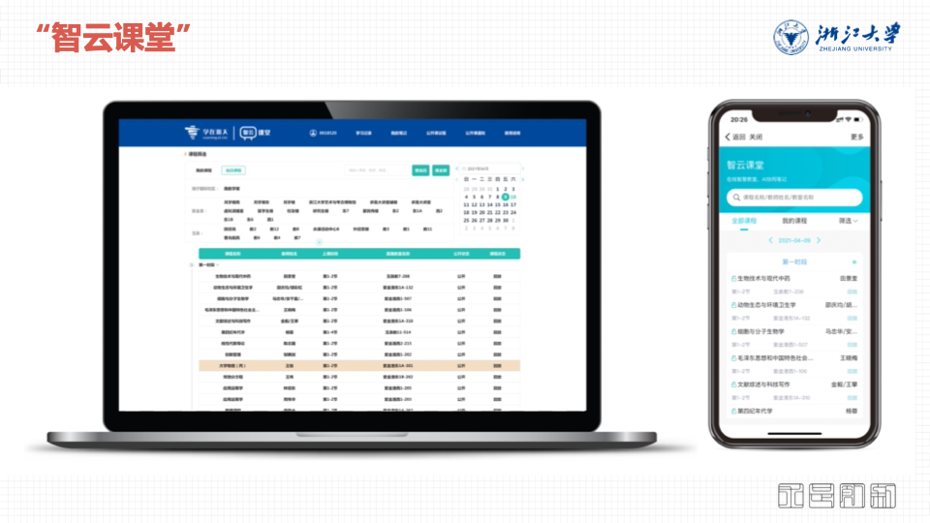
智云课堂
https://classroom.zju.edu.cn

Slide 59

THANK YOU
THANK YOU

