Slide 1

Computer Architecture ----A Quantitative Approach
陈文智
浙江大学计算机学院
chenwz@zju.edu.cn

Slide 2
Topics in Chapter 1
1.1 Introduction
1.2 Classes of computers
1.3 Defining computer architecture and What’s the task of computer design?
1.4 Trends in Technology
1.5 Trends in power in Integrated circuits
1.6 Trends in Cost
1.7 Dependability
1.8 Measuring, Reporting and summarizing Perf.
1.9 Quantitative Principles of computer Design
1.10 Putting it altogether

Slide 3
History of the Computer
Original:
Big Fishes Eating Little Fishes

Slide 4
Computer Food Chain
Mainframe
Work-
station
PC
Mini-
supercomputer
Mini-
computer
Supercomputer
Massively Parallel Processors

Slide 5
Computer Food Chain
Mini-
supercomputer
Mini-
computer
Massively Parallel Processors
Embedded system
Mainframe
Work-
station
PC
Server
Supercomputer

Slide 6
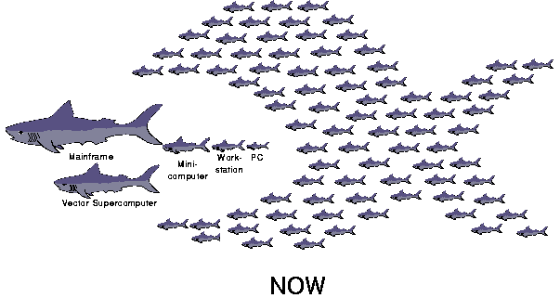

Slide 7
Incredible performance improvement
20%/year
Now 500$ computer with more perf, More MM and more Disk
||
1,000,000 $ computer in 1985
25% /year

Slide 8
Conclusion
Technological improvements more steady than progress in computer architecture
After emergence of RISC, computer design emphasized both architectural innovation and efficient use of technology improvements.
CA plays an important role in performance Improvement
Little ILP left to exploit due to power dissipation
Faster uniprocessor => multiple processor on chip
ILP => TLP and DLP
Implicitly, compiler and hardware => Explicitly, programmer and arch engineer

Slide 9
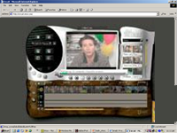
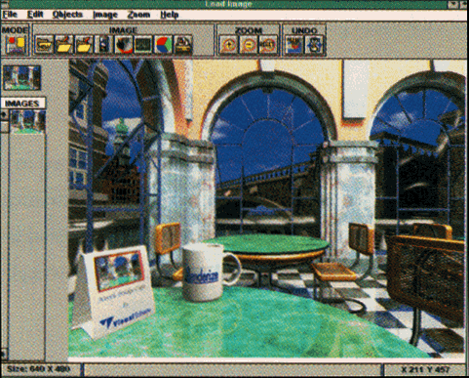
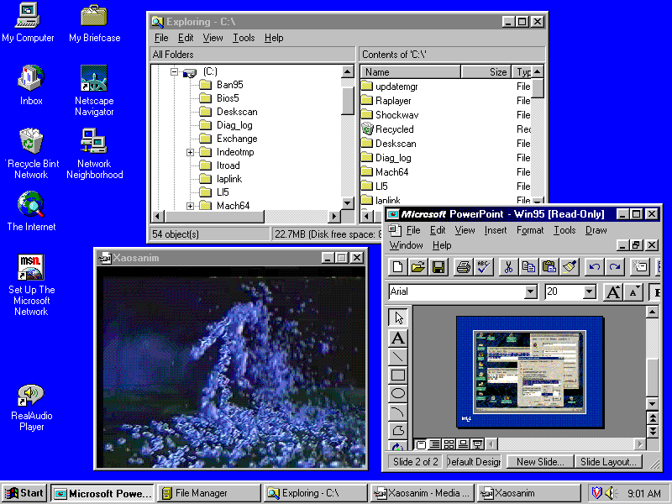
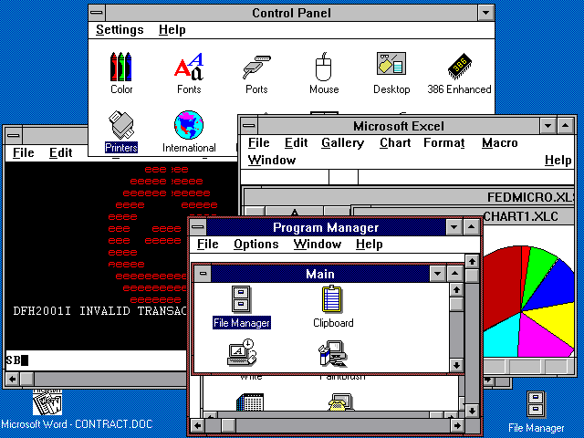
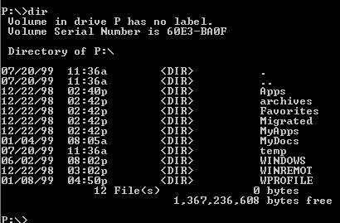
Develop of x86
Process ability → New Applications
MIPS
10,000
_{Pentium} ® IV
1,000
_{Pentium} ® III
_{Pentium} ® II
100
Pentium®
10
i486
i386
1
80286
8086
0.1
1975
1980
1985
1990
1995
2000

Slide 10
Why Such Change in 60 years?
Two reasons:
Advances in the technology used to build computers
IC
Storage device(including RAM and DISK)
Peripheral device
Innovation in computer design
Simple → complex → most complex → simple → complex → most complex
Sometimes rapid, sometimes slow
Many technology have been washed out

Slide 11
Four Decades of microprocessor
The Decade of the 1970’s “Microprocessors”
- Programmable Controller
- Single-Chip Microprocessors
- Personal Computers (PC)
The Decade of the 1980’s “Quantitative Architecture”
- Instruction Pipelining
- Fast Cache Memories
- Compiler Considerations
- Workstations
The Decade of the 1990’s “Instruction-Level Parallelism”
- Superscalar Processors
- Speculative Microarchitectures
- Aggressive Code Scheduling
- Low-Cost Desktop Supercomputing
The Decade of the 2000’s “Thread-level/Data-level parallelism”

Slide 12
Forces on Computer Architecture
Technology
Parallelism
Programming
Languages
Applications
Interface Design
(ISA)
Computer Architecture:
• Instruction Set Design
• Organization
• Hardware/Software Boundary
Compilers
Operating
Systems
Measurement & Evaluation
History
Computer architecture has been at the core of such technological development and is still on a forward move

Slide 13
Topics in Chapter
1.1 Introduction
1.2 Classes of computers
1.3 Defining computer architecture and What’s the task of computer design?
1.4 Trends in Technology
1.5 Trends in power in Integrated circuits
1.6 Trends in Cost
1.7 Dependability
1.8 Measuring, Reporting and summarizing Perf.
1.9 Quantitative Principles of computer Design
1.10 Putting it all together

Slide 14
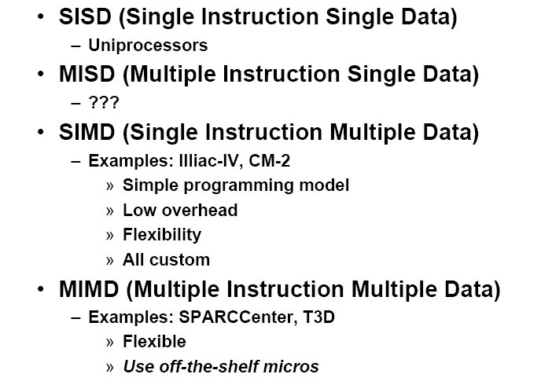

Classes of computers
Flynn’s Taxonomy: A classification of computer architectures based on the number of streams of instructions and data

Slide 15
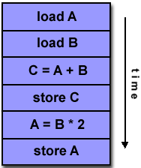
SISD
A serial (non-parallel) computer
Single instruction: only one instruction stream is being acted on by the CPU during any one clock cycle
Single data: only one data stream is being used as input during any one clock cycle
Deterministic execution
This is the oldest and until recently, the most prevalent form of computer
Examples: most PCs, single CPU workstations and mainframes
IS
IS
DS
CU
PU
MU
I/O

Slide 16
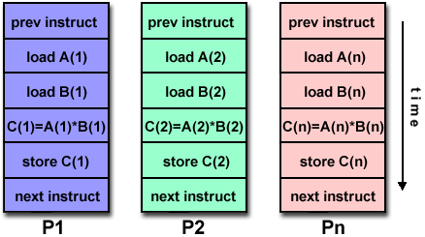
SIMD
A type of parallel computer
Single instruction: All processing units execute the same instruction at any given clock cycle
Multiple data: Each processing unit can operate on a different data element
This type of machine typically has an instruction dispatcher, a very high-bandwidth internal network, and a very large array of very small-capacity instruction units.
Best suited for specialized problems characterized by a high degree of regularity, such as image processing.
Synchronous (lockstep) and deterministic execution
Two varieties:
Processor Arrays: Connection Machine CM-2, Maspar MP-1, MP-2
Vector Pipelines: IBM 9000, Cray C90, Fujitsu VP, NEC SX-2, Hitachi S820
DS
PU1
MM1
IS
IS
CU
DS
PUn
MMn

Slide 17
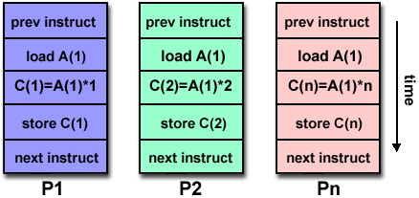
MISD
A single data stream is fed into multiple processing units.
Each processing unit operates on the data independently via independent instruction streams.
Few actual examples of this class of parallel computer have ever existed. One is the experimental Carnegie-Mellon C.mmp computer (1971).
Some conceivable uses might be:
multiple frequency filters operating on a single signal stream
multiple cryptography algorithms attempting to crack a single coded message.
DS
IS
CU₁
PE₁
……
I/O
…
MM₁
…
MM_{n}
IS
CU_{n}
PE_{n}
DS
……

Slide 18
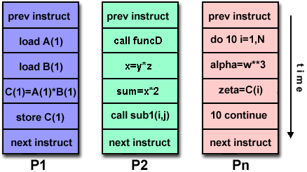
MIMD
Currently, the most common type of parallel computer. Most modern computers fall into this category.
Multiple Instruction: every processor may be executing a different instruction stream
Multiple Data: every processor may be working with a different data stream
Execution can be synchronous or asynchronous, deterministic or non-deterministic
Examples: most current supercomputers, networked parallel computer "grids" and multi-processor SMP computers - including some types of PCs.
IS
SM
IS
CU₁
PE₁
MM₁
I/O
…
…
…
IS
I/O
CU_{n}
PE_{n}
MM_{n}
IS

Slide 19
Classification-market
Mainframe
1960s
Embedded system
2000s
Mini-
Supercomputer
1970s
Mini-
Computer
1970s
Supercomputer
1970s
Work-
Station
1980s-2000s
PC
Server
2000s
Massively Parallel Processors
1980s

Slide 20
Effect of dramatic performance growth
Enhanced the capability available to computer users.
Microprocessor-based computers across the entire range of the computer design.
Minicomputer => servers using microprocessors
Mainframe => multiprocessors consisting of microprocessors
Supercomputer => multiprocessor collections

Slide 21
Four computing markets
Feature | Mobile | Desktop | Server | Embedded
Price of system | $100–$1000 | $300–$2500 | $5000 -$5,000,000 | $10 -$100,000
Price of microprocessor module | $10–$100 | $50-$500 per proc. | $200 -$10,000 per proc. | $0.01 -$100 per proc.
Critical system design issues | Cost, energy, media performance, responsiveness | Price-perf. Graphics perf. | Throughput, availability, scalability, energy | Price, Power consumption, application-specific perf.

Slide 22
Desktop Computing
The first, and still the largest market in dollar terms, is desktop computing.
Requirement:
Optimized price-performance
New challenges:
Web-centric, interactive application
How to evaluate performance?

Slide 23
Servers
The role of servers to provide larger scale and more reliable file and computing services grew.
For servers, different characteristics are important. First, dependability is critical.
A second key feature of server systems is an emphasis on scalability.
Lastly, servers are designed for efficient throughput.

Slide 24
Internet of Things(IoT)/Embedded Computers
Have the widest spread of processing power and cost.
8-bit 16-bit 32-bit 64-bit
0.1mWatts ~ 2000Watts(peak)
Real time performance (soft & hard)
Rich OS (linux, windows Embedded)
Real Time OS (FreeRTOS, VxWorks, acts in limited time)
Strict resource constraints
limited memory size, minimun power consumption,...
The use of processor cores together with application-specific circuitry.
DSP, mobile computing

Slide 25
Personal Mobile Device
Share many of the characteristics of desktop computers.
Web-based and media-oriented
Ability to run third-party software (APPs)
major difference with embedded computers
Energy efficiency
Battery powered, absence of a fan
Low-cost
Real-time performance requirement
Notes:
Personal mobile device (PMD) is the term we apply to a collection of wireless
devices with multimedia user interfaces such as cell phones, tablet computers,
and so on. Cost is a prime concern given the consumer price for the whole
product is a few hundred dollars. Although the emphasis on energy efficiency
is frequently driven by the use of batteries, the need to use less expensive packag-
ing—plastic versus ceramic—and the absence of a fan for cooling also limit total
power consumption. We examine the issue of energy and power in more detail
in Section 1.5. Applications on PMDs are often web-based and media-oriented,
like the previously mentioned Google Translate example. Energy and size
requirements lead to use of Flash memory for storage (Chapter 2) instead of
magnetic disks.
The processors in a PMD are often considered embedded computers, but we
are keeping them as a separate category because PMDs are platforms that can
run externally developed software, and they share many of the characteristics of
desktop computers. Other embedded devices are more limited in hardware and
software sophistication. We use the ability to run third-party software as the divid-
ing line between nonembedded and embedded computers.
Responsiveness and predictability are key characteristics for media applica-
tions. A real-time performance requirement means a segment of the application
has an absolute maximum execution time. For example, in playing a video on a
PMD, the time to process each video frame is limited, since the processor must
accept and process the next frame shortly. In some applications, a more nuanced
requirement exists: the average time for a particular task is constrained as well as
the number of instances when some maximum time is exceeded. Such
approaches—sometimes called soft real-time—arise when it is possible to miss
the time constraint on an event occasionally, as long as not too many are missed.
Real-time performance tends to be highly application-dependent.
Other key characteristics in many PMD applications are the need to minimize
memory and the need to use energy efficiently. Energy efficiency is driven by both
battery power and heat dissipation. The memory can be a substantial portion of the
system cost, and it is important to optimize memory size in such cases. The impor-
tance of memory size translates to an emphasis on code size, since data size is dic-
tated by the application.

Slide 26
Questions
What we need to design for different computing markets?
What a computer Architecture designer need to know ?

Slide 27
Topics in Chapter
1.1 Why take this course ?
1.2 Classes of computers in current computer market
1.3 Defining computer architecture and What’s the task of computer design.
1.4 Trends in Technology
1.5 Trends in power in Integrated circuits
1.6 Trends in Cost
1.7 Dependability
1.8 Measuring, Reporting and summarizing Perf.
1.9 Quantitative Principles of computer Design
1.10 Putting it altogether

Slide 28
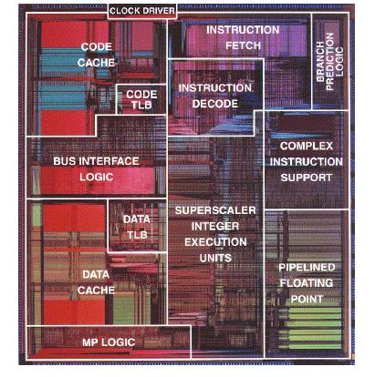
What computer architecture is all about
What are the components of a computer?
How to effectively put together the various components

Slide 29
Original Concept of Computer architecture
The attributes of a [computing] system as seen by the programmer, i.e.,
The conceptual structure and functional behavior, as distinct from the organization of the data flows and controls the logic design, and the physical implementation.
Amdahl, Blaaw, and Brooks, 1964

Slide 30
Instruction Set Architecture (ISA)

Slide 31

ISA: the interface between hardware and software
Purpose 1: (now irrelevant)
Re-use of fixed hardware resources
Purpose 2:
Interface between developer and hardware
Contract from one chip generation and the next
software
instruction set
hardware

Slide 32
Evolution of Instruction Sets
Single Accumulator (EDSAC 1950)
Accumulator + Index Registers
(Manchester Mark I, IBM 700 series 1953)
Separation of Programming Model
from Implementation
High-level Language Based
Concept of a Family
(B5000 1963)
(IBM 360 1964)
General Purpose Register Machines
Complex Instruction Sets
Load/Store Architecture
(Vax, Intel 432 1977-80)
(CDC 6600, Cray 1 1963-76)
RISC
(Mips,Sparc,HP-PA,IBM RS6000, . . .1987)

Slide 33
Interface Design
A good interface:
Lasts through many implementations (portability, compatibility)
Usable in many different scenarios (generality)
Provides convenient functionality to higher levels
Permits an efficient implementation at lower levels

Slide 34
Seven dimensions of ISA
Class
Memory addressing
Addressing modes
Types and sizes of operands
Operations
Control flow instructions
Encoding

Slide 35
Evolution of Computer Architecture Course
1950s to 1960s:
Computer Arithmetic
1970s to mid 1980s:
Instruction Set Design, especially ISA appropriate for compilers
1990s:
Design of CPU, memory system, I/O system, Multiprocessors, Networks.
2010s:
Multicore, Self adapting systems? Self organizing structures?
Power-aware design, reconfigurable
2020s:
Heterogeneous accelerator, GPU, FPGA, TPU, NPU
Security design

Slide 36
Computer Architecture
Computer Architecture is the science and art of selecting and interconnecting hardware components to create computers that meet functional, performance and cost goals.
It Covers:
Instruction Set design
Organization: high level of aspects of a computer’s design
Memory, memory interconnect, internal CPU
Hardware: specifics of computer
Detailed logic design, packaging, cooling system, board displacement, power

Slide 37
Computer Architecture Topics
Input/Output and Storage
Disks, WORM, Tape
RAID
Emerging Technologies
Interleaving
Bus protocols
DRAM
Memory
Hierarchy
L2 Cache
Coherence,
Bandwidth,
Latency
Network
Communication
Other Processors
L1 Cache
Addressing,
Protection,
Exception Handling
VLSI
Instruction Set Architecture
Pipelining, Hazard Resolution,
Superscalar, Reordering,
Prediction, Speculation,
Vector, Dynamic Compilation
Pipelining and Instruction
Level Parallelism

Slide 38
Computer Architecture Topics
Shared Memory,
Message Passing,
Data Parallelism
P
M
P
M
P
M
P
M
° ° °
S
Interconnection Network
Network Interfaces
Processor-Memory-Switch
Topologies,
Routing,
Bandwidth,
Latency,
Reliability
Multiprocessors
Networks and Interconnections

Slide 39
The Task of Computer Design 1
Define the user requirement:
Functional requirement: Fig1.4
Application area
Level of software compatibility
OS requirements
Standards
Nonfunctional requirements:
Price/performance
Availability, scalability, throughput, ...
Power, size, memory, temperature, ...

Slide 40
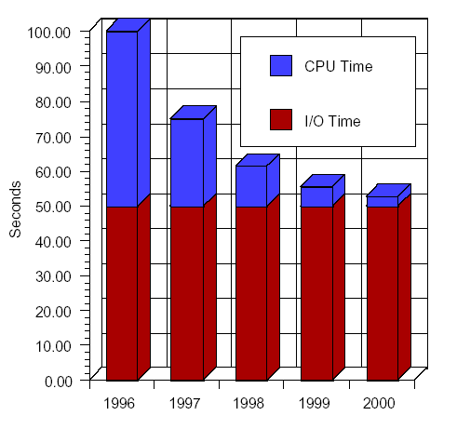
Application Performance
1996 - 1997
CPU performance improves by N = 400/200 = 2
program performance improves by N = 100/55 = 1.81
1997 - 1998
CPU performance - factor of 2
program performance N = 55/32.5 = 1.7
1998 - 1999
CPU performance - factor of 2
program performance N = 32.5 / 21.25 = 1.53
1999 - 2000
CPU Performance - factor of 2
program performance N = 21.25 / 15.6 = 1.36

Slide 41
Performance for Web Surfing
Assume 50% CPU, 50% I/O
1996 - 1997
CPU performance improves by N = 400/200 = 2
Program performance improves by N = 100/75 = 1.33
1997 - 1998
CPU performance *= 2
Program performance N = 75/62.5= 1.2
1998 - 1999
CPU performance *= 2
Program performance N = 62.5/56.5 = 1.11

Slide 42
Computer Applications
Architects need to understand applications’ behavior
We say we design general purpose processors, but we should also focus on specific sets of applications
Architecture can be tuned for applications
Types of applications today
Scientific
Weather prediction, crash analysis, earthquake analysis, medical imaging, imaging of the earth (searching for oil)
Business
database, data mining, video
General purpose
Microsoft Word, Excel
Real-time
automated control systems,
Others: Games, Mobile

Slide 43
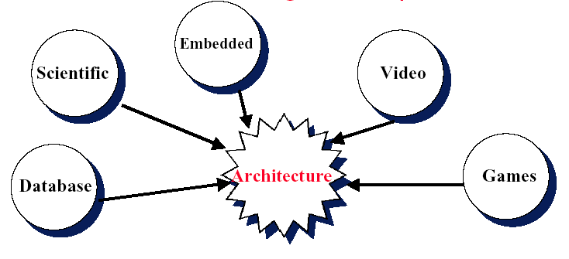
Architectures are Tuned to Applications
HP’s: 1.5 MB cache for transaction processing
Alpha: very fast FP for scientific
StrongARM: embedded
Intel MMX: multimedia
Sony EE: graphics rendering
Applications drive the design of the processor

Slide 44
The Task of Computer Design 2
Determine the important attributes of a new machine to maximize performance while staying with constrains, such as cost, power, availability, etc.
instruction set architecture design
functional organization
High level aspects of computer design,
i.e. memory system, bus architecture and internal CPU design.
logic design (hardware)
implementation (hardware)

Slide 45
Trend of Architecture
Emerging issues
High Speed
Multi-issue (superscalar) / Multithreading / Multiprocessor
CPU Cores / Multiple cores
Embedded
IRAM
Emerging applications
Digital media / Digital library
Toaster on the internet
Wireless everything
Star Trek communicator
Intelligent appliances & agents

Slide 46
Computer Engineering Methodology
Evaluate Existing
Systems for
Bottlenecks !
Benchmarks
User
requirement
Technology
Trends
Quantitative Principles
Implement Next
Generation System
Simulate New
Designs and
Organizations
Workloads

Slide 47
Computer Design life cycle
Evaluate Existing
Systems for
Bottlenecks
Requirements
Implementation
Complexity
Benchmarks
Technology
Trends
Implement Next
Generation System
Simulate New
Designs and
Organizations
Quantitative
principle
Workloads

Slide 48
Summary:Task of computer design
Considerations:
Functional and non functional requirements
Implementation complexity
Complex designs take longer to complete
Complex designs must provide higher performance to be competitive
Technology trends
Not only what's available today, but also what will be available when the system is ready to ship. (more on this later)
Trends in Power in IC
Trends in cost
Arguments
Evaluate Existing Systems for Bottlenecks
Quantitative Principles

Slide 49
Topics in Chapter
1.1 Why take this course ?
1.2 Classes of computers in current computer market
1.3 Defining computer architecture and What’s the task of computer design?
1.4 Trends in Technology
1.5 Trends in power in Integrated circuits
1.6 Trends in Cost
1.7 Dependability
1.8 Measuring, Reporting and summarizing Perf.
1.9 Quantitative Principles of computer Design
1.10 Putting it altogether

Slide 50
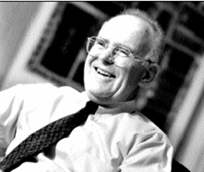

Technology Trends
Moore Law
In 1965 he predicted that the number of components the industry would be able to place on a computer chip would double every year. In 1975, he updated his prediction to once every two years. It has become the guiding principle for the semiconductor industry to deliver ever-more-powerful chips while decreasing the cost of electronics.
Gordon Moore

Slide 51
Technology Trends
Integrated circuit logic technology
Transistor Density: incr. 35% per year, (4x every 4 years)
Die size: 10%-20% per year
Transistor count per chip:40-55% per year
Semiconductor DRAM
Capacity: 40% per year (2x every 2 years)
Memory speed: about 10% per year
Magnetic Disk tech.
Density: 30% per year before 1990;60% per year in1990-1996
100% per year in 1996-2004;30% per-year after 2004
capacity: about 60% per year
Network bandwidth
10Mb ⎯⎯⎯→ 100Mb ⎯⎯⎯→ 1Gb ⎯⎯⎯→ 10Gb ⎯⎯⎯→ 100Gb ⎯⎯⎯→ …
10 years 5 years
Designers often design for the next technology.

Slide 52
Notes
A rule of thumb
Cost decrease rate ~ density increase rate
Technology thresholds
Technology improves continuously, an impact of this improvements can be in discrete leaps.

Slide 53
Perf. Trends: Bandwidth over latency
Bandwidth/throughput: total amount of work done in a given time
Latency/response time: the time between the start and the completion of an event.
Rule of thumb
Bandwidth grow rate ~ improvement in latency2

Slide 54
Performance milestones in microprocessor

Slide 55
Challenges for IC Tecnology
IC characteristic: feature size
10 microns in 1971 → 0.18microns in 2001
→ 0.09 microns in 2006 → 65nm
→40nm →28nm →14nm →7nm →5nm…
Rule of thumb: transistor performance Improves linearly with decreasing feature size.
IC density improvement is both opportunity and Challenge:
Signal delay for a wire increase in proportion to the product of its resistance and capacitance.
Major design limitation: signal delay

Slide 56
Topics in Chapter
1.1 Why take this course ?
1.2 Classes of computers in current computer market
1.3 Defining computer architecture and What’s the task of computer design?
1.4 Trends in Technology
1.5 Trends in power in Integrated circuits
1.6 Trends in Cost
1.7 Dependability
1.8 Measuring, Reporting and summarizing Perf.
1.9 Quantitative Principles of computer Design
1.10 Putting it altogether

Slide 57
Trends in Power
Power also provide challenges as device scaled
First microprocessor: 1~10 watt
2GHz Pentium 4: 135 watt
3.6GHz Pentium 4 Prescott: 225 watt+
Challenges:
Distributing the power
Removing the heat
Preventing hot spot

Slide 58
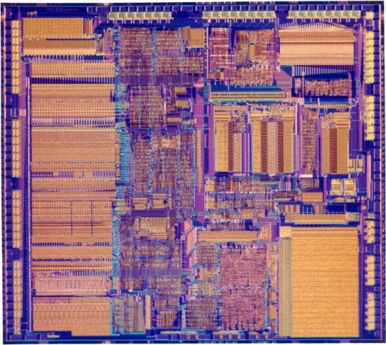
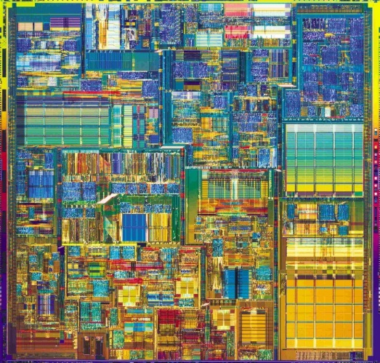
PPA(power & performance & area) of a chip
386 Processor
Pentium® 4 Processor
May 1986
@16 MHz core
275,000 1.5µ transistors
~1.2 SPECint2000
17 Years
200x
200x/11x
1000x
August 27, 2003
@3.2 GHz core
55 Million 0.13µ transistors
1249 SPECint2000

Slide 59
PPA(power & performance & area) of a chip
Performance scales with area**0.5
Power efficiency has dropped

Slide 60
Two concepts
Dynamic power: power consumption in switching transistors.
Power dynamic = ½ *Capacitive load * Voltage2 * Frequency switched
Energy dynamic = Capacitive load * Voltage2
Static power: power consumption when a transistor is off due to power leakage
Power static = current static * Voltage

Slide 61
Rule of Thumb
10% reduction of voltage yields:
10% reduction in frequency
30% reduction in power
Less than 10% reduction in performance
Rule of Thumb
Voltage | Frequency | Power | Performance
1% | 1% | 3% | 0.66%

Slide 62


Dual core with voltage scaling
RULE OF THUMB
A 15%
Reduction
In Voltage
Yields
Frequency Reduction | Power Reduction | Performance Reduction
15% | 45% | 10%
SINGLE CORE
DUAL CORE
Area = 1
Voltage = 1
Freq = 1
Power = 1
Perf = 1
Area = 2
Voltage = 0.85
Freq = 0.85
Power = 1
Perf = ~1.8

Slide 63
Multiple cores deliver more performance per watt
Cache
Power
Big core
4
3
Performance
2
2
Small
core
1
1
1
1
C1
C2
Many core is more power efficient
Power ~ area
Single thread performance ~ area**0.5
4
4
Cache
3
3
C3
C4
2
2
1
1

Slide 64

THANK YOU
THANK YOU

