Slide 1

Computer Architecture ----A Quantitative Approach
陈文智
浙江大学计算机学院
chenwz@zju.edu.cn

Slide 2
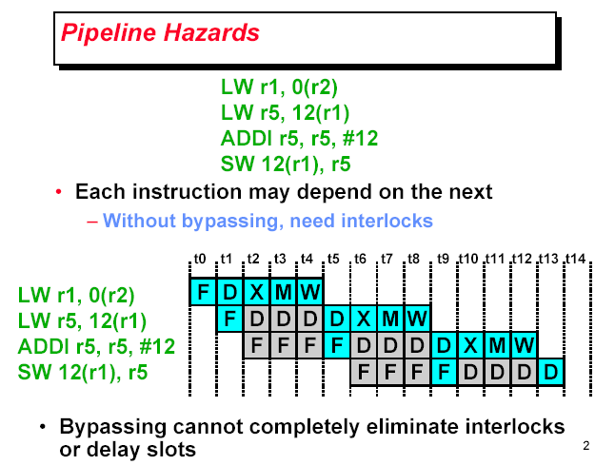

Slide 3
Multithreaded Software
Process
Each process has its unique address space
Can consist of several threads
Thread – each thread has its unique execution context:
Its own PC + registers + stack
All threads within a process share same address space
Private heap is optional
Multithreaded app’s: process broken into threads
Increase concurrency
Partial blocking
Centralized (smarter) resource management (by process)

Slide 4
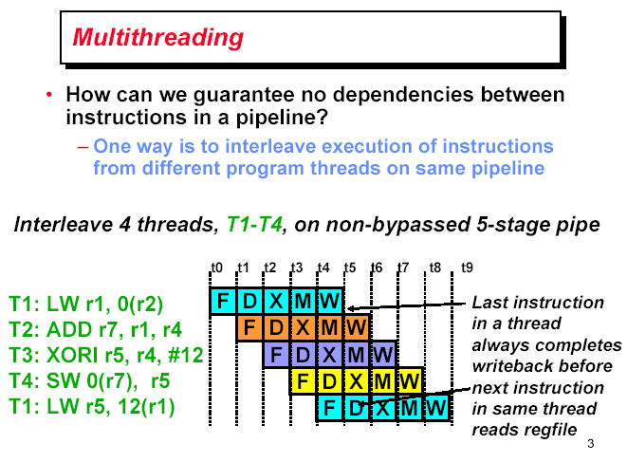

Slide 5
Multithreaded Architecture
Processor capable of executing multiple software threads
Can execute “simultaneously”
Thread can be HW switched without OS control
Shared resource
Sharing -> better resource utilization -> better throughput
Can belong to the same process – but not have to !

Slide 6
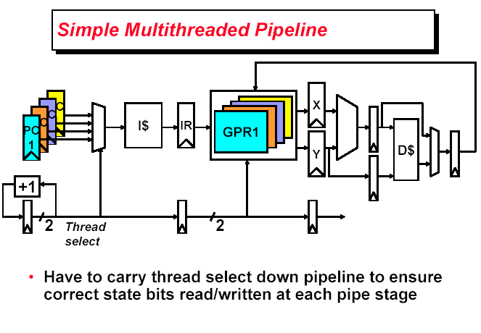

Slide 7
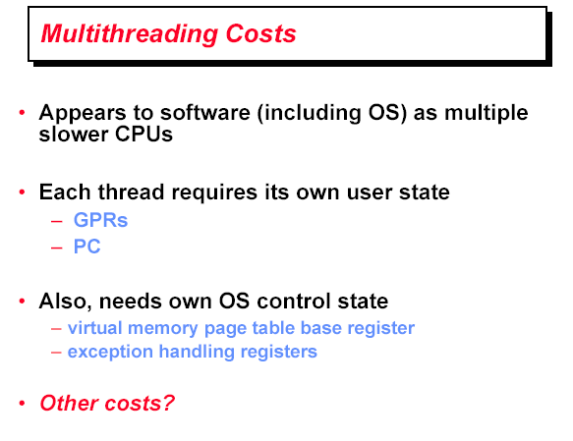

Slide 8
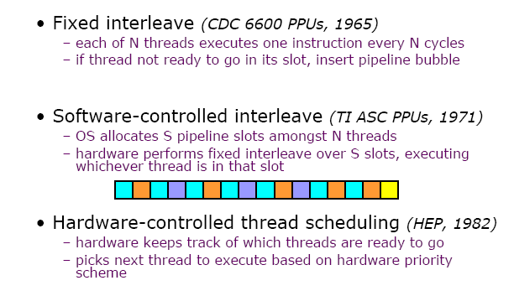
Thread scheduling policies

Slide 9
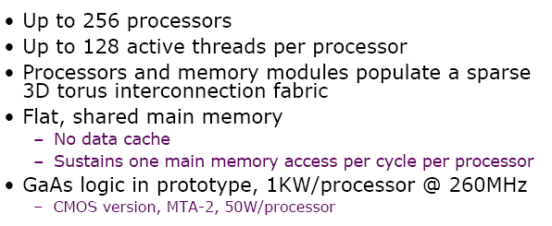
Tera MTA

Slide 10
MTA Architecture

Slide 11
Coarse-Grain Multithreading

Slide 12
IBM Power RS64-IV (2000)

Slide 13
Multithreading design choices

Slide 14
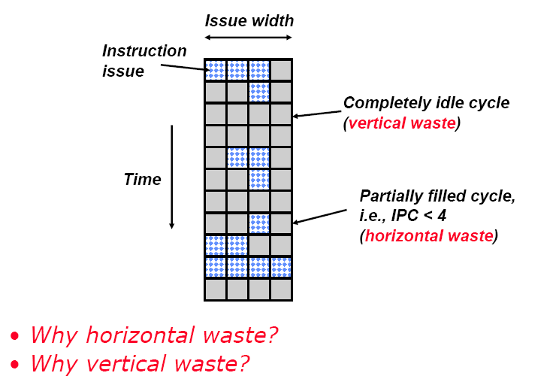
Super scalar Machine Efficiency
Cache misses

Slide 15
Vertical Multithreading

Slide 16
Chip Multiprocessing

Slide 17
Ideal Superscalar Multithreading

Slide 18
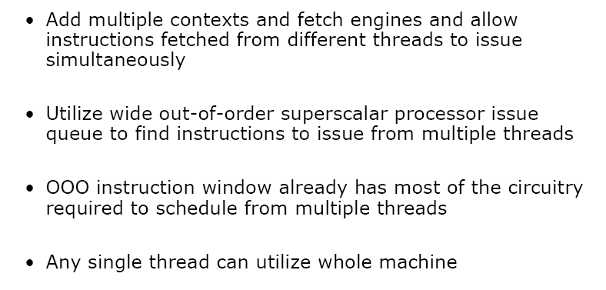
O-o-O Simultaneous Multithreading

Slide 19
Basic Out-of-order Pipeline

Slide 20
SMT Pipeline

Slide 21
Design Challenges in SMT
Trade-off between fine-grained implementation performance and single-thread performance.
preferred thread : might sacrifices throughput
Less likely to have a mix of instructions from several threads.
Maximize single-thread performance, should fetch as far ahead as possible, and have the fetch unit free when a branch is mispredicted or miss occur in prefetch buffer.

Slide 22
Design Challenges in SMT
A larger register file to hold multiple context
Not affecting the clock cycle, such as in instruction issue, in instruction completion.
Ensuring that Cache and TLB conflicts do not cause performance degradation.

Slide 23
Pentium-4 Hyperthreading

Slide 24
HT Technology Architecture
Front End
Execution trace cache
Microcode store ROM (MSROM)
Instruction translation look-aside buffer (ITLB) and branch prediction
IA-32 instruction decode
Micro-op queue
System Bus
Bus unit
3rd level cache
Optional server product
2nd level cache
1st level cache
4 way
Fetch/
Decode
Trace Cache
MS ROM
OOO
Execution
Retirement
BTBs/
Branch Prediction

Slide 25
Front End
Responsible for delivering instruction to the later pipe stages
Trace cache hit
When the requested instruction trace is present in trace cache
Trace cache miss
Requested instruction is brought in the trace cache from L2 cache

Slide 26
Trace Cache (TC) Hit - Front End
IP
IP
Micro-Op Queue
Trace Cache
Two sets of instruction pointers
Two logical processors arbitrates access to TC every clock cycle
If one logical processor stalled, then other logical processor can use the full bandwidth of TC

Slide 27
Trace Cache Miss - Front End
L2 Access
Buffer
Decode
Queue
ITLB
Decode
L2 Access
(ping-pong)
(ping-pong)
(ping-pong)
Micro-op Queue
Trace Cache Fill

Slide 28
HT Technology Architecture
Back End
Allocator
Register rename
Instruction scheduling
Execution units
Retirement
System Bus
Bus unit
3rd level cache
Optional server product
2nd level cache
1st level cache
4 way
Fetch/
Decode
Trace Cache
MS ROM
OOO
Execution
Retirement
BTBs/
Branch Prediction

Slide 29
Detailed Pipeline
Micro-op Queue
Sched.
Register Read
Register
Rename
Queue
Allocate
Execute
Retire
Register Write
L1 D Cache

Slide 30
Allocator - Back End
Allocates many of the key machine buffers including
126 re-order buffer entries
128 integer and floating point physical registers
48 load 24 store buffers
When HT Technology is enabled, each logical processor can use maximum of 63 re-order buffer entries, 24 load buffers and 12 store buffers

Slide 31
Register Rename - Back End
There are two Register Alias Tables (RAT) for each processor
Rename done in parallel with allocator logic
Once done, micro-ops are placed into two sets of queues: MIAQ (memory instruction address queue) and GIAQ (general instruction address queue)
Queues are partitioned such that micro-ops from each logical processor can use at most half the entries

Slide 32
Instruction Scheduling - Back End
Five schedulers are used to schedule different types of micro-ops
Both MIAQ and GIAQ send micro-op to five schedulers as fast as they can
Each scheduler has its own scheduler queue
Micro-ops are simply evaluated based on dependent inputs and availability of execution resources
To avoid deadlock, there is a limit on number of active entries that a logical processor can have in scheduler’s queue

Slide 33
Execution units - Back End
After execution, micro-ops are placed in re-order buffer. It decouples execution stage from retirement stage
Re-order buffer (ROB) is partitioned such that each logical processor can use half entries

Slide 34
Retirement - Back End
Tracks when micro-ops from two logical processors are ready to be retired, then retires the micro-ops by alternating between two logical processors

Slide 35
HT Technology Architecture
Memory Subsystem
DTLB
L1 data cache
L2 unified cache
L3 unified cache
System Bus
Bus unit
3rd level cache
Optional server product
2nd level cache
1st level cache
4 way
Fetch/
Decode
Trace Cache
MS ROM
OOO
Execution
Retirement
BTBs/
Branch Prediction

Slide 36
DTLB - Memory Subsystem
Tagged resource
Each entry in dual translation lookaside buffer (DTLB) includes a logical processor ID tag
Each processor has reservation register to ensure fairness and forward progress in processing DTLB misses

Slide 37
Memory Subsystem L1/2/3 Cache
Both logical processors can share all entries in all three levels of cache

Slide 38
Bus
Logical processors are treated on first-come first-serve basis. Priority is not given to any logical processor
Distinction between requests from two logical processors are maintained
Requests to APIC and interrupt delivery resources are unique and separate per logical processor

Slide 39
Speculative, Out-of-Order Superscalar Processor

Slide 40
Granularity of Multithreading

Slide 41
Sun T1 Multiprocessor
Focus on Thread Level Parallelism
Commercial application oriented
Small single-issue core employ multithreading
Multi core on chip

Slide 42
Single Thread Design
L2 cache is getting larger with less performance contribution
Power efficiency decrease
Hot-spot
Lower processor utilization

Slide 43
Single Thread design multiple issue

Slide 44
Hardware Multi Threading

Slide 45
Chip Multithreading

Slide 46
Why CMT works ?

Slide 47
T1 Architecture
8 core/chip
4 Treads/core
1 FPU shared for 8 cores
Core connected via crossbar switch(134.4GB/s)
High-bandwidth, 12-way associative 3MB L2 cache
4 DDR2 channels (23GB/s)
Power < 80W
`300M transistors
378 mm² die
1 core

Slide 48
T1 Architecture
L1 cache: 16KB Icache, 32B line; Dcache, 8KB, 16B line; 4-way set associative, 64B block, L1 miss penalty=23 cycles,
L2 cache: 4 banks, each 750KB, 64B block, L2 miss penalty = 110 cycles
L1 cache coherence is enforced by directory associate with each L2 cache block
Memory controller on chip to decrease miss penalty

Slide 49
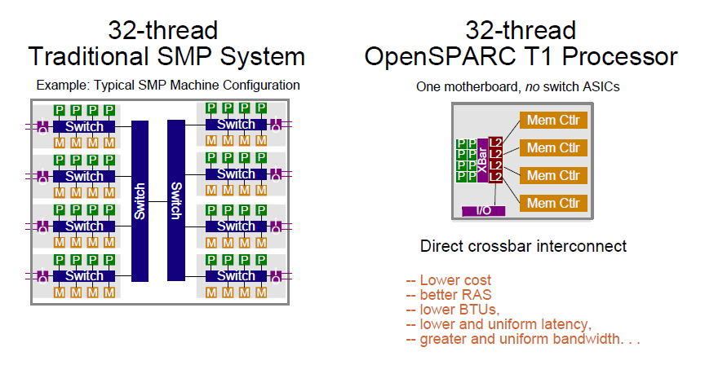
Compare with SMP
BTU: british theraml Unit

Slide 50
Core structure
4 threads /core
Single issue
6 stage pipeline
Unique resources/thread
Registers
Portions of I-fetch datapath
Store and Miss buffers
Resource shared by 4 threads
Caches, TLBs, Exe Units
Pipeline registers and Data path
Core area = 11mm² in 90nm
MT adds ~20% area to core

Slide 51
T1 processor core pipeline

Slide 52
Thread Selection Policy
Switch among available ( ready to run) threads every cycle
Priority given to least-recently-executed thread
Thread becomes not-ready-to-run due to:
Long latency operations like load, branch, mul, or div ( load, branch incur 1 3-cycle delay )
Pipeline stall when cache miss, trap, or structure hazard

Slide 53
Instruction Fetch/Switch/Decode Unit (IFU)
I-cache
16KB data, 4ways, 32B line
Single-ported Instruction Tag
Dual-ported(1R/1W) Valid-bit array
Invalidate operations access Valid-bit array, not instruction Tags
Pseudo-random replacement
Fully associative Instruction TLB
64 entries, Page sizes: 8K, 64K, 4M, 256M
Multiple hits in TLB prevented by doing auto-demap on fill
2 instructions fetched each cycle

Slide 54
Windowed Int Register file
5KB 3R/2W/1T structure
>640 64b regs
Only the 32 registers from current window is visible to thread
8 global + 24 window register
Window changing in background under thread switch
Single cycle R/W accwss

Slide 55
Execution Units
Single ALU and shifter. ALU reused for branch address and virtual address calculation.
Integer Multiplier
5 clock latency, throughput of ½ per cycle
Constrains accumulate function for Mod Arithmetic
1 integer mul allowed outstanding per core
Multiplier shared between Core Pipe and Modular Arithmetic unit on a round robin basis
Simple divider, with one divide outstanding per core
Thread issuing a MUL/DIV will rollback and switch out if mul/div units is occupied.

Slide 56
Load Store Unit (LSU)
D-Cache complex
8KB data, 4 ways, 16B line
Single ported Data Tag
Dual ported(1R/1W) Valid bit array
Pseudo-random replacement
Load are allocating, stores are non allocating
8 entry store buffer per thread, unified into single 32 entry array, with RAW bypassing

Slide 57
LSU (continued)
Crossbar interface
LSU priorities requests to the crossbar for FPops, streaming ops, I and D misses, stores and interrupts.
Request priority
Imiss > ldmiss > stores, {fpu, strm, interrupt}
Packed assembly for pcx.
Handles return from crossbar and maintains order for cache updates and invalidates.

Slide 58
Other Functions
Support for up to 64 pending interrupts per thread
Support for 6 trap levels. Traps cause pipeline flush.
Floating Point
The thread switch out when detecting ans FPop
FPop is further decoded and FRF is read
FPop with operands are packetized and shipped over the crossbar to the FPU
FPU returned the result via crossbar
Write back to FRF and thread restart

Slide 59
Cross Bar
Each requestor queues up to 2 packets per destination
3 stage pipeline: request, arbitrate and transmit
Oldest requestor first
Core to cache bus;
Address+double word store
Cache to core bus
16B line 32B Icache line fill delivered in 2 back to back clock cycles

Slide 60
L2 Cache
3MB, 4-way banked, 12-way associative, writeback
64B line size, 64B interleaved between banks
Latency: 8 clocks for load, 9 clocks for I-miss, critical chunk first
16 outstanding misses per bank → 64 total
Coherence maintained by shadowing L1 tags in an L2 directory structure
L2 is global visibility. DMA from IO is serialized write traffic from cores in L2
L2 has a 8-stage pipeline ( C1-C8)

Slide 61
L2 Cache - Directory
Directory shadows L1 tags
2048 entries, half-half for Icache and Dcache
L1 set index and L2 bank interleaving is such that ¼ of L1 entries come from each L2 bank
On and L1 miss, the L1 replacement way and set index identify the physical location of tag
On a store, write invalidate will be done
Invalidate operation are pointer to the physical location of L1. ( no tag lookup in L1)
An acknowledgement packet is sent to the request CPU, an invalidation packet sent to all other core

Slide 62
L2 Cache Single Bank
Arbiter ( instruction from CCX, DMA instruction, stall signals from pipeline, instruction from FB and MB )
L2 tag
L2 VUAD array –Valid, Used, Allocated( set when a line is picked for replacement) Dirty
L2 data
Input Queue ( 16 entry FIFO ) – packets arriving on the PCX
Output Queue ( 16 entry FIFO ) – operations waiting for access to CPX(cache-to-processor interface)
Snoop input Queue ( 2-entry FIFO )
Miss buffer (MB) (L2 misses, same line address with previous miss or write-back buffer, atomics and partial stores etc.)
Fill buffer ( temp store data from DRAM )
Write-back buffer
Remote DMA write buffer ( 4 entry ) for DMA write
L2 cache directory –coherency management and maintain inclusive property

Slide 63
Coherence/consistency
Load update directory & fill the L1 on return
Stores are non-allocating in L1
TSO, PSO, RMO ( one TSO store outstanding to L2 per thread)
Check directory and determine L1 hit
Directory send store ack/inv to core
Store update happens to Dcache on store ack
Crossbar orders responses across cache banks
3 atomic instructions are processed by L2 cache
LDSTUB, SWAP, Compare and swap(CAS)
Two passes down to cache pipeline

Slide 64
On chip Mem controller
4 independent DDRII DRAM channels
Up to 128GB memory size
25GB/s peak bandwidth
Schedules across 8 rds + 8 writes
128+16b interface, chipkill support, correction, byte error detection
Designed to work from 125-200Mhz

Slide 65
T1 Performance

Slide 66
Conclusion
Sun T1 provides much better performance in terms of performance/watt, especially for TPC-C-like and SPECJBB05 benchmark.
TLP approach is much more power efficient than an ILP-intensive approach for multithreaded applications.
CMT may provide a way to increase performance in a power efficient fashion.

Slide 67

THANK YOU
THANK YOU

