Slide 1
Ch.18 MobileApp Design

Slide 2
18.1 Mobile Development Considerations – 1
Multiple hardware and software platforms
Many development frameworks and programming languages.
Many app stores with differing acceptance rules and tool requirements
Short development cycles
User interface limitations

Slide 3
18.1 Mobile Development Considerations – 2
Complex camera/sensor interaction
Effective use of context
Power management
Security and privacy models/policies
Device limitations (computation and storage)
Integration of external services
Testing complexities

Slide 4
18.2 MobileApp Development Process Model
Formulation
Planning
Analysis
Engineering
Implementation and testing
User evaluation

Slide 5
18.3 MobileApp Quality Checklist - 1
Can content and/or function and/or navigation options be tailored to the user’s preferences?
Can content and/or functionality be customized to the bandwidth at which the user communicates? Does the app account for weak or lost signal in an acceptable manner?
Can content and/or function and/or navigation options be made context aware according to the user’s preferences?
Has adequate consideration been given to the power availability on the target device(s)?
Have graphics, media (audio, video), and other web or cloud services been used appropriately?

Slide 6
18.3 MobileApp Quality Checklist - 2
Is the overall page design easy to read and navigate?
Does the app take screen size differences into account?
Does the user interface conform to the display and interaction standards adopted for the targeted mobile device(s)?
Does the app conform to the reliability, security, and privacy expectations of its users?
What provisions have been made to ensure app remains current?
Has the MobileApp been tested in all targeted user environments and for all targeted devices?

Slide 7
18.4 MobileApp User Interface Design Considerations
Define user interface brand signatures
Focus the portfolio of products
Identify core user stories
Optimize UI flows and elements
Define scaling rules
Create user performance dashboard
Rely on dedicated champion with user interface engineering skills

Slide 8
18.5 MobileApp Design Mistakes
Kitchen sink
Inconsistency
Overdesigning
Lack of speed
Verbiage
Non-standard interaction
Help-and –FAQ-itis

Slide 9
18.6 MobileApp Design Best Practices
Identify the audience
Design for context of use
There is a fine line between simplicity and laziness
Use the platform as an advantage
Allow for discoverability of advanced functionality
Use clear and consistent labels
Cleaver icons should never be developed at the expense of user understanding
Long scrolling forms trump multiple screens

Slide 10
18.7 Assessing Mobile Interactive Development Environments
General productivity features
Third-party SDK integration
Post-compilation tools
Over the air development support
End-to-end mobile application development
Documentation and tutorials
Graphical user interface builders

Slide 11
18.8 MobileApp Middleware
Facilitates communication and coordination of distributed components
Allows developers to rely on abstractions and hide mobile environment details
Helps MobileApps to achieve context awareness as required

Slide 12
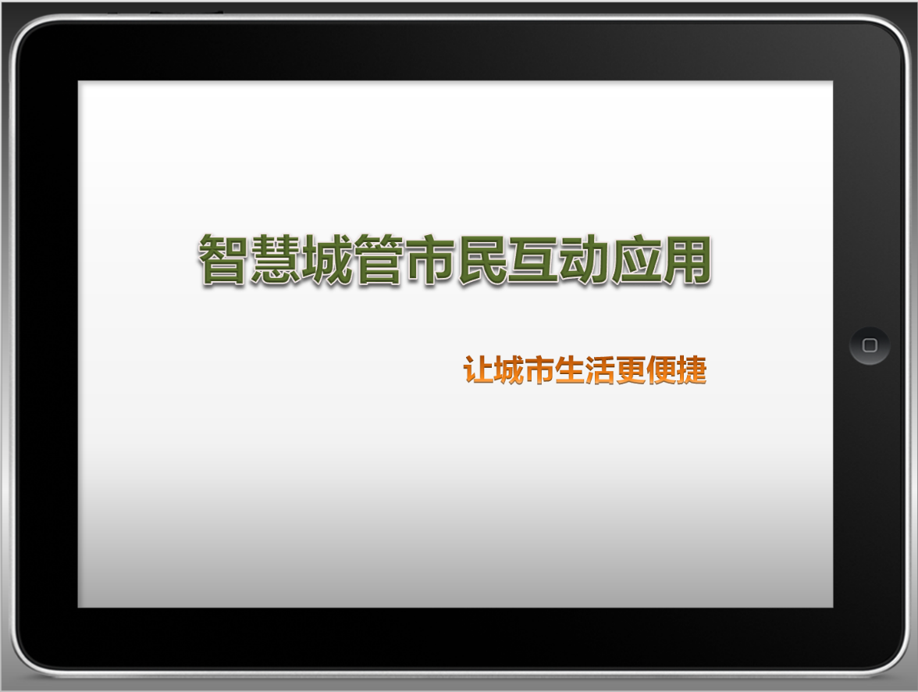
Case:智慧城管市民互动应用
智慧城市建设示范试点项目
提供城市管理的多项公共服务
提供市民快速参与城市管理的渠道
iOS&Android

Slide 13

























城管窗口
便民驿站
找找公厕
公交慢行
城管拍拍
城管动态
便民公告
政策法规
每日一题
放心供气
防汛抗冻
河道水质
紧急开挖
便捷支付
关联设置
泊车达人
挪车求助
路况预告
云呼热线
天天骑车
我的积分
我的任务
我的爱车
我的宠物
我的店铺

Slide 14
城管拍拍
城管动态
便民公告
政策法规
每日一题
泊车达人
挪车求助
路况预告
云呼热线
天天骑车
我的积分
我的任务
我的爱车
我的宠物
我的店铺

Slide 15
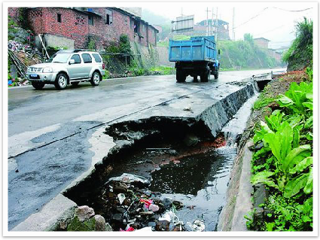




现场抓拍 记录查询
1
请选择案卷类型
管道爆裂
路面塌陷
上报提示
当前案卷已成功上报，案卷号： 201300432244。
错误提示
由于网络原因，案卷上报失败。请排除故障后重传！
井盖丢失
重 传
确 认
取 消
墙体坍塌
其他类型
拍照
确认上报

Slide 16
城管拍拍
城管动态
便民公告
政策法规
每日一题
泊车达人
挪车求助
路况预告
云呼热线
天天骑车
我的积分
我的任务
我的爱车
我的宠物
我的店铺

Slide 17
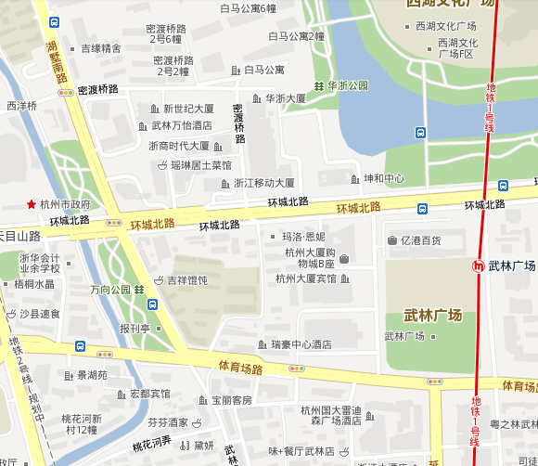











路线导航 图例说明
泊位建议
费用最省
距离最近
开始导航

Slide 18
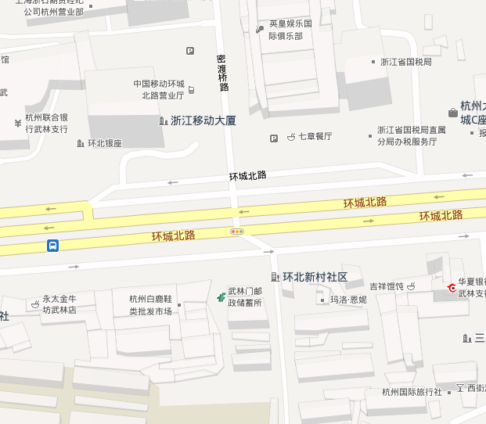

路线导航 图例说明
泊位建议
费用最省
距离最近
开始导航

Slide 19


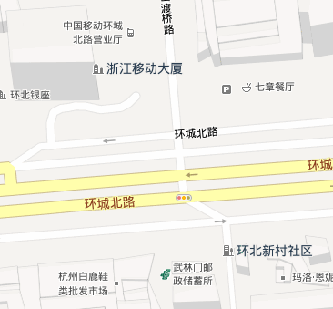
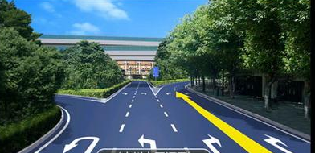
泊位查询 图例说明
环城北路
100m
5m
前方靠右进入辅道，直行100m后达到泊位。
当前还有剩余车位2个，该车位可使用IC卡支付。

Slide 20




泊位查询 路线导航
您当前所在的位置
道路停车泊位紧张
小区企业内部停车泊位紧张
道路停车泊位较少
小区企业内部停车泊位较少
道路停车泊位充足
小区企业内部停车泊位充足
经营性停车泊位紧张
经营性停车泊位较少
经营性停车泊位充足

Slide 21
Case: Features
应用界面简洁美观，易于上手
满足iOS、Android多平台使用需求
应用功能贴近用户实际需求
案件上报成功或错误均有明确提示
泊位查找选项充分考虑到用户喜好，可以进行个性化定制
注意点：后台数据库需要定时更新，保证数据准确性

Slide 22
《System Design》
(Speaker: 15-minute presentation + 3-minute Q&A )
Due: June 5th , 2020
Site：Chaodong Building 502
Grading Policy: Each group will evaluate the other groups’ performances and fill in the grading tables.

