Slide 1











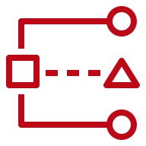

AWS Cloud
Organization Management Account
OU: management
1.0
1.3
1.1
Lambda CloudWatch Log Group
1.4
AWS CloudFormation
Lambda Role
1.2
1.5
AWS Lambda
AWS Organizations
Delegated Administrator Account (Audit)
OU: Core
2.0
2.1
Services

