Slide 1


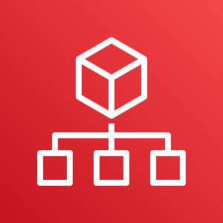



AWS Cloud
Organization Management Account
OU: management
Security Log Archive Account
OU: Core
1.0
2.0
region-1
1.1
1.2
2.1
region-2
region-n
AWS CloudFormation
AWS Organizations
AWS CloudFormation
2.2
2.3
Conformance Pack Delivery Bucket
Organization Conformance Pack
Audit Account
OU: Core
All Existing and Future
Organization Member Accounts
3.0
4.0
region-1
region-1
3.1
region-2
region-2
region-n
4.1
region-n
AWS CloudFormation
3.2
3.3
4.2
Service-Linked Role
Conformance Pack Templates Bucket
Organization Conformance Pack
Organization Conformance Pack

