Slide 1





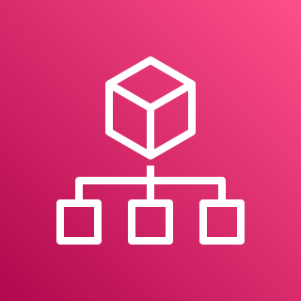



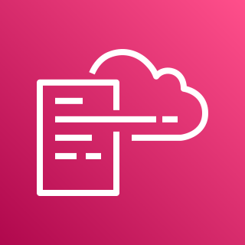

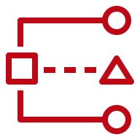

AWS Cloud
Organization Management Account
OU: management
1.0
1.3
Lambda CloudWatch Log Group
1.4
1.1
Lambda Role
AWS CloudFormation
1.2
1.5
AWS Lambda
AWS Organizations
Delegated Administrator Account (Security Tooling)
OU: security
2.0
2.1
Services

