Slide 1


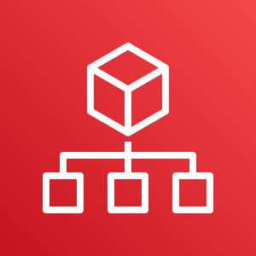
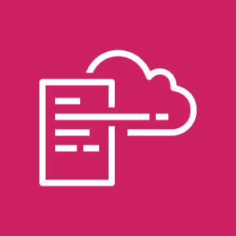




AWS Cloud
Organization Management Account
Security Log Archive Account
OU: security-prod
1.0
2.0
1.2
1.4
region-1
1.1
1.3
2.1
region-2
AWS Lambda
Organizations Delegated Admin
Lambda Role
region-n
AWS CloudFormation
AWS CloudFormation
2.2
2.3
1.5
1.6
Conformance Pack Delivery Bucket
Organization Conformance Pack
Lambda CloudWatch Log Group
Service-Linked Role
Security Tooling Account
OU: security-prod
All Existing and Future
Organization Member Accounts
3.0
4.0
region-1
4.1
region-1
3.1
region-2
region-2
Service-Linked Role
region-n
region-n
AWS CloudFormation
3.2
3.3
4.2
Conformance Pack Templates Bucket
Organization Conformance Pack
Organization Conformance Pack

