Slide 1
Senior Project _ Week 6
Yongyuan (Aaron) Zhang
Ziyan (Shirley) Lin

Slide 2
General Interest
Hidden Markov Model
Mathematical Definitions and other additional recall of the formulas
Reading on one paper: FPGA Acceleration of the Pair-HMMs Forward Algorithm for DNA Sequence Analysis (2015)

Slide 3
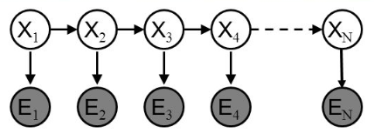
MathematicalDefinitions
Discrete random variables Xn → hidden variables
Random variables En → observed variables

Slide 4
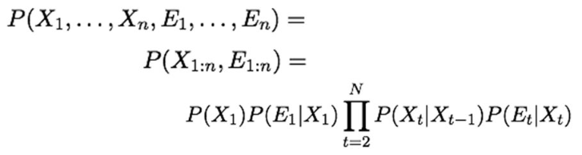
Joint distribution

Slide 5
Parameters
Transmission Probability: X_k → X_k+1
Emission Probability: X_k → E_k
Initial Distribution: P(X1=i), i={1,…,m}

Slide 6
Readings from the Paper on FPGA
Mentioned the Algorithms:
Virtibi Algorithm(multiplications) and Forward Algorithm
Used Forward Algorithm in the paper (additions)

Slide 7
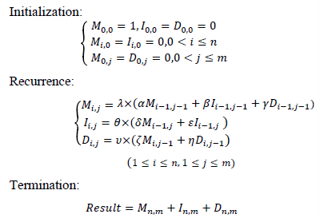

Slide 8
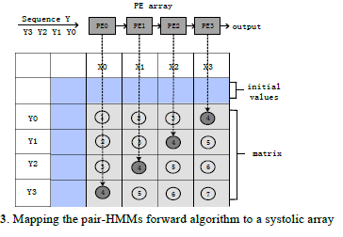

Slide 9
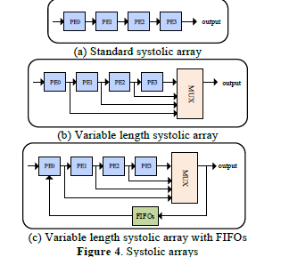

Slide 10
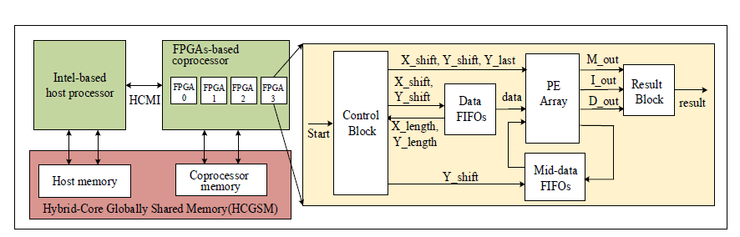

Slide 11
Questions on the Paper
Clarification of the matrix definition M, I, D matrix
How the pair-HMM different then the simple
10 floating-point multipliers and 4 floating adders
The number of synthesizable PE arrays
Why correlates better with the number of exit points rather the number of PEs
https://www.bluebee.com/wp-content/uploads/2018/10/FPGA-Acceleration-hpc_bcb_15.pdf

