Slide 1
Senior Project _ Week 8
Yongyuan (Aaron) Zhang
Ziyan (Shirley) Lin

Slide 2
HMM→ Viterbi Algorithm
Paper presented in 2002 from University of Birmingham
Speech Recognition Application

Slide 3
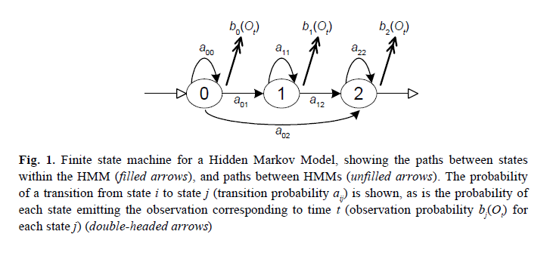

Slide 4
Terms Used
a_ij are the transition probabilities, where state j at time t give that state I at time t-1
b_j(O_t) is the observation probability that state j emits a particular O_t at time t
Implemented as look up table, read from memory during recognition

Slide 5
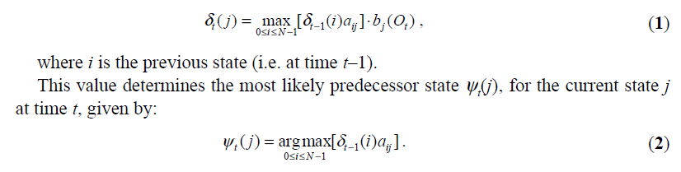
Viterbi Decoding
Define the maximum probability in state j at time t, which predicts the most likely state sequence ends in state j.

Slide 6
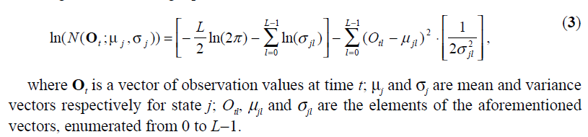
Equation involved with Viterbi Decoding

Slide 7
FPGA involvement
Referred model…
Uses 10,900 states grouped into 1,100 “genomes” with each genome being represented by 32 Gaussians. For Altera FLEX 10KE at 66MHz with speed up to 7.74 times. Accuracy above 85%

Slide 8
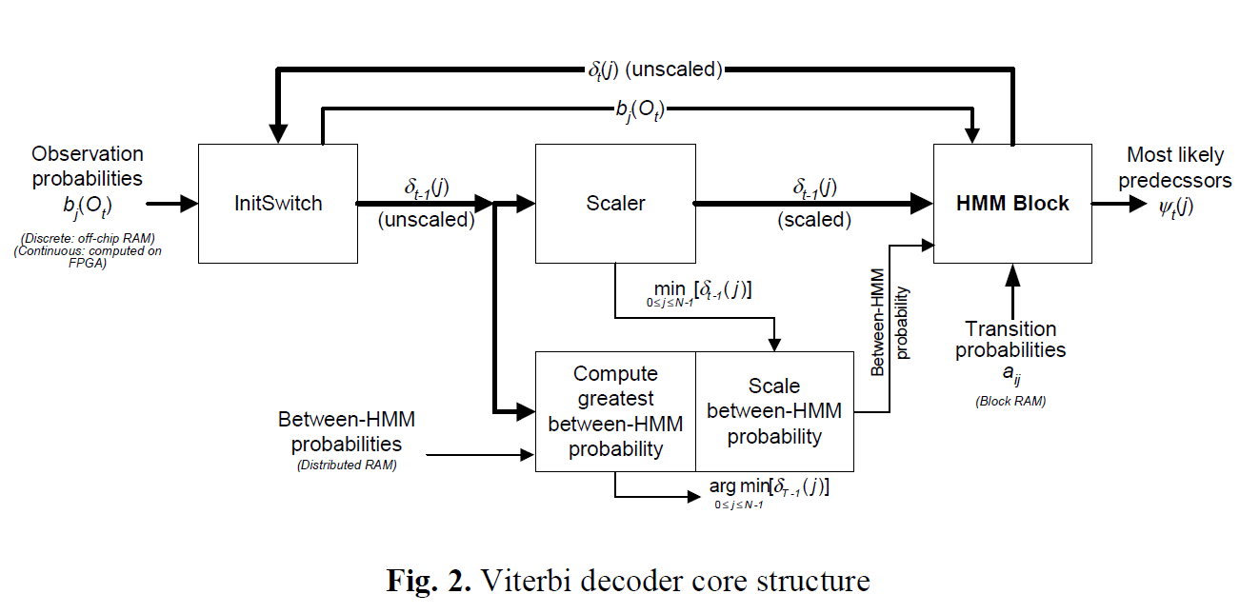

Slide 9
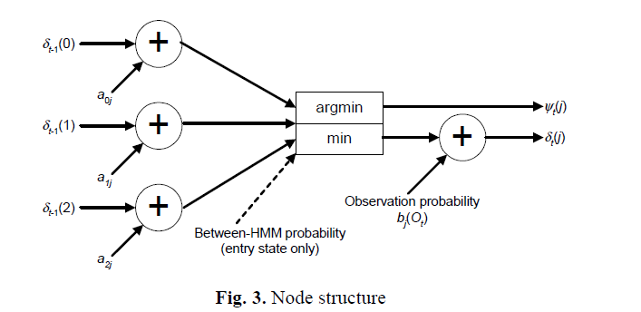

Slide 10
Computation
For observation…
Using a fully pipelined architecture, processes 39 elements for each observation state at a time.
Floating point subtractor, squarer and multiplier are used.
Stored in FIFO
Data only read once for each time frame

Slide 11
Hardware used
Xilinx Virtex XCV1000 FPGA on Celoxica’s RC1000-PP development board
8MB of RAM
Pentium III 450 MHz processor
256-entry,15-bit wide look-up tables

