Slide 1
Senior Project _ Week 7
Yongyuan (Aaron) Zhang
Ziyan (Shirley) Lin

Slide 2
Topic and Readings
Hidden Markov Model
Readings on the paper

Slide 3
Paper from 2017 IEEE
On Accelerating Pair-HMM Computations in Programmable Hardware

Slide 4
General information
Another example of using pair-HMM algorithm to analyze mutations in sequenced genomes
Faster process the data sequence and reduce the transferred data into the accelerator
in an IBMXilinx Virtex 7 FPGA Power8 system
Compared with 8-core CPU baseline and improvement of energy with NA12878 sample

Slide 5
Terms
Variant Calling
Intra-task parallelism (entire source budget)
By dee pipelining→147.49 x speed up per unit energy
Reduce the usage of FA kernel and reduce the size of the comparing sequence
Evaluation of potential high bandwidth for the host accelerator bandwidth limitations in PCIe/CAPI

Slide 6
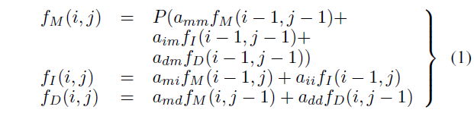
Pair-HMM
Mutation(M), Insertion(I), and Deletion(D)
GATK-single-precision floating point, double for recompute

Slide 7
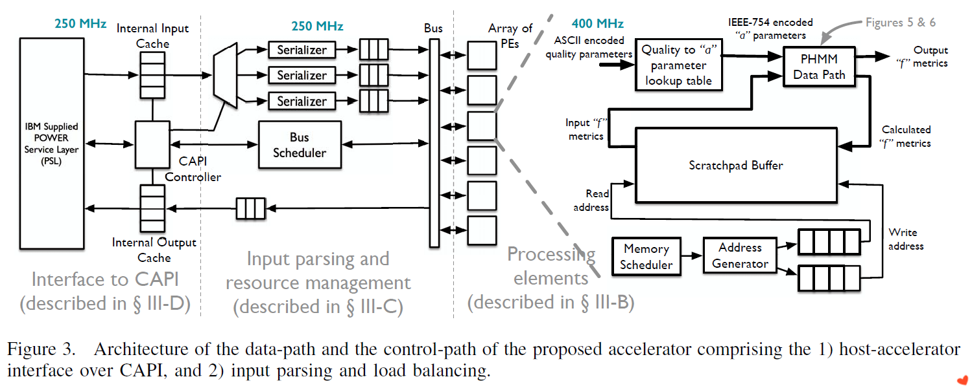

Slide 8
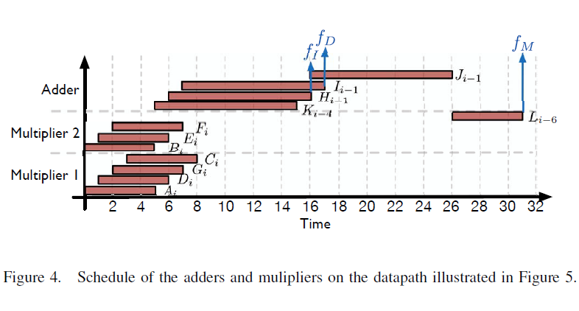
Scheduling

Slide 9
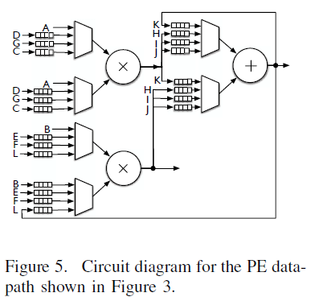
PE data path circuit

Slide 10
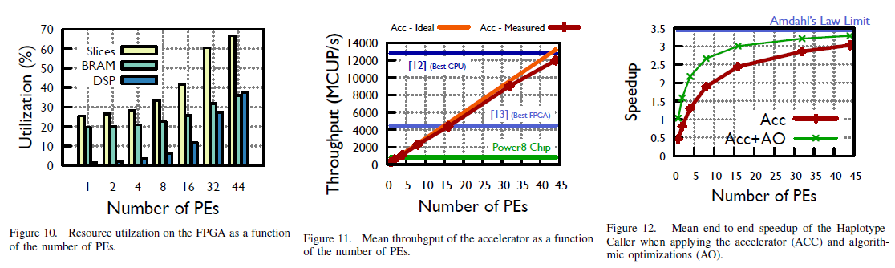

Slide 11
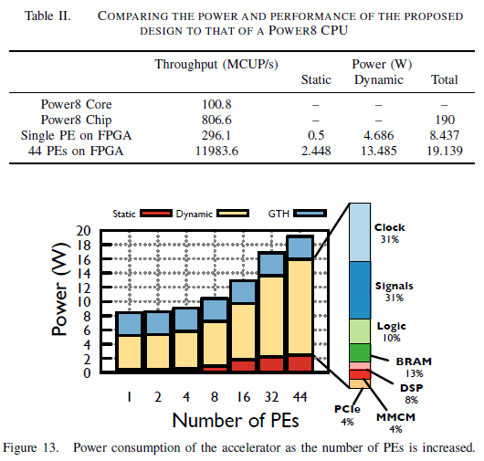
Power Consumption

Slide 12
