Slide 1
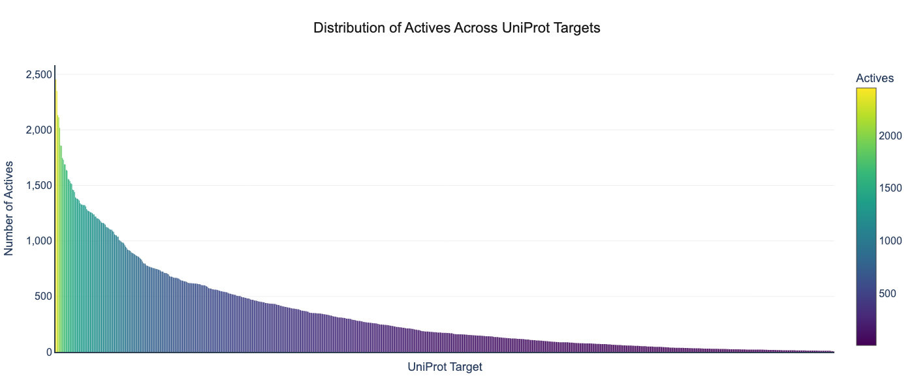
Notes:
Distribution of the number of actives per uniport target.
X-axis is for Uniport ID and y-axis is the number of actives for each uniport target. Each bar represents the number of actives for each uniport target.

Slide 2
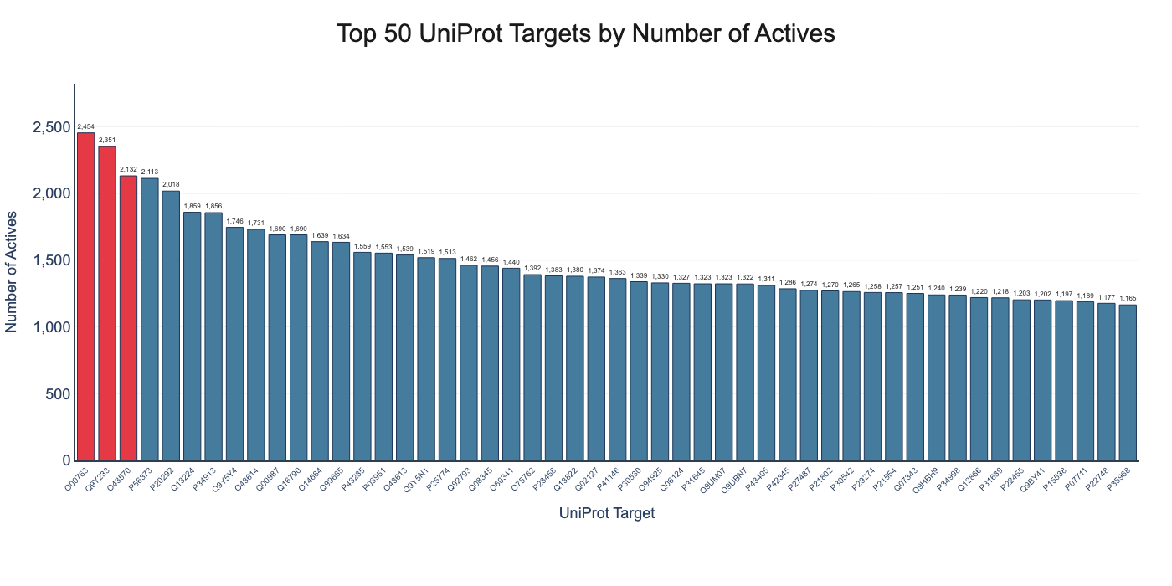
Notes:
Distribution of the Top-50 uniport targets by the number of actives.
This takes the top-50 uniport targets with most actives. X-axis is their uniport ID

Slide 3
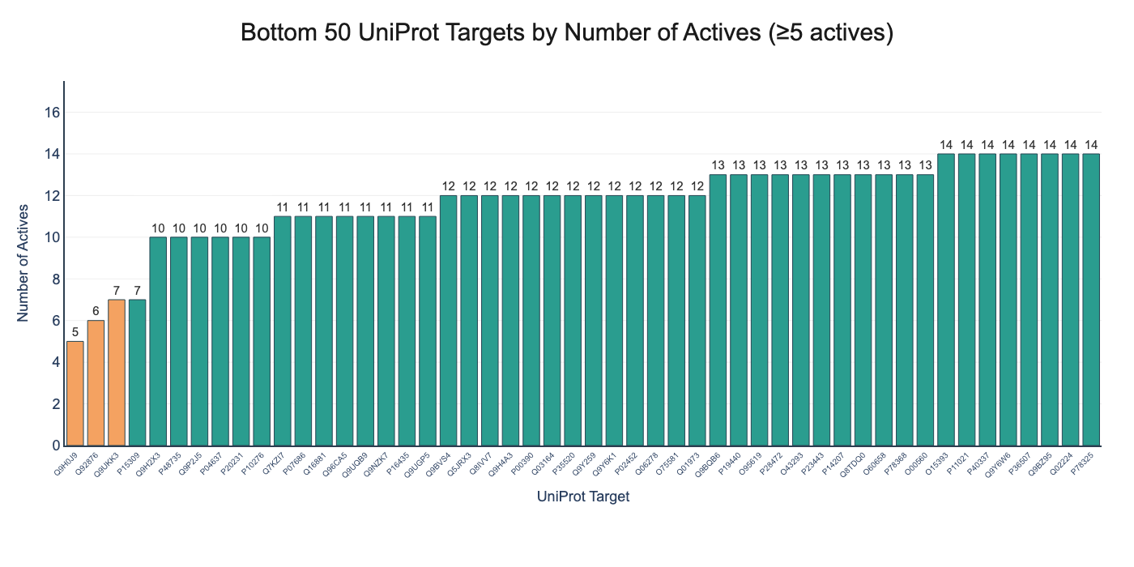
Notes:
Distribution of the Bottom-50 uniport targets by the number of actives
This takes the bottom-50 uniport targets with fewest actives. X-axis is their uniport ID

Slide 4
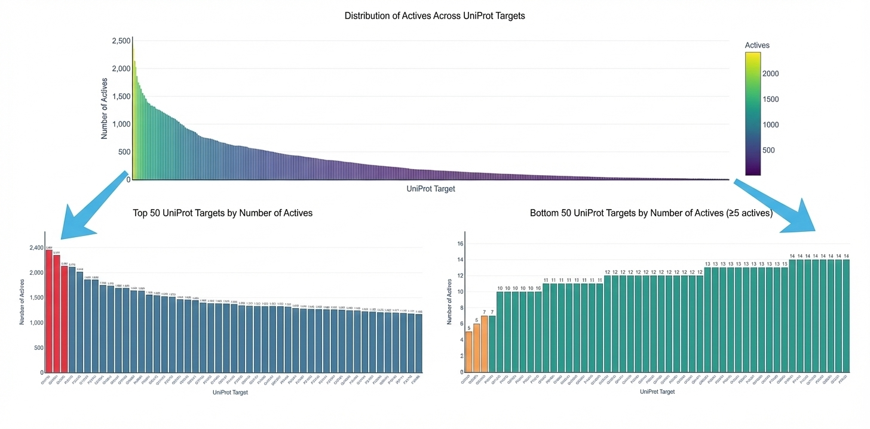
Notes:
Making zoom-in view of the distribution of actives per uniport target by on each end

Slide 5
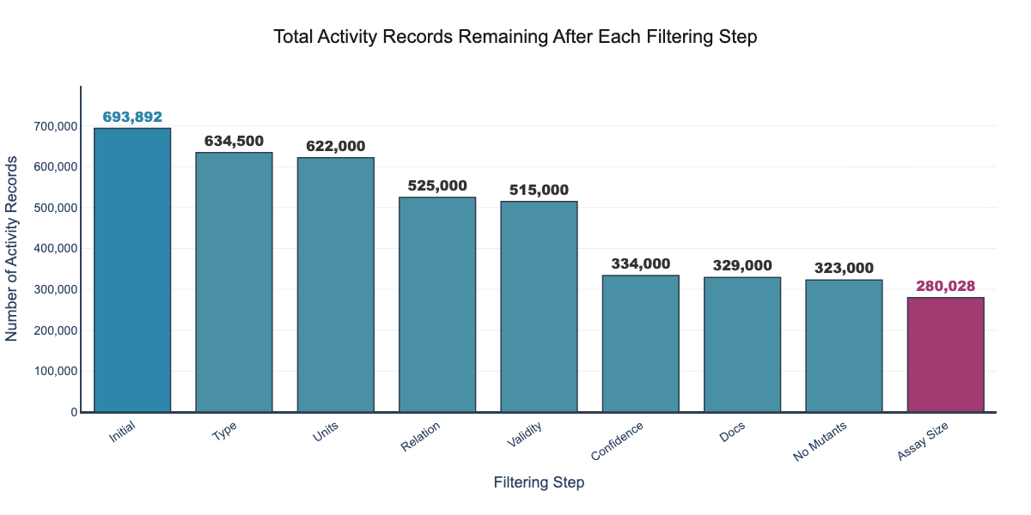
Notes:
The number of actives after each data curation step.
Initial: the raw affinity data retrieved from chembl database by querying with uniport IDs
Type: Keep only affinity data that are of type Ki or IC50
Units: Keep only affinity data with the ‘nM’ unit
Relation: keep only affinity data that are of type “=“ not “<=” or “>=“ because some affinity is e.g. <= 50nM
Validity: keep only affinity data where they have a validity comment
Confidence: keep only data with a confidence score greater than or equal to 9
Docs: keep only affinity data which have confirmed document publishing date
No Mutants: no keep only affinity data that does not have “mutant”, “mutation”, “variant” in any of their assay description information
Assay size: keep only uniport targets with more than 10 actives

Slide 6
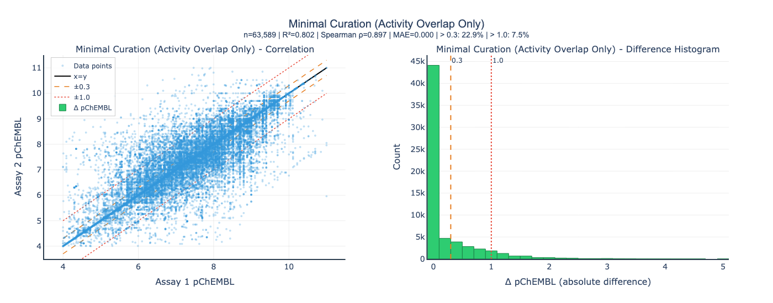
Notes:
This is the result where we try to find compounds that appear in at least two assays to check if their results are consistent.
It can be shown that after the filtering, for those compounds that appear in at least two assays, they have a pretty high correlation, suggesting a consistency of the measure activity value.
So we can partially conclude that the basic filtering is effective.

Slide 7
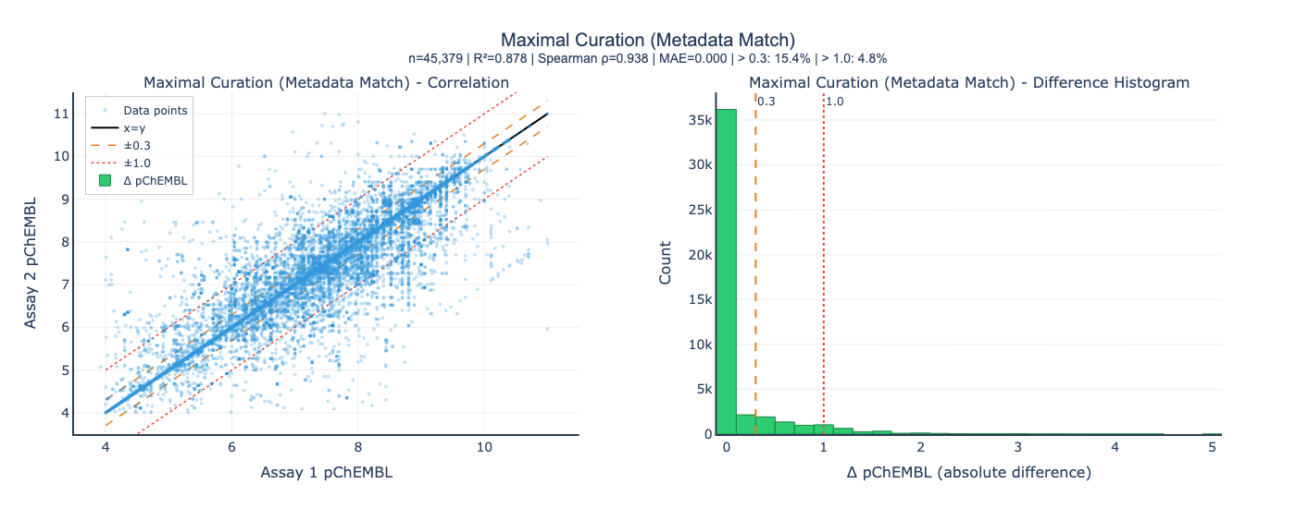
Notes:
For comparison, this also checks if the compounds appear in at least two assays. Additionally, it also checks if the two assays have matching assay annotation: \
'assay_organism_enriched',
'assay_tissue_enriched',
'assay_cell_type_enriched',
'assay_subcellular_fraction_enriched',
'assay_bao_format_enriched’,
The results are similar to that in minimal overalp filtering.

Slide 8
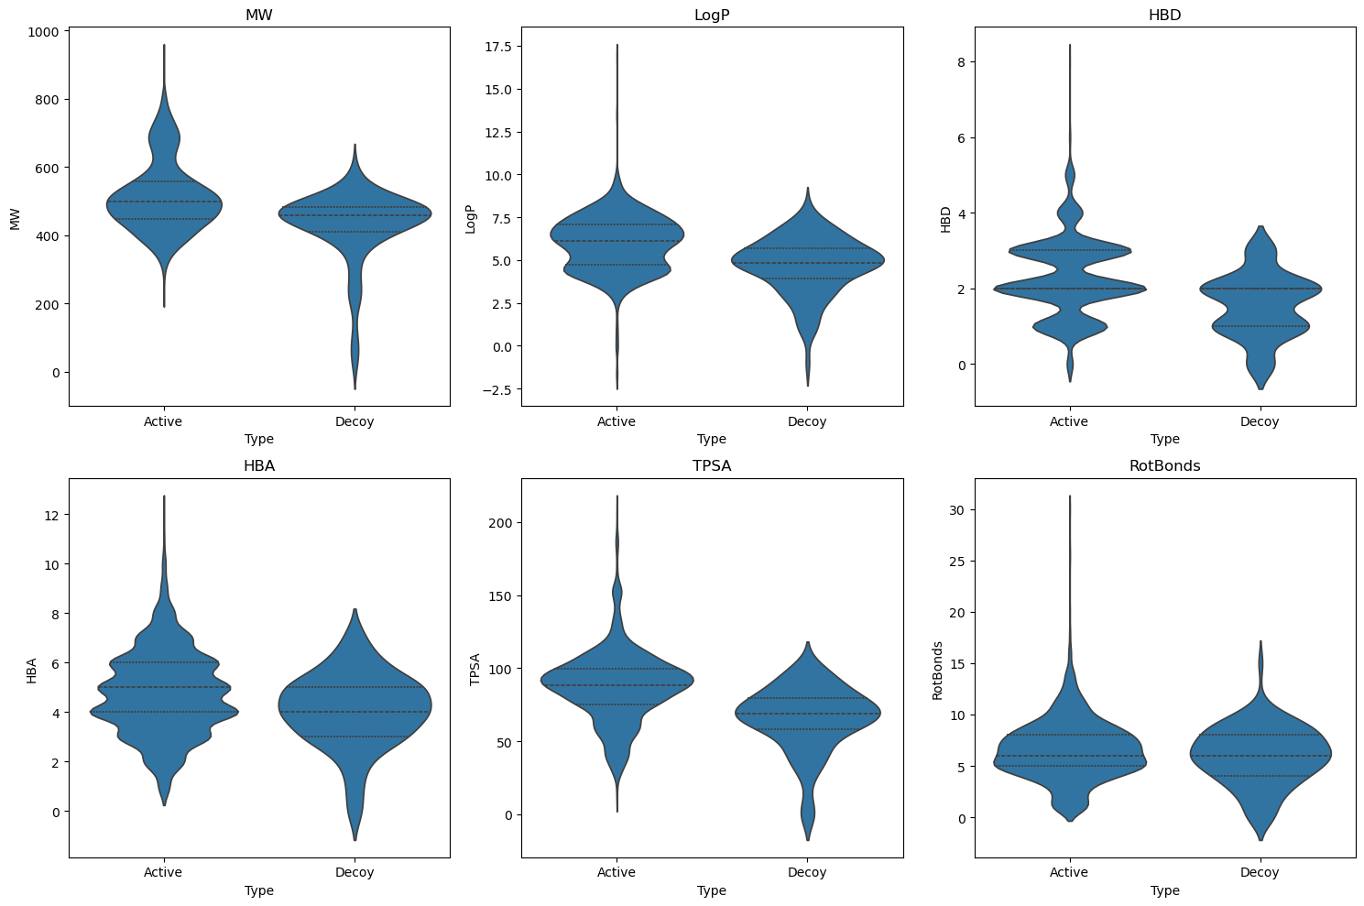
Notes:
The violin plot of physical chemistry properties (molecular weight, LogP, number of hydrogen bond donors, number of hydrogen bond acceptors, topological polar surface, number of rotatable bonds) of actives and generated decoys for a particular uniport target O14684.

Slide 9
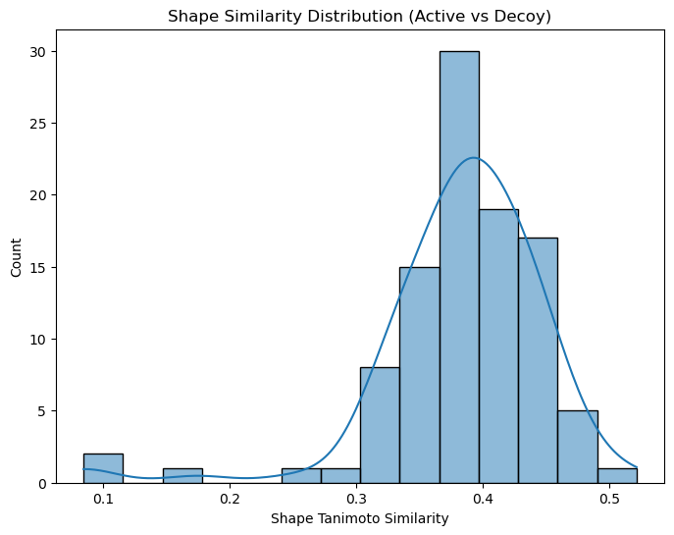
Notes:
Shape Similarity of the Active and generated decoys measured in Tanimoto Distance for a particular uniport target O14684.
X-axis is the Tanimoto distance and y-axis is the count of the active-decoys pairs with that particular Tanimoto distance.

Slide 10
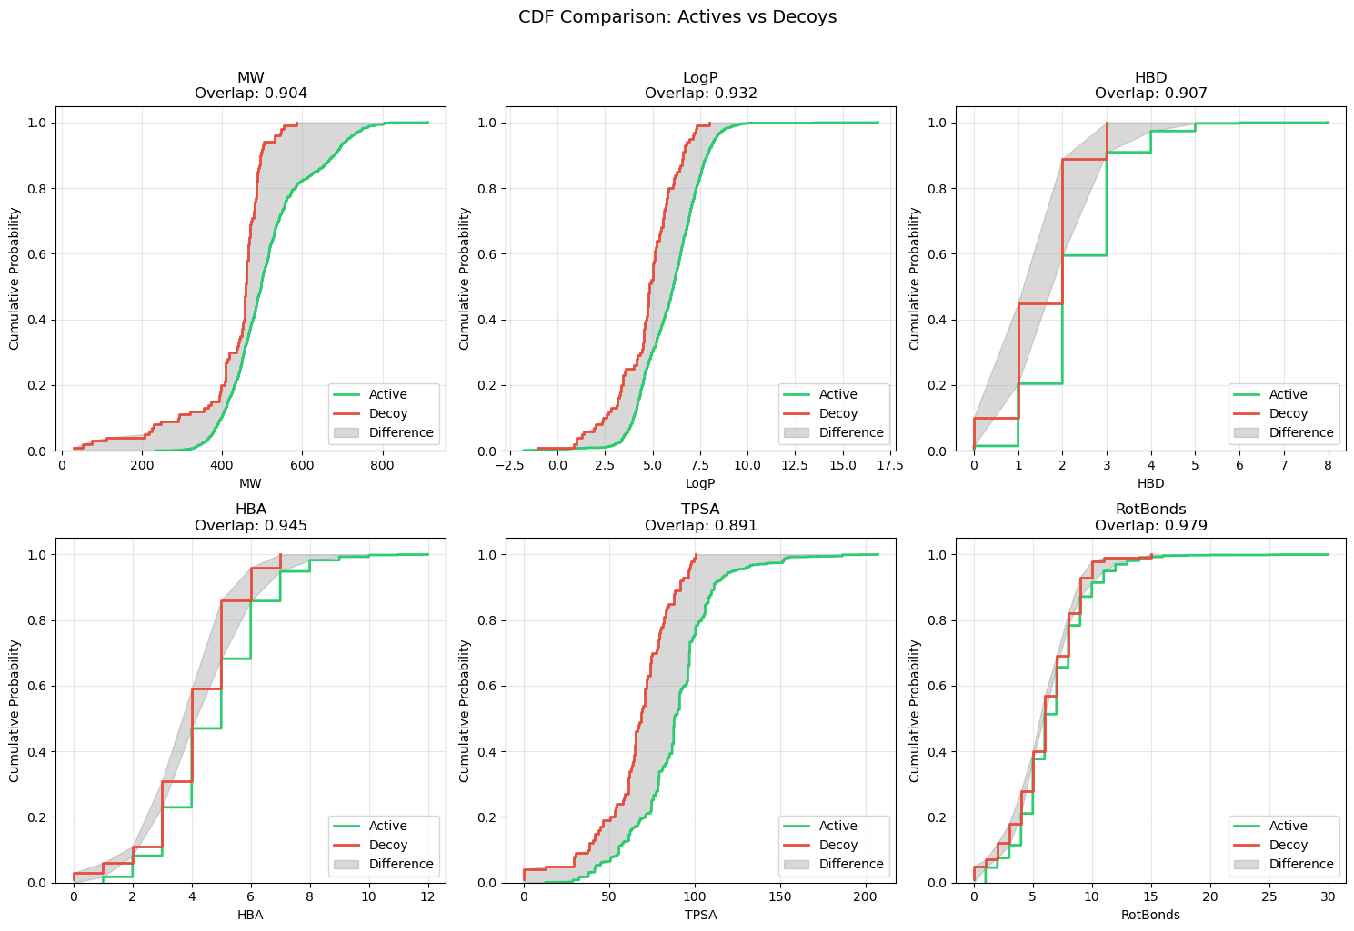
Notes:
The CDF 6 physical chemistry properties (molecular weight, LogP, number of hydrogen bond donors, number of hydrogen bond acceptors, topological polar surface, number of rotatable bonds) of actives and generated decoys

