Slide 1
League of Legends Overlay Assistant
Project Proposal
Xihao Zhou
Bo Yang
Hao Yang
Ziheng Gong

Slide 2
Function Design
Champion Ban/Pick Tool
In Game Item Build Tool
Personalized Game Shop

Slide 3
Function Design
Champion Ban/Pick Tool
Using image detection algorithms to get to know which champions have been banned by your enemy
Based on history match records in all divisions, our assistant will help you to choose a hero and runes.
We will learn how well your opponents play their champs and which blind spot you can exploit

Slide 4
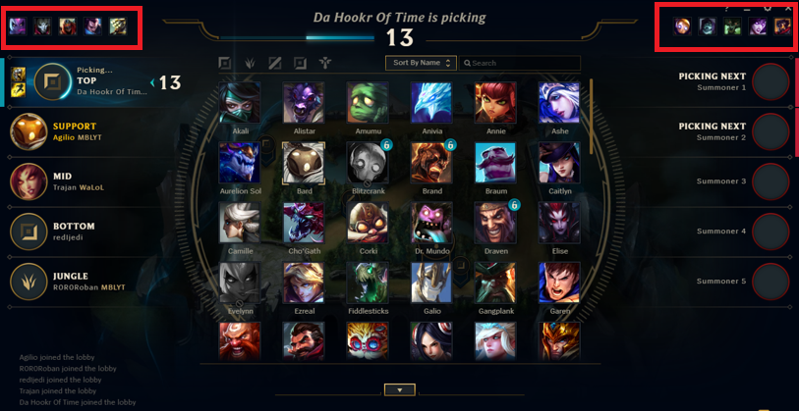
Champion Ban/Pick Tool
Using image detection to know what champions has been banned by the enemy team.
Based on champion win rate and other information, we suggest champions to pick. (Similar to those banned champions.)

Slide 5
Function Design
In-Game Item Build Tool
Using image detection to know what items the enemy team has purchased. (By pressing Tab button)
Give suggestions to your own build. (Based on your champion)

Slide 6
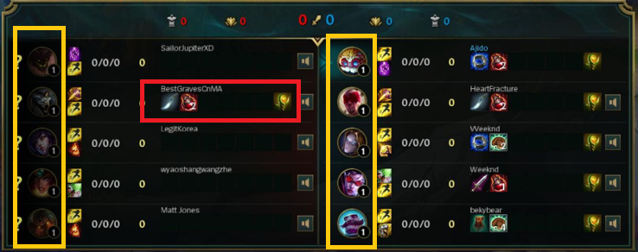

Slide 7
Function Design
Personalized Game Shop
Using historical RP purchase data, and other account data (game length, frequent time, rank level, most played champions…)
Create a personalized shop for each user. (Most likely to spend more money)

Slide 8
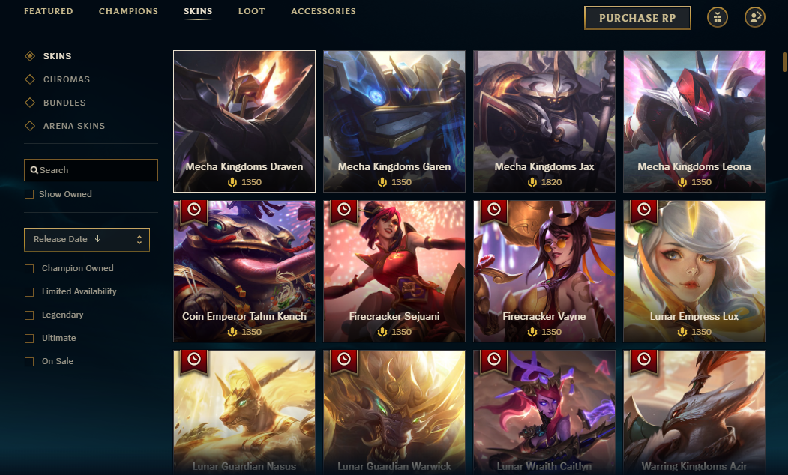
Function Design
Personalized Game Shop
Using historical RP purchase data, and other account data (game length, frequent time, rank level, most played champions…)
Create personalized shop for each user. (Most likely to spend more money)

