Slide 1
League of Legends Overlay Assistant
Project report 1
Xihao Zhou
Bo Yang
Hao Yang
Ziheng Gong
Date: 2020/2/4

Slide 2
Project Progress
Champions portrait classification
Champions attribute database & similarity matrix
Others

Slide 3
Project Progress 1
Champions portrait classification
Used database of 148 champions’ portrait.
Database size – 120,000 images(100,000 for training, 20,000 for testing)
Recognized rate – 99%

Slide 4
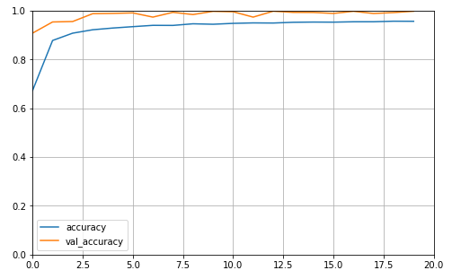
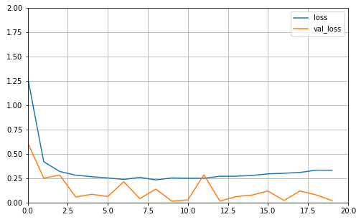
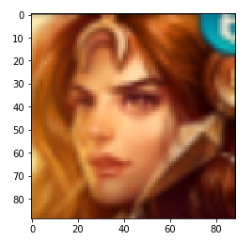
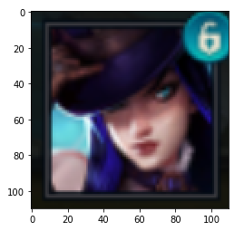
Accuracy learning curves:
Loss learning curves:
Image example:

Slide 5
Project Progress 2
Champions attribute database & similarity matrix
Crawled data of champion basic stats and their win rate to other champions from OP.GG and LOLWiki
Used cosine similarity to generate similarity matrix of all champions. Will use this similarity to apply champion suggestion in project.

Slide 6
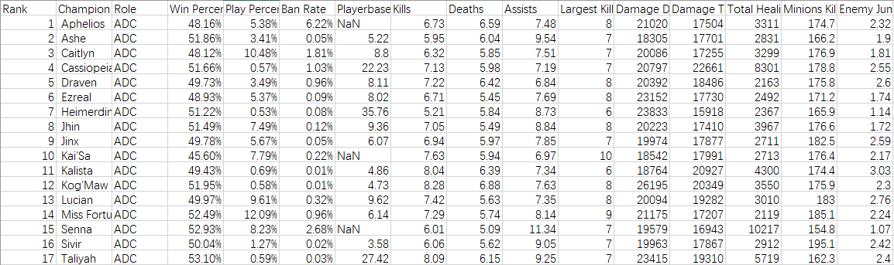
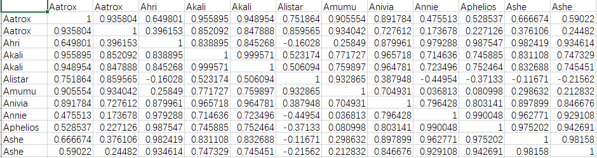
Champion database
Similarity matrix

Slide 7
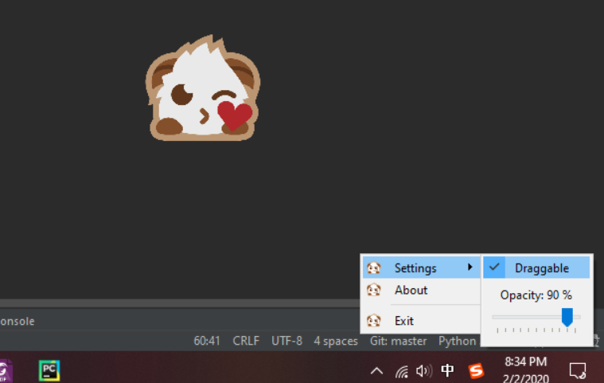
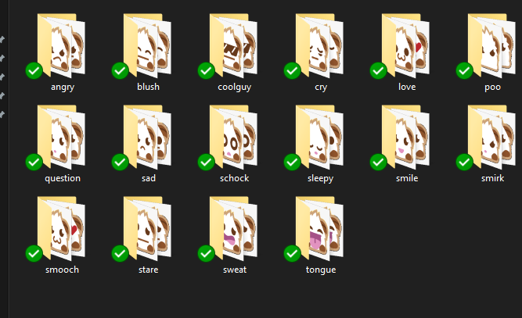
Project Progress 3
UI
Designed a draggable-suspended-Dynamic User Interface of our project App.

Slide 8
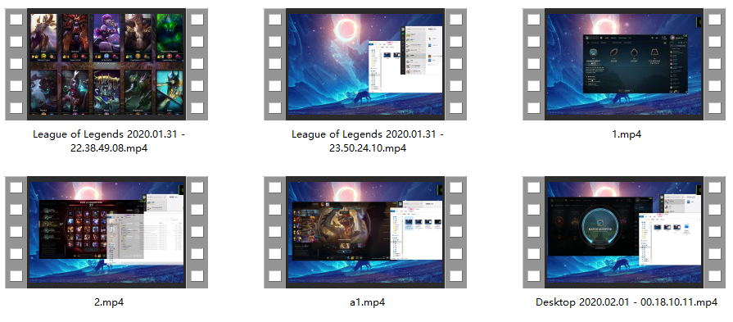
Project Progress 3
Preparing video material for next step

Slide 9
Thank you !

