Slide 1
League of Legends Overlay Assistant
Project report 2
Xihao Zhou
Bo Yang
Hao Yang
Ziheng Gong
Date: 2020/2/18

Slide 2
Project Progress
Item image recognition
Champions selection tool test

Slide 3
Project Progress 1
Item image recognition
Used database of 160 items’ image.
Database size – 120,000 images(48089 for training, 13840 for validation,160 for testing)
Recognized rate – 100%

Slide 4
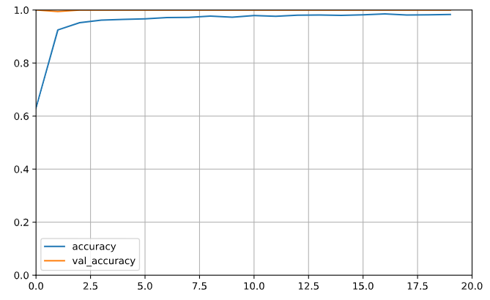
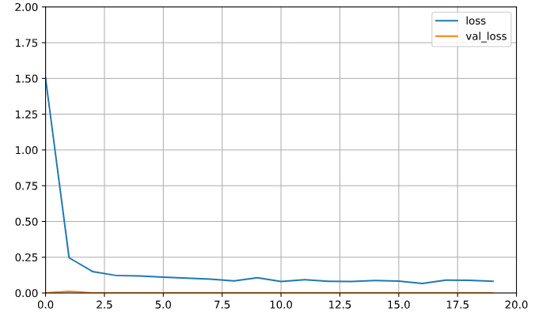
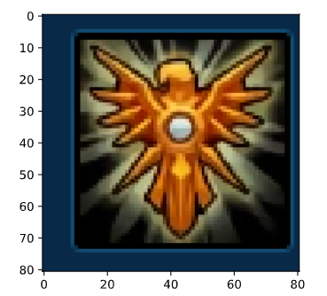
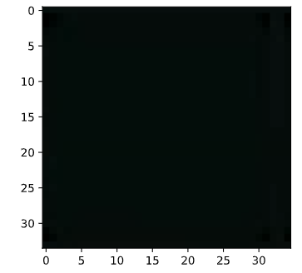
Accuracy learning curves:
Loss learning curves:
Image example:
Empty item example:

Slide 5
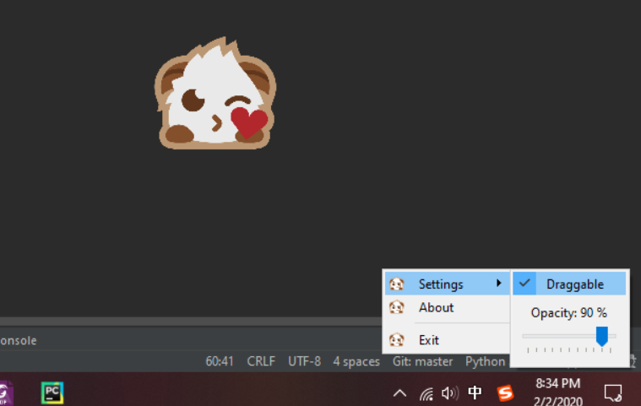
Project Progress 2
Champions selection tool test
Loaded our champion portrait detection function and champion suggestion function on the UI and test in real game.

Slide 6
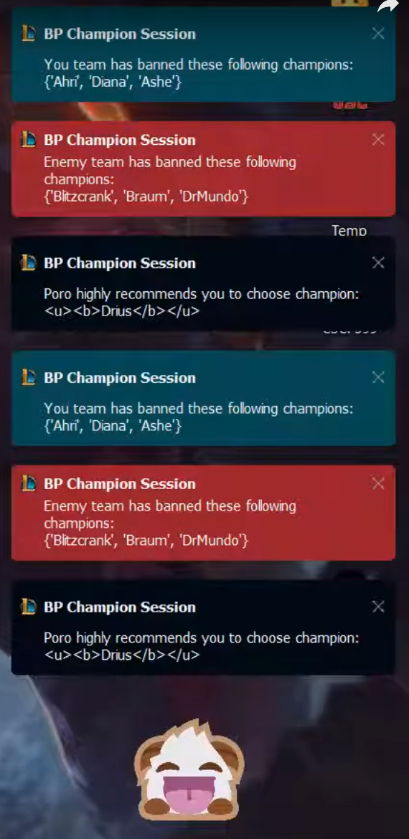
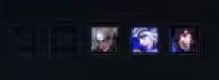
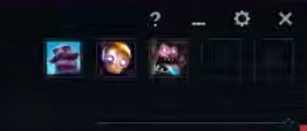
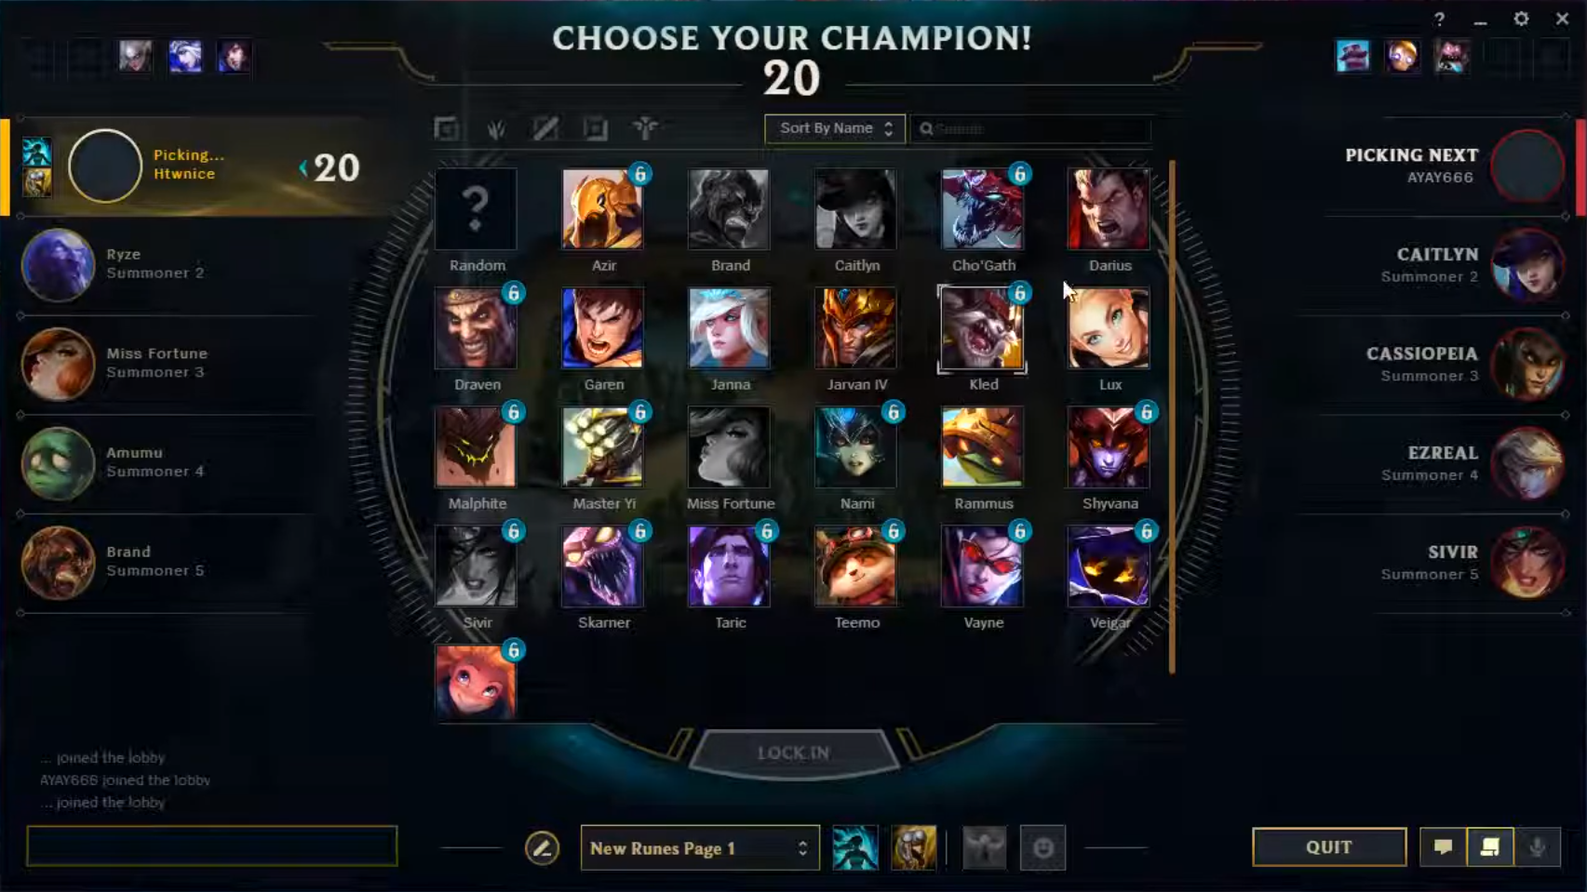
Test interface: https://www.youtube.com/watch?v=KZCnNVcFSGA
Suggestion

Slide 7
Thank you !

