Slide 1

Apache Calcite
《SQL 高级特性》 - 解析层

Slide 2
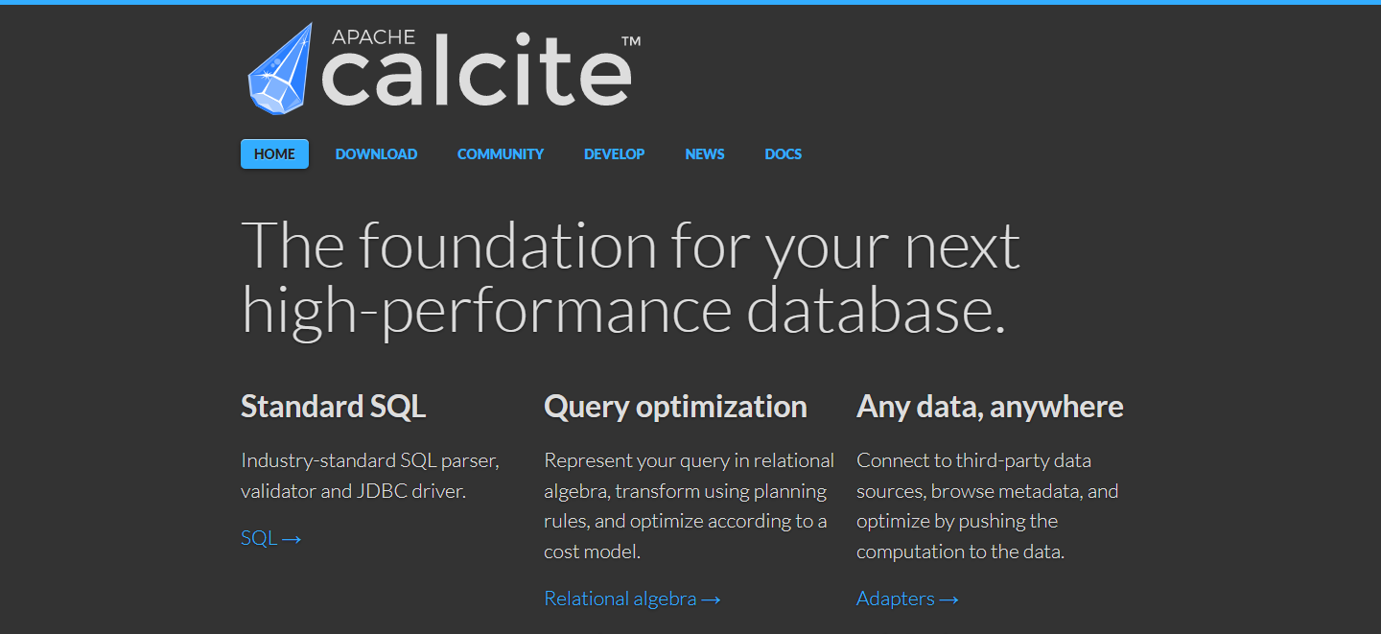
Home Page <https://www.calcite.apache.org>

Slide 3
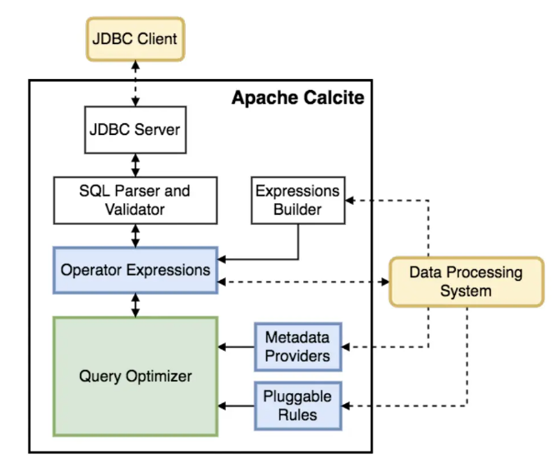
Architecture

Slide 4
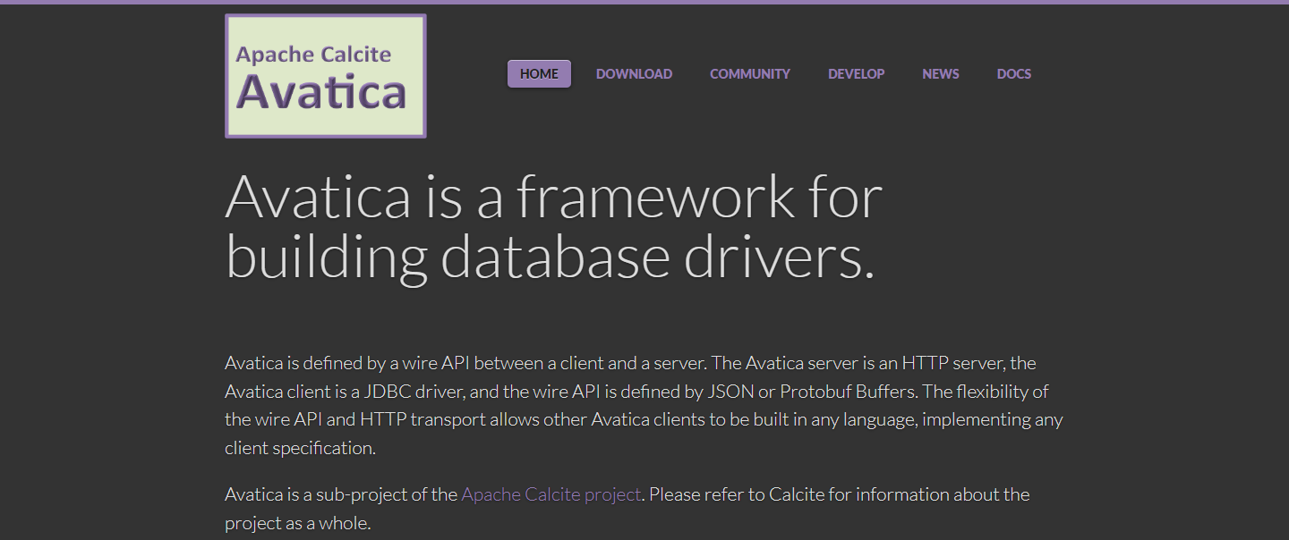
Avatica<https://calcite.apache.org/avatica/>

Slide 5
Architecture

Slide 6
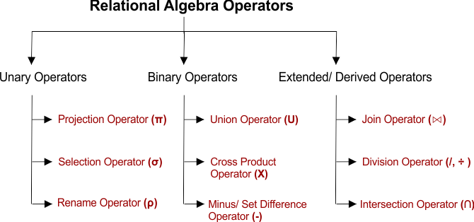

Slide 7
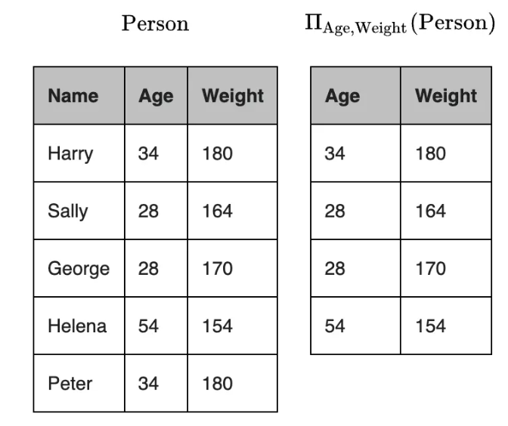
Relation Algebra – Project Ⅱ

Slide 8
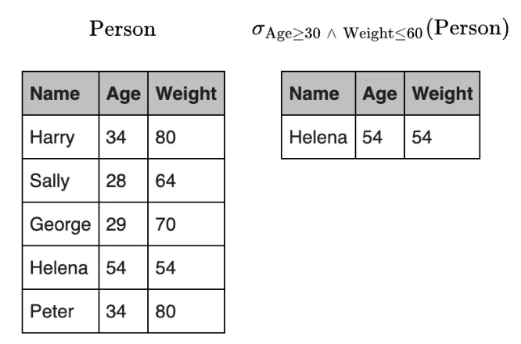
Relation Algebra – Select σ

Slide 9
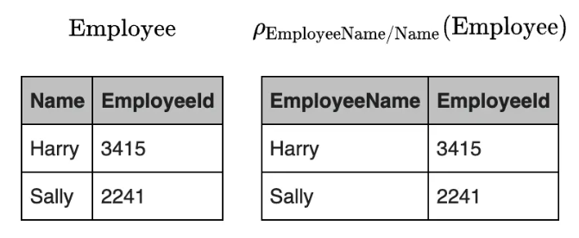
Relation Algebra – Rename ρ

Slide 11
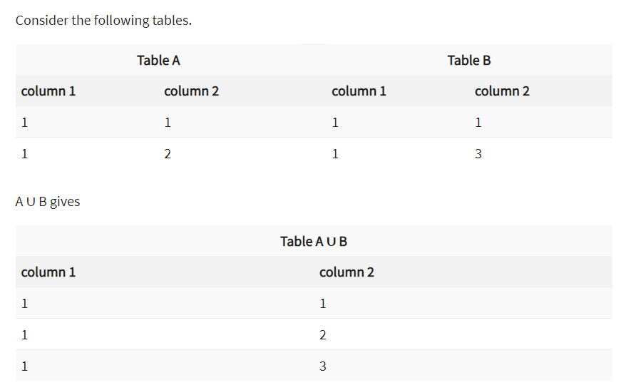
Relation Algebra – Union ∪

Slide 12
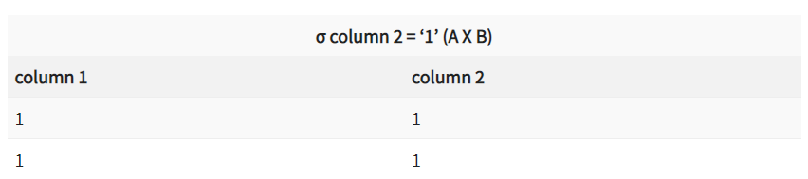
Relation Algebra – Cartesian Product X

Slide 13
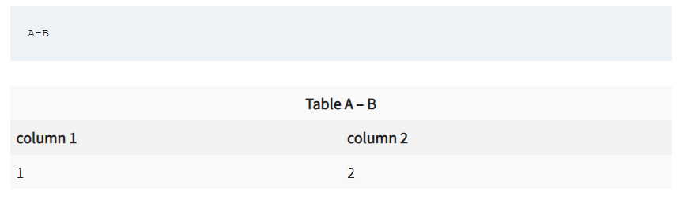
Relation Algebra – Set Difference -

Slide 15
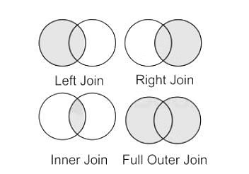
Relation Algebra – Join

Slide 16
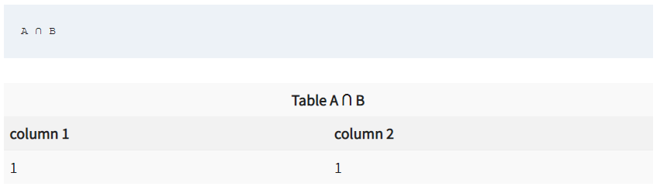
Relation Algebra – Intersection ∩

Slide 17
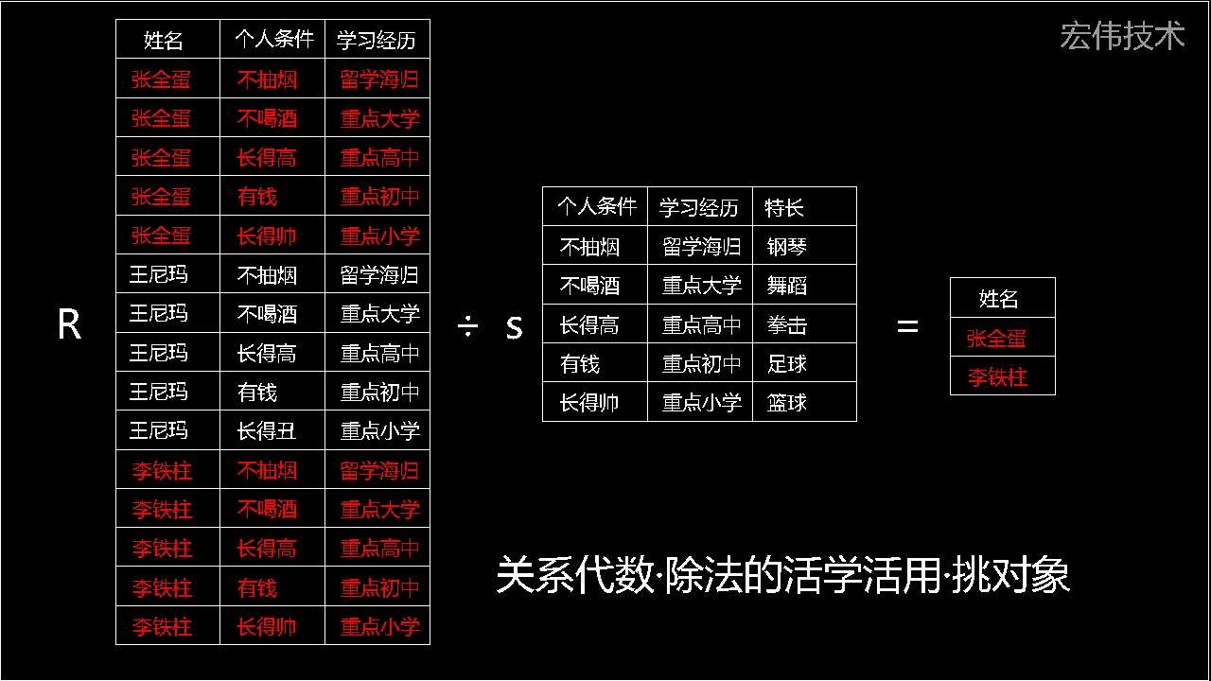
Relation Algebra – Division ÷ (知乎)

Slide 18
Architecture

Slide 19
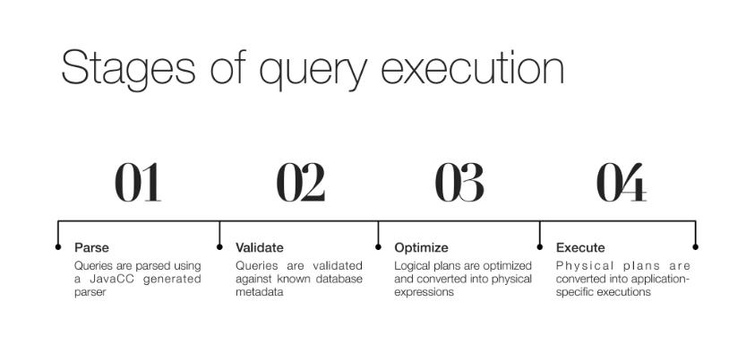
Four Steps

Slide 20
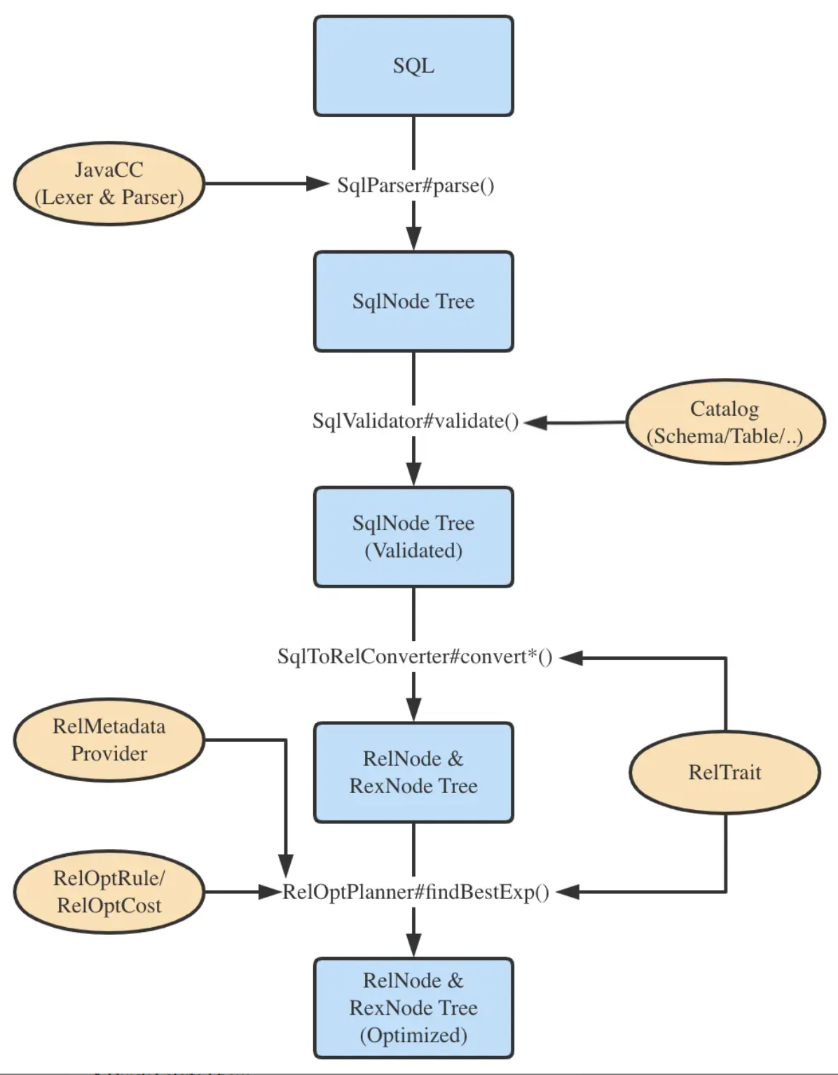
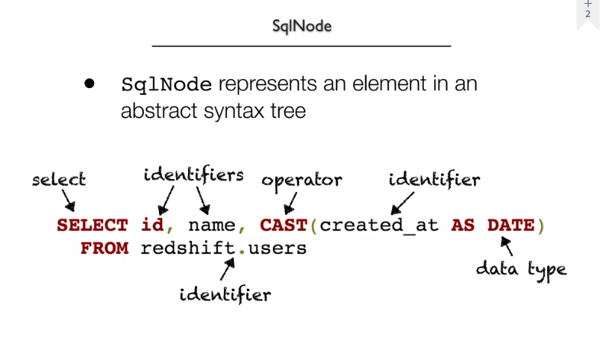
Parse-SqlNode

Slide 21
Home Page <https://www.calcite.apache.org>

Slide 22
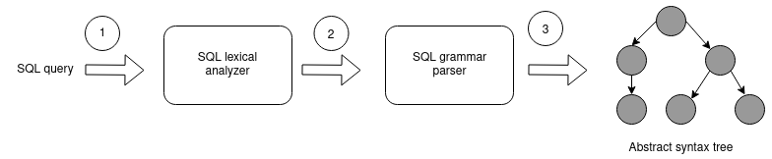
Standard SQL

Slide 23
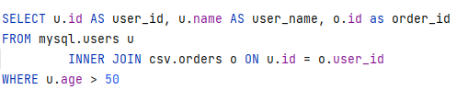
Standard SQL

Slide 24
Home Page <https://www.calcite.apache.org>

Slide 25
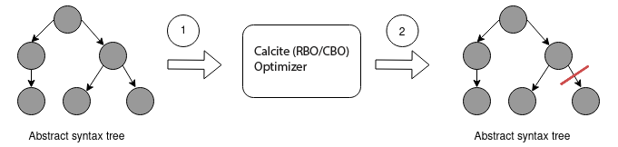
Query Optimization

Slide 26
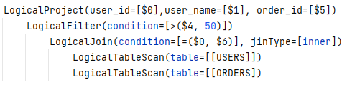
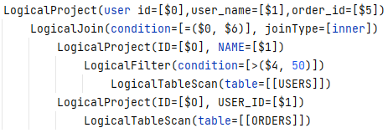
Query Optimization
Before:
After:

Slide 27
Home Page <https://www.calcite.apache.org>

Slide 28
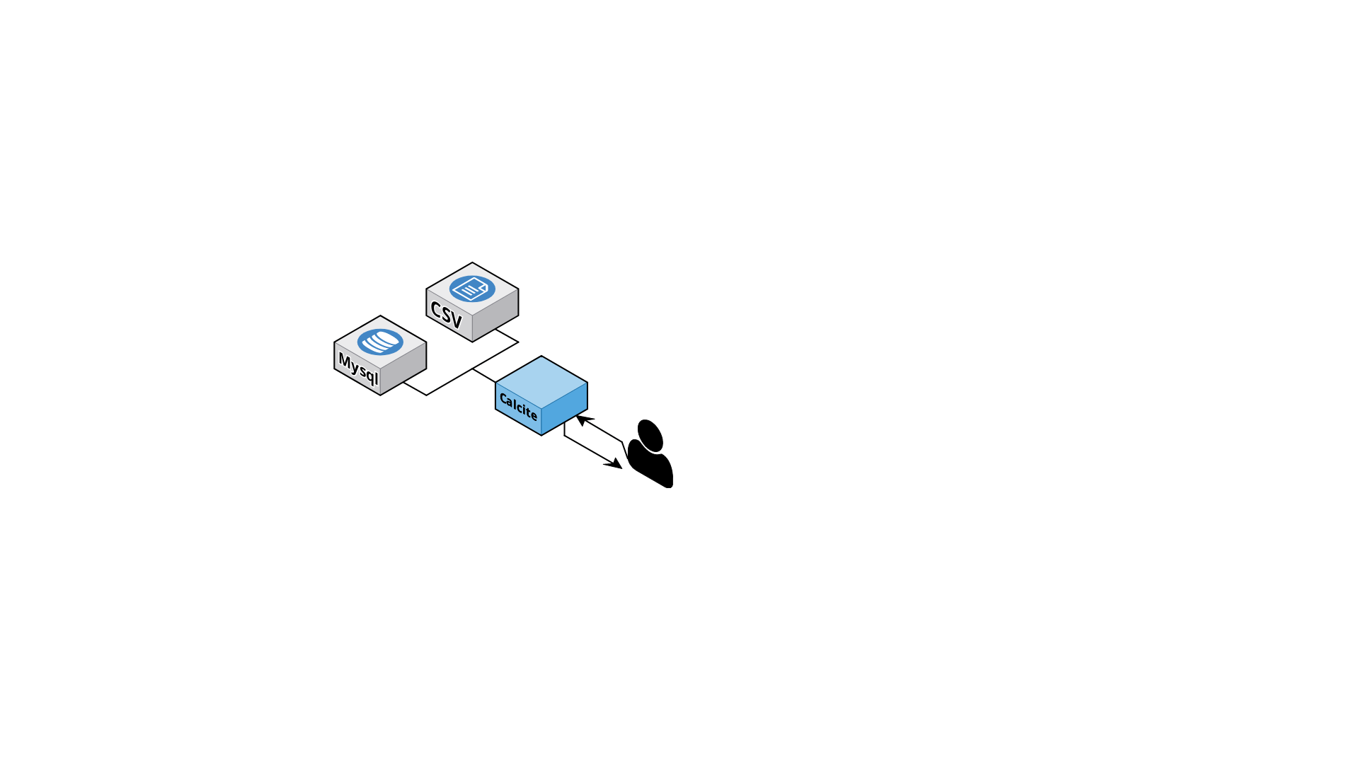
Any data, Anywhere

Slide 29
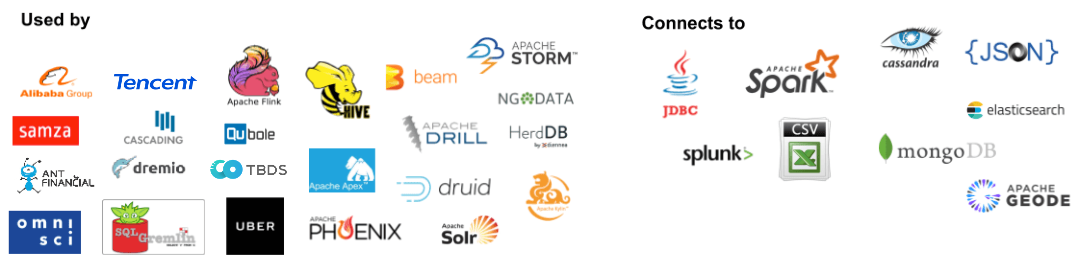


Powered By Calcite

Slide 30
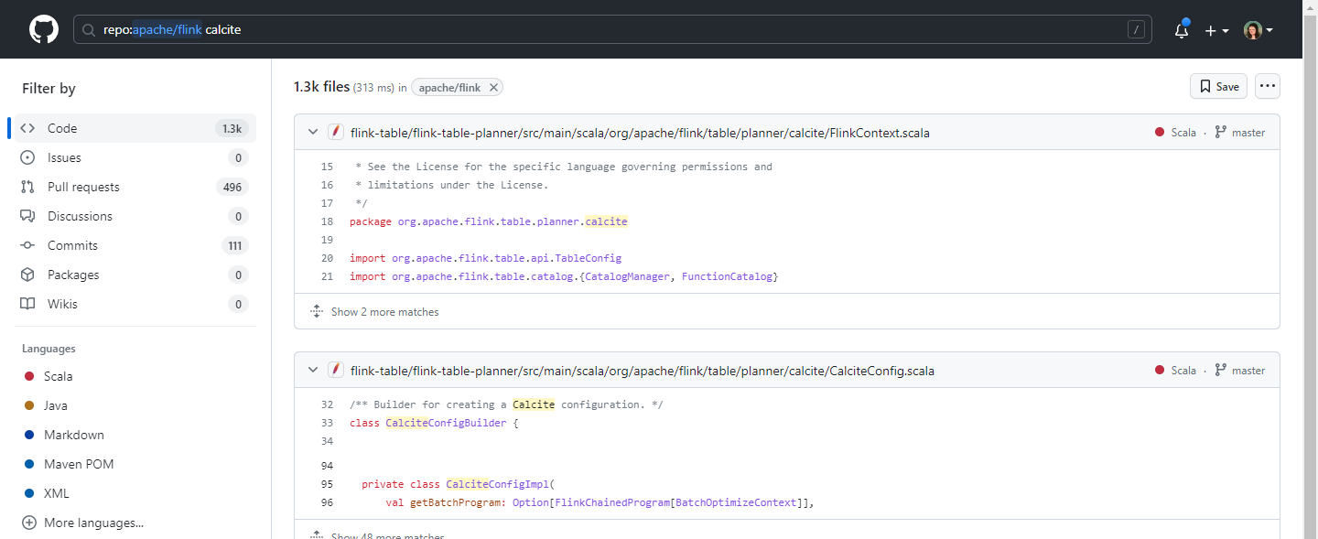
Flink Github Page <https://github.com/apache/flink>

Slide 31
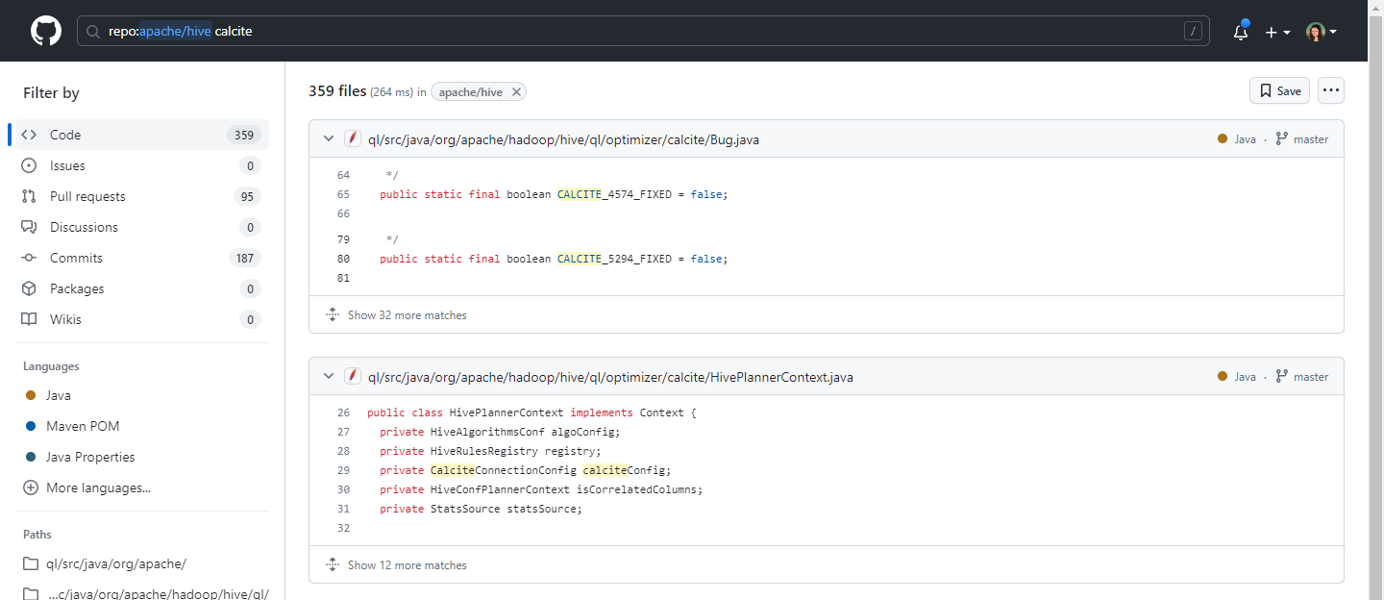
Hive Github Page <https://github.com/apache/hive>

Slide 32
Apache Calcite
《SQL 高级特性》 - 主要内容

Slide 33
1
Calcite主要概念和关键特性
从源码角度理解SQL解析，验证，优化，执行步骤 ; 以及Calcite中独特的Schema,Table等概念。
Standard SQL.
2
Calcite SQL优化器
关系代数转换操作，以及逻辑计划优化等；手把手带领完成自定义schema构建。
Query Optimization.
3
Calcite扩展内容
了解和掌握包括联邦查询，sql扩展，javacc代码生成，以及流式sql等相关技术；在之后工作晋升中，有更多的底气和核心竞争力。
Any data, Anywhere.
Copyright @ 2017 - 2023 Aaron. All rights reserved.

Slide 34
Apache Calcite
《SQL 高级特性》

