Slide 1

Apache Calcite
《SQL 高级特性》 - 解析层

Slide 2
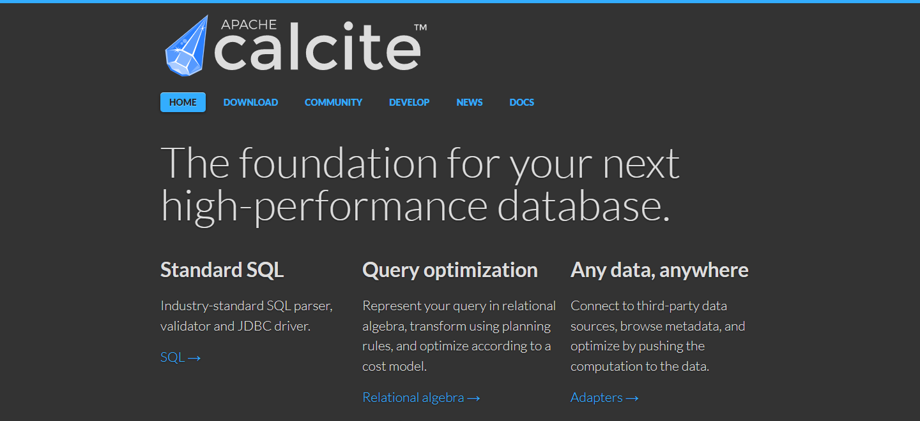
Home Page <https://www.calcite.apache.org>

Slide 3
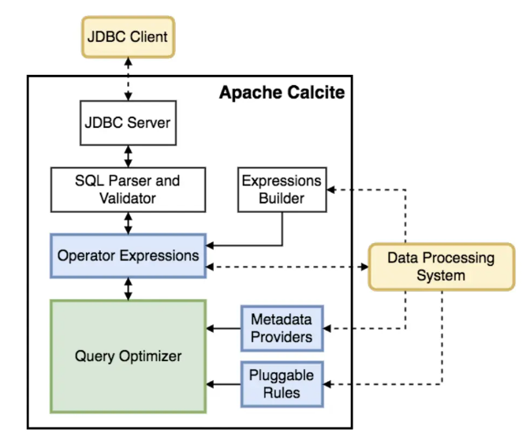
Architecture

Slide 4
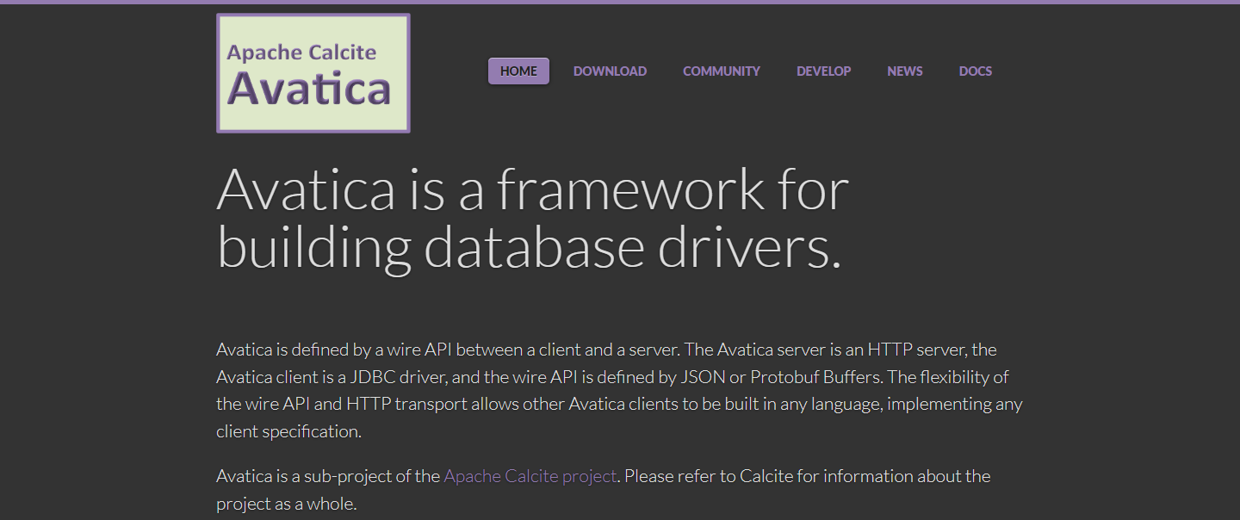
Avatica<https://calcite.apache.org/avatica/>

Slide 5
Architecture

Slide 6
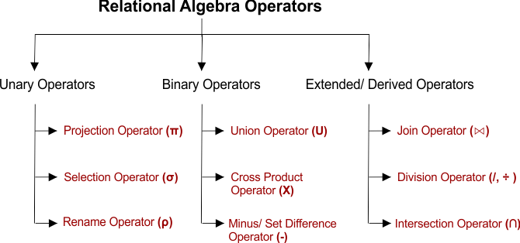

Slide 7
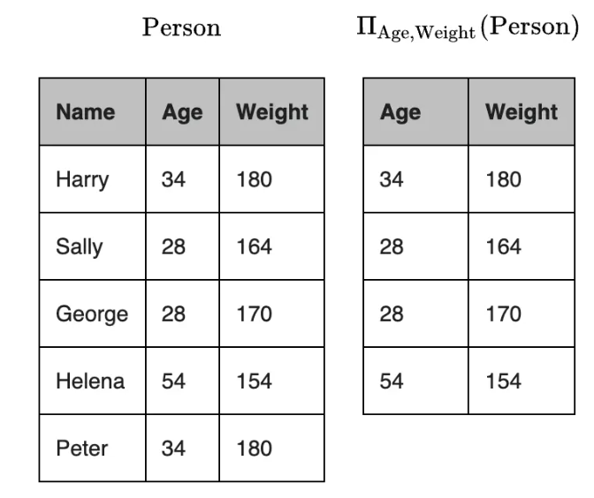
Relation Algebra – Project Ⅱ

Slide 8
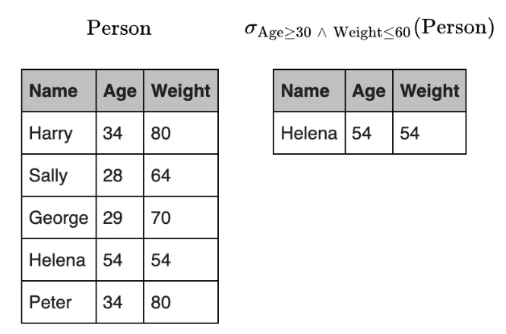
Relation Algebra – Select σ

Slide 9
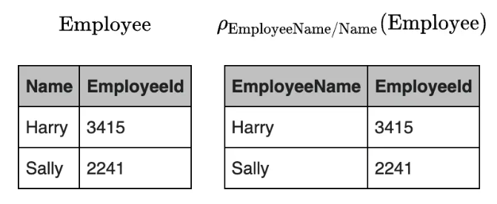
Relation Algebra – Rename ρ

Slide 11
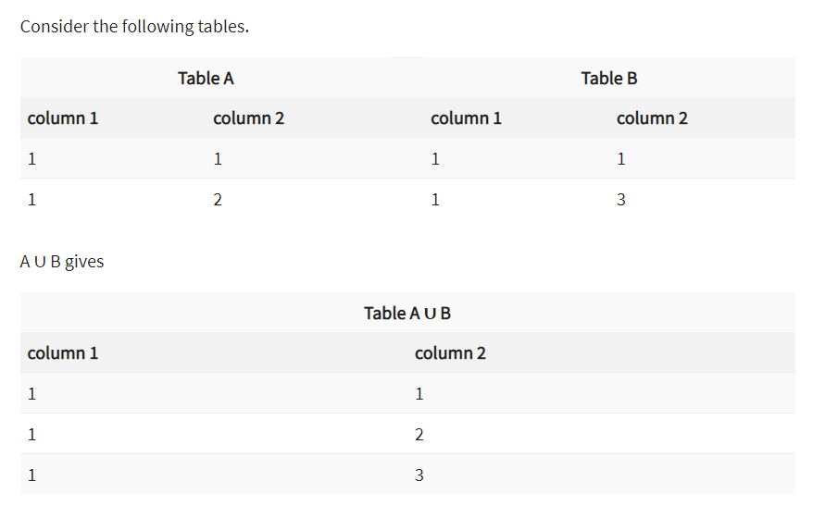
Relation Algebra – Union ∪

Slide 12
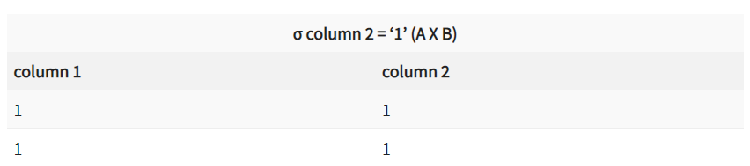
Relation Algebra – Cartesian Product X

Slide 13
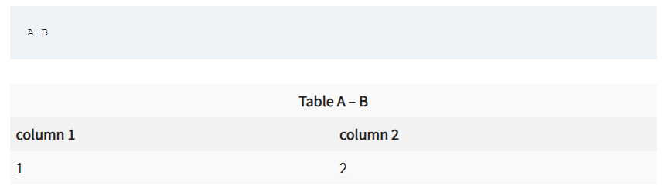
Relation Algebra – Set Difference -

Slide 15
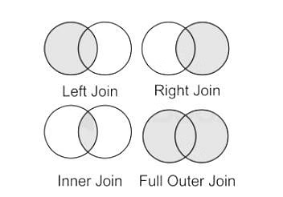
Relation Algebra – Join

Slide 16
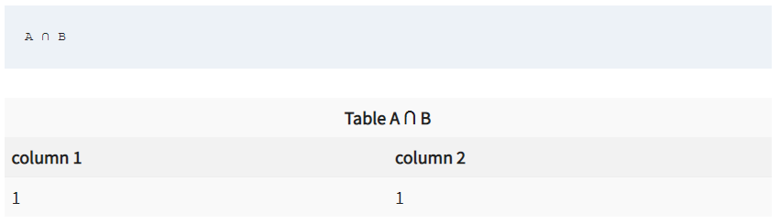
Relation Algebra – Division ÷

Slide 17
Relation Algebra – Intersection ∩

Slide 18
Home Page <https://www.calcite.apache.org>

Slide 19
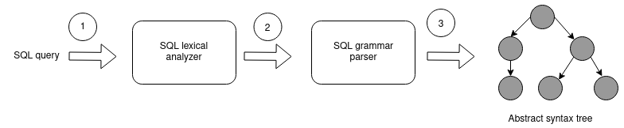
Standard SQL

Slide 20
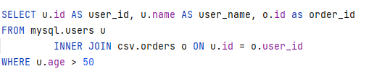
Standard SQL

Slide 21
Home Page <https://www.calcite.apache.org>

Slide 22
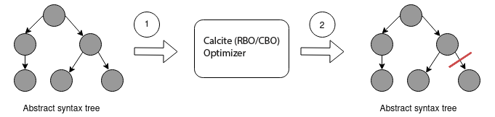
Query Optimization

Slide 23
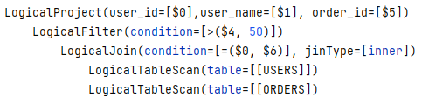
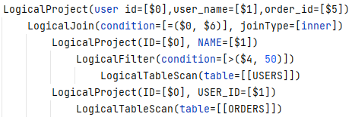
Query Optimization
Before:
After:

Slide 24
Home Page <https://www.calcite.apache.org>

Slide 25
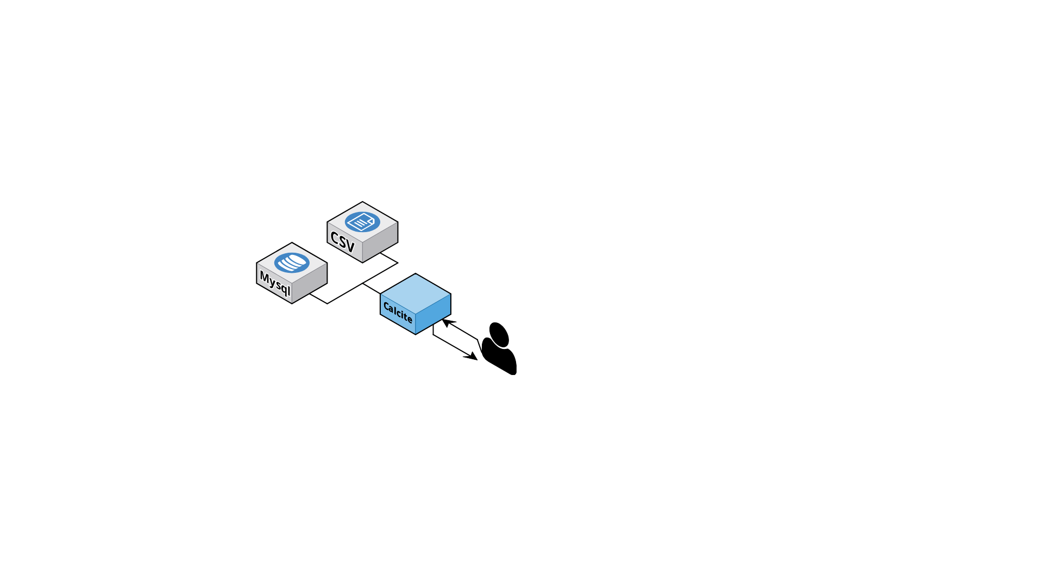
Any data, Anywhere

Slide 26
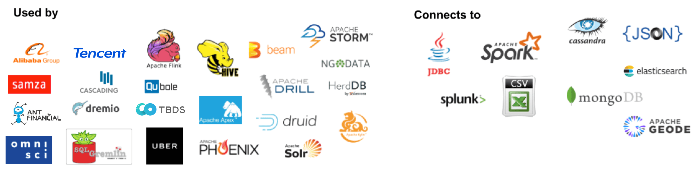


Powered By Calcite

Slide 27
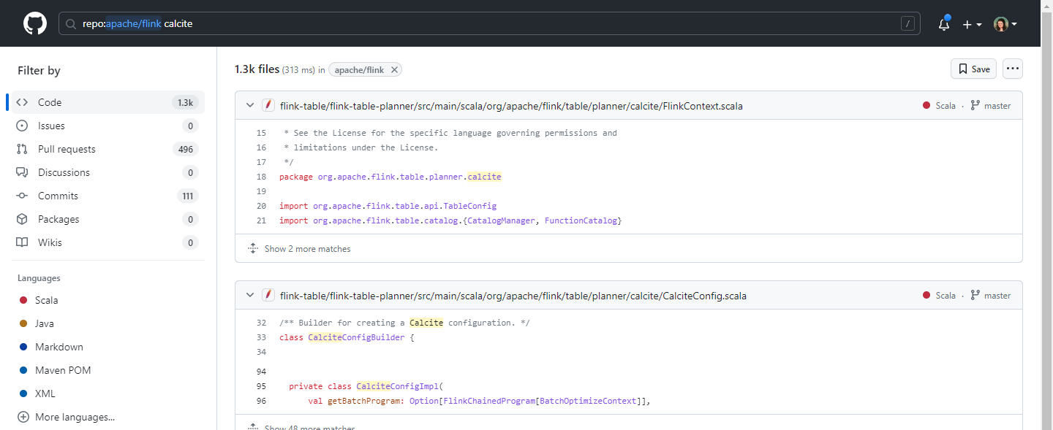
Flink Github Page <https://github.com/apache/flink>

Slide 28
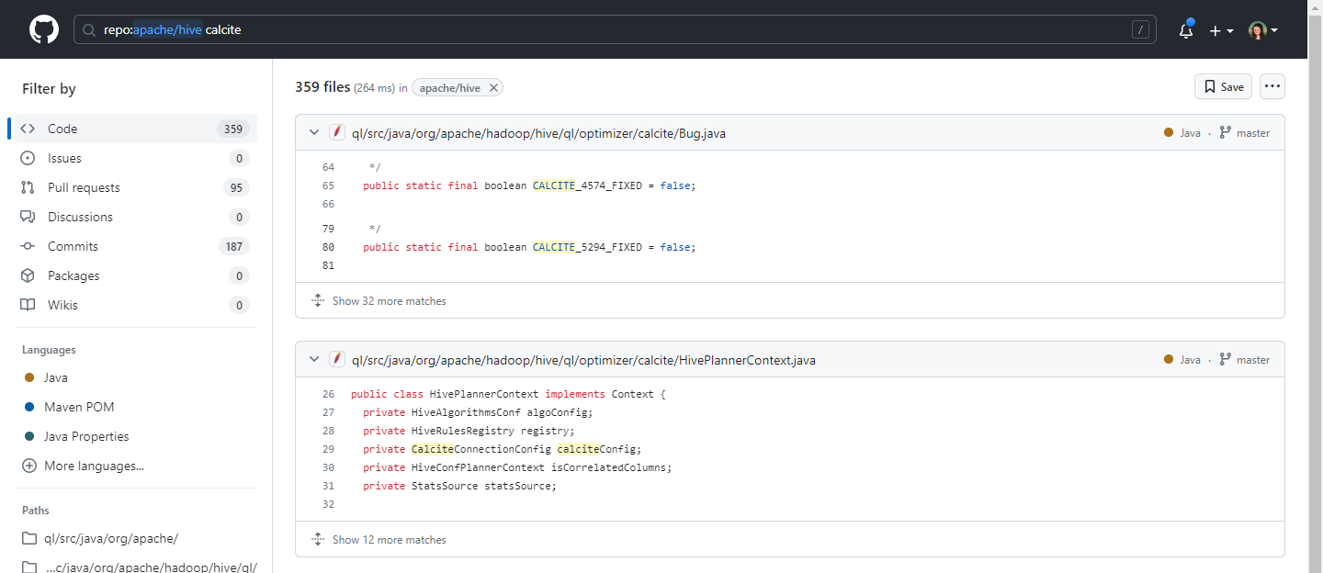
Hive Github Page <https://github.com/apache/hive>

Slide 29
Apache Calcite
《SQL 高级特性》 - 主要内容

Slide 30
1
Calcite主要概念和关键特性
从源码角度理解SQL解析，验证，优化，执行步骤 ; 以及Calcite中独特的Schema,Table等概念。
Standard SQL.
2
Calcite SQL优化器
关系代数转换操作，以及逻辑计划优化等；手把手带领完成自定义schema构建。
Query Optimization.
3
Calcite扩展内容
了解和掌握包括联邦查询，sql扩展，javacc代码生成，以及流式sql等相关技术；在之后工作晋升中，有更多的底气和核心竞争力。
Any data, Anywhere.
Copyright @ 2017 - 2023 Aaron. All rights reserved.

Slide 31
Apache Calcite
《SQL 高级特性》

