Slide 1
Firebase

Slide 2
Why Firebase?
NoSQL
Have access to real time data
Built in authentication
It’s run by Google

Slide 3
Why NoSQL?
Offers superior scalability as we grow out users
NoSQL can handle large amounts of structured and unstructured data
NoSQL can have many implementations
Firebase used a document based database
Offers a dynamic or flexible schema

Slide 4
Firebase has access to real time data
Traditional client server systems require the client to send data to a server where the server returns the requested data. If at anypoint the data changes, a request would have to be made to the server.
With Firebase, we can be constantly listening to data at a specific URL where Firebase will notify the client with an event if the database changes its state.
Can update forms in real time as users communicate with each other.

Slide 5
Why does Google support matter?
We will have servers to host our service.
Google offers multiregional support so that users do not have to deal with connectivity issues.
Authentication is serviced through Google
Because our application is serviced by Google we do not have to worry about users not being able to access our application such as servers being offline.

Slide 6
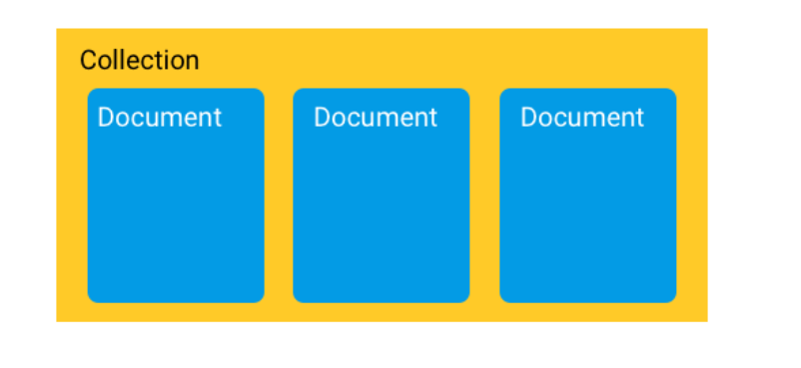
A quick overview how data is structured in Firebase

Slide 7
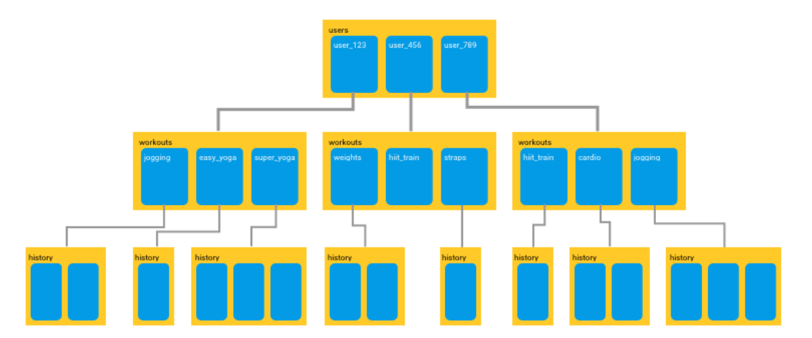
Implementation with users

Slide 8
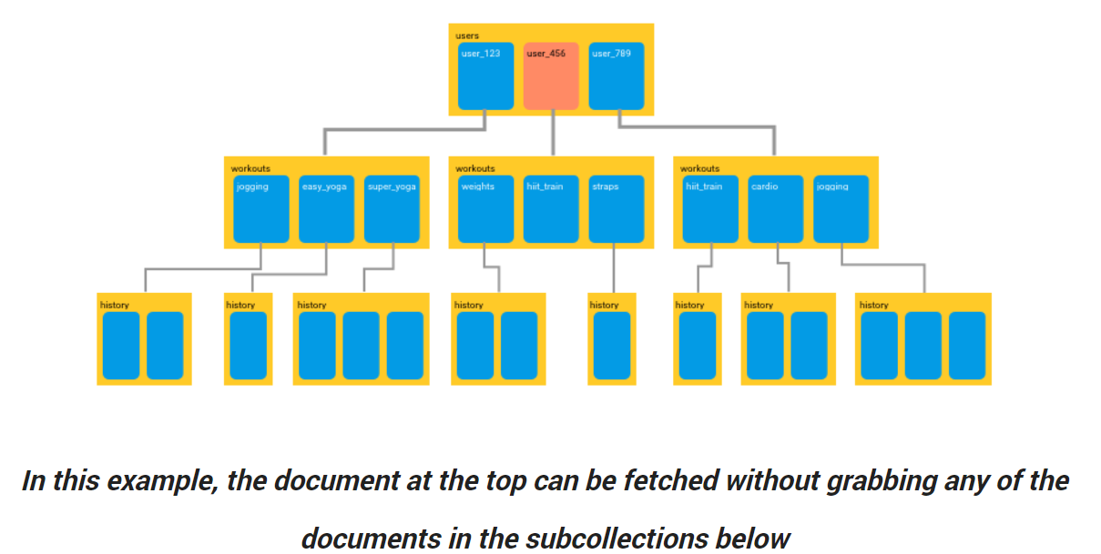
Accessing data is more efficient

Slide 9
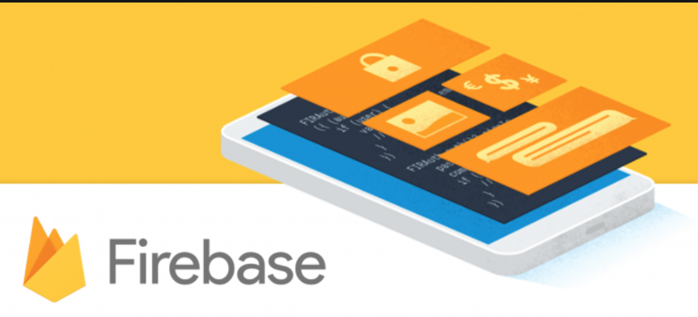
Thank You

