Slide 1
Chef Workshop
Awesome Appliance Repair

Slide 2
Agenda
Introduce the project
Discuss learning objectives
Hacking!
Regular check-ins, Q & A, and hints
Demos
Next Steps

Slide 3
Objectives
Build something in Chef with very little guidance
Write custom Chef recipes
Use the Chef Documentation to identify and use resources that will help you model the desired state of your infrastructure
Include guards in Chef resources

Slide 4
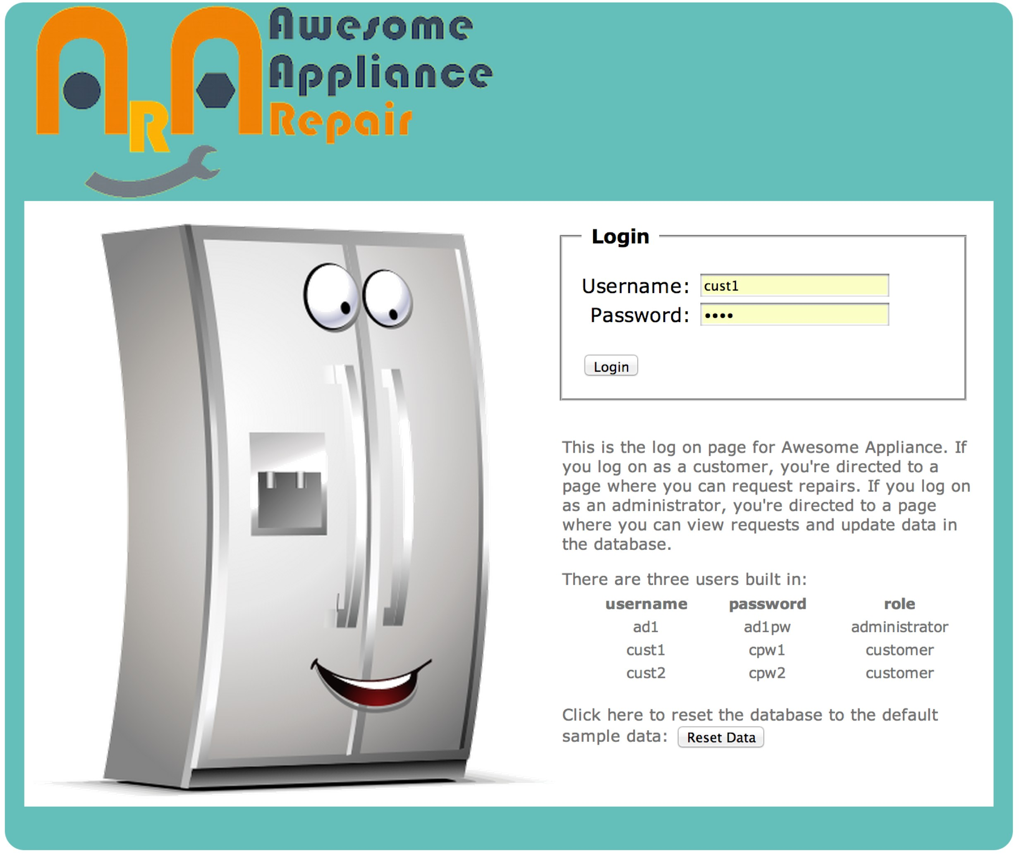
Awesome Appliance Repair
https://github.com/learnchef/Awesome-Appliance-Repair
Simple python application
Uses Apache and MySQL
Has an install script
http://awesome.modeled-computation.com/

Slide 5
Defining Success - TISMTOWTDI
There are no right solutions
If it works & doesn't throw an error, then its right
Best practices can be implemented in subsequent steps (CI/CD)
This is a totally open-ended exercise
No matter how far you get, there will be more you can do
Get as far as you can at the pace that's right for you
Take it away and hack in your own time!
Notes:
TISMTOWTDI - There's more than one way to do it

Slide 6
What is Your Objective?
You determine, define, and describe what success means for you.
Know where to start
Confidence to experiment
Deploy Awesome Appliance Repair with Chef
What is your objective?
Notes:
Take five minutes to think about what “success” will mean for you. Before we move on, please write down your goal, we’ll revisit this at the end of the day.

Slide 7
In this workshop we will
Work as individuals or pairs to find a solution
Value the process more than the solution
Demo work in progress, bad ideas, and solutions
Make mistakes

Slide 8
In this workshop we will not
Guide you through the project step-by-step
Give you THE answer

Slide 9
Getting started
AARinstall.py
Describes the pre-requisites
Includes python code to implement many of the steps
Install some packages
Write a few configuration files
Execute some .sql files to manipulate the database
Is incomplete
Is inaccurate in parts
Notes:
In other words, it’s a great place for us to start!

Slide 10
AARinstall.py
#!/usr/bin/python
# -*- coding: utf-8 -*-
from subprocess import Popen
import os, sys, getpass, binascii
# The following script assumes that apache2, mysql, and unzip have been installed.
Notes:
Can largely ignore the first four lines, they’re really there as dependencies for the python script
apache2, mysql, and unzip are packages that will need to be installed. The names of the packages aren’t necessarily correct though!
This might be a good place to stop and have the students start working. Can they get from baseline OS to these three packages installed with Chef?

Slide 11
AARinstall.py
# 1. wget https://github.com/colincam/Awesome-Appliance-Repair/archive/master.zip
# 2. unzip master.zip
# 3. cd into Awesome-Appliance-Repair
# 4. sudo mv AAR to /var/www/
# 5. sudo su root
# 6. run script: python AARinstall.py
# 7. manually execute: apachectl graceful
Notes:
How would we do all of this with Chef?
Sure, you could do step #6 with Chef, just use Chef to run some python code. That might be an OK start but that’s probably not where you want to end.

Slide 12
AARinstall.py
if __name__ == '__main__':
root_dbpswd = getpass.getpass('enter the mysql root user password: ')
Popen(['chown', '-R', 'www-data:www-data', '/var/www/AAR'], shell=False).wait()
Notes:
We’ll need a database password. Can’t really prompt for that during a chef-client run.
Need to chown a directory path

Slide 13
AARinstall.py
# apt-get the stuff we need
proc = Popen([
'apt-get', 'install', '-y',
'libapache2-mod-wsgi',
'python-pip',
'python-mysqldb'], shell=False)
proc.wait()
Notes:
What’s this? More packages!

Slide 14
AARinstall.py
# pip install flask
Popen(['pip', 'install', 'flask'], shell=False).wait()
Notes:
Using pip to install a python package.
pip is a python packaging tool that is used to install python packages from the Python Package Index (PyPi)

Slide 15
AARinstall.py
# Generate the apache config file in sites-enabled
Popen(['apachectl', 'stop'], shell=False).wait()
pth = '/etc/apache2/sites-enabled/'
for f in os.listdir(pth):
os.remove(pth + f)
f = open('/etc/apache2/sites-enabled/AAR-apache.conf', 'w')
f.write("""
<VirtualHost *:80>
ServerName /
WSGIDaemonProcess /AAR user=www-data group=www-data threads=5
WSGIProcessGroup /AAR
WSGIScriptAlias / /var/www/AAR/awesomeapp.wsgi
<Directory /var/www/AAR>
WSGIApplicationGroup %{GLOBAL}
WSGIScriptReloading On
Order deny,allow
Allow from all
</Directory>
CustomLog ${APACHE_LOG_DIR}/access.log combined
ServerAdmin ops@example.com
</VirtualHost>
""")
f.close()
Notes:
This looks familiar. Writing out a VirtualHost file for apache.

Slide 16
AARinstall.py
# Generate AAR_config.py with secrets
f = open('/var/www/AAR/AAR_config.py', 'w')
appdbpw = binascii.b2a_base64(os.urandom(6)).strip('\n')
secretkey = binascii.b2a_base64(os.urandom(12)).strip('\n')
conn_args_string = """CONNECTION_ARGS = {"host":"localhost", "user":"aarapp", "passwd":"%s", "db":"AARdb"}\n\n""" % appdbpw
secret_key_string = """SECRET_KEY = "%s"\n\n""" % secretkey
database_values_string = """DB_VALUES = [(3,'Maytag','Washer',…")]
"""
f.write(conn_args_string + secret_key_string + database_values_string)
f.close()
Notes:
Lots going on here, but basically just writing out a file. The file’s content are a mix of randomly generate strings and static information.

Slide 17
AARinstall.py
# Create DB, user, and permissions
import MySQLdb
db = MySQLdb.connect(host='localhost', user='root', passwd=root_dbpswd)
sql_script = open('make_AARdb.sql', 'r').read()
cur = db.cursor()
cur.execute(sql_script)
cur.close()
cur = db.cursor()
cur.execute('use AARdb')
cur.execute("CREATE USER 'aarapp'@'localhost' IDENTIFIED BY %s", (appdbpw,))
cur.execute("GRANT CREATE,INSERT,DELETE,UPDATE,SELECT on AARdb.* to aarapp@localhost")
cur.close()
db.close()
Notes:
Running some database scripts!
This is easy to do once; care must be used to ensure this doesn’t fail on subsequent chef-client runs.

Slide 18
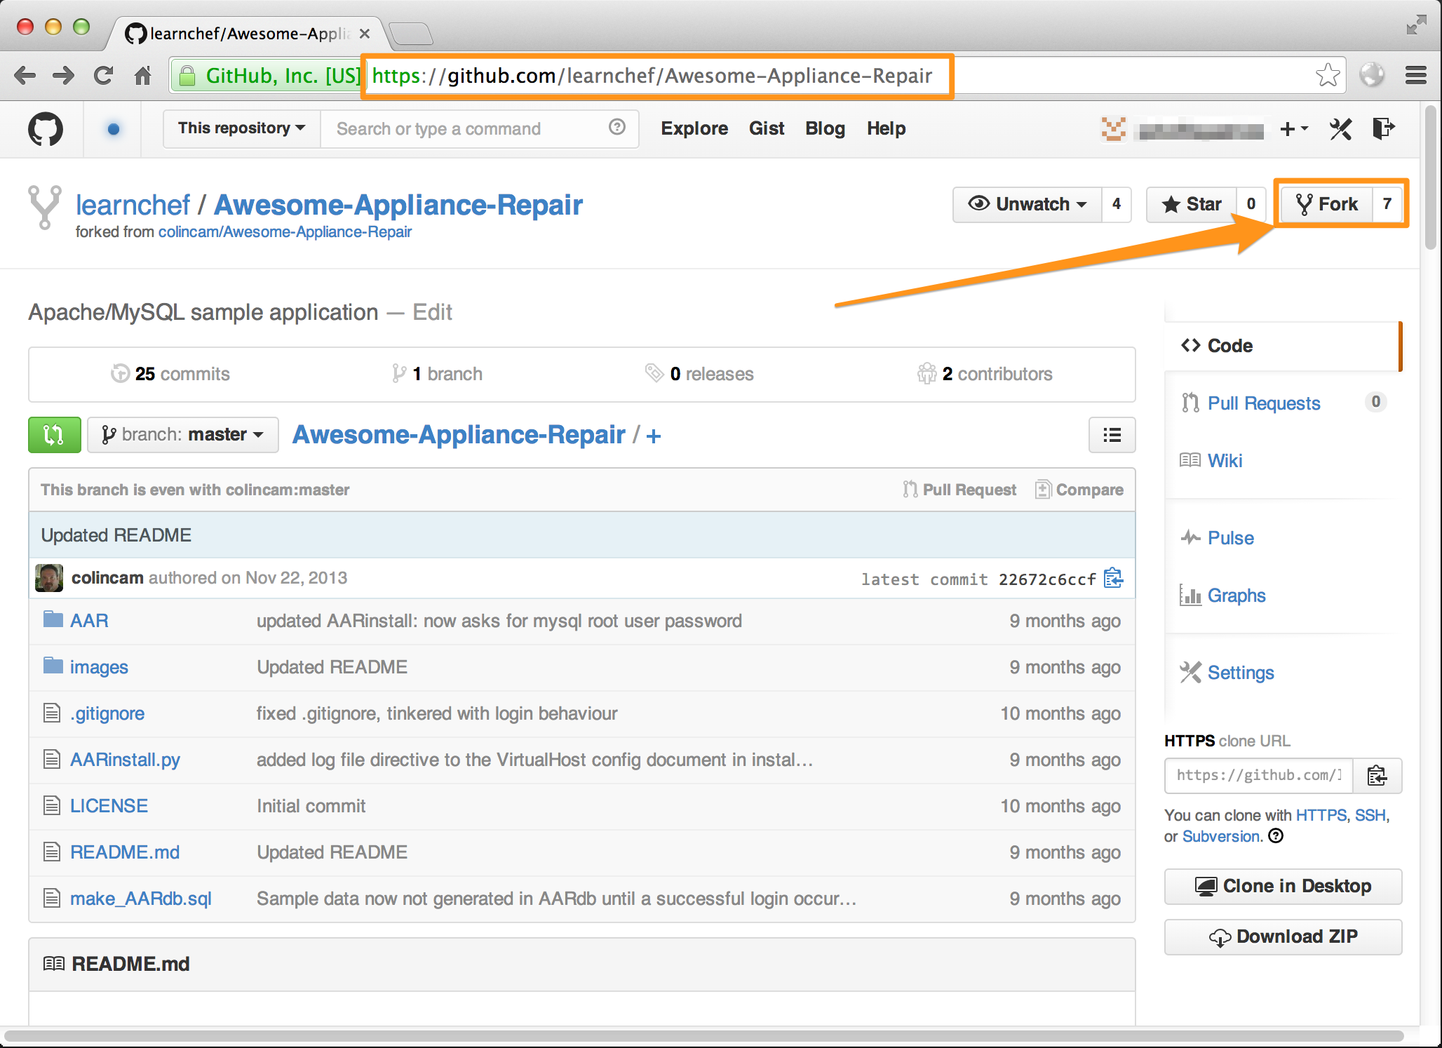
Exercise: Fork the AAR repo
Notes:
<<WIP – The don't necessarily need to fork this particular repo, but could be a good workflow to get across. Also, easier than have them create a repo on github, then 'git init', 'git remote add origin …' etc

Slide 19
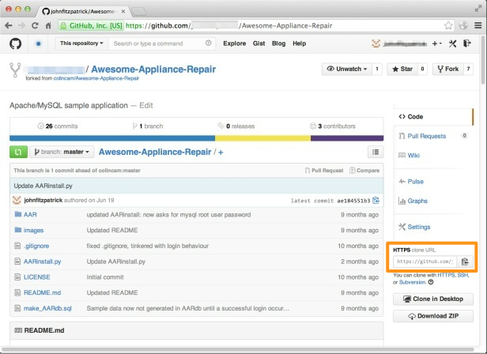
Exercise: Copy the forked repo URL
Notes:
<<WIP – The don't necessarily need to fork this particular repo, but could be a good workflow to get across. Also, easier than have them create a repo on github, then 'git init', 'git remote add origin …' etc

Slide 20
Exercise: Clone the repo to workstation
$ git clone https://github.com/YOU/Awesome-Appliance-Repair.git
Cloning into 'Awesome-Appliance-Repair'...
remote: Counting objects: 204, done.
remote: Total 204 (delta 0), reused 0 (delta 0)
Receiving objects: 100% (204/204), 870.81 KiB | 640.00 KiB/s, done.
Resolving deltas: 100% (96/96), done.
Checking connectivity... done.

Slide 21
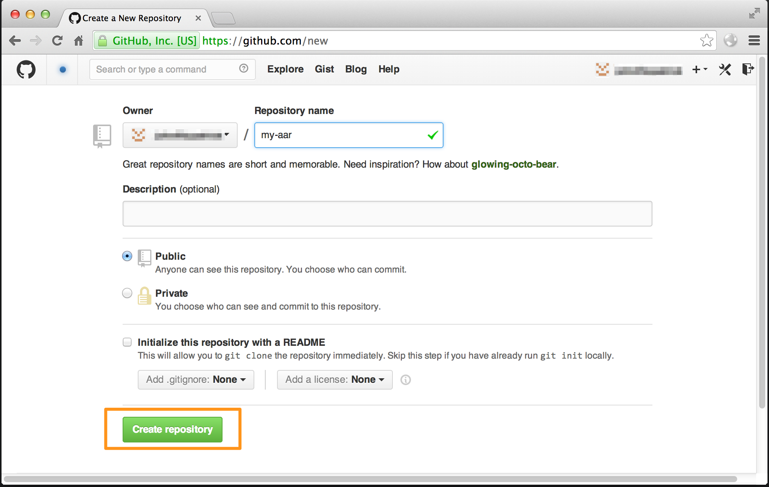
Exercise: Create GitHub Repo

Slide 22
Exercise: Create AAR cookbook
$ chef generate cookbook AAR
Compiling Cookbooks...
Recipe: code_generator::cookbook
* directory[/Users/YOU/Documents/Scratch/AAR-temp/Awesome-Appliance-Repair/AAR/AAR] action create
- create new directory /Users/YOU/Documents/Scratch/AAR-temp/Awesome-Appliance-Repair/AAR/AAR
* template[/Users/YOU/Documents/Scratch/AAR-temp/Awesome-Appliance-Repair/AAR/AAR/metadata.rb] action create
- create new file /Users/YOU/Documents/Scratch/AAR-temp/Awesome-Appliance-Repair/AAR/AAR/metadata.rb
- update content in file /Users/YOU/Documents/Scratch/AAR-temp/Awesome-Appliance-Repair/AAR/AAR/metadata.rb from none to f4bd5e
(diff output suppressed by config)
* template[/Users/YOU/Documents/Scratch/AAR-temp/Awesome-Appliance-Repair/AAR/AAR/README.md] action create
- create new file /Users/YOU/Documents/Scratch/AAR-temp/Awesome-Appliance-Repair/AAR/AAR/README.md
- update content in file /Users/YOU/Documents/Scratch/AAR-temp/Awesome-Appliance-Repair/AAR/AAR/README.md from none to 1666ef

Slide 23
Exercise: Add cookbook to git
$ cd AAR
$ git add .
$ git commit -m "first commit of AAR cookbook"
[master (root-commit) 5c162aa] first commit
7 files changed, 151 insertions(+)
create mode 100644 .gitignore
create mode 100644 .kitchen.yml
create mode 100644 Berksfile
create mode 100644 README.md
create mode 100644 chefignore
create mode 100644 metadata.rb
create mode 100644 recipes/default.rb

Slide 24
Exercise: Upload cookbook to GitHub repo
$ git remote add origin git@github.com:YOU/my-aar.git
$ git push –u origin master
Counting objects: 10, done.
Delta compression using up to 8 threads.
Compressing objects: 100% (8/8), done.
Writing objects: 100% (10/10), 1.51 KiB | 0 bytes/s, done.
Total 10 (delta 0), reused 0 (delta 0)
To git@github.com:johnfitzpatrick/my-aar.git
* [new branch] master -> master
Branch master set up to track remote branch master from origin.

Slide 25
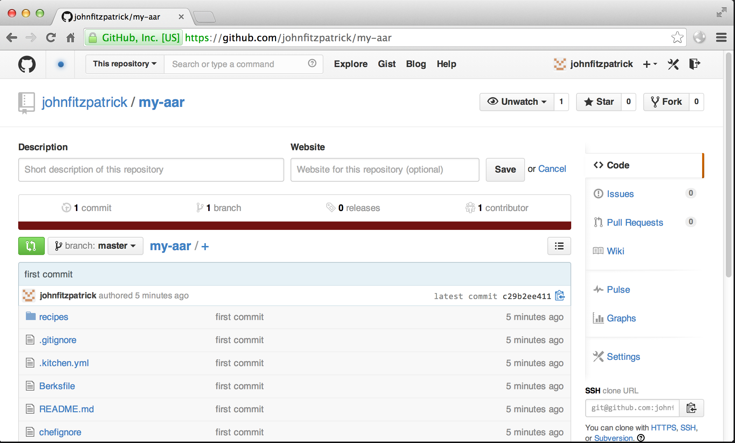
Exercise: View your cookbook in GitHub

Slide 26
Getting started tips…
You can start with the default recipe, default.rb
Backup to GitHub regularly
$ git commit -am "commit message here"
$ git push

Slide 27

Time to hack!
https://www.flickr.com/photos/peterpearson/424047087
Notes:
Go!
Get started on your own, let’s check-in again in 20 minutes or so.

Slide 28
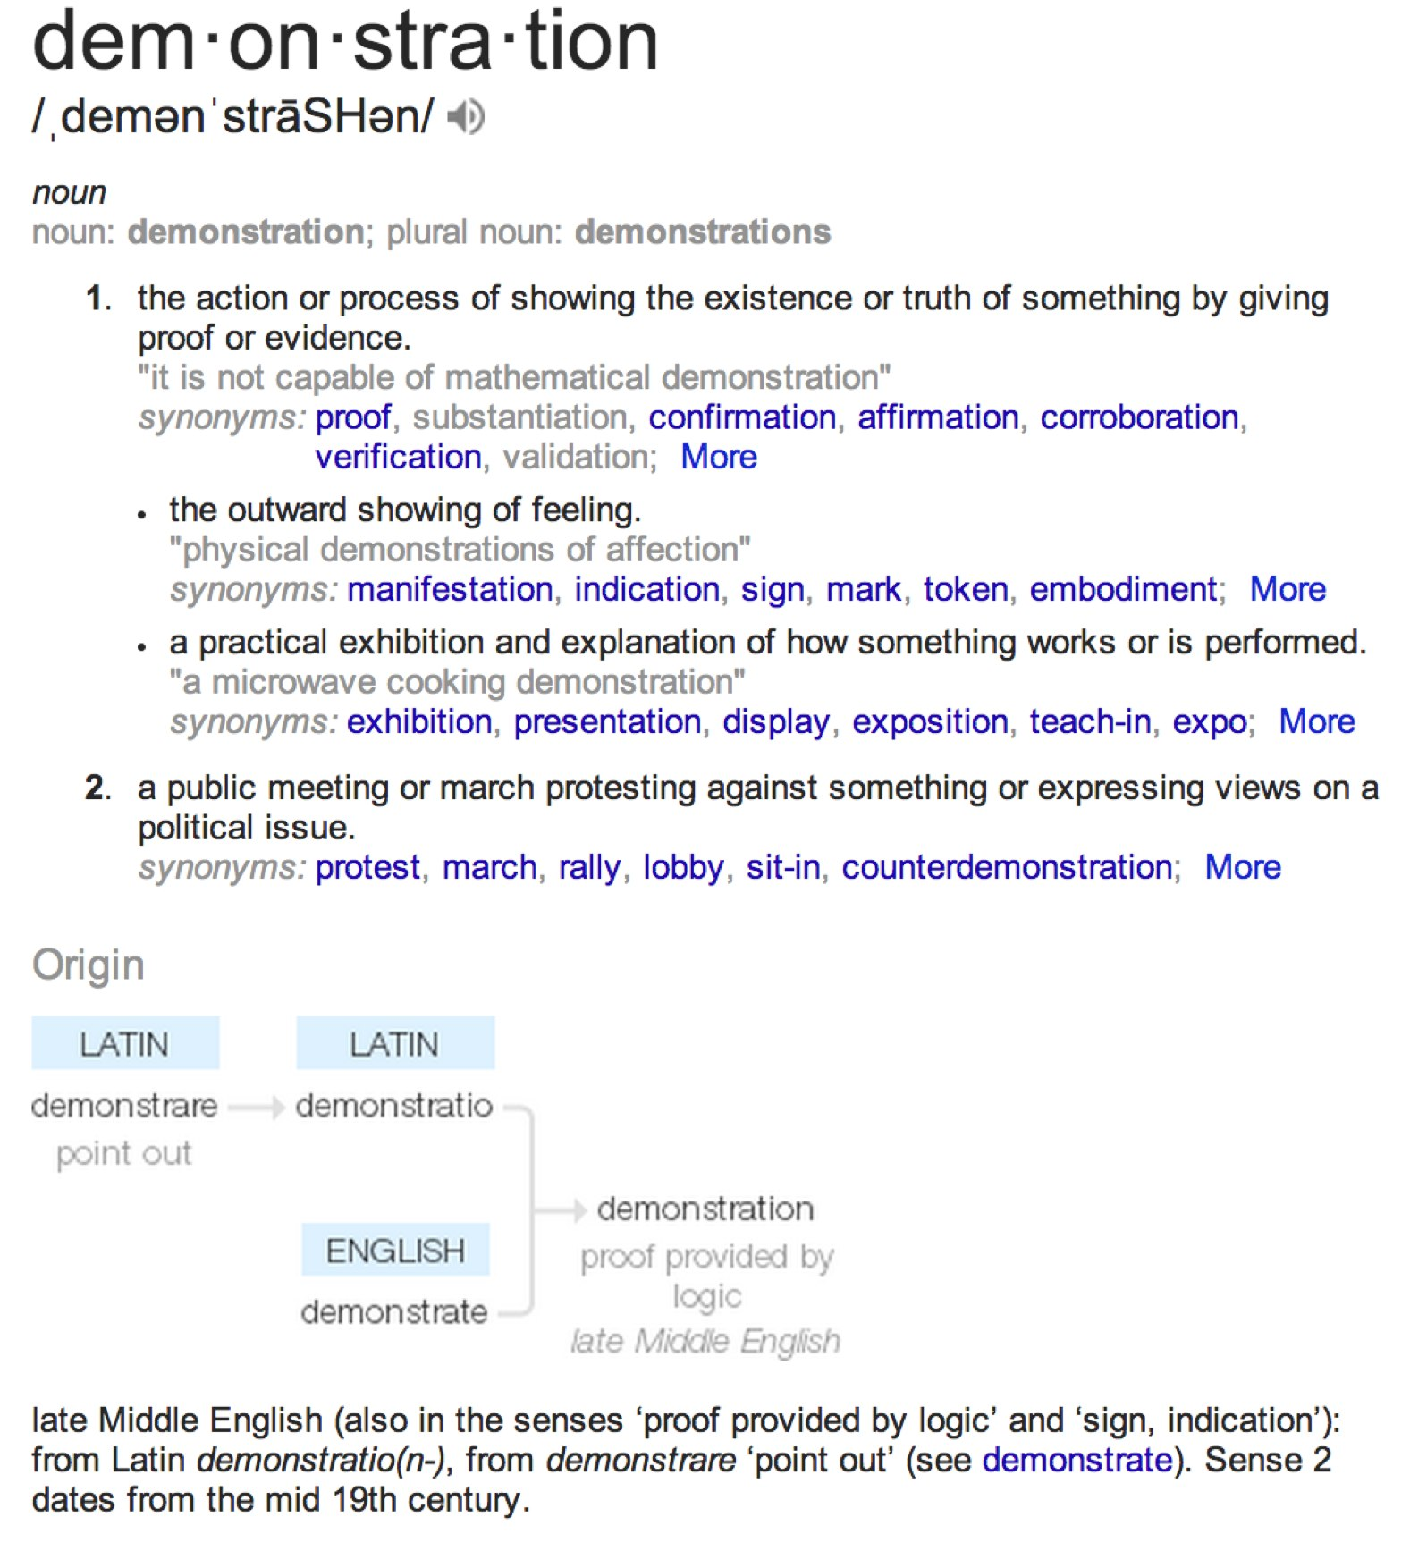
Demo Time!
Show your work
Discuss your choices
Gather feedback and ideas
https://www.google.com/webhp?sourceid=chrome-instant&ion=1&espv=2&ie=UTF-8#q=demonstration
Notes:
Demo early and demo often! Have the participants share their progress, maybe every 20-40 minutes have another participant share what they’ve done so far and share with the class.

Slide 29
Hints
# The following script assumes that apache2, mysql, and unzip have been installed.
mysql-server is probably the package you’re looking for.
Notes:
Do not show these until the participants have had ample time to find and fix them on their own.

Slide 30
Time to hack!
https://www.flickr.com/photos/peterpearson/424047087
Notes:
Go!
Get started on your own, let’s check-in again in 20 minutes or so.

Slide 31
Demo Time!
Show your work
Discuss your choices
Gather feedback and ideas
https://www.google.com/webhp?sourceid=chrome-instant&ion=1&espv=2&ie=UTF-8#q=demonstration
Notes:
Demo early and demo often! Have the participants share their progress, maybe every 20-40 minutes have another participant share what they’ve done so far and share with the class.

Slide 32
Hints
# 1. wget https://github.com/colincam/Awesome-Appliance-Repair/archive/master.zip
# 2. unzip master.zip
# 3. cd into Awesome-Appliance-Repair
# 4. sudo mv AAR to /var/www/
Do you need to download every time the chef-client runs?
What are the pros and cons of doing so?

Slide 33
Time to hack!
https://www.flickr.com/photos/peterpearson/424047087
Notes:
Go!
Get started on your own, let’s check-in again in 20 minutes or so.

Slide 34
Demo Time!
Show your work
Discuss your choices
Gather feedback and ideas
https://www.google.com/webhp?sourceid=chrome-instant&ion=1&espv=2&ie=UTF-8#q=demonstration
Notes:
Demo early and demo often! Have the participants share their progress, maybe every 20-40 minutes have another participant share what they’ve done so far and share with the class.

Slide 35
Hints
# Create DB, user, and permissions
import MySQLdb
db = MySQLdb.connect(host='localhost', user='root', passwd=root_dbpswd)
sql_script = open('make_AARdb.sql', 'r').read()
cur = db.cursor()
cur.execute(sql_script)
cur.close()
cur = db.cursor()
cur.execute('use AARdb')
cur.execute("CREATE USER 'aarapp'@'localhost' IDENTIFIED BY %s", (appdbpw,))
cur.execute("GRANT CREATE,INSERT,DELETE,UPDATE,SELECT on AARdb.* to aarapp@localhost")
cur.close()
db.close()
Should you do this every time the chef-client runs?
How would you prevent that from happening?

Slide 36
Time to hack!
https://www.flickr.com/photos/peterpearson/424047087
Notes:
Go!
Get started on your own, let’s check-in again in 20 minutes or so.

Slide 37
Demo Time!
Show your work
Discuss your choices
Gather feedback and ideas
https://www.google.com/webhp?sourceid=chrome-instant&ion=1&espv=2&ie=UTF-8#q=demonstration
Notes:
Demo early and demo often! Have the participants share their progress, maybe every 20-40 minutes have another participant share what they’ve done so far and share with the class.

Slide 38
Next steps
Refactor
Testing
Multi-tier implementation
Community Cookbooks
Multi-OS Support
Cloud deployment
Operationalize
Monitoring
Central logging
Application deployments
Notes:
So many options for where to go next with this project! What will you do?
Check https://github.com/learnchef/workshops/tree/master/Awesome_Appliance_Repair for additional ideas and / or additional detail.
## Next steps
You can take expand on this project a number of ways including:
* Testing
* Use [Test Kitchen](http://kitchen.ci) to validate your chef-client runs.
* Add static code analysis using [Rubocop](https://github.com/bbatsov/rubocop) and [Food Critic](foodcritic.io).
* Add [ChefSpec](http://sethvargo.github.io/chefspec/) tests.
* Add [Serverspec](http://serverspec.org/) tests.
* Add a continuous integration server, such as Jenkins
* Multi-tier implementation
* move the database to a separate node
* add a load balancer and additional web server
* Community Cookbooks - What cookbooks in the [Supermarket](http://supermarket.getchef.com) might help?
* Multi-OS support - what changes are required to deploy the application to CentOS?
* Cloud deployment
* Can you deploy this applicaiton to another infrastructure as a service environment? (AWS, Azure, Rackspace, Digital Ocean, etc.)
* Operationalize
* Add monitoring (nagios, sensu, etc.)
* Add central logging (splunk, logstash, etc.)
* Schedule database backups
* Add an additional database for replication (master / slave)
* Applicaiton Deployments
* How do you deploy updates to the Awesome Appliance Repair application?

Slide 39
Time to hack!
https://www.flickr.com/photos/peterpearson/424047087
Notes:
Go!
Get started on your own, let’s check-in again in 20 minutes or so.

Slide 40
Demo Time!
Show your work
Discuss your choices
Gather feedback and ideas
https://www.google.com/webhp?sourceid=chrome-instant&ion=1&espv=2&ie=UTF-8#q=demonstration
Notes:
Demo early and demo often! Have the participants share their progress, maybe every 20-40 minutes have another participant share what they’ve done so far and share with the class.

Slide 41
Objectives
Build something in Chef with very little guidance
Write custom Chef recipes
Use the Chef Documentation to identify and use resources that will help you model the desired state of your infrastructure
Include guards in Chef resources
Notes:
Wrapping up, let’s revisit our objectives.

Slide 42
Your Objectives
Review the objectives you set for yourself at the beginning of the workshop.
Have you met them?
Take a few minutes to reflect on what you’ve learned today.
Notes:
Let’s spend 15 minutes reflecting on what we’ve learned today. Give participants some time to reflect and ask a few of them to share some key insights.
Employees who spent the last 15 minutes of their training period writing and reflecting on what they had learned did 23% better in the final training test than other employees, according to a study by Giada Di Stefano, of HEC Paris; and Bradley Staats, of the University of North Carolina. “Learning by doing” is more effective when coupled with deliberate reflection, or “learning by thinking,” the study shows.
"Stat Watch" Harvard Business Review July-August 2004: 28. Print.

Slide 43
Thank you!
What did you learn?
What questions do you have?
What are you going to do next?
Share your solutions – http://github.com/learnchef/workshops
Notes:
Provide feedback, share your solutions in the project

