Slide 1
FrontEndAPI
A front-end API reference guide
Will bring all front end reference guides
to one place
No need to download multiple Apps

Slide 2
How it works
The application will link to the official
Reference guides
The user can navigate through different
Reference guides, such as JavaScript, Html
And CSS
Then when a reference is selected the
Application pulls this reference from the
webpage

Slide 3
Benefits
Not downloaded to phone, saving valuable
Phone space, 90% of current apps are
Downloaded.
Official reference guides look
Minimal updates due to loading
from webpage instead of download

Slide 4
Competitors
Dash Docs
Good
Bad
Large selection
Too many documents
Official documentation
Price € 8.99!!!

Slide 5
Competitors
HTML5 Reference Guide: 84K on iphone 7.9k on android
Html + css + javascript: 27K on iphone n/a
JavaScript for android: n/a 373k
jQuery aide: 21K on iphone (similar app)26k on android

Slide 6
Business model
A mix of Advertising and freemium model
Add banners will generate revenue for the
Free version of the app
The paid version will remove add, as well as
Add other features

Slide 7
revenue
Search for ‘web’ on course sites
332 courses in Ireland
761 courses in England
Average places based on 20 courses was 32 students per class
Ire-10064 students of 151,010 total students = 6.6 %
Eng-24352 students of 1,180,885 total students = 2.06 %
Average of 4.33% of all students study a web course
Total average = 4.33% of total global students 131mil = 5,672,300
27% of 5,672,300 = 1,531,521 downloads.
40% of 1,531,521= 612,608 paid users.

Slide 8
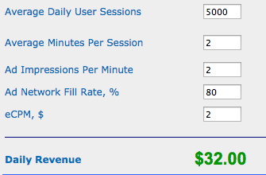
Revenue
Siteadwiki.com
€11,360 per year for every 5000 users

Slide 9
Spending
Average app development: €6,000 per platform
Total of €12,000
Register fees for ios and andriod: €198
Initial Advertising: €3000
Total: €15,198
Paid users revenue: €1,291,089.92 for first year
€1,279,8891
20% to be used to reinvest – the rest is mine

