Slide 1

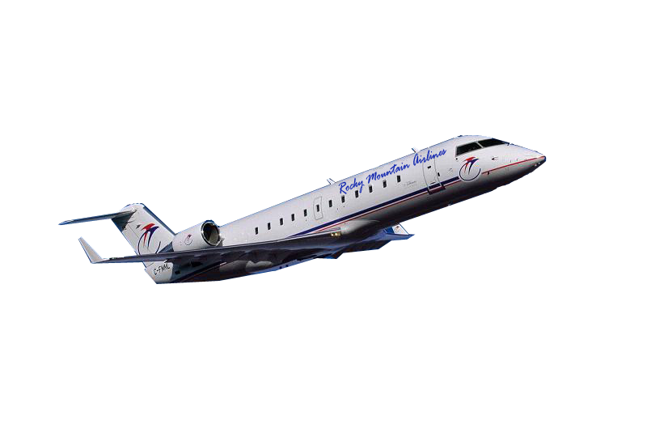
Rocky Mountain Airlines Information System Proposal

Slide 2
PRESENTATION OVERVIEW
  The Problem
  The Solution
  Work Breakdown
  System Capabilities
  Financial Analysis
  Risk Analysis
  Deployment Environment
  Database Design
  Graphical User Interface

Slide 3
THE PROBLEM
With the next phase of expansion on the horizon, the current information system is inadequate for managing maintenance and inventory
Each day, RMA is missing out on over $2100 in potential savings due to an abundance of paperwork
The inadequacy of the current system may endanger RMA in future years when trying to comply with FAA standards

Slide 4
THE PROBLEM
Insufficient detailed information about inventory in the air reduces the quality of business decisions
Safety of aircraft may be compromised by faulty or inadequate information
RMA’s business strategy of providing excellent customer service may be at risk

Slide 5
THE SOLUTION
Jjaw Enterprises will provide a new inventory and maintenance information system capable of handling RMA’s admirable and continued growth
The proposed system will save RMA $767,000 annually, including a decrease in cost per available seat mile by one twentieth of a cent
A highly interactive interface will provide filtered reports customized to the user’s needs
Automation of new system will eliminate unnecessary paperwork

Slide 6
WORK BREAKDOWN
Milestone Duration Start Date
Inception Iteration 39 days 12/1/2005
Analysis & Planning
Managerial Presentation
Structured Walkthrough
Elaboration Iteration 78 days 1/25/2006
Code High Risk Modules
Test High Risk Modules
Construction Iteration 62.5 days 5/15/2006
Code Low Risk Modules
Test Coded Modules
Install System Hardware/Software
Transition Iteration 45 days 8/9/2006
"Go Live" with Pilot
Deploy Final System
Pass Off System 10/4/2006

Slide 7
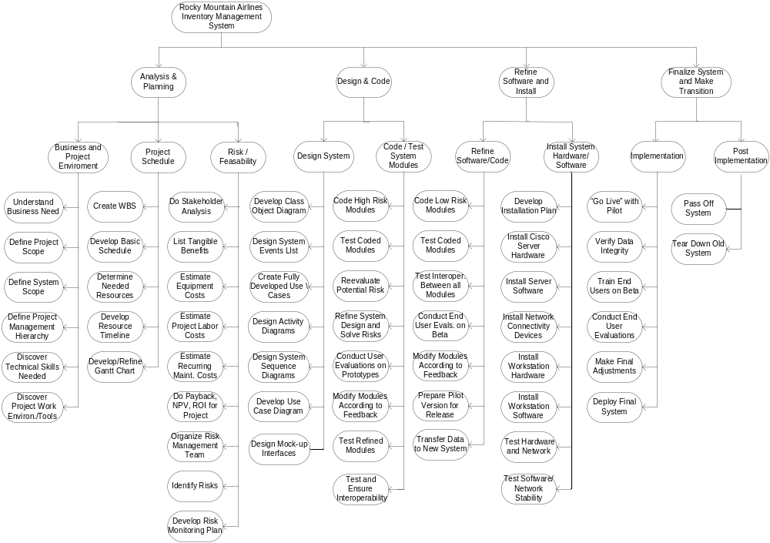
WORK BREAKDOWN

Slide 8





SYSTEM CAPABILITIES
The proposed system will provide the following:
Schedule maintenance activities and supplies
Monitor maintenance requirements
Integrate with the Flight Release System, the Financial Accounting System, and the Human Resource Management System
Track part maintenance history and location
Maintain profit maximizing inventory levels

Slide 9
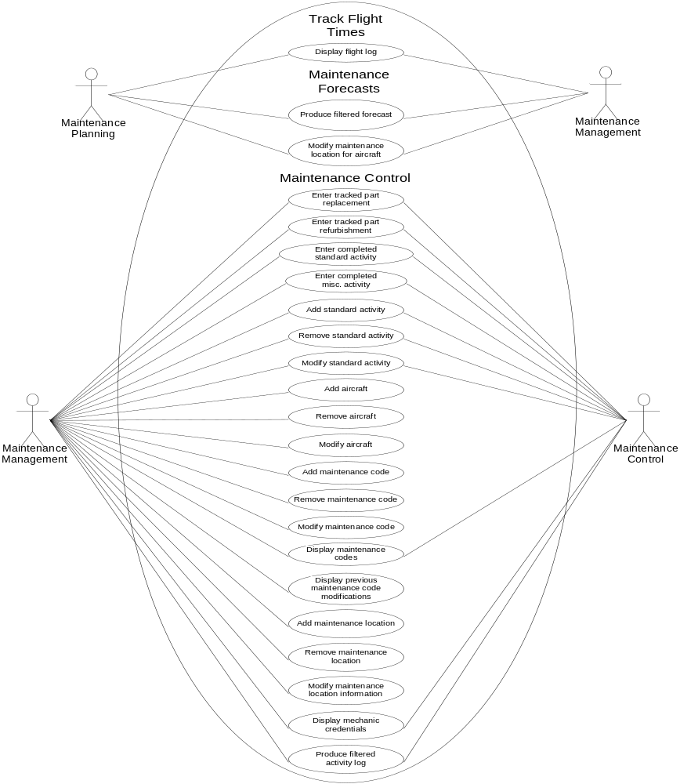
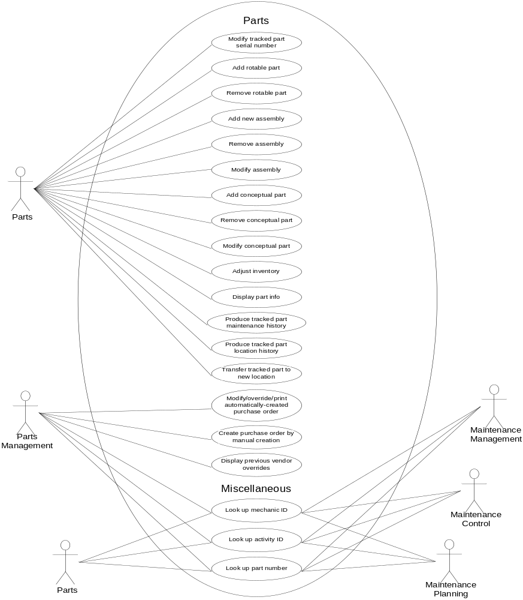
SYSTEM CAPABILITIES

Slide 10
FINANCIAL ANALYSIS
BENEFITS
An immediate $150,000 in reduced consumable inventories due to increased accuracy of inventory information
One less full-time employee resulting in decreased labor expense
Estimated savings of $732,000 from a reduction in CASM from current 15.8 cent level to a new 15.75 cent level
Total estimated recurring benefits of $767,000 per year
Payback period of just over one year

Slide 11
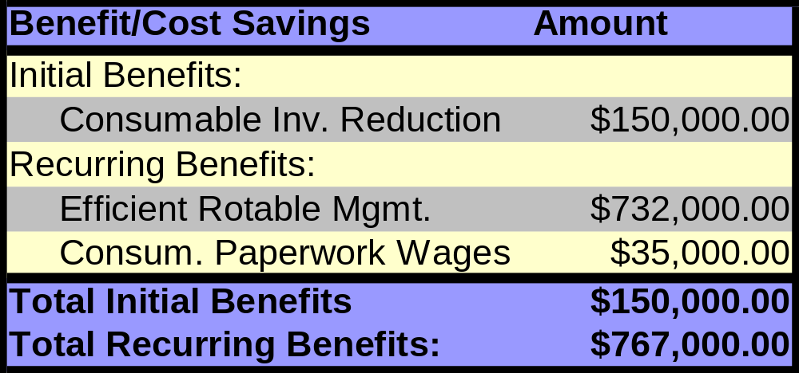
FINANCIAL ANALYSIS
BENEFIT/COST SAVINGS

Slide 12
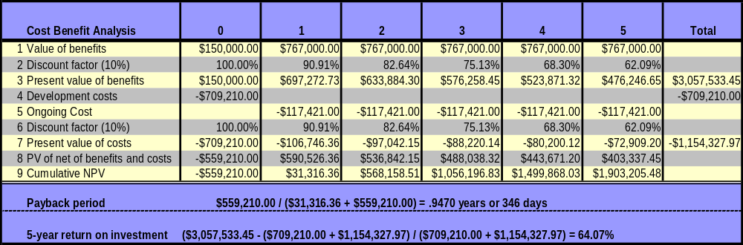
Cost/Benefit Analysis Table

Slide 13
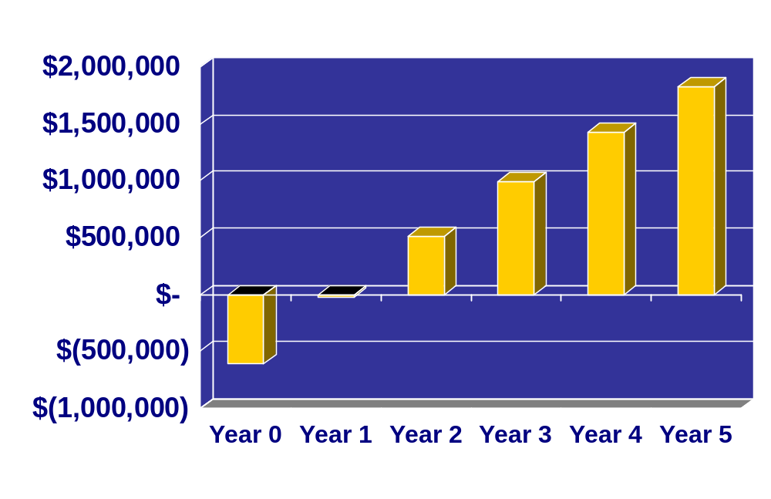
FINANCIAL ANALYSIS
CUMULITIVE NET PRESENT VALUE

Slide 14




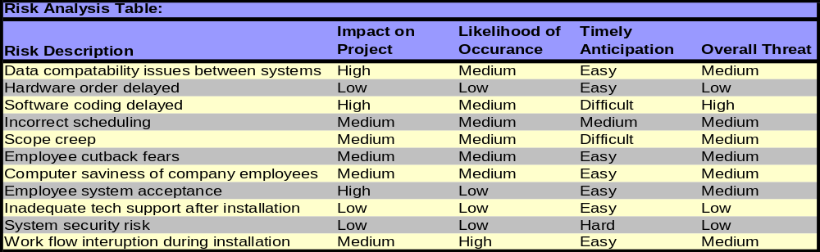
RISK ANALYSIS
RISK MANAGEMENT TEAM
Jjaw Enterprises
Rocky Mountain Airlines
Risk Management Team

Slide 15



RISK ANALYSIS
ORGANIZATIONAL
RMA management can reduce organizational risks by:
Calming employee job cutback fears due to system automation
Communicating positive benefits of the new system to employees
Solving frustrations related to changes in long-standing work procedures
Portray a confident and optimistic attitude about the new system
Provide employees with adequate training

Slide 16
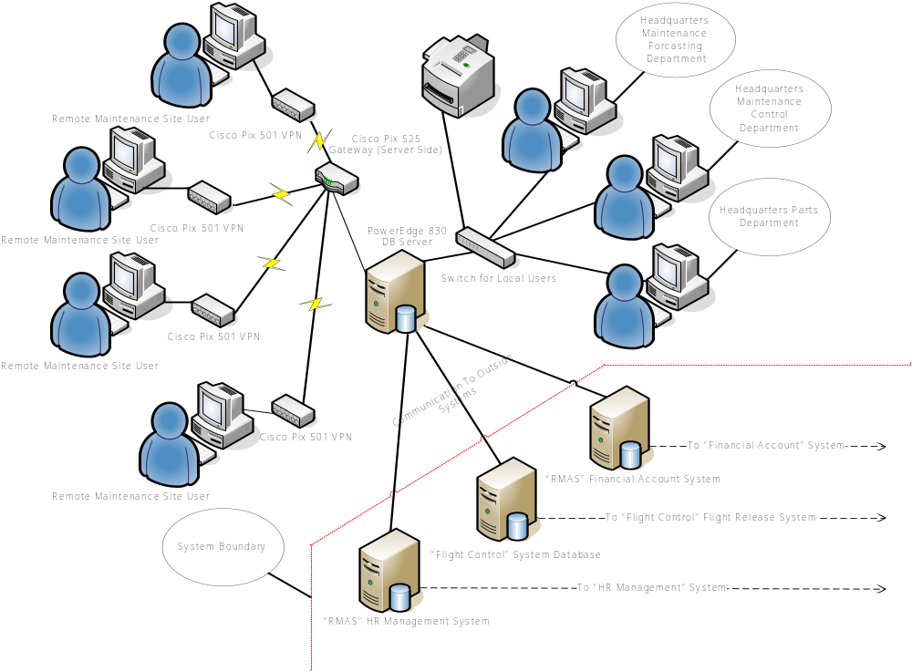
DEPLOYMENT ENVIRONMENT

Slide 17
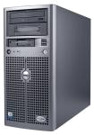
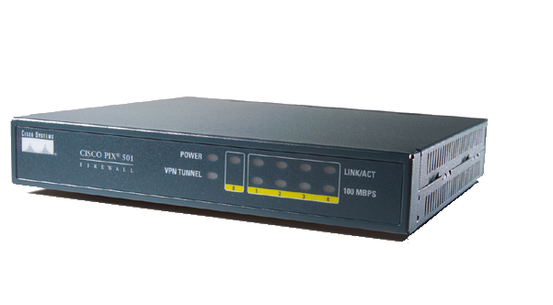
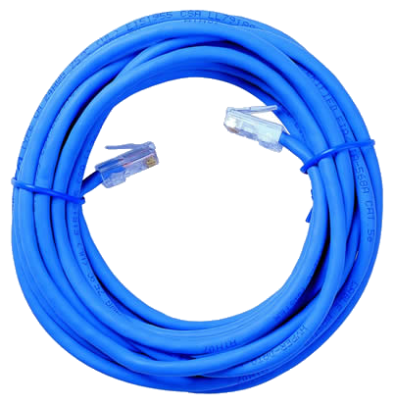
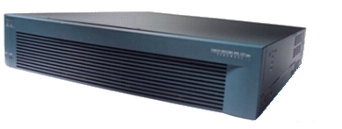
DEPLOYMENT ENVIRONMENT
HARDWARE SNAPSHOTS
1 x PowerEdge 830 Database Server
4 x Cisco Pix 501 VPN Devices
1 x Cisco Pix 525 VPN Gateway
Network Cabling

Slide 18
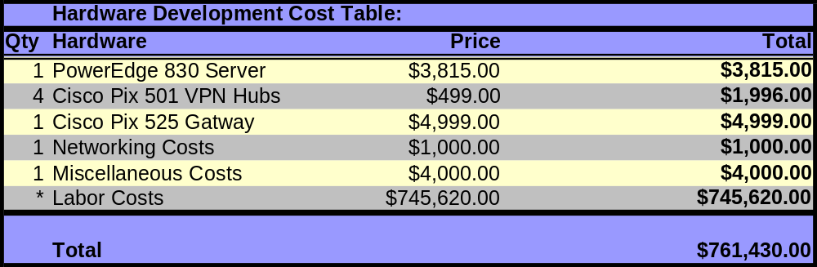
DEPLOYMENT ENVIRONMENT
HARDWARE COSTS

Slide 19
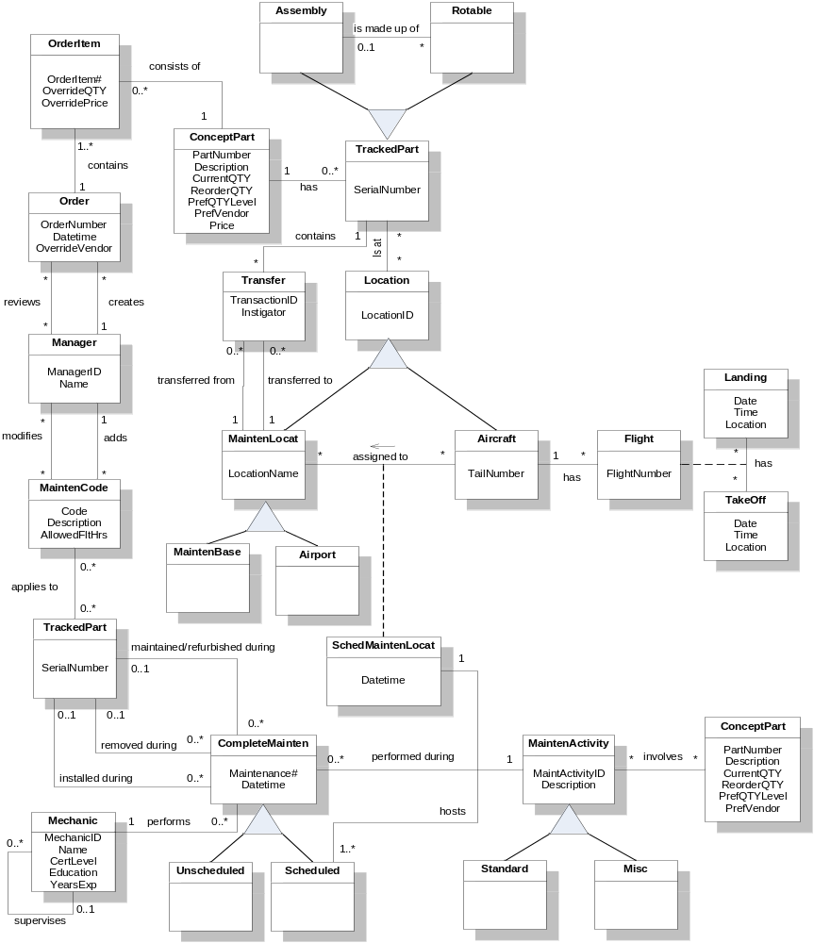
DATABASE DESIGN
CONCEPTUAL MODEL

Slide 20
DATABASE DESIGN
RELATIONAL MODEL
Relational Database Schema
OrderItem(OrderItem#, OrderNumber, PartNumber, OverrideQTY, OverridePrice)
FK: OrderNumber references Order
FK: PartNumber references ConceptPart
ConceptPart(PartNumber, Description, CurrentQTY, ReorderQTY, PrefQTYLevel, PrefVendor, Price)
Order(OrderNumber, ManagerID, Datetime, OverrideVendor)
FK: ManagerID references Manager
Manager(ManagerID, Name)
Manager_ receives_Order(ManagerID, OrderNumber)
FK: ManagerID references Manager
FK: OrderNumber references Order
MaintenCode(Code, ManagerID, Description, AllowedFltHrs)
FK: ManagerID references Manager
Manager_modifies_MaintenanceCode(ManagerID, Code)
FK: ManagerID references Manager
FK: Code references MaintenCode
TrackedPart(SerialNumber)
CompleteMainten(Maintenance#, SerialNumber, Datetime, MechanicID,
maintenanceActivityID)
FK: SerialNumber references TrackedPart
FK: MechanicID references Mechanic
FK: MaintenanceActivityID references MaintenActivity
Mechanic(MechanicID, SupervisorID, Name, CertLevel, Education, YearsExp)
FK: SupervisorID references Mechanic
Schedule(Maintenance#, LocationName, TailNumber, LocationID)
FK: Maintenance# references CompleteMainten
FK: LocationName, TailNumber, LocationID references SchedMaintenLocation
MaintenanceActivity(MaintenActivityID, Description)
ConceptPart(PartNumber, Description, CurrentQTY, ReorderQTY, PrefQTYLevel, PrefVendor)
MaintenActivity_involves_ConceptPart(MaintActivityID, PartNumber)
FK: MaintActivityID references MaintActivity
FK: PartNumber references ConceptPart
MaintenLocat(LocationName, LocationID)
FK: LocationID references Location
Aircraft(LocationID, TailNumber)
FK: LocationID references Location
SchedMaintenLocat(LocationID, LocationName, TailNumber, Datetime)
FK: LocationID references MaintenLocat and/or Aircraft
FK: LocationName references MaintenLocat
FK: TailNumber references Aircraft
Flight(Landing#, TakeOff#, LocationID, TailNumber, FlightNumber)
FK: Landing# references Landing
FK: TakeOff# references TakeOff#
FK: LocationID, TailNumber references Aircraft
Landing(Landing#, Date, Time, Location)
TakeOff(TakeOff#, Date, Time, Location)
Transfer(TransactionID, LocationName, SerialNumber)
FK: LocationName references MaintenLocat
FK: SerialNumber references TrackedPart
TrackedPart(SerialNumber, PartNumber)
FK: PartNumber references ConceptPart
TrackedPart_isAt_Location(SerialNumber, LocationID)
FK: SerialNumber references TrackedPart
FK: LocationID references Location
Assembly(SerialNumber)
FK: SerialNumber references TrackedPart
Rotable(SerialNumber, SerialNumber_{Assembly})
FK: SerialNumber references TrackedPart
FK: SerialNumber_{Assembly} references Assembly

Slide 21
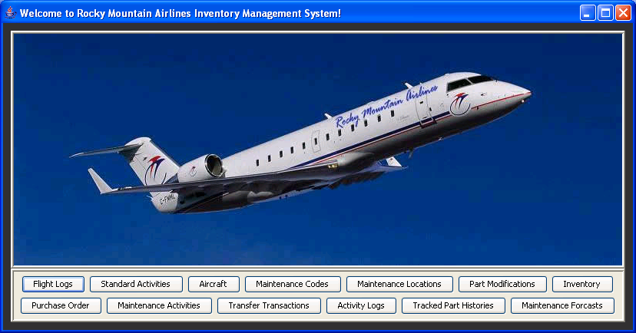
GRAPHICAL USER INTERFACE
MAIN INTERFACE

Slide 22
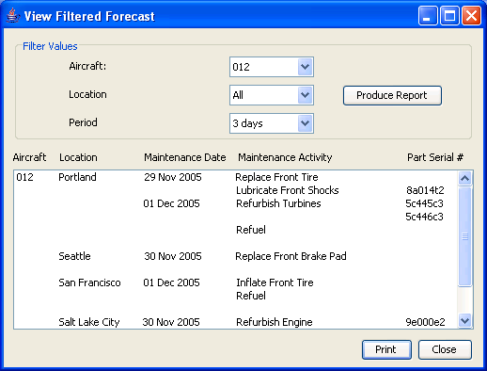
GRAPHICAL USER INTERFACE
VIEW FILTERED FORECAST

Slide 23
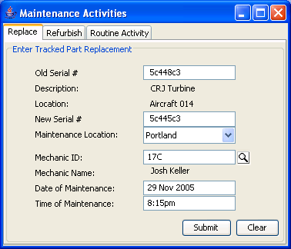
GRAPHICAL USER INTERFACE
MAINTENANCE ACTIVITIES

Slide 24
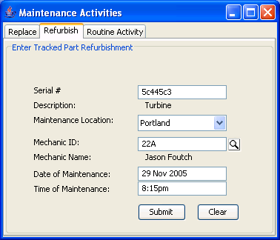
GRAPHICAL USER INTERFACE
MAINTENANCE ACTIVITIES

Slide 25
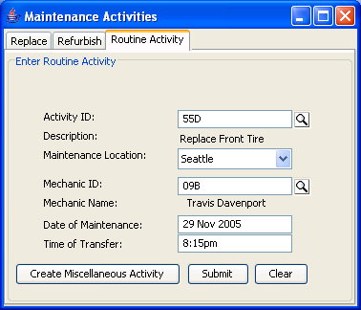
GRAPHICAL USER INTERFACE
MAINTENANCE ACTIVITIES

Slide 26
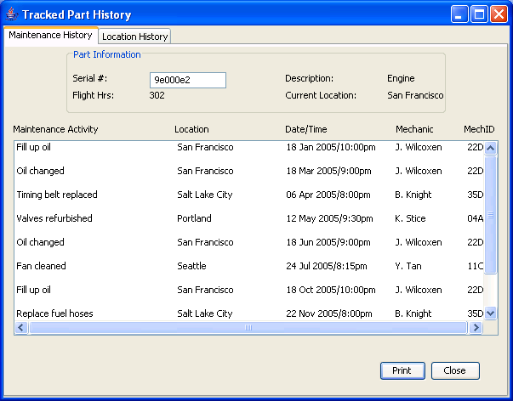
GRAPHICAL USER INTERFACE
TRACKED PART HISTORY

Slide 27
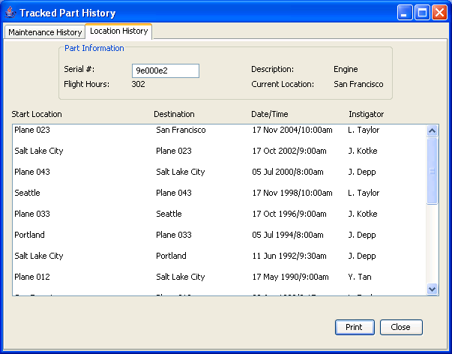
GRAPHICAL USER INTERFACE
TRACKED PART HISTORY

Slide 28
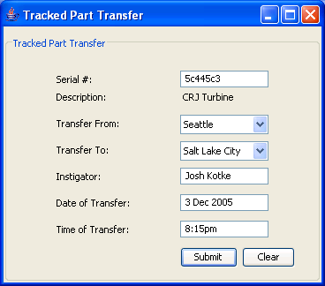
GRAPHICAL USER INTERFACE
TRACKED PART TRANSFER

Slide 29
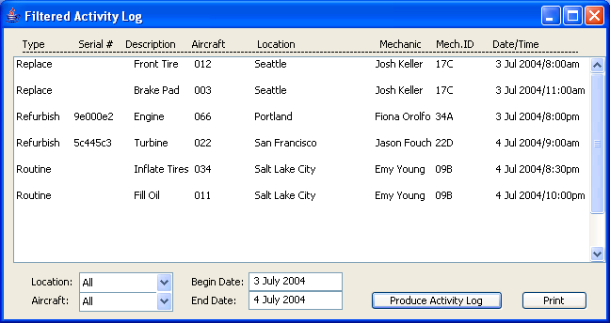
GRAPHICAL USER INTERFACE
FILTERED ACTIVITY LOG

Slide 30
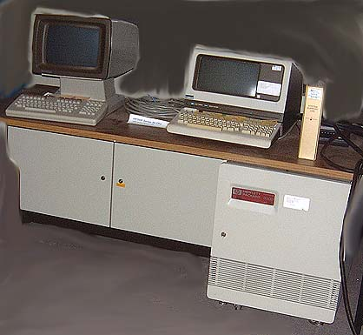
THE BIGGEST PROBLEM OF ALL
Rocky Mountain Airlines current Maintenance and Inventory Management System, the HP 3000:
Isn’t it about… time?

Slide 31
Rocky Mountain Airlines Information System Proposal

