Slide 1
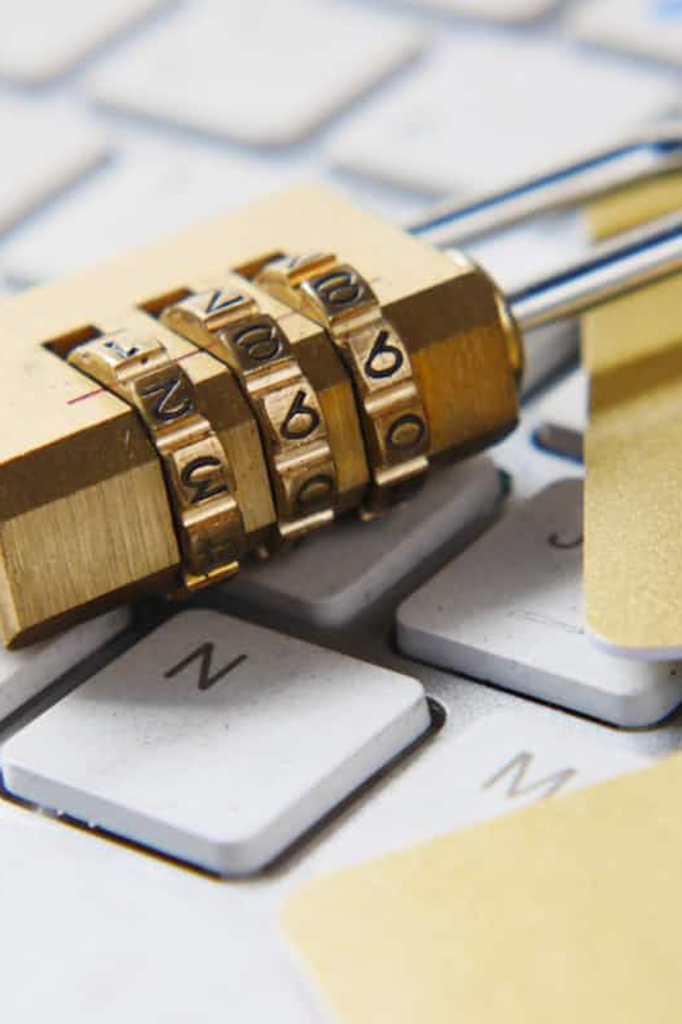

Citizen Safety App
The Citizen Safety App aims to protect individuals against cybercrimes by flagging malicious or fraudulent indicators in real time. By analyzing mobile numbers, SMS headers, URL links, UPI addresses, Bitcoin wallet addresses, and SMS templates, the app identifies potential threats and alerts users accordingly.

Slide 2

Real-time Malicious Indicator Detection
1
Continuous Monitoring
The app should continuously monitor incoming data such as SMS, URLs, and other digital communication channels for potential threats.
2
Threat Identification
Identify and flag potential threats in real time to ensure users are promptly alerted.
3
Alert System
Instantly alert users when a potential threat is detected, providing them with information on the type of threat and recommended actions to take.

Slide 3

Mobile Number Analysis
1
Suspicious Patterns
2
Spam Calls Detection
Analyze incoming calls and messages to identify suspicious patterns associated with mobile numbers, such as spam calls, phishing attempts, or scam messages.
Detect and alert users about potential spam calls to prevent any malicious activities or fraud attempts.
3
Scam Messages Identification
Identify and flag scam messages to ensure users can avoid engaging with fraudulent activities.

Slide 4

SMS Header Inspection
Header Scrutiny
Fraudulent Message Detection
Scrutinize SMS headers to detect spoofed or suspicious sources, ensuring users are aware of potential phishing or fraudulent messages.
Identify and flag suspicious messages to protect users from falling victim to fraudulent schemes.
Privacy Protection
Protect user privacy by ensuring they are informed about the legitimacy of incoming messages.

Slide 5
URL Link Scanner
Scan URLs
Threat Detection
Cyber Threat Intelligence
Scan URL links received through messages or other platforms to identify potential phishing websites, malware-infected pages, or suspicious domains.
Detect and flag suspicious URLs to prevent users from accessing harmful or fraudulent websites.
Utilize TAXII/STIX by Open Cyber Threat Intelligence (alienvault) for comprehensive threat analysis and identification.

Slide 6




UPI Address Verification
Transaction Security
Fraud Prevention
User Protection
Validate UPI addresses during transactions to ensure users are protected from UPI-related scams or fraudulent payments.
Prevent users from engaging in transactions involving fraudulent UPI addresses.
Enhance user protection and confidence in digital transactions through rigorous address verification.

Slide 7

Bitcoin Wallet Address Checker
Fraudulent Transactions
User Safety
Scam Prevention
Verify Bitcoin wallet addresses to prevent users from engaging in fraudulent cryptocurrency transactions or scams.
Ensure the safety and security of users' cryptocurrency transactions and wallet operations.
Prevent users from becoming victims of cryptocurrency-related scams by rigorously verifying wallet addresses.

Slide 8

SMS Template Analysis
1
Content Inspection
2
Scam Patterns Recognition
Analyze the content and structure of SMS templates to identify common scam patterns, ensuring users are informed about potential threats.
Recognize and flag SMS templates with known scam patterns to alert users of potential fraudulent activities.
3
User Awareness
Empower users by providing insights into common scam tactics within SMS messages, helping them stay vigilant.

Slide 9

User Reporting & Education
User Reporting
1
Allow users to report suspicious activity or false positives, helping improve the app's detection algorithms and database.
2
User Empowerment
Provide educational resources within the app to help users recognize and avoid common cyber threats, empowering them to protect themselves proactively.

