Slide 1

TA 111 - Engineering Graphics
Lecture 1 – Lines and Letterings (Self-readable material)

Slide 2
Summary of Presentation
Line
Letterings
Scale

Slide 3
Lines and Letterings
‘Lines’ represent the shape of an object in the form of either an edge, a surface, or contours of the object
‘Lettering’ is used to describe the size and other necessary information
Lines & lettering along with certain symbols, abbreviations, and standard practices collectively make the complete description of an object on an engineering drawing

Slide 4
Types of Lines
Object- Continuous thick
Dimension-Arrowed line
Construction-Continuous thin
Hidden-Dashed line
Center line-Chain thin
Hinge line-Chain thick

Slide 5
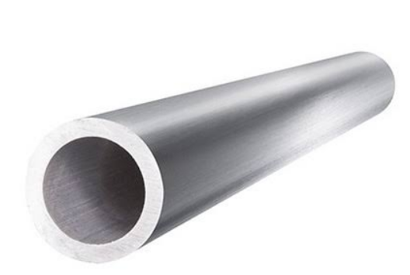
Types of Lines in a simple drawing
Center Line
Object Line
Top Viewing Direction
100
Top View
Construction Line
Hidden Line
Front Viewing Direction
Front View
IMPORTANT NOTE:
Object lines and construction lines should always be distinguishable
You may use H for object lines and 2H for construction lines
You should NOT erase the construction lines after drawing (in this course)

Slide 6
Letterings
Atg
Lettering: It all starts with A, B, C,.. .1, 2,3… !!!!!
Guidelines are construction lines
Light pencil lines – use 2H/H pencil
For capital letters: Draw only cap line and base line
For lowercase letters: Draw waist line and drop line also
Cap Line
Waist Line
Base Line
Drop Line
Body of small letters = 2/3 of Capital letters
Cap line and Drop line are 1/3 each from waist and Base lines
e.g. Capital letter = 9 mm
Body of small letter = 6 mm
Cap and Drop lines = 3 mm

Slide 7
Principles of Letterings
Engineering lettering is commonly UPPERCASE
Title Block: 8/6 mm, Dimensions: 6 mm
Each letter is made up of a series of single strokes
Judging by the eye, the distance between the letters should be approximately equal
Letters and Number using H Pencil
Use only CAPITAL LETTERS and NUMBERS

Slide 8
Principles of Letterings
Legibility: Each letter must be distinct.
Stability: The bottom of letters such as B are larger than the top.
Composition: Each portion of each letter is formed to an exact standard.
Uniformity: All “A’s” are alike, all “B’s are alike, etc.
Alignment: The vertical axes passing through all letters are parallel. No slant!

Slide 9
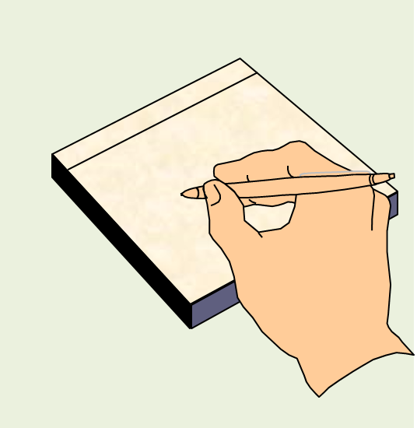
Acute Angle Stroking
ü
û
Stroke the pencil in the acute angle direction. This will save the paper from tearing

Slide 10
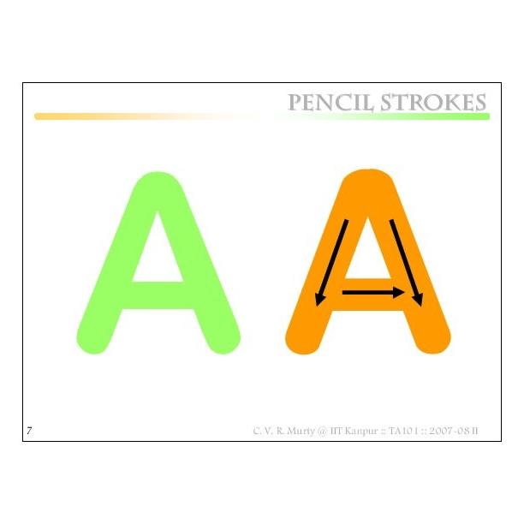

Slide 11
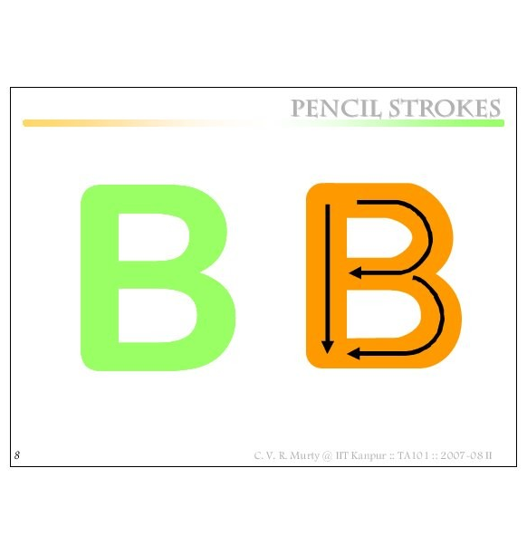

Slide 12
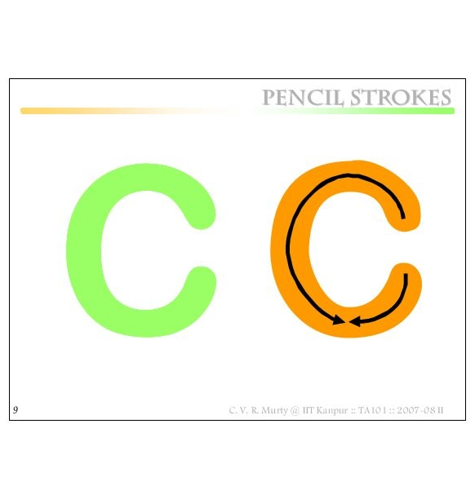

Slide 13
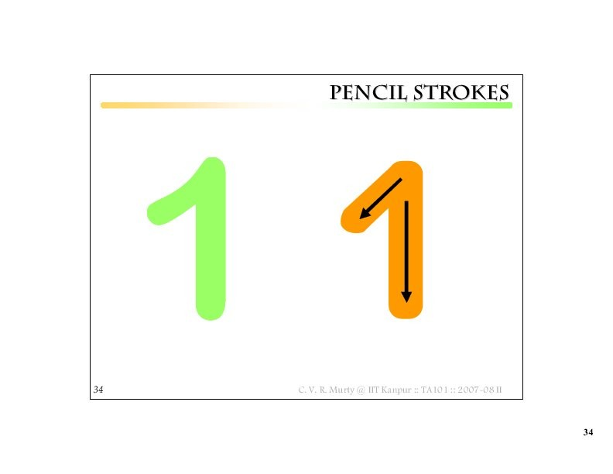

Slide 14
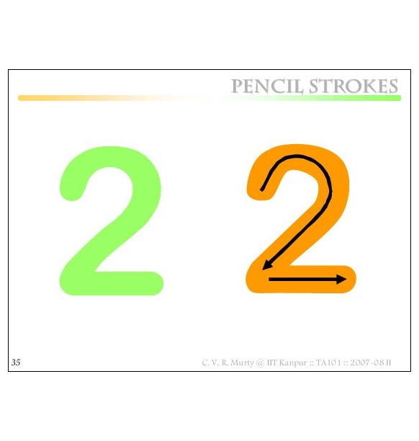

Slide 15
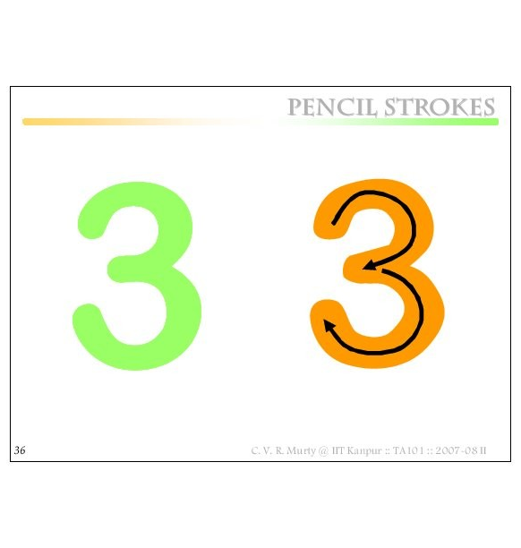

Slide 16
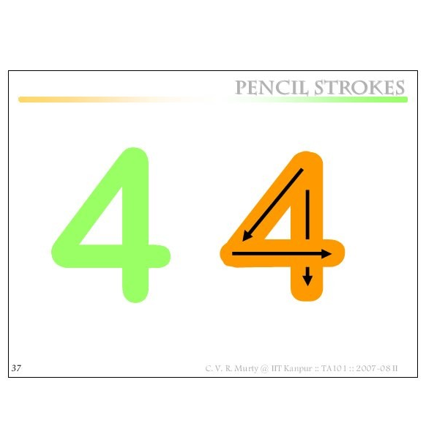
USE THIS IN ALL DRAWINGS

Slide 17
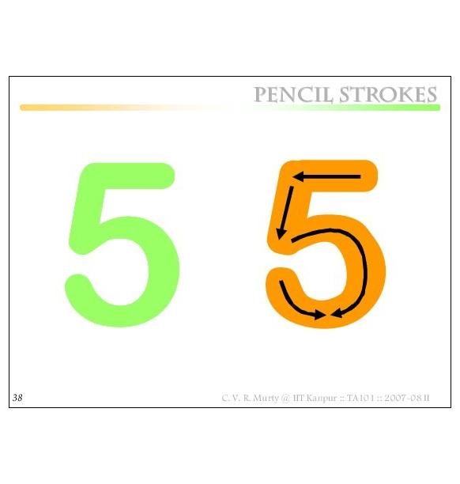

Slide 18
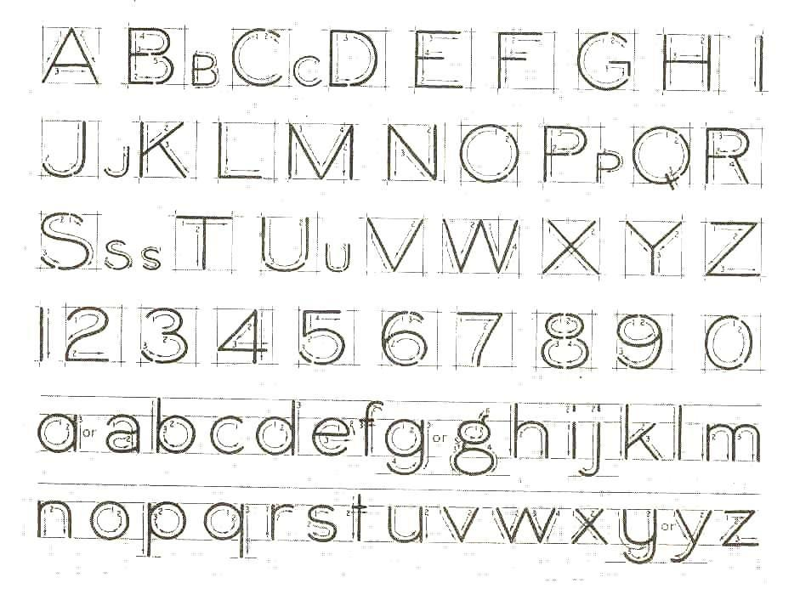
Lettering Practice – Lab + Home

Slide 19
Why take so much trouble?
Drawings made in one country may be used for manufacturing parts or assembly in another country !
Need for STANDARDS !
(BIS, DIN, JIS, ASTM …)

Slide 20
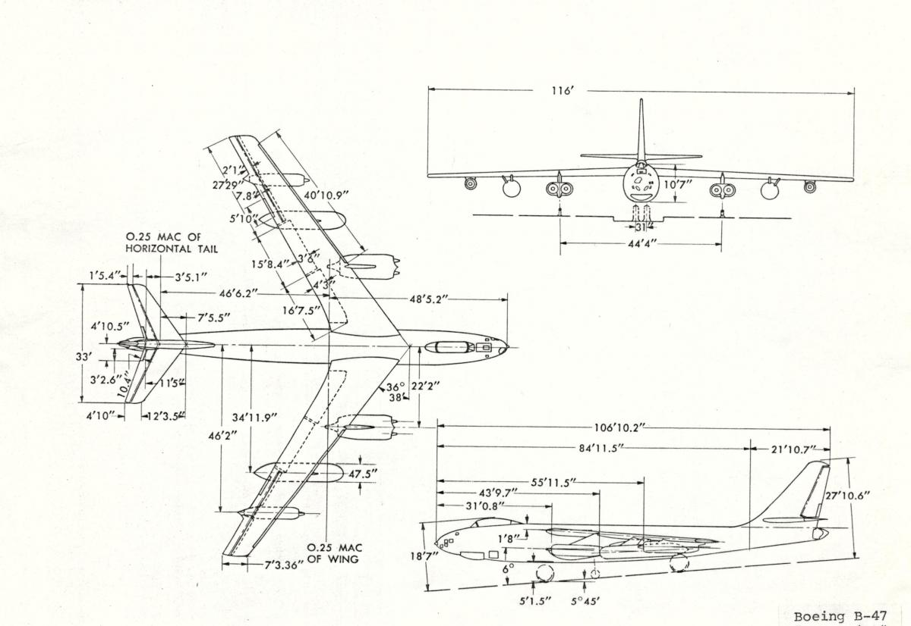
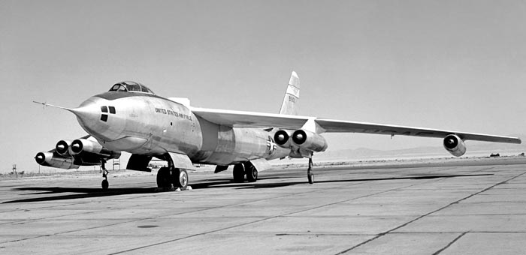
Scale
Cannot draw all objects on drawing sheet in full size
Scales e.g.:
1:2, 1:5,1:10, etc.
Note: Always actual dimension are written on drawings.
Note: A drawing should always have the SCALE

Slide 21
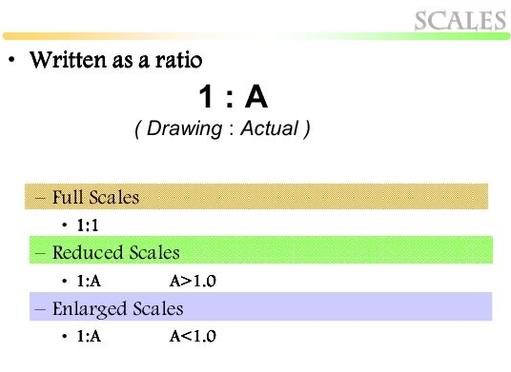
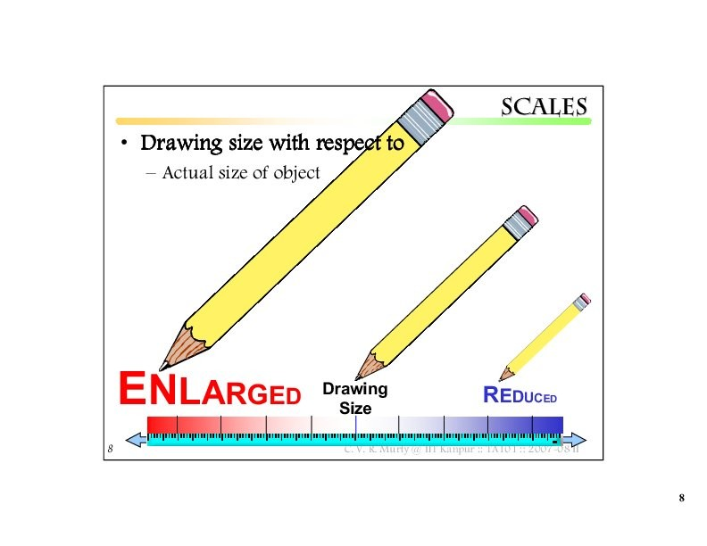
Scale

Slide 22
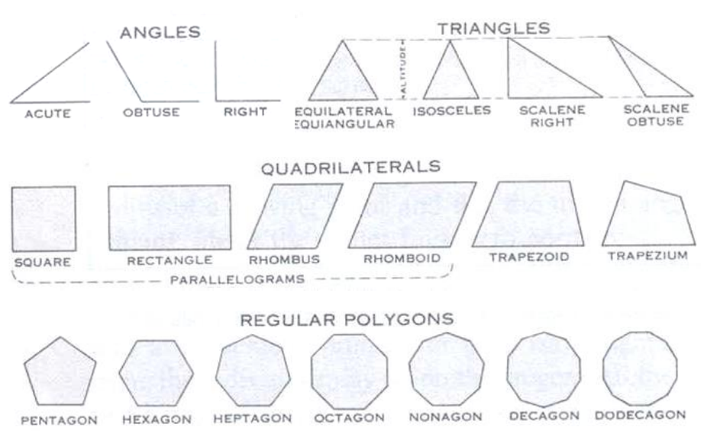
Some basic geometric shapes
5 6 7 8 9 10 12

Slide 23
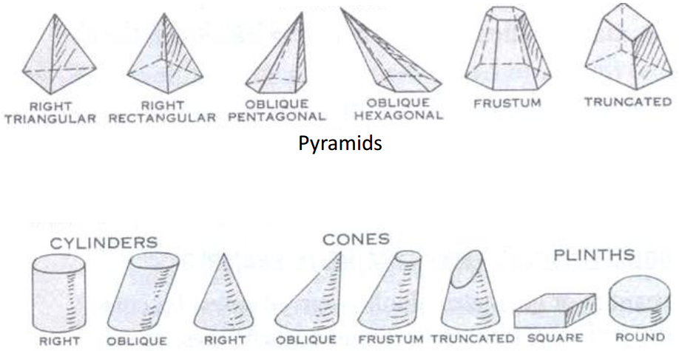
Some basic geometric shapes
Cylinders and Cones

Slide 24
THANKS

