Slide 1
Capacity Planning
Achieve match between the long-term supply capabilities of an organization and the predicted level of long-term demand
Overcapacity: high cost
Undercapacity: strained resources and possible loss of customers
Key Questions:
What kind of capacity is needed?
How much is needed to match demand?
When is it needed?
Capacity
The maximum amount that a process can produce in a given unit of time
Process : collection of activities that transforms inputs into outputs that are valuable to the customer
Capacity (process capacity) is the capacity of the bottleneck activity

Slide 2
Elements of a Process
Activity
Flow
Inventory buffer
Decision point

Slide 3
Process Flow Diagram
Customer order
Burger making
RM
Cook
Assemble
Deliver

Slide 4
Process Flow Diagram---Process Capacity
Customer order
45 units/hour
Burger making: Scenario 1
RM
Cook
Assemble
Deliver
Activity time |  | 2 min/unit |  | 3 min/unit |  | 1 min/unit
Number of resources |  | 1 |  | 1 |  | 1
Capacity |  | 30 units/hr |  | 20 units/hr |  | 60 units/hr

Slide 5
Process Flow Diagram---Demand Constrained System
Customer order
45 units/hour
Burger making: Scenario 2
RM
Cook
Assemble
Deliver
Activity time |  | 2 min/unit |  | 3min/unit |  | 1 min/unit
Number of resources |  | 2 |  | 3 |  | 1
Capacity |  | 60 units/hr |  | 60 units/hr |  | 60 units/hr
Flow rate = demand = 45 units/hour

Slide 6
Process Flow Diagram---Supply Constrained Process
Customer order
45 units/hour
Burger making: Scenario 1
RM
Cook
Assemble
Deliver
Activity time |  | 2 min/unit |  | 3 min/unit |  | 1 min/unit
Number of resources |  | 1 |  | 1 |  | 1
Capacity |  | 30 units/hr |  | 20 units/hr |  | 60 units/hr
Flow rate = capacity of Assemble stage = 20 units/hour

Slide 7
Cycle Time and Flow Time
Burger : Scenario 1
Cycle time = 3 minutes
Flow time = 7 minutes (measured in the steady state)

Slide 8
Process Flow Diagram---Process Capacity
Customer order
45 units/hour
Burger: Scenario 3
RM
Cook
WIP
Assemble
Deliver
Activity time |  | 2 min/unit |  | 3 min/unit |  | 1 min/unit
Number of resources |  | 1 |  | 1 |  | 1
Capacity |  | 30 units/hr |  | 20 units/hr |  | 60 units/hr

Slide 9
Supply Constrained: Adding Buffer does not Change the Capacity
Burger: Scenario 3
Cycle time = 3 minutes
Flow time = Increasing
Buffer

Slide 10
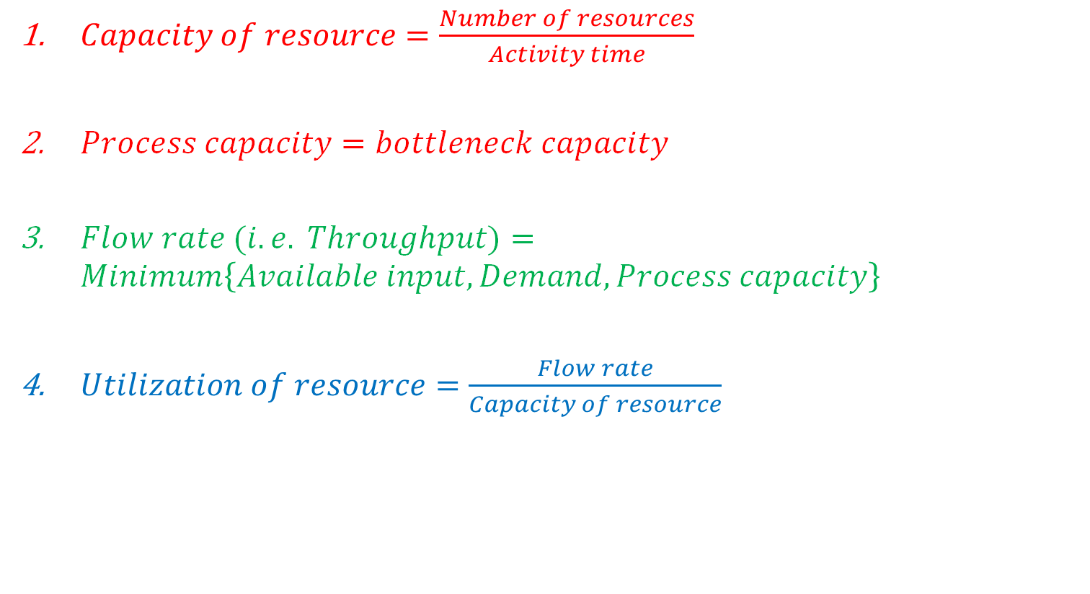
Process Analysis
$Capacity of resource=\frac{Number of resources}{Activity time}$
$Process capacity=bottleneck capacity$
$Flow rate (i.e. Throughput)=Minimum\left\{Available input, Demand, Process capacity\right\}$
$Utilization of resource=\frac{Flow rate}{Capacity of resource}$

Slide 11
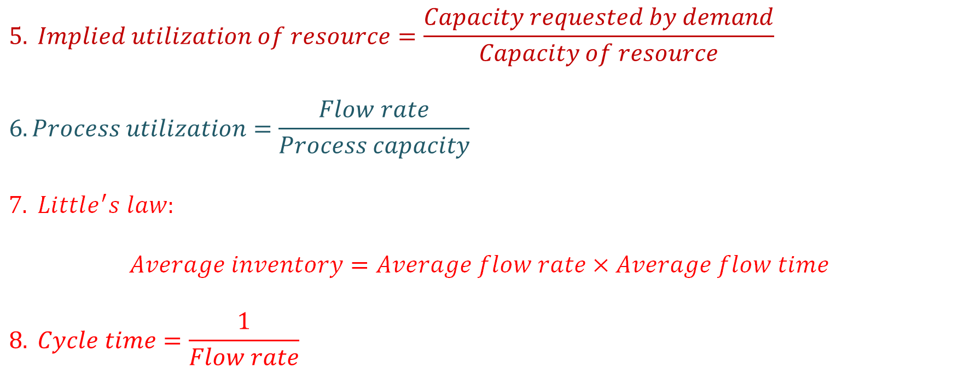
Process Analysis
$$5. Implied utilization of resource=\frac{Capacity requested by demand}{Capacity of resource}$$
$$6. Process utilization=\frac{Flow rate}{Process capacity}$$
$$7. Little^{′}s law:$$
$$Average inventory=Average flow rate×Average flow time$$
$$8. Cycle time=\frac{1}{Flow rate}$$

Slide 12
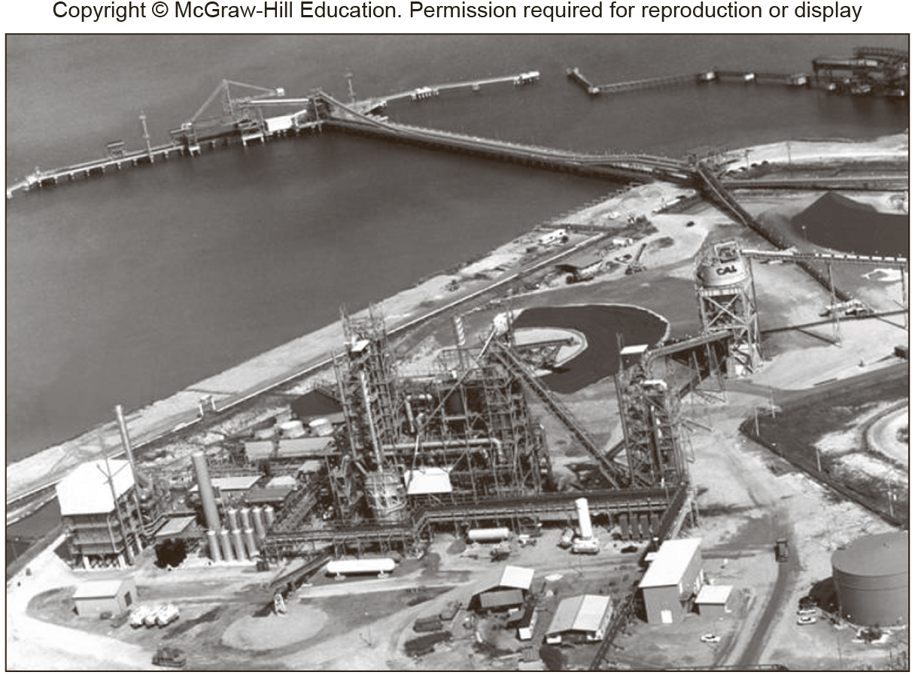
Process Analysis of Circored Plant
Source: Matching supply with demand: An introduction to operations management, Cachon and Terwiesch

Slide 13
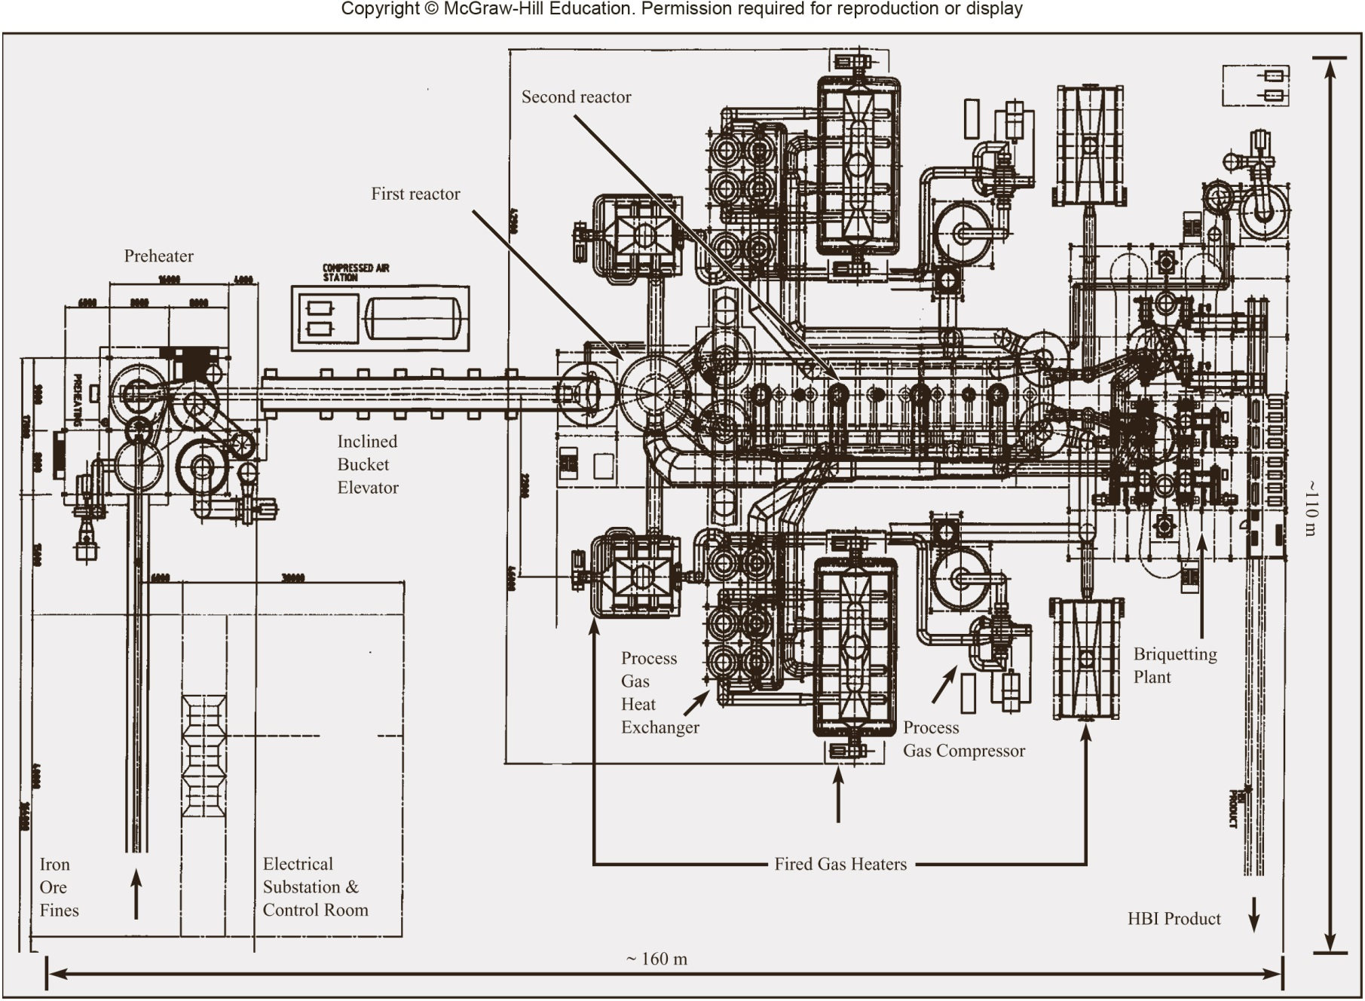
Source: Matching supply with demand: An introduction to operations management, Cachon and Terwiesch

Slide 14
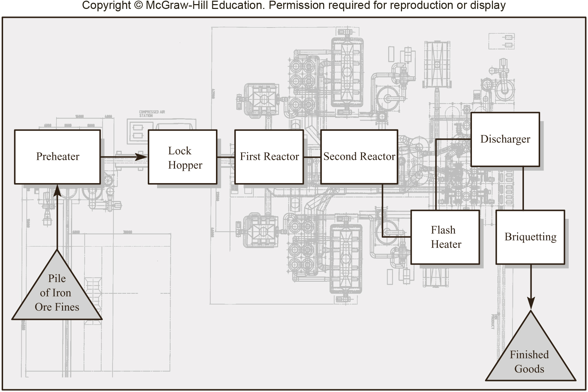
Source: Matching supply with demand: An introduction to operations management, Cachon and Terwiesch

Slide 15
Case 1: Unlimited Demand
Process Step | Capacity | Utilization
Preheater | 120 tons/hr | 100/120 = 83.3%
Lock hoppers | 110 tons/hr | 100/110 = 90.9%
First reactor | 112 tons/hr | 100/112 = 89.3%
Second reactor | 100 tons/hr | 100/100 = 100%
Flash heater | 135 tons/hr | 100/135 = 74.1%
Discharger | 118 tons/hr | 100/118 = 84.7%
Briquetting | 165 tons/hr | 100/165 = 60.6%
Flow rate = bottleneck capacity = 100 tons/hr

Slide 16
Case 2: Demand =125 tons/hr
Process Step | Capacity | Utilization | Implied Utilization
Preheater | 120 tons/hr | 100/120 = 83.3% | 125/120 = 104.2%
Lock hoppers | 110 tons/hr | 100/110 = 90.9% | 125/110 = 113.63%
First reactor | 112 tons/hr | 100/112 = 89.3% | 125/112 = 111.6%
Second reactor | 100 tons/hr | 100/100 = 100% | 125/100 = 125%
Flash heater | 135 tons/hr | 100/135 = 74.1% | 125/135 = 92.6%
Discharger | 118 tons/hr | 100/118 = 84.7% | 125/118 = 105.9%
Briquetting | 165 tons/hr | 100/165 = 60.6% | 125/165 = 75.8%
Flow rate = bottleneck capacity = 100 tons/hr

Slide 17
Case 3: Demand =80 tons/hr
Process Step | Capacity | (Implied ) Utilization
Preheater | 120 tons/hr | 80/120 = 66.67%
Lock hoppers | 110 tons/hr | 80/110 = 72.72%
First reactor | 112 tons/hr | 80/112 = 71.42%
Second reactor | 100 tons/hr | 80/100 = 80%
Flash heater | 135 tons/hr | 80/135 = 59.25%
Discharger | 118 tons/hr | 80/118 = 67.79%
Briquetting | 165 tons/hr | 80/165 = 48.48%
Flow rate = Min{Demand, Process capacity} = Min{80, 100}= 80 tons/hr

