Slide 1
Student Name : Aartheeswari.R
Final Project

Slide 2
PROJECT TITLE
Face Emotion Recognition using CNN Algorithm

Slide 3


AGENDA
Introduction
Problem Statement
Project Overview
End Users
Solution and Value Proposition
Unique Features
Modelling Approach
Results
3/21/2024 Annual Review

Slide 4

PROBLEM STATEMENT
Traditional emotion recognition systems often struggle to accurately interpret subtle facial expressions or emotions expressed in non-standard ways. Additionally, existing models may not effectively adapt to the dynamic and diverse nature of human emotions, especially within Generative AI contexts.

Slide 5

PROJECT OVERVIEW
This project aims to leverage CNNs, a type of deep learning algorithm known for its effectiveness in image recognition tasks, to develop an emotion recognition system tailored for Generation AI. By training the model on large datasets of facial expressions, we intend to create a robust system capable of accurately identifying emotions such as happiness, sadness, anger, surprise, fear, and disgust.

Slide 6

End Users
Researchers in psychology and neuroscience
Developers of emotion recognition software
Industries implementing emotion-based marketing strategies

Slide 7

Solution and Its Value Proposition:
A CNN-based model that accurately recognizes facial emotions, providing valuable insights into human emotions.
Helps businesses understand customer sentiments for improved marketing strategies.
Assists psychologists and neuroscientists in studying human behavior and emotions.

Slide 8

THE WOW IN YOUR SOLUTION
High accuracy in recognizing subtle facial emotions.
Real-time processing capability for dynamic applications.
Scalability for diverse use cases and datasets.
3/21/2024 Annual Review

Slide 9
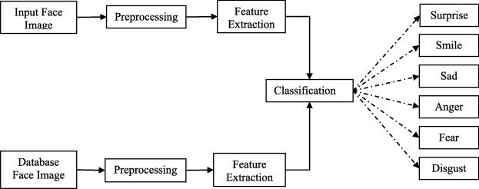
MODELLING

Slide 10
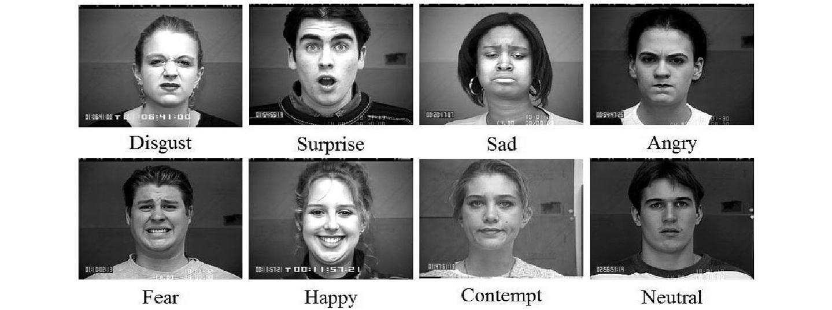
RESULT
Initial testing shows promising results in accuracy and adaptability.
Ongoing evaluation and refinement to optimize performance.

