Slide 1

STEEL DATA
SQL CHALLENGE-6
MARKETING
ANALYSIS

Slide 2
Intro
As a Marketing Analyst, we have to provide insights to The 'Sustainable Clothing Co.' who have been running several marketing campaigns and analyzing whether they have been successful or not.
Analyzing the following tables to find out crucial information about the products, Performance and Revenue, etc,.

Slide 3
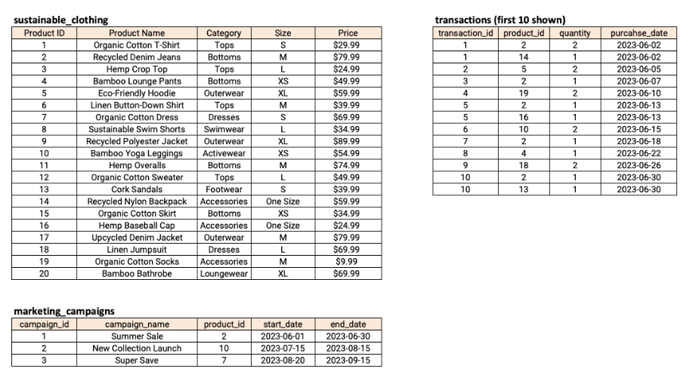
Tables

Slide 4
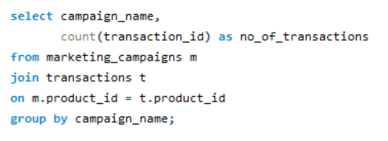
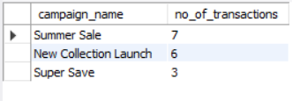
Customer Insights Analysis
1. Total number of Transactions during each marketing campaign

Slide 5
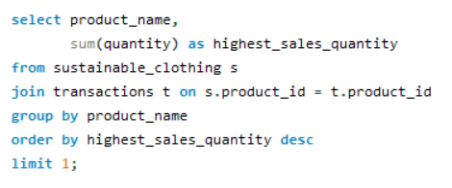

2. The product with the highest sales quantity

Slide 6
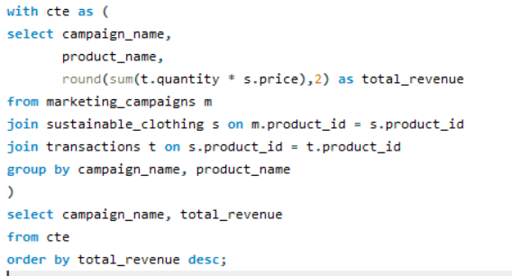
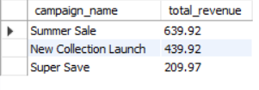
3. The total revenue generated from each marketing campaign

Slide 7
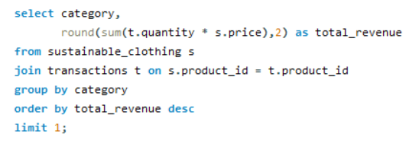

4. The top-selling product category based on the total revenue.

Slide 8
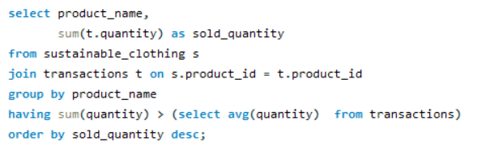
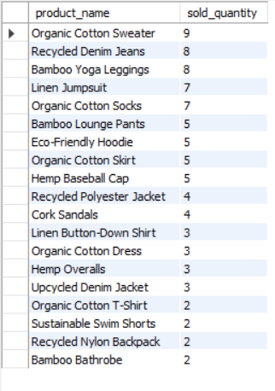
5. The products had a higher quantity sold compared to the average quantity sold

Slide 9
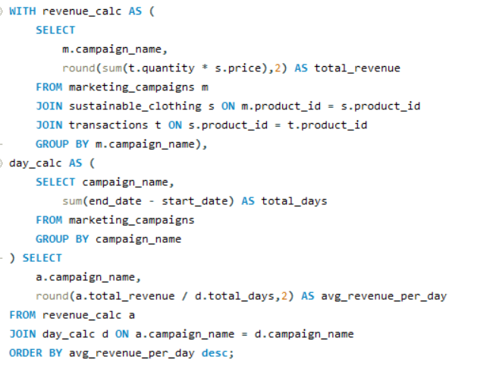
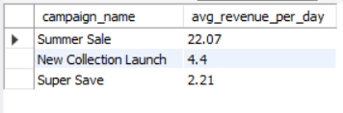
6. The average revenue generated per day during the marketing campaigns.

Slide 10
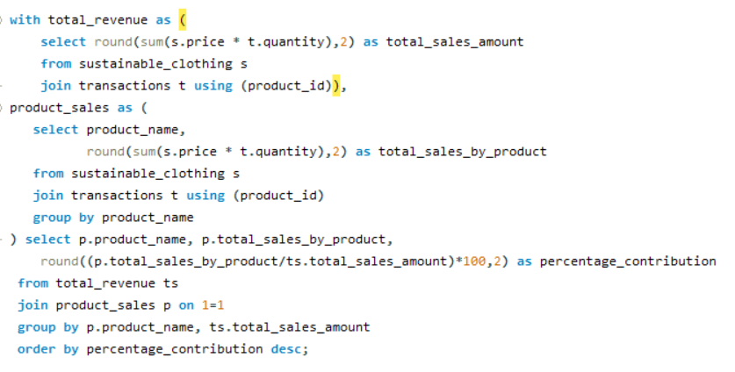
7. The percentage contribution of each product to the total revenue

Slide 11
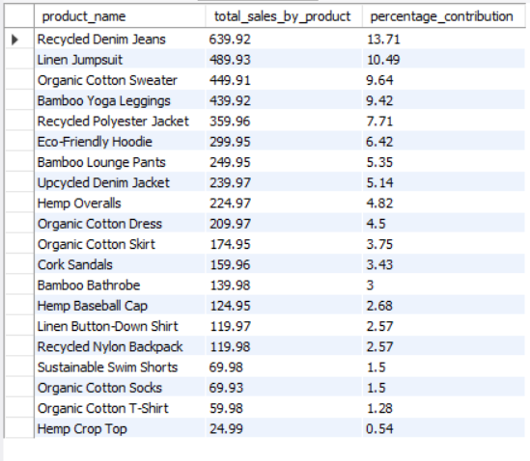
7. The percentage contribution of each product to the total revenue

Slide 12
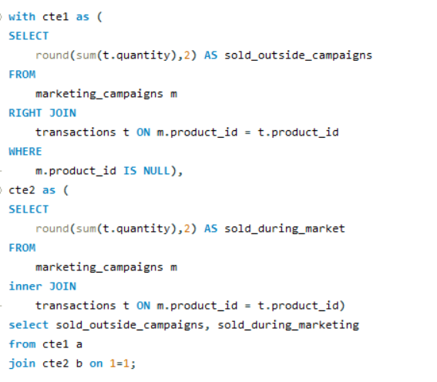

8. Compare the Total quantity sold during marketing campaigns to outside the marketing campaigns

Slide 13
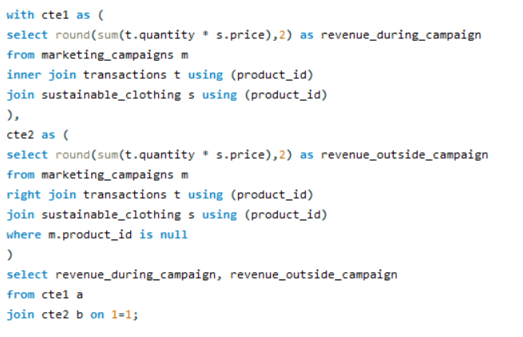

9. Compare the revenue generated by products inside the marketing campaigns to outside the campaigns

Slide 14
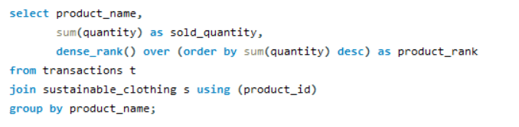
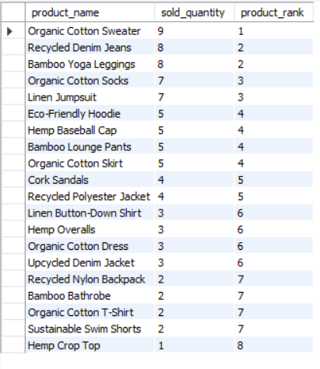
10. Rank the products by their average daily quantity sold

Slide 15
Insights
1. "Summer Sale" Campaign has the highest sale Transactions of 7, followed by "New Collection Launch" Campaign of 6 total transactions.
2. Organic Cotton Sweater has the highest sales quantity of 9.
3. "Summer Sale" Campaign ranked No.1 in Total Revenue generation of 639.92, followed by "New Collection Launch" Campaign with 439.92 of Total Revenue.
4. "Bottoms" Ranked No.1 in The Top Selling Product Category by the Total Revenue of 1289.79
5. "Recycled Denim Jeans" Product Contributed Highest of 13.71% Of sales to the Total Revenue and "Hemp Crop Top" Contributed Lowest of 0.54% of sales to the Total Revenue.
6. The Revenue Generated during Campaign is 1289.81 and the Revenue generated outside Campaign is 3379.31 which is 38% Contribution.
Aarthi Durai

