Slide 1
We don‘t want to
model,
we want to
program!

Slide 2
We don‘t want to
model,
we want to
program!
… at different levels of abstraction
… from different viewpoints
… integrated!

Slide 3
We don‘t want to
model,
we want to
program!
… with different degrees of
domain-specificity
… with suitable notations
… with suitable expressiveness

Slide 4
We don‘t want to
model,
we want to
program!
And always:
precise and tool processable

Slide 5

Big Language?
L
c
d
e
b
f
g
h
i
j
k
m
n
o
a
with many first class concepts!

Slide 6
Small Language?
L
α
β
λ
ω
δ
with a few, orthogonal
and poweful concepts

Slide 7
Modular Language
my L
α
β
a
b
c
d
e
f
g
h
i
j
k
l
with many optional,
composable concepts

Slide 8
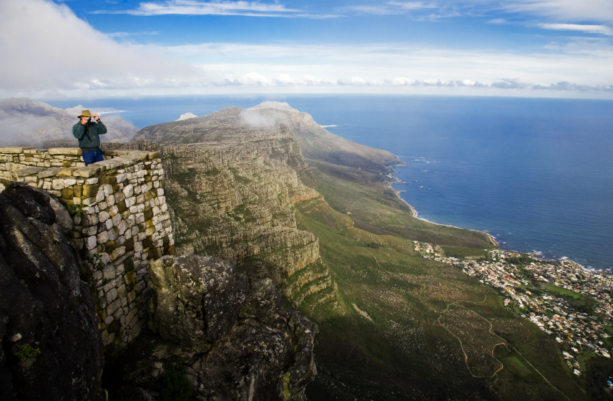
Viewpoints
suitable
abstractions
and
notations
for each

Slide 9
Viewpoints
Integrated
via
symbolic
references
or
syntactic
composition

Slide 10
Viewpoints
General Purpose
C
Domain Specific
LEGO Robot Control

Slide 11
Viewpoints
General Purpose
C
Components
State Machines
Domain Specific
Sensor Access
LEGO Robot Control

Slide 12

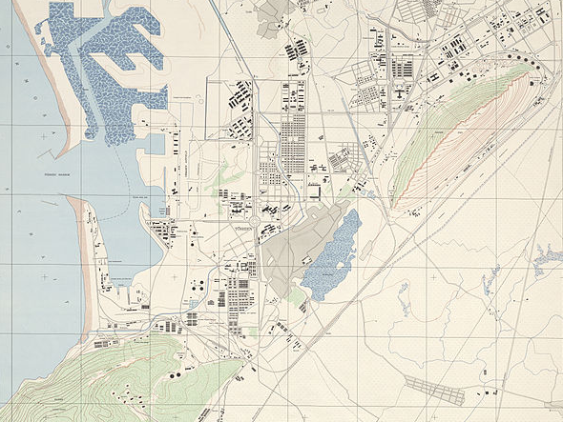
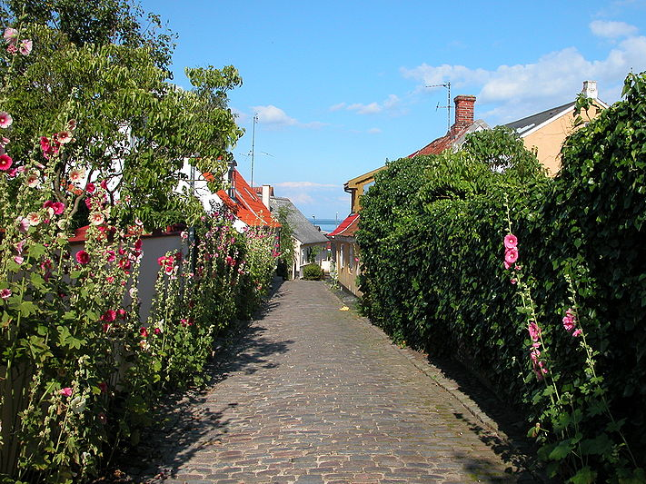
Two Classes in Embedded Systems
Development
(yes, this is a slight simplification)

Slide 13
Plan Oriented
Top Down
Big Systems
Big Companies
Modeling

Slide 14
Grown
Bottom Up
Small/Medium Systems
Smaller Companies
C Code

Slide 15




LWES
Language Workbenches
for
Embedded Systems
http://mbeddr.com

Slide 16
LWES
Language Workbenches
for
Embedded Systems
Incremental Extension of C
http://mbeddr.com
with DSLs for Embedded Systems,
integrated with Formal Methods
and support for PLE and
Requirements Tracing

Slide 17
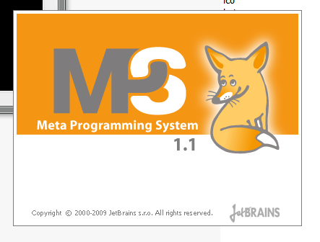
LWES
Language Workbenches
for
Embedded Systems
http://mbeddr.com

Slide 18




LWES
Language Workbenches
for
Embedded Systems
http://mbeddr.com

Slide 19
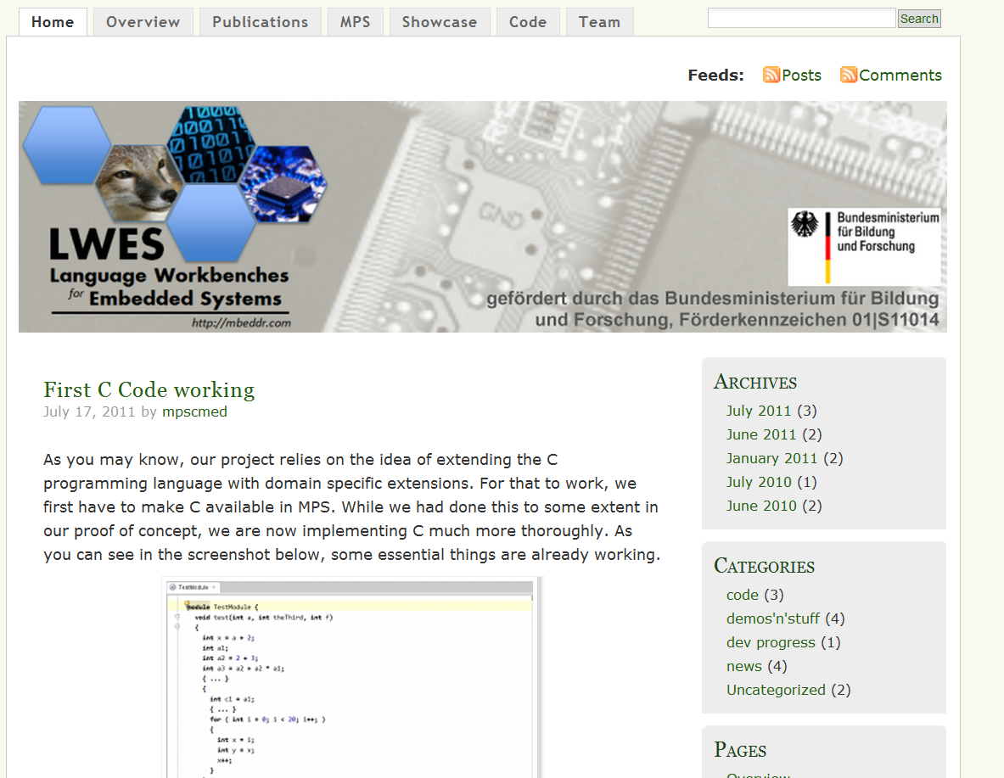
mbeddr.com

Slide 20
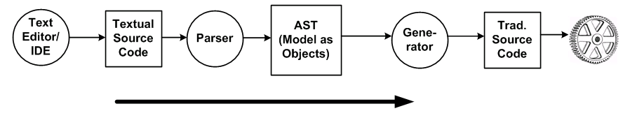
Parser-based
text
… to tree
… to text

Slide 21
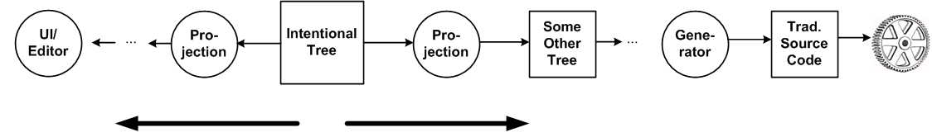
Projectional
tree
… to text-lookalike (editor)
… to other trees … [*]
… to text
Tree

Slide 22
Language
Composition
There‘s no parsing.
Unique Language Element Identity.
Unlimted language composition.

Slide 23
Flexible
Notations
Textual
like ASCII
treated the same
}
Graphical
can be mixed
box & line
Semi-Graphical
mathematical

Slide 24
Automatic
IDE Extension
tool support is inherent
for languages build with
projectional tools
language definition
implies
IDE definition

Slide 25
Multiple
Notations
… for the same concepts
e.g. in different contexts
or for different tasks

Slide 26
Partial
Projections
… different views
… for different roles/people
… only a particular variant

Slide 27
Tree Editing
… is different from editing text
… try to make it feel like text
… takes some getting used to
but: for more flexible notations a more general editing paradigm is needed

Slide 28
Infrastructure
Integration
… storage is not text
… diff/merge must be in tool
… existing text tools don‘t work

Slide 29
Proprietary
Tools
… no standards
… no interop

Slide 30


http://jetbrains.com/mps

Slide 31
Open Source (Apache 2.0)
Projectional Editor
Very good at lang. Composition
Version 2.0.2 current
Improved performance
Unified generate/compile/build
Debug MPS in MPS
Tables in the editor

Slide 32
Open Source (Apache 2.0)
Projectional Editor
Very good at lang. Composition
Version 2.0.2 current
Version 2.1 early 2012
Several Editors per Concept,
Generate into language models,
Wiki-Language and more.

Slide 33
Open Source (Apache 2.0)
Projectional Editor
Very good at lang. Composition
Version 2.0.2 current
Version 2.1 early 2012
Version 3.0 late 2012
Graphical Editors
Eclipse-Integration

