Slide 1


Salary Predictions Of Data Professions

Slide 2
Problem Statement
Salaries in the field of data professions vary widely based on factors such as experience, job role, and performance. Accurately predicting these salaries is essential for both job seekers and employers to make informed decisions.

Slide 3


Your Mission
1
Exploratory Data Analysis
Dive into the dataset, conduct comprehensive EDA, and unveil valuable insights about data professionals' salaries. EDA will involve data visualization, summary statistics, and identifying patterns in the data.
2
Feature Engineering
Create new features or transform existing ones that can provide additional insights or improve model performance. This might involve deriving features related to experience, job role, and performance.
3
Model Development
Train various machine learning regression models to predict salaries, experimenting with different algorithms to find the best-performing model.

Slide 4
Your Mission (continued)
Data Preprocessing
Model Evaluation
ML Pipelines and Deployment
Prepare the data for model training, including handling missing values, encoding categorical variables, and scaling or normalizing features as needed.
Assess the performance of your models using appropriate evaluation metrics like MAE, MSE, RMSE, and R2 score. Identify the model that provides the most accurate salary predictions.
Create ML Pipelines to streamline the end-to-end machine learning process and deploy a model that can generate predictions for unseen data.

Slide 5
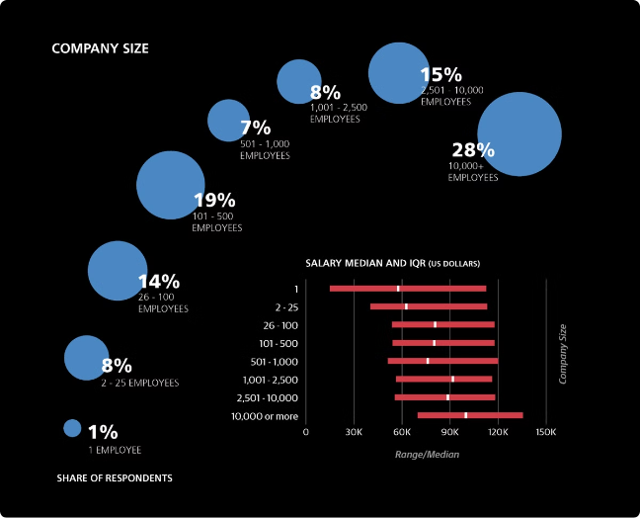
Dataset Overview
1
Comprehensive Data
The dataset contains a wealth of information, including personal details, job characteristics, and performance metrics, providing a rich foundation for salary prediction.
2
Diverse Attributes
The dataset covers a range of attributes, such as gender, age, experience, job role, and ratings, which can be leveraged to uncover the key drivers of data professionals' salaries.
3
Target Variable
The target variable, "SALARY," represents the salary of the data professional, which is the key focus of this predictive modeling exercise.

Slide 6



Recommendations
Salary Insights
Career Strategies
Job Market Trends
Analyze the factors that influence data professionals' salaries and provide actionable recommendations to help job seekers and employers make informed decisions.
Leverage the insights from the predictive model to suggest strategies for data professionals to enhance their earning potential and advance their careers.
Identify trends and patterns in the data that can inform job seekers and employers about the current state of the data profession job market.

Slide 7
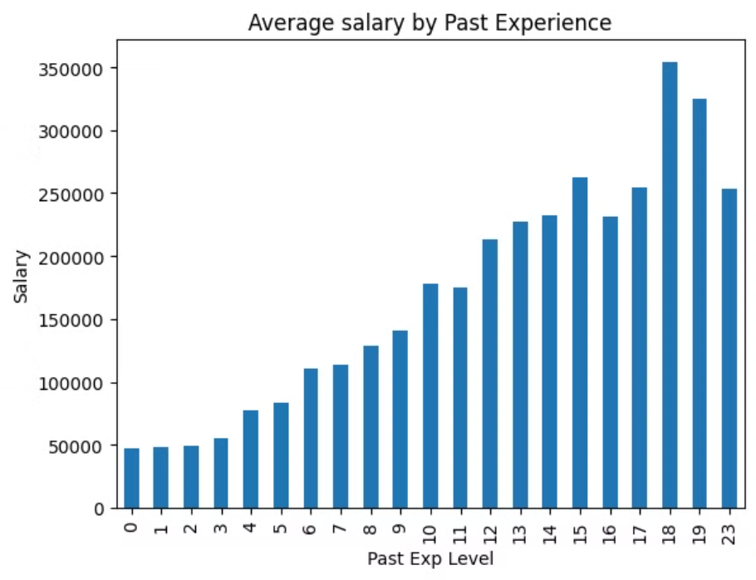
Salary Prediction With Past Experience

Slide 8



Conclusion
Valuable Skills
By the end of this internship, you will have gained valuable skills in data analysis, feature engineering, regression model development, ML Pipelines, and model deployment.
Impactful Insights
Your work will contribute to providing valuable insights for job seekers and employers in the field of data professions, helping them make informed decisions.
Exciting Journey
This internship offers an exciting opportunity to apply machine learning techniques and make a real impact in the job market for data professionals.

