Slide 1
UCS1625 - Foundations of Data Science : Project Work ANALYSIS OF TECHNIQUES FOR POPULARITY PREDICTION OF SPOTIFY TRACKS
Aarthi.V.S
185001003

Slide 2
Problem Statement
Spotify is a popular music streaming service. It has a huge dataset of songs and the service also collects data about the musical features, the release details and the artists that release those tracks. Spotify also tracks the popularity of each track based on a lot of factors like number of streams, frequency of streams, number of playlists that a track has been added to, how recently the track has been streamed etc.
For an artist or record label a higher popularity of their track on Spotify indicates higher revenue generation. For any music enthusiast it is certainly interesting to analyse why songs become popular and what are the factors affecting the popularity of songs.
This project attempts to build a Spotify popularity predictor and analyse various methods to achieve the same. The project also attempts to identify which factors are most important in determining the popularity of a track. Clustering-then-Regression analysis has also been done.

Slide 3
Literature Survey
An example of the strategy of using social network data to assess current public perception and extrapolate how successful a song or album will be is the work of Dhar and Chang [2]. The authors gathered comments related to 108 albums, before and after they were released, from sources that included social networks and blogs. Their objective was to verify if the sales were reflected in the comments. They also took into consideration data from the songs and artists: the recording label, the time between announcement and release of the album and the reception of the artists’ previous work—the number and positiveness of the reviews published in specialized venues, such as the Rolling Stone and Entertainment Weekly magazines, and the scores given by users in online platforms. The authors concluded that the factors that best correlated with sales were the number of posts in social networks and blogs—without checking if those comments were positive or negative—, and the average rating of the artist’s previous works by users. At the same time, they also remark that traditional factors, such as traditional media coverage, are still important, and that albums released by larger musical labels attain results 12 times greater.
Herremans, Martens and Sorensen [1] is an example of the second approach that uses past data from charts to predict whether a song will be featured in that same chart in the future. The authors extracted data from the OCC Top 40 Dance Music between 2009 and 2013 and considered a song to be successful if it was featured up to a certain position in the ranking. The authors obtained the better results when the Top as success, the ones in positions #11 to #30 were not used in the experiment and the last 10 were considered as flop. Using a SVM classifier with polynomial kernel they reached an accuracy of 85% in average.
Among works in the third group, using acoustic information of songs to predict their success, Lee and Lee [3] collected data on 16; 686 songs that appeared for more than two weeks on Billboard’s Hot 100 ranking between 1970 and 2014. For each song, the authors extracted features like chroma, rhythm, timbre, and MFCC. They also employed non acoustic information, including the number of weeks each song was featured in the ranking and the average of their weekly ranks. They trained a Support Vector Machine (SVM) model with RBF kernel and achieved 70% accuracy when predicting which would be the best rank a song would achieve.

Slide 4
Scope
This project is limited to analysing the tracks of a particular music streaming service and as with any streaming service the users of the service are primarily young people. This might affect the model’s accuracy in predicting the popularity of tracks across the entire population.
The dataset only contains information about the tracks themselves but not any relevant information about the artists producing the tracks. The dataset also does not contain any historical data about popular songs that might be useful.
The dataset does however contain relevant data from a business use-case standpoint where in the popularity of a track on a service like Spotify generally indicates a good reach and overall “hit” level.

Slide 5
Dataset Description
The dataset contains the data about the features of tracks on Spotify, the popular music streaming platform. The data was collected using the Spotify Web API.
Link : https://www.kaggle.com/yamaerenay/spotify-dataset-19212020-160k-tracks
There are 174389 tracks in the dataset with each track being described by 19 features.

Slide 6
Features of the Dataset
Primary
ID: The primary identifier for the track, generated by Spotify
Numerical
Valence: The positiveness of the track. Higher values mean, the track evokes positive emotions (like joy) otherwise means, it evokes negative emotions (like anger, fear). Ranges between 0-1.
Year: The release year of the track.
Acousticness: The value that describes how acoustic a song is. Higher values mean that the song is most likely to be an acoustic one. Ranges between 0-1.
Danceability: The relative measurement of the track being danceable. Higher values mean that the song is more danceable. Ranges between 0-1.
Duration: The length of the track. In milliseconds.
Energy: The energy value of the track. Higher values mean that the song is more energetic. Ranges between 0-1.
Instrumentalness: The relative ratio of the track being instrumental. Higher values mean that the song contains more instrumental sounds. Ranges between 0-1.
Liveness: Detects the presence of an audience in the recording. Higher values represent an increased probability that the track was performed live. A value above 0.8 provides a strong likelihood that the track is live. Ranges between 0-1.
Loudness: The overall loudness of a track in decibels (dB). Loudness values are averaged across the entire track and are useful for comparing the relative loudness of tracks. Loudness is the quality of a sound that is the primary psychological correlate of physical strength (amplitude). Values typical range between -60 and 0 dB.
Popularity: The popularity of the song. Ranges between 0 and 100.
Speechiness: The relative length of the track containing any kind of human voice. Ranged between 0-1.
Tempo: The tempo of the track in Beat Per Minute (BPM).

Slide 7
Features of the Dataset
Categorical
Key: All keys on octave encoded as values ranging from 0 to 11, starting on C as 0, C# as 1, etc.
Mode: Mode indicates the modality (major or minor) of a track, the type of scale from which its melodic content is derived. Major is represented by 1 and minor is 0.
Explicit: The binary value whether the track contains explicit content or not.
Nominal
Artists: The list of artists credited for the production of the track.
Release Date: The date of release of the track in yyyy-mm-dd, yyyy-mm, or even yyyy format
Name: The name of the song.

Slide 8
Proposed Solution
The strategies used for popularity prediction are:
1. EDA and Feature Analysis
2. Linear Regression – Only selected acoustic features
3. Linear Regression – Only selected acoustic features and artist information
4. Linear Regression – All available information
5. Decision Tree – only selected acoustic features and artist information
6. Logistic Regression – All available information
7. Clustering-then-Regression: K-Means Clustering and Decision Tree using only selected acoustic features and artist information

Slide 9
Tools used
Python
Jupyter Notebook
Python Libraries Used:
Numpy
Scipy
Pandas
Scikit-learn
matplotlib
Other Tools/Methodologies
Some other algorithms that can be used are:
K Nearest Algorithm
Support Vector Machines
Lasso Regression
Artificial Neural Networks
Some other tools that can be used include :
R
TensorFlow
TensorBoard
Tableau

Slide 10
EDA

Slide 11
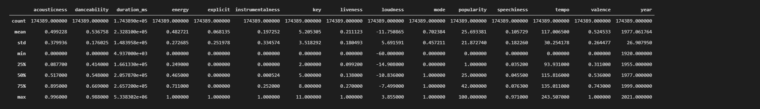
Numerical Description of the Features of the Dataset

Slide 12
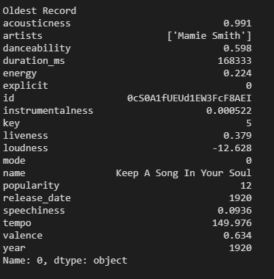
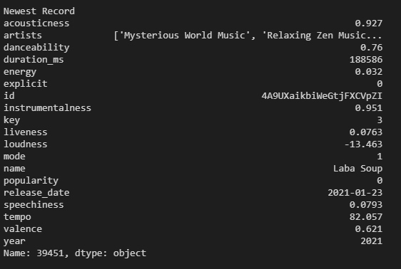
Oldest and Newest Record
Oldest Song: https://open.spotify.com/track/0cS0A1fUEUd1EW3FcF8AEI?si=XUxI1s9aTSuf__oQAFfWQA
Since we have data about tracks spanning over 100 years; A time-series analysis of the data might give some relevant insights.

Slide 13
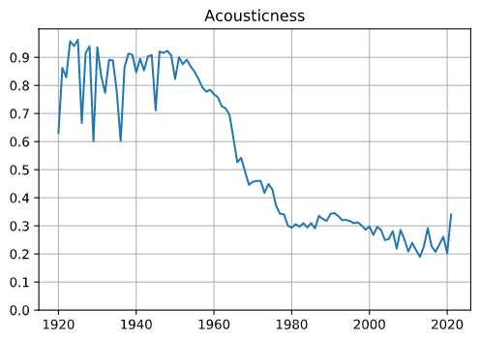
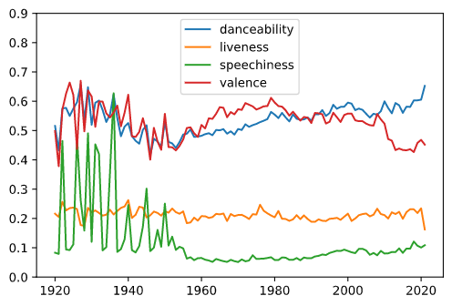
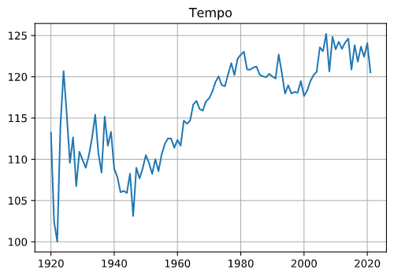
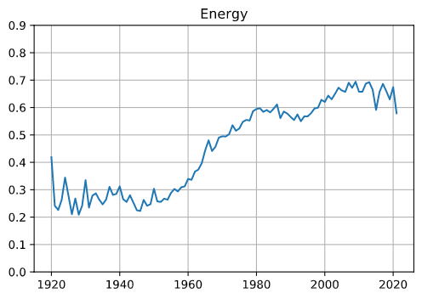
Time Series Visualizations

Slide 14
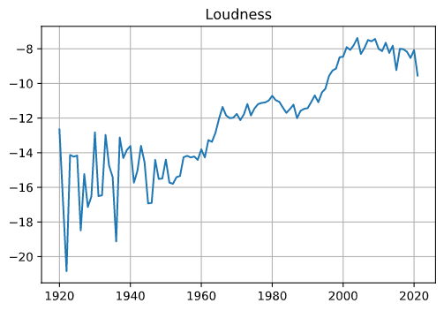
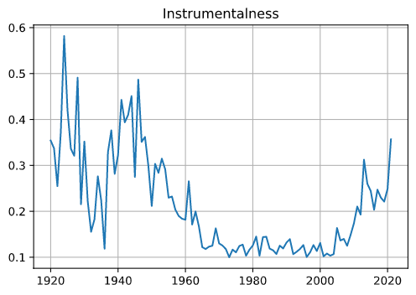
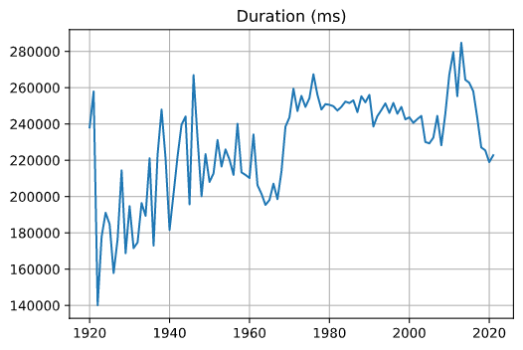
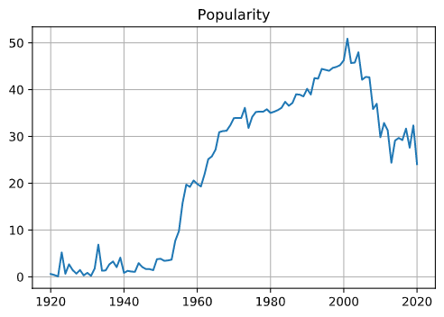
Time Series Visualizations

Slide 15
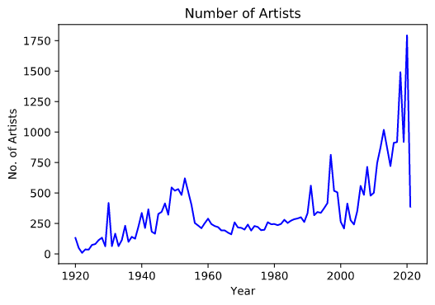
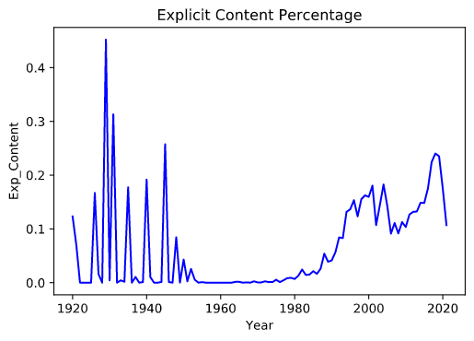
Time Series Visualizations
The number of artists releasing songs has increased over the years.
Possible reasons:
Easier access to recording studios and equipment
Not all older songs are available on Spotify
The percentage of songs with explicit content has a fairly increasing trend except for some abnormal spikes.
( 1921,1929,1931,1935,1940,1945 …)
In 1929, 430 songs out of the 951 songs had explicit content but all 430 songs were released only by 4 artists.
Out of these 4, two of the artists’ songs have been mislabelled and the other two were prominent Russian writers who wrote about war and the military experience.

Slide 16
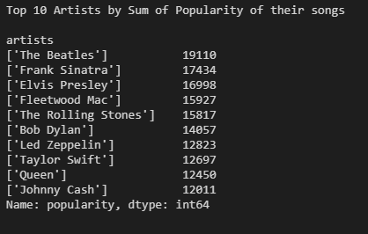
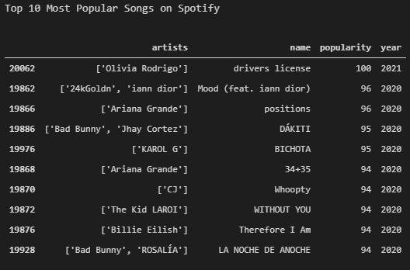
Rankings
This list may even be considered as the most popular artists in history on Spotify as summing the popularity ensures that they have released a good number of songs and that most of their songs are popular.
The most popular songs on Spotify are all released very recently (2020/2021). This indicates that Spotify users tend to prefer newer songs.

Slide 17
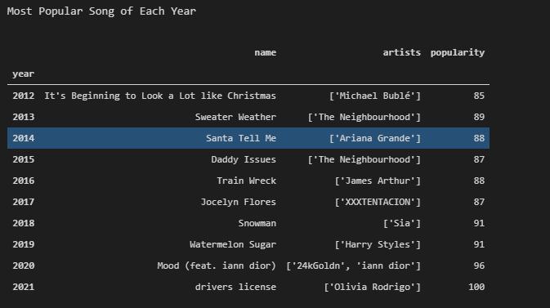
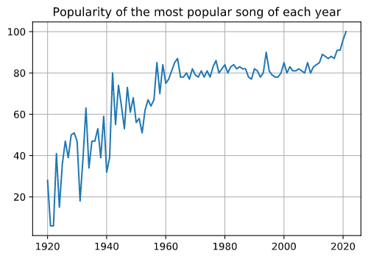
Rankings Most Popular Song of each year
The graph clearly shows reinforces the fact that the popularity of songs on Spotify has increased over time as the most popular song of this year is about 34% more popular than the most popular song in the 1960's.

Slide 18
Hypothesis Testing Relationship between the Mode of a song and its Popularity
Null Hypothesis : The mode and popularity of songs in the dataset are not related.
Alternate Hypothesis: The mode and popularity of songs in the dataset are related.
A Chi-Square test of independence was performed, and the following results were obtained:
Contingency Table:
[[58927, 43980, 18455, 1126]
[25904, 16879, 8428, 690]]
χ2 : 235.32844529966354
P-value: 9.742906186847722e-51
Result: Null Hypothesis is rejected. The mode and popularity of songs in the dataset are related.

Slide 19
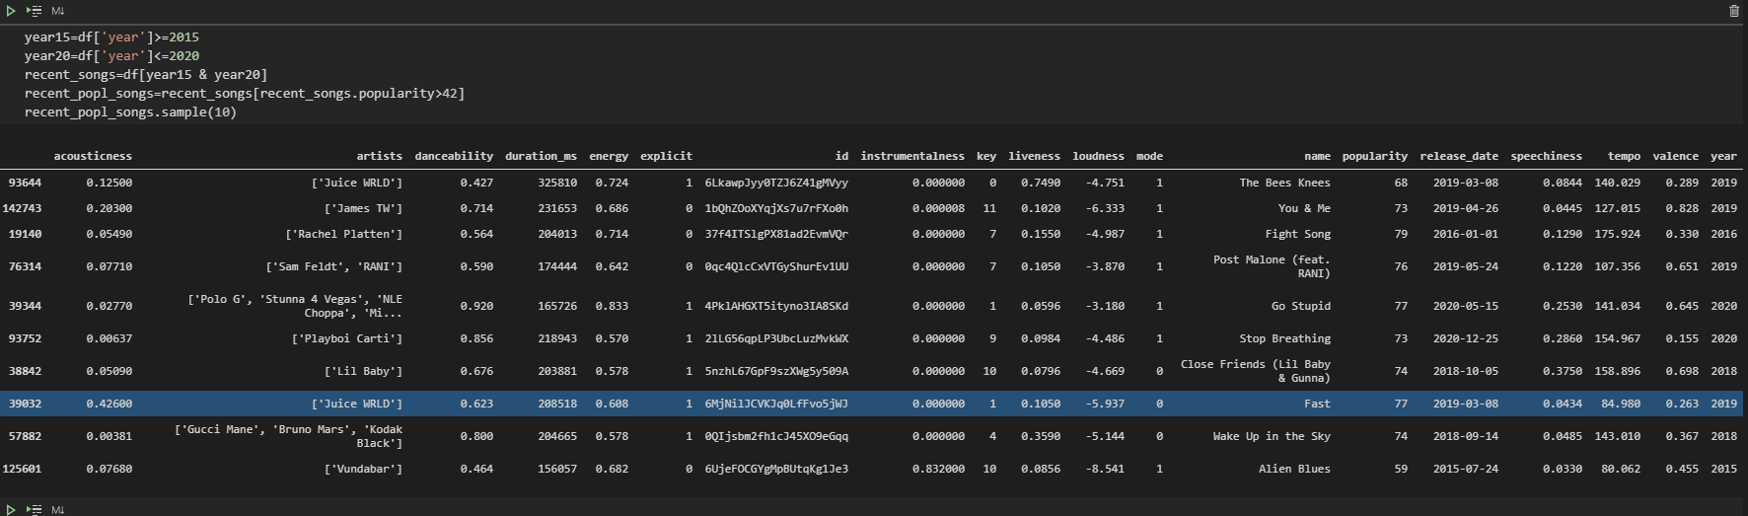
PART Approach
The subset of data used are the tracks that fall above the top 75th percentile that were released after 2015.
This was done to ensure that the features selected and the insights obtained are relevant to today.
This step is necessary given that the corelation of the year of release of a track with its corelation.

Slide 20
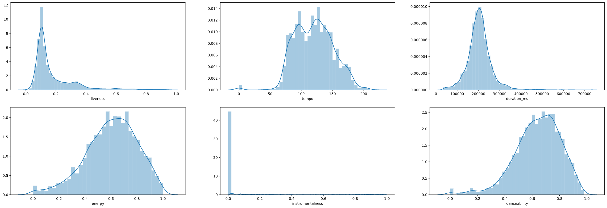
Distribution of the Features

Slide 21
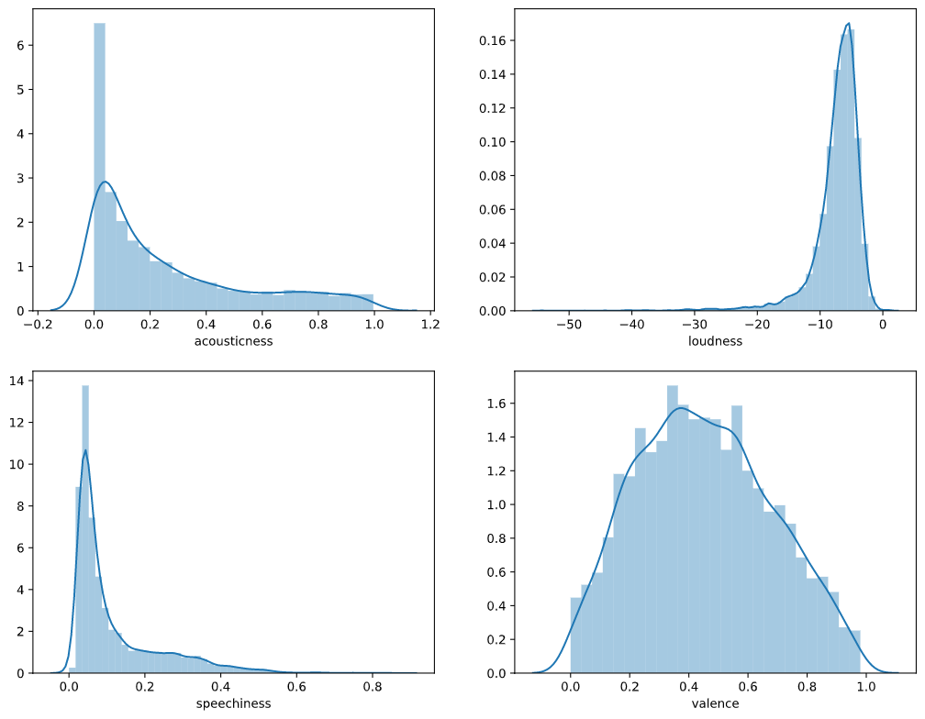
Distribution of the Features

Slide 22
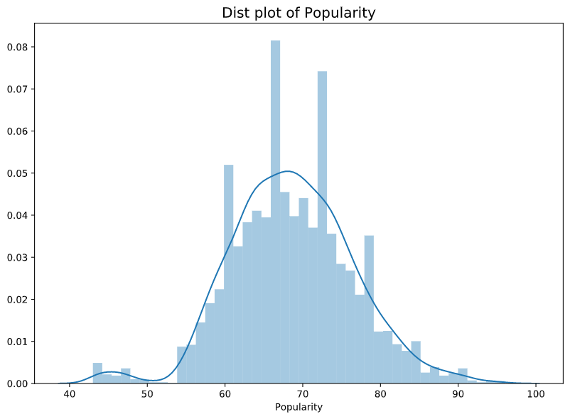
Distribution of the Features

Slide 23
Hypothesis Testing
Will The Beatles be popular today? Will The Beatles fall in the same group as the top 25% of songs in 2015-2020?
Testing done based on Acousticness and Loudness.
Motivation: These attributes have the highest negative and positive correlation with popularity.
T tests: The t score is a ratio between the difference between two groups and the difference within the groups. The larger the t score the more the difference between the groups is.

Slide 24
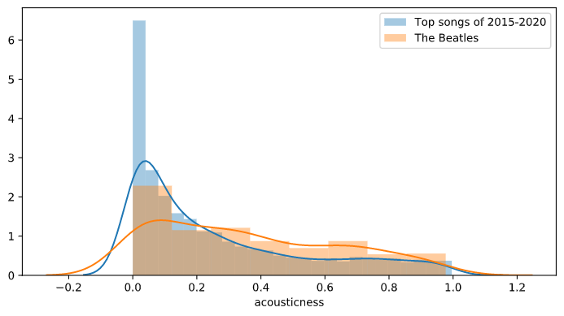
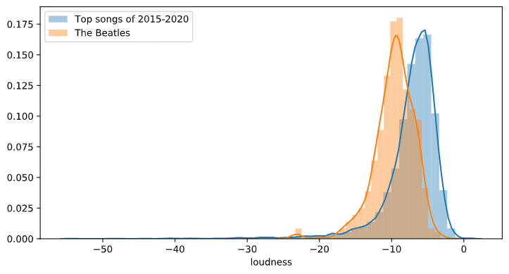
Hypothesis Testing
Acousticness
Null Hypothesis : There is no significant difference between the Beatle's songs’ acousticness and the acousticness of the top 25% songs of 2015-2020.
Alternate Hypothesis: There is a significant difference between the Beatle's songs' acousticness and the acousticness of the top 25% songs of 2015-2020.
Null Hypothesis is rejected. There is a significant difference between the Beatle's songs' acousticness and the acousticness of the top 25% songs of 2015-2020.
Loudness
Null Hypothesis : There is no significant difference between the Beatle's songs’ loudness and the loudness of the top 25% songs of 2015-2020.
Alternate Hypothesis: There is a significant difference between the Beatle's songs' loudness and the loudness of the top 25% songs of 2015-2020.
Null Hypothesis is rejected. There is a significant difference between the Beatle's songs' loudness and the loudness of the top 25% songs of 2015-2020.
Based on the above conducted tests, it can be concluded that the Beatles' songs and the top 25% songs of 2015-2020 based on the acousticness and loudness.
So, it may be concluded that The Beatles songs would not have been as popular if they were released today.

Slide 25
Performance Metrics
For the linear regression models (Linear Regression and Decision Tree) the metrics used were:
RMSE: The RMSE is the square root of the variance of the residuals. It indicates the absolute fit of the model to the data–how close the observed data points are to the model’s predicted values. RMSE is an absolute measure of fit. RMSE has the useful property of being in the same units as the response variable. Lower values of RMSE indicate better fit. RMSE is a good measure of how accurately the model predicts the response, and it is the most important criterion for fit if the main purpose of the model is prediction.
R-squared: It signifies the “percentage variation in dependent that is explained by independent variables”.
Adj. R-squared: This is the modified version of R-squared which is adjusted for the number of variables in the regression. It increases only when an additional variable adds to the explanatory power to the regression.
Prob(F-Statistic): This tells the overall significance of the regression. This is to assess the significance level of all the variables together unlike the t-statistic that measures it for individual variables. The null hypothesis under this is “all the regression coefficients are equal to zero”. Prob(F-statistics) depicts the probability of null hypothesis being true
AIC/BIC: It stands for Akaike’s Information Criteria and is used for model selection. It penalizes the errors mode in case a new variable is added to the regression equation. It is calculated as number of parameters minus the likelihood of the overall model. A lower AIC implies a better model. Whereas, BIC stands for Bayesian information criteria and is a variant of AIC where penalties are made more severe.
Durbin-Watson: Another assumption of OLS is of homoscedasticity. This implies that the variance of errors is constant. A value between 1 to 2 is preferred.
For the classification model (Logistic Regression) the performance metrics used were:
Accuracy: It is the number of correct predictions made as a ratio of all predictions made.
Precision: It is the ratio between true positives and all actual positive samples.
Recall: It is the ratio between true positives and all samples that the model predicted as positive.
F1-Score: It is the harmonic mean of precision and recall.
AUC: A curve is plotted between True Positive Rate and False Positive rate. The area with the curve and the axes as the boundaries is called the Area Under Curve(AUC). It is this area which is considered as a metric of a good model. With this metric ranging from 0 to 1, we should aim for a high value of AUC.

Slide 26
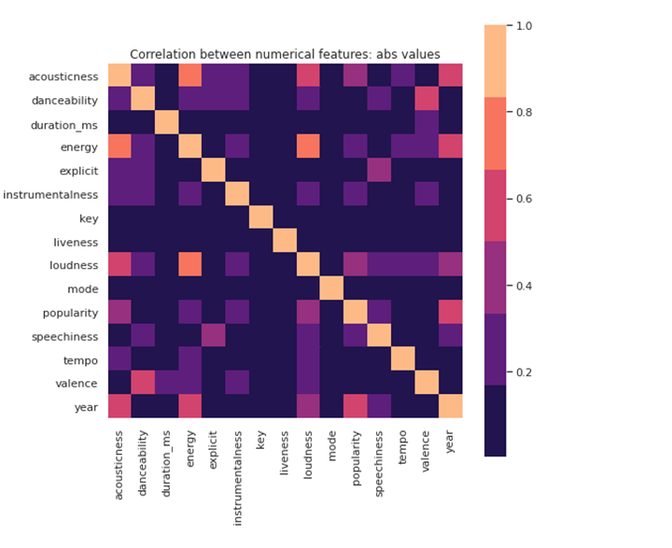
Results
EDA & Feature Analysis
The strongest linearly correlated numeric features to popularity are:
Year: 0.51
Acousticness: 0.40
Loudness: 0.34
Energy: 0.33
Instrumentalness : 0.30

Slide 27
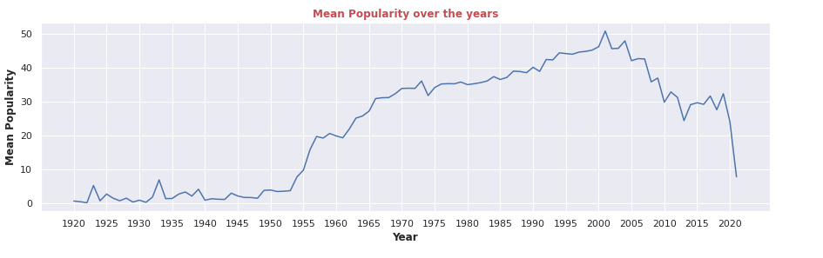
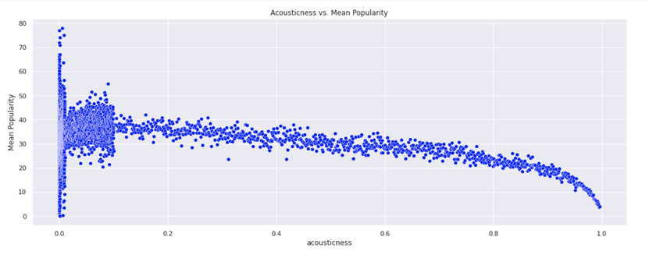
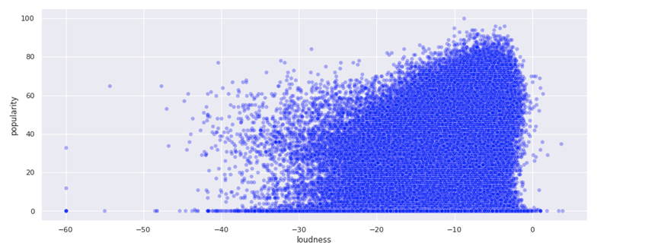
Year
Acousticness
Loudness
This indicates a steady increase in popularity of songs that are released more recently.
This shows a negative correlation between popularity and Acousticness.
This shows a positive correlation between loudness and popularity.

Slide 28
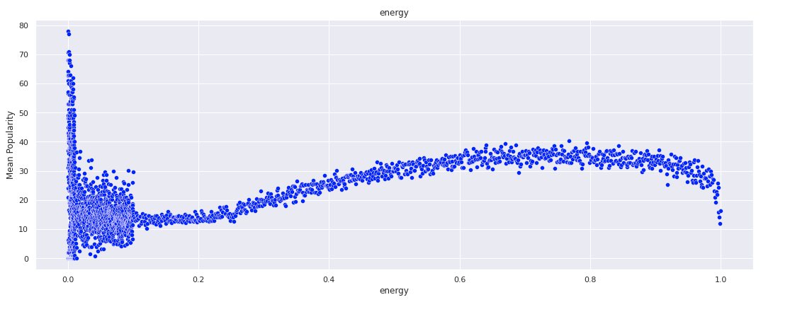
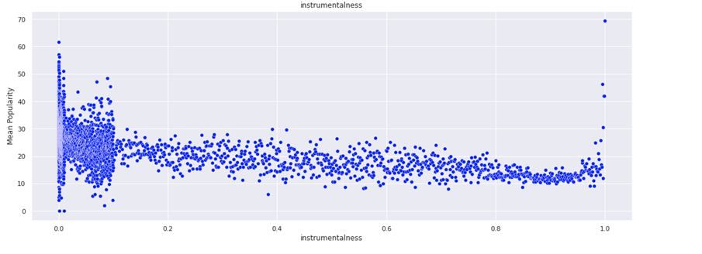
Energy
Instrumentalness
This shows a positive correlation between energy and popularity.
This shows a negative correlation between popularity and Instrumentalness.

Slide 29
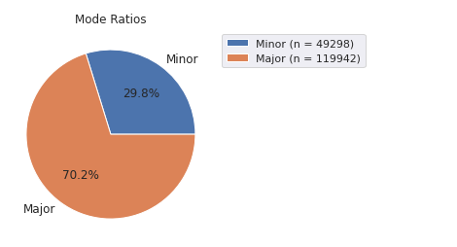
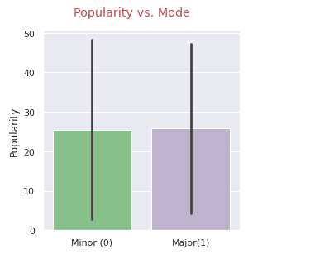
Categorical Features
Mode
Major mode songs are much more common in the dataset.
The bar graph shows that major mode songs are slightly more popular than minor mode songs.

Slide 30

Contingency Table:
Popularity Mode | <25 | 25-50 | 50-75 | >75
Major | 58927 | 43980 | 18455 | 1126
Minor | 25904 | 16879 | 8428 | 690
A chi-square test for independence between the mode and popularity of tracks in the dataset gave the following results:
Null Hypothesis: The mode and popularity of the songs are not related.
Alternate Hypothesis: The mode and popularity of songs in the dataset are related.
The results of the Chi-Square test of independence:
χ2 : 235.32844529966354
P-value: 9.742906186847722e-51
Null Hypothesis is rejected.
The mode and popularity of songs in the dataset are related.

Slide 31
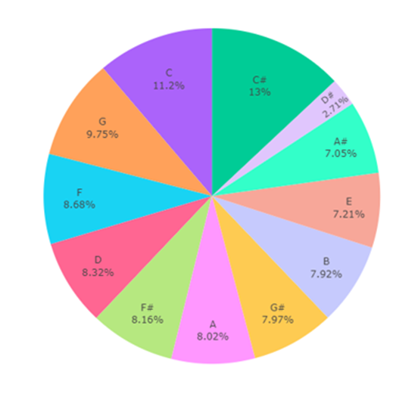
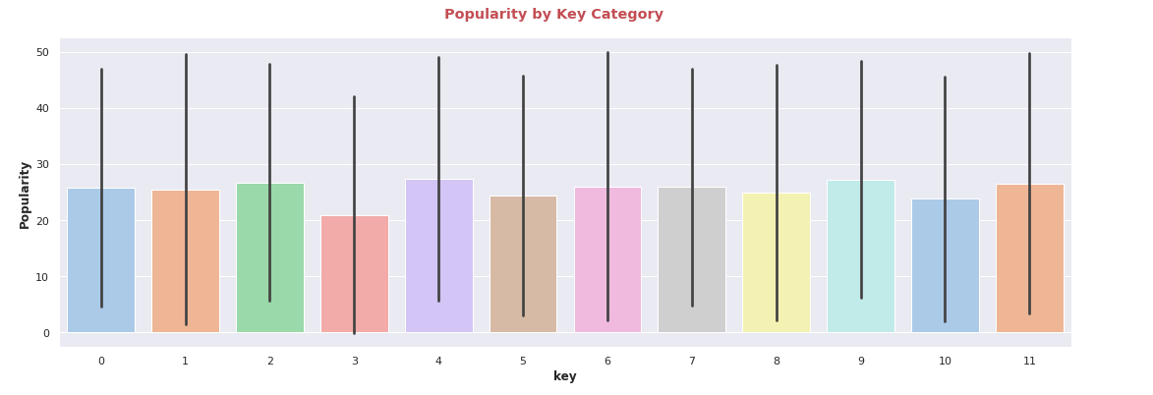
Key
The bar graph shows that even though the popularity of songs in all keys are not the same the difference in mean popularity of songs in different keys is almost insignificant.

Slide 32
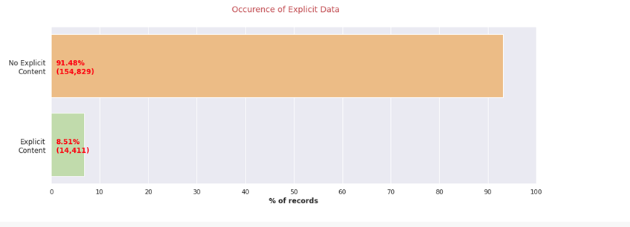
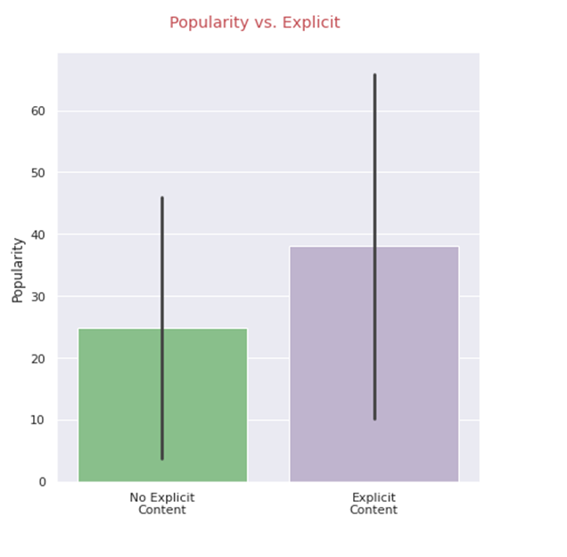
Explicit Content
Songs with explicit content have a higher mean popularity but this result can also arise because of the inaccuracy of averages in a skewed dataset.

Slide 33
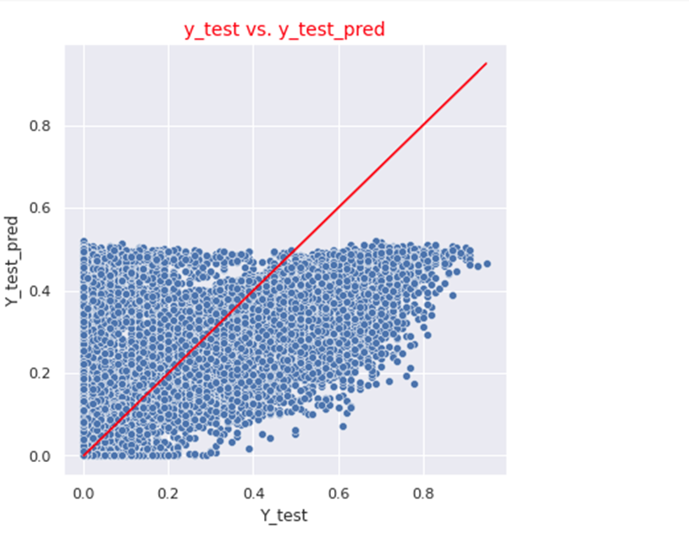
Linear Regression using only selected acoustic features
The features selected were:
Year
Acousticness
Energy
Loudness
Instrumentalness
RMSE:
Train = 0.17532
Test = 0.17412
R-squared (uncentered): 0.684
Adj. R-squared (uncentered):0.684
F-statistic: 5.911e+04
AIC: -6.391e+04
Durbin-Watson: 2.001

Slide 34
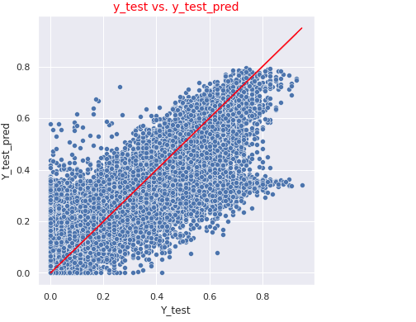
Linear Regression using only selected acoustic features and artist information
The features selected were:
Year
Acousticness
Energy
Loudness
Instrumentalness
Artist Information
RMSE:
Train = 0.13327
Test = 0.13902
R-squared (uncentered): 0.838
Adj. R-squared (uncentered): 0.838
F-statistic: 1.180e+05
AIC: -1.555e+05
Durbin-Watson: 2.000

Slide 35
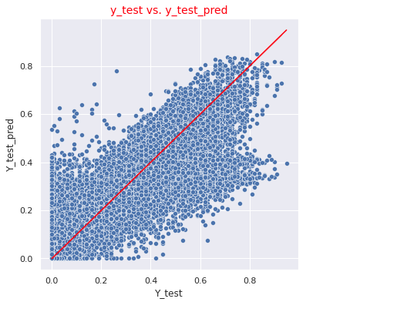
Linear Regression using all available features
RMSE:
Train = 0.131639
Test = 0.137098
R-squared (uncentered): 0.843
Adj. R-squared (uncentered): 0.843
F-statistic: 2.938e+04
AIC: -1.597e+05
Durbin-Watson: 1.999

Slide 36
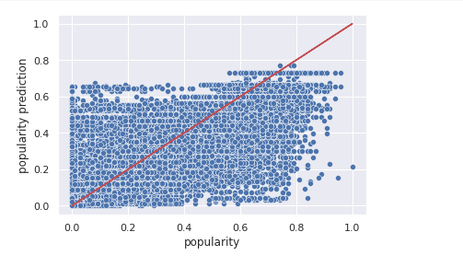
Decision Tree – only selected acoustic features and artist information
RMSE:
Train: 0.105
Test: 0.114
R-squared (uncentered): 0.838
Adj. R-squared (uncentered): 0.838
F-statistic: 1.180e+05
AIC: -1.555e+05
Durbin-Watson: 2.000

Slide 37
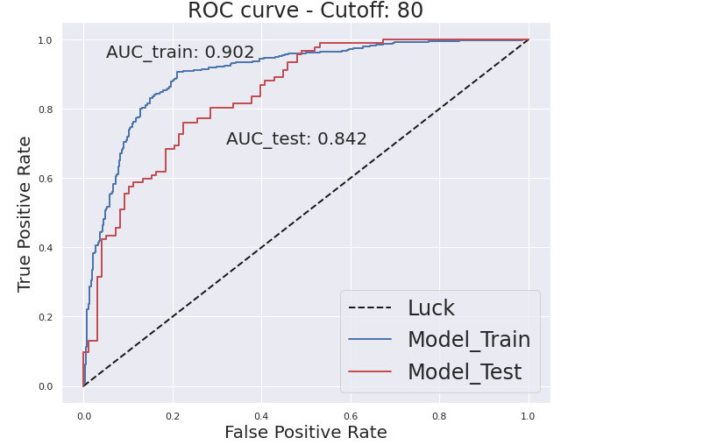
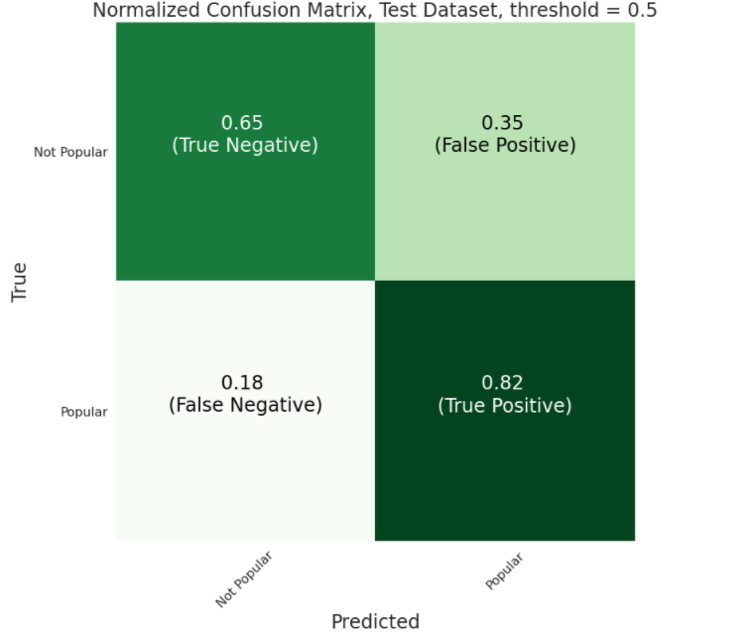
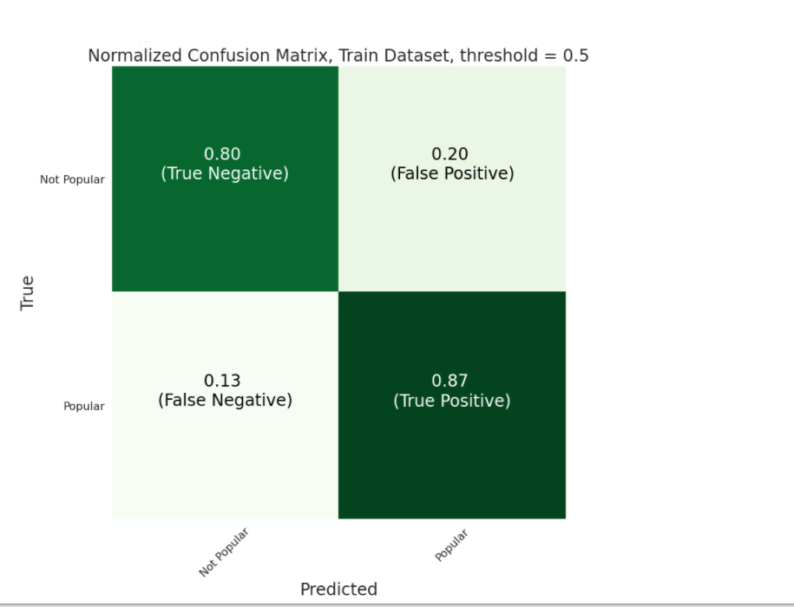
Logistic Regression – all available information
Train accuracy: 0.84
Test accuracy: 0.73
Train recall: 0.87
Test recall: 0.82
Train precision: 0.82
Test precision: 0.69
Train AUC: 0.902
Test AUC: 0.842
Delta in p-Value: -0.2482833

Slide 38
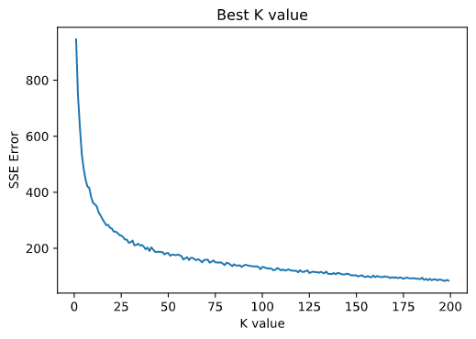
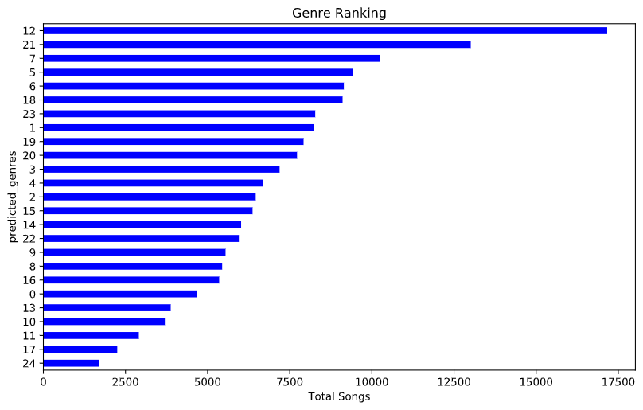
Clustering-then-Regression: K-Means Clustering and Decision Tree using only selected acoustic features and artist information K-Means Clustering
Determining k:
The optimal number of clusters is 25. ( Elbow Method)
The genre information is added to the dataset.

Slide 39
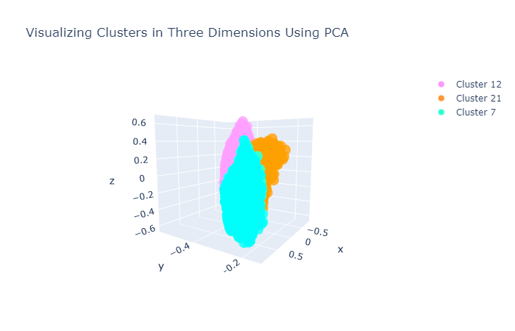
Clustering Results – PCA for Visualization

Slide 40
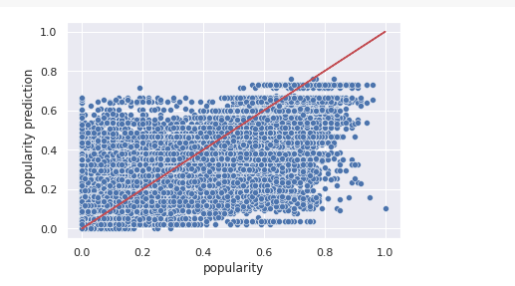
Decision Tree – modified dataset using only selected acoustic features and artist information
The features selected were:
Year
Acousticness
Energy
Loudness
Instrumentalness
Artist Information
Genre Information
RMSE:
Train: 0.10421681427960094
Test: 0.11232989759946345
R-squared (uncentered): 0.838
Adj. R-squared (uncentered): 0.838
F-statistic: 1.012e+05
AIC: -1.556e+05
Durbin-Watson: 2.001

Slide 41
Conclusion
In this project a methodology to predict the popularity of a song using data collected from Spotify was presented.
The best results were achieved using a decision tree using only the highly corelated features, artist data and the genre data obtained using clustering. The logistic regression algorithm performed very well for the case of binary classification with a training AUC of 0.90 and a test AUC of 0.84.
With the available dataset currently a logistic regression model performs much better than any linear regression model.
Even though the project is limited to data on Spotify, the models can be extended to other platforms.
Furthermore, while this project explored models that use only acoustic information, historical data about the previously popular songs and other information about the current social media trends can help greatly in improving the accuracy of the models.

Slide 42
References
[1] D. Herremans, D. Martens, and K. Sorensen, “Dance hit song prediction,” Journal of New Music Research, vol. 43, no. 3, pp. 291–302, 2014..881888
[2] V. Dhar and E. A. Chang, “Does chatter matter? the impact of user-generated content on music sales,” Journal of Interactive Marketing, vol. 23, no. 4, pp. 300 – 307, 2009.
[3] J. Lee and J. Lee, “Music popularity: Metrics, characteristics, and audio based prediction,” IEEE Transactions on Multimedia, vol. 20, no. 11, pp. 3173–3182, Nov 2018.
[4] https://www.kaggle.com/yamaerenay/spotify-dataset-19212020-160k-tracks

Slide 43
Thank You

