Slide 1
KEYLOGGER
CAPSTONE PROJECT
Presented By: AARTHIKA R
AVCCE-CSE III YEAR
au820321104002

Slide 2
OUTLINE
Problem Statement (Should not include solution)
Proposed System/Solution
System Development Approach (Technology Used)
Algorithm & Deployment
Result (Output Image)
Conclusion
Future Scope
References

Slide 3
PROBLEM STATEMENT
In today's digital age, where cybersecurity threats loom large ,one of the significant concerns is the proliferation of keyloggers, stealthy software tools designed to monitor and record keystrokes on a user's computer without their knowledge. Keyloggers pose a severe threat to individuals and organizations as they can capture sensitive information such as passwords, credit card details and other personal data, leading to identity theft, financial loss and privacy breaches.

Slide 4
PROPOSED SOLUTION
Keylogger Implementation:
Develop a keylogger application using Python, leveraging the pynput library to capture keyboard events including key presses and releases.
Data Logging:
Create functions to log the captured keystrokes into text and JSON files for easy storage and analysis. The text file will provide a simple chronological record of keystrokes, while the JSON file will allow for more structured data storage, enabling additional metadata to be captured alongside keystrokes.
Event Handling:
Implement event handlers for key press and release events using the pynput.keyboard.Listener class. These handlers will be responsible for capturing the keystrokes and logging them appropriately.
User Interface:
Develop a user-friendly interface using the Tkinter library to facilitate interaction with the keylogger application. The interface should include buttons to start and stop the keylogger, as well as a label to display the current status of the keylogger.
Error Handling:
Implement robust error handling mechanisms to gracefully handle any unexpected errors or exceptions that may occur during the operation of the keylogger. This will help maintain the reliability and stability of the application under various conditions.

Slide 5
SYSTEM APPROACH
The "System Approach" section outlines the overall strategy and methodology for developing and implementing the keylogger. Here's a suggested structure for this section:
Requirement Assessment:
Identify the need for a keylogger system and determine its intended use cases.
Define the essential features required for the keylogger, such as keystroke capturing and data storage.
Technology Selection and Library Requirements:
Choose suitable technologies for keylogger implementation, focusing on reliability and cross-platform compatibility.
Select Python as the programming language for development and utilize the `pynput` library for Python to capture keyboard events and interact with input devices.
Development Strategy:
Break down the development process into manageable tasks and prioritize critical functionalities.
Allocate resources efficiently to meet development timelines and milestones.
Testing and Quality Assurance:
Develop test cases to validate the functionality and performance of the keylogger system.
Conduct thorough testing to identify and address any bugs or issues before deployment.
Deployment and Maintenance:
Deploy the keylogger system following a well-defined deployment strategy, considering platform compatibility and security requirements.
Establish processes for ongoing maintenance, including updates and user support.

Slide 6
ALGORITHM & DEPLOYMENT
Algorithm Selection:
For the keylogger, we have chosen to utilize the pynput library in Python, which provides functionality for capturing keyboard events in real-time. This library offers a straightforward and efficient solution for capturing keystrokes and logging them for analysis.
Data Input:
The data input for the keylogger consists of keyboard events, including key presses and releases, captured by the pynput library. These events are processed in real-time and logged for further analysis and monitoring.
Training Process:
Since the keylogger does not involve a traditional training process like machine learning algorithms, there is no specific training phase. Instead, the keylogger continuously listens for keyboard events and logs them as they occur, without the need for explicit training.

Slide 7
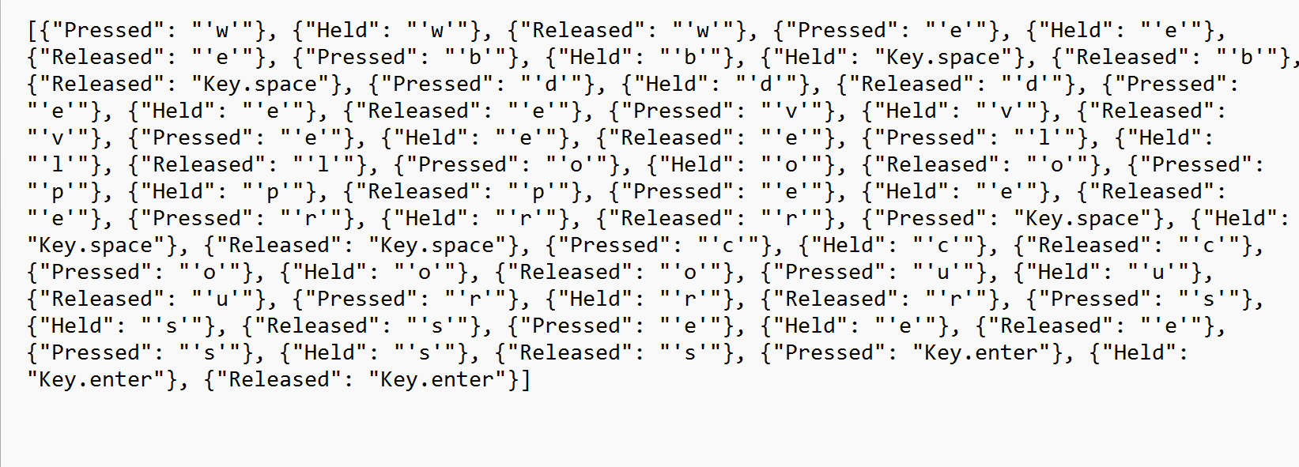
RESULT

Slide 8
CONCLUSION
Implementation Challenges:
Platform Compatibility
Security Concerns
User Interface Complexity
Solutions:
Utilizing Cross-Platform Libraries
Implementing Robust Security Measures
Streamlining User Interface
User Interface Enhancement Challenges:
Lack of Intuitiveness
Accessibility Issues
Solutions Implemented
Redesigning Interface
Implementing Accessibility Features
Ethical Usage and Data Privacy Challenges:
Ethical Concerns
Data Protection
Compliance with Regulations
Solutions Implemented:
Establishing Usage Guidelines
Implementing Encryption and Access Controls
Conducting Privacy Audits

Slide 9
FUTURE SCOPE
Enhanced Data Capture:
Incorporate additional data sources such as mouse clicks and application usage to provide a more comprehensive view of user activity.
By expanding the scope of data capture, the keylogger can offer deeper insights into user behavior and interactions beyond keyboard activity.
Improved Algorithm Performance:
Implement real-time analysis and anomaly detection techniques to enhance the keylogger's ability to identify patterns and anomalies in user behavior.
By optimizing the algorithm for better performance, the keylogger can provide more timely and accurate insights into potential security threats or unusual activities.
Expanded Coverage and Compatibility:
Extend the keylogger's support to multiple users and devices, enabling monitoring of diverse environments such as shared workspaces or family computers.
By ensuring compatibility with a wide range of devices and platforms, the keylogger can offer broader coverage and usability for various use cases.

Slide 10
REFERENCES
Building a Keylogger in Python using the Pynput Module: A Beginner's Guide - Adventures in Machine Learning

Slide 11
THANK YOU

