Slide 1

Project MASET 697J
FPGA Implementation of LZ77 Lossless Data Compressor
School of Electronics Engineering (SENSE)
Under the guidance of
Dr. Augusta Sophy Beulet P Professor
25MVD1004, Arthy A

Slide 2
Contents
1. Introduction
2. Objective
3. Literature review
4. Methodology
5. Implementation
6. Simulation
7. Work Plan

Slide 3
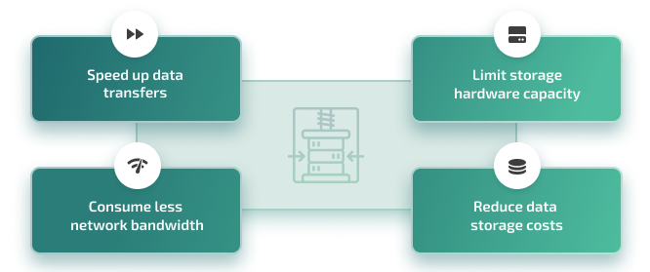
Objective
With the rapid growth of AI and Machine Learning applications, the amount of data generated and processed is increasing at an unprecedented rate. These applications demand high-speed, efficient, and lossless data compression to reduce storage requirements, transmission bandwidth, and associated costs while ensuring data integrity.
Conventional approaches often fail to meet the stringent requirements of real-time performance, low power, and scalability. Hence, there is a strong need for an FPGA-based hardware implementation of efficient compression techniques, leveraging parallelism and reconfigurability to deliver high throughput, reduced latency, and energy efficiency for modern data-intensive systems.
Notes:
Experimental results on FPGA show that TF mode achieves about 11.39% higher throughput with only a 0.07 reduction in compression ratio compared to CF mode.
The compressor achieves a throughput of about 1.76 bytes per cycle in TF mode and 1.58 bytes per cycle in CF mode, with respective compression ratios of 2.48 and 2.55.
In essence, this design enables a hardware LZ77 compressor that can flexibly trade off between speed and data compression efficiency by adjusting how many substring comparisons it performs in parallel, adapting dynamically to system requirements without needing hardware changes.

Slide 4
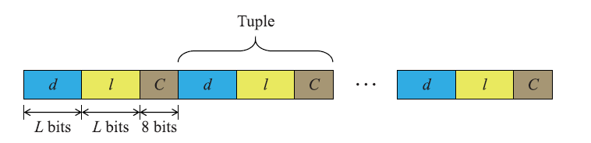
Literature Review
“Accurate Blind Lempel-Ziv-77 Parameter Estimation via 1-D to 2-D Data Conversion Over Convolutional Neural Network”
BEOM KWON 1, HYEWON SONG 2, AND SANGHOON LEE 2, (Senior Member, IEEE)
Proposes a new way to convert the compressed data into images (LZ77 images) to reveal hidden patterns.
When the header containing this length is lost, estimating it from compressed data alone is difficult.
The authors create 2-D images from 1-D LZ77 data, termed LZ77 images, where tuple length affects visual line patterns.
A CNN is employed to extract features from these LZ77 images, enabling blind, accurate tuple length estimation. Develops an iterative algorithm to generate these images and accurately guess the tuple length even when the original header is lost.
Tuple/Triplet <OFFSET,LENGTH,NEXT>
STRUCTURE OF LZ77 COMPRESSED DATA

Slide 5
“FPGA-Based Lossless Data Compression using Huffman and LZ77 Algorithms”
Suzanne Rigler., William Bishop., and Andrew Kennings
The literature indicates that while software-based compressors can achieve high compression ratios, they often fail to meet real-time constraints in embedded applications. Therefore, hardware-based solutions—particularly those using FPGA—provide a compelling alternative by offering customizability, parallelism, and high-speed performance.
“Low-Overhead Compressibility Prediction for High-Performance Lossless Data Compression”
YOUNGIL KIM 1, SEUNGDO CHOI 1, DAEYONG LEE 1, JOONYONG JEONG 1,JAEWOOK KWAK 1, JUNGKEOL LEE 1, GYEONGYONG LEE 1, AND YONG HO SONG1, 2, (Member, IEEE)
DEFLATE first compresses data using LZ77 for repeated patterns and then applies Huffman coding to optimize encoding size, balancing speed and compression efficiency
combines two main techniques: LZ77 encoding and Huffman coding to achieve efficient lossless compression

Slide 6
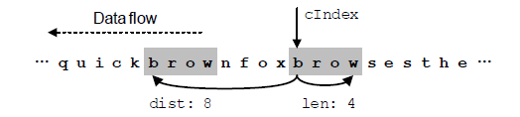
Design of FPGA-based LZ77Compressor with Runtime Configurable Compression Ratio and Throughput
LZ77 compression involves finding repeated strings in data by comparing multiple substrings.
The architecture changes the degree of parallelism in these comparison operations to balance CR and throughput dynamically.
Two modes are supported:
  Throughput-First (TF) mode prioritizes faster data processing by reducing comparisons, which slightly lowers the compression ratio.
  Compression Ratio-First (CF) mode prioritizes better compression by performing more comparisons, slightly reducing throughput.
The parallelism of comparisons can be changed dynamically, skipping unnecessary comparisons to optimize the desired metric without changing hardware.
Notes:
Experimental results on FPGA show that TF mode achieves about 11.39% higher throughput with only a 0.07 reduction in compression ratio compared to CF mode.
The compressor achieves a throughput of about 1.76 bytes per cycle in TF mode and 1.58 bytes per cycle in CF mode, with respective compression ratios of 2.48 and 2.55.
In essence, this design enables a hardware LZ77 compressor that can flexibly trade off between speed and data compression efficiency by adjusting how many substring comparisons it performs in parallel, adapting dynamically to system requirements without needing hardware changes.

Slide 7
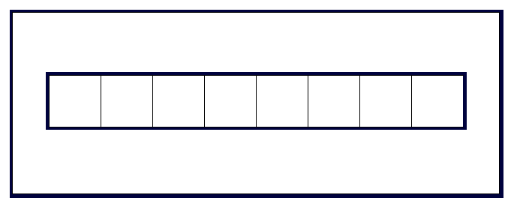
Implementation
Input Stream Buffer Implementation
Temporarily stores input data received from the host before compression, enabling pipelined access for downstream modules.
Design a FIFO buffer (register array or RAM block), sized to match lookahead window length.
Use two pointers (read/write) to manage incoming data and supply data to the DMU and comparators.
Implement logic to prefetch data from host/memory and signal when enough data is available
wr_en
wr_ptr
rd_en
Data_in
0 1 2 3 4 5 6 7
Data_out
Full
Empty
rd_ptr
Block Diagram Of Input Buffer
clk
rst

Slide 8
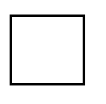

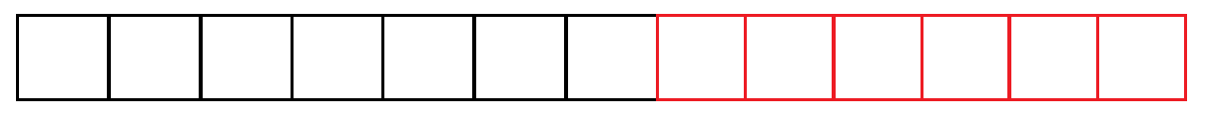
Methodology – LZ77 Algorithm
Encoding
SEARCH WINDOW SIZE (7)
SLIDING WINDOW SIZE (13)
LOOKAHEAD WINDOW SIZE (6)
…BA X A B R A C A D A B R A R R A …
1 Byte
SEARCH WINDOW (56 bits)
LOOKAHEAD WINDOW (48 bits)
Encoded Data
Incoming Data
Tuple/Triplet <OFFSET,LENGTH,NEXT>

Slide 9
…BA X A B R A C A D A B R A R RA …
( 0 , 0 , D )
BAX A B R A C A D A B R A R R A …
( 7 , 4 , R )
…BAXABRAC A D A B R A R R A R R A X
( 3 , 5 , X )

Slide 10
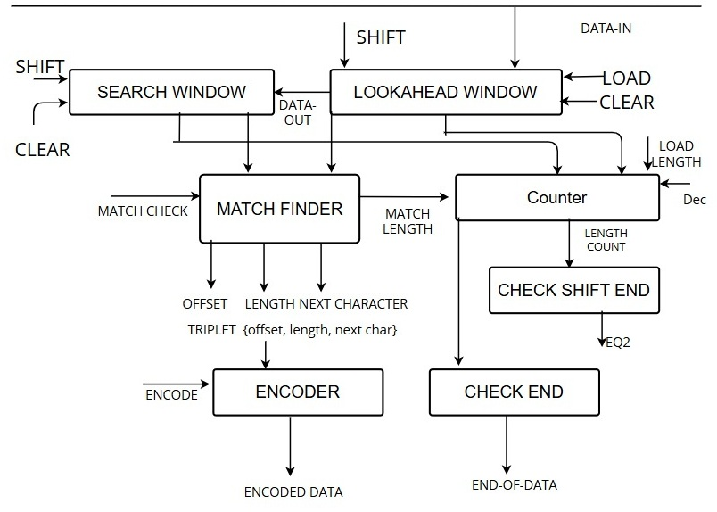
LZ77 Algorithm – Data Path

Slide 11
Module 1: Input Buffer
Purpose
Receives and stores raw data stream from external source
Port Specification
  Input: clk, rst, data_in, load_input
  Output: data_out, read_count
Functionality
  load_input signal: When HIGH, store data_in to buffer
  data_out: Continuously available for Lookahead Buffer
  read_count: Tracks total bytes read from input
  Implements FIFO or pointer-based ring buffer
Module 2: Search Buffer (Sliding Window)
Purpose
Maintains history of previously encoded bytes for pattern matching reference
Port Specification
  Input: clk, rst, data_in, shift
  Output: buffer_out
Functionality
  Stores W bytes (typically 4KB-32KB window)
  shift signal: When HIGH, slides all bytes left + inserts new data_in
  buffer_out: Full history available for Match Finder comparison
  Implemented as circular buffer or shift register for efficiency

Slide 12
Module 3: Lookahead Buffer
Purpose
Stores next bytes to be matched (pattern to search in history)
Port Specification
  Input: clk, rst, data_in, load, clear
  Output: buffer_out, data_out
Functionality
  load signal: Append data_in to buffer when HIGH
  clear signal: Reset buffer
  buffer_out: All the bytes available to Match Finder
  data_out: First byte (next character to match and to be shifted)
Module 4: Match Finder
Purpose
Searches history buffer to find longest matching pattern in lookahead buffer
Port Specification
  Input: clk, lookahead_in , search_in, match_check
  Output: match_offset, match_length, next_char
Functionality
  match_check HIGH: Compare lookahead pattern against all search buffer positions
  match_offset: Distance to match start in history (0 = no match)
  match_length: Number of consecutive matching bytes
  next_char: First unmatched byte for literal encoding

Slide 13
Module 5: Encoder
Purpose
  Formats (offset, length, next_char) into compressed token output
Port Specification
  Input: clk, rst, encode, match_offset, match_length, next_char
  Output: encoded_data
Token Format
  encode signal latches and formats output on clock edge
Module 6: Controller (FSM)
Port Specification
  Input: clk, rst, start, eqz (length=0), end_of_data
  Output: load_input, load_lookahead, load_search, match_check, encode, slide_search, done, ld_length, dec
FSM States & Control Signals
  IDLE: Wait for start signal
  LOAD_INPUT: load_input=1, read bytes into Lookahead
  MATCH_SEARCH: match_check=1, compare patterns
  ENCODE_DATA: encode=1, output tokens
  SLIDE: slide_search=1, shift windows forward
  DONE: done=1 when end_of_data HIGH
  Control-driven: Each module waits for control signals from FSM

Slide 14
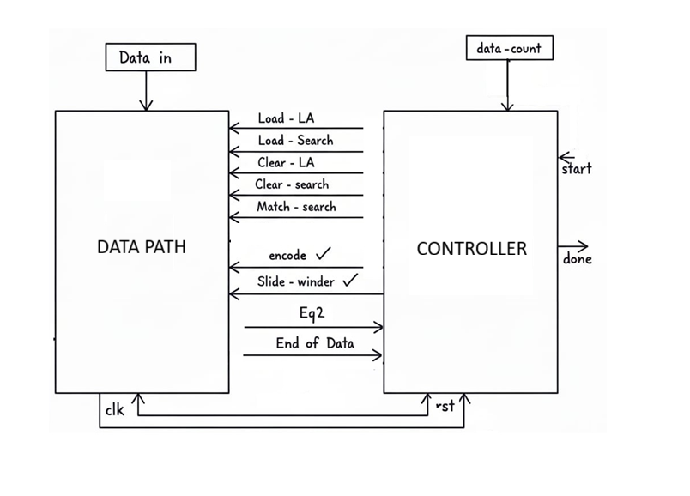
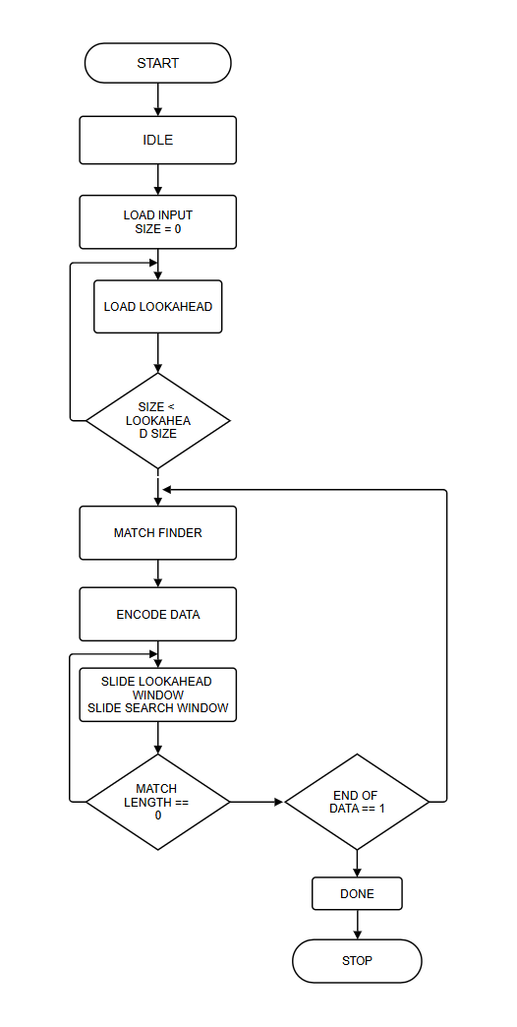
LZ77 Algorithm – Controller

Slide 15
Module 7: Support Modules (Counter, Check)
Counter Module
load_length, dec, match_length
Tracks match length during sliding. ld_length loads counter with match_length, dec decrements each cycle.
Check Units
check_eql (eqz), check_end (end_of_data)
eqz = counter is zero. end_of_data = all lookahead bytes consumed.
Module 8: Datapath Compressor
Purpose
Implements the complete LZ77 data path, connecting all submodules: input buffer, lookahead buffer, search buffer, match finder, encoder, counter, and check units.
Performs the actual compression operations while the controller FSM only generates control signals.
Internal Functioning
input_buffer receives data_in when load_input=1 and feeds lookahead_buffer.
lookahead_buffer and search_buffer provide lookahead_in and search_in to match_finder when match_check=1.
match_finder outputs match_offset, match_length, and next_char to encoder.
encoder generates encoded_data when encode=1.
counter loads match_length on ld_length=1 and decrements with dec, check_eql converts it to eqz.
check_end asserts end_of_data when no more valid data is available in lookahead/input.

Slide 16
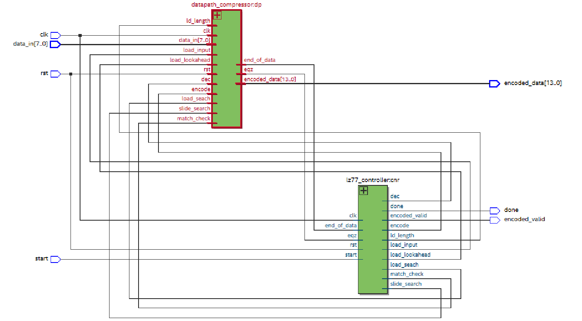

Slide 17
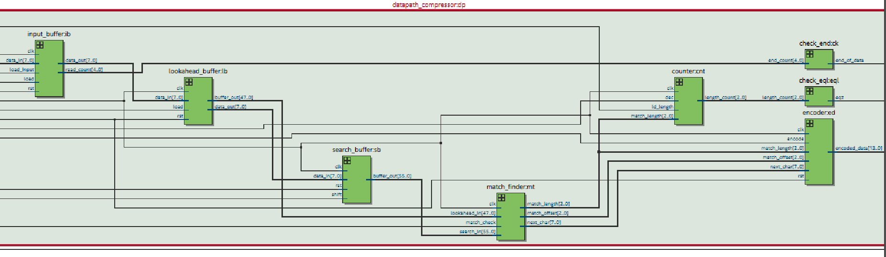

Slide 18
Consolidated Results Table
S.No. | Test Data | Input Bits | Compressed Bits | Cycles | Compression Ratio (CR) | Compression Gain (%) | Throughput (Bytes/cycle)
1 | High compression (BEST CASE) | 240 | 84 | 50 | 2.857 | 65.00 | 4.80
2 | Overlapping pattern | 224 | 84 | 48 | 2.667 | 62.50 | 4.67
3 | HELLOHELLOHELLOHELLOHELLO | 200 | 98 | 48 | 2.041 | 51.00 | 4.17
4 | Realistic text-like data | 216 | 112 | 54 | 1.929 | 48.15 | 4.00
5 | Medium compression | 240 | 196 | 63 | 1.224 | 18.33 | 3.81
6 | Low compression | 192 | 168 | 59 | 1.143 | 12.50 | 3.25
7 | No compression (worst case) | 240 | 336 | 82 | 0.714 | −40.00 | 2.93

Slide 19
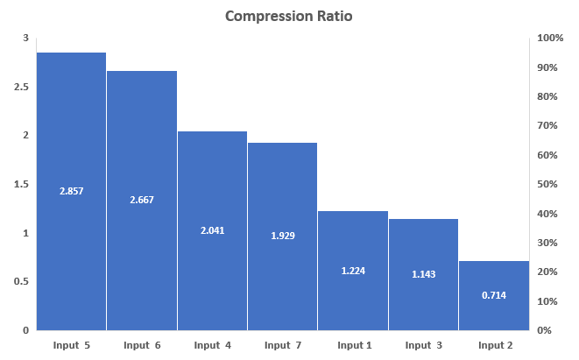
Data Compression Ratio and Throughput
$$\text{Compression} \text{Ratio}\text{ (}\text{CR}\text{)=}\frac{\text{Compressed} \text{file} \text{size}\text{ (}\text{bytes}\text{)}}{\text{Original} \text{file} \text{size}\text{ (}\text{bytes}\text{)}}$$
Input Samples
Input 1 | abracadabrarrabcdefgabracadabr
Input 2 | ABCDEFGHIJKLMNOPQRSTUVWXYZ1234
Input 3 | ABCABCABCXYZXYZXYZABCABC
Input 4 | HELLOHELLOHELLOHELLOHELLO
Input 5 | AAAAAAAAAAAAAAAAAAAAAAAAAAAAAA
Input 6 | ABABABABABABABABABABABABABAB
Input7 | the the the the the the the

Slide 20

Input Samples
Input 1 | abracadabrarrabcdefgabracadabr
Input 2 | ABCDEFGHIJKLMNOPQRSTUVWXYZ1234
Input 3 | ABCABCABCXYZXYZXYZABCABC
Input 4 | HELLOHELLOHELLOHELLOHELLO
Input 5 | AAAAAAAAAAAAAAAAAAAAAAAAAAAAAA
Input 6 | ABABABABABABABABABABABABABAB
Input7 | the the the the the the the
$\text{Compression} \text{Gain}\text{ (\%)=}\frac{\text{Sorig}\text{​−}\text{Scomp} }{\text{Sorig}\text{​}}$ × 100
$$\text{Throughput}\text{ =}\frac{\text{Total} \text{Input} \text{Bytes}}{\text{Total} \text{Processing} \text{Cycle}}$$

Slide 21
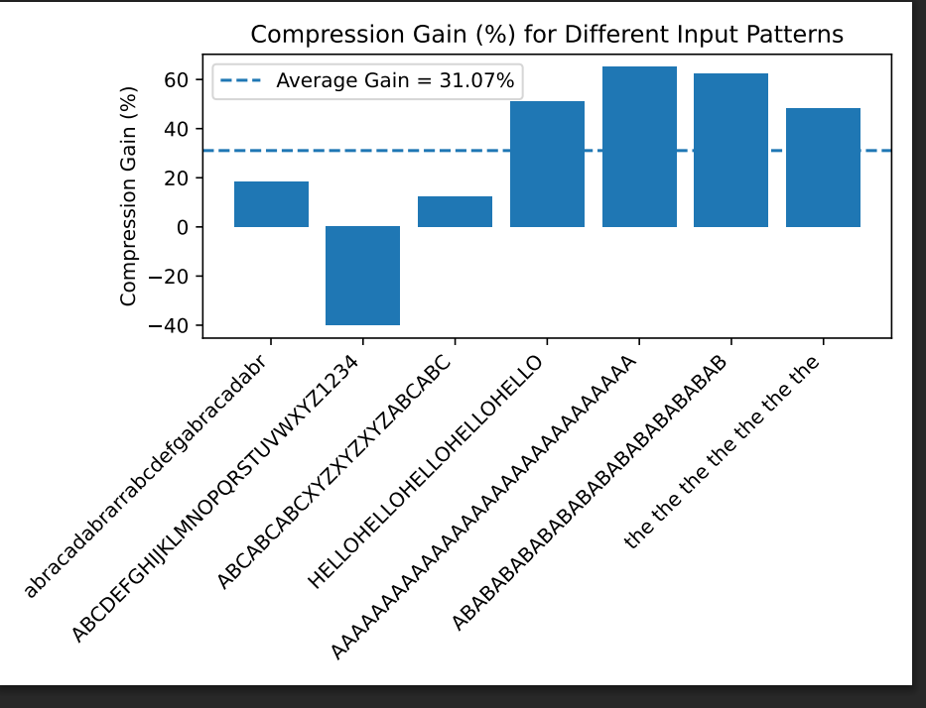

Slide 22
References
“Low-Overhead Compressibility Prediction for High-Performance Lossless Data Compression”
YOUNGIL KIM 1, SEUNGDO CHOI 1, DAEYONG LEE 1, JOONYONG JEONG 1,JAEWOOK KWAK 1, JUNGKEOL LEE 1, GYEONGYONG LEE 1, AND YONG HO SONG1, 2, (Member, IEEE)
“Accurate Blind Lempel-Ziv-77 Parameter Estimation via 1-D to 2-D Data Conversion Over Convolutional Neural Network”
BEOM KWON 1, HYEWON SONG 2, AND SANGHOON LEE 2, (Senior Member, IEEE)
“FPGA-Based Lossless Data Compression using Huffman and LZ77 Algorithms”
Suzanne Rigler., William Bishop., and Andrew Kennings

Slide 23
Thank you!

