Slide 1

Sprocket Central Pty Ltd
Data analytics approach
[Division Name] - [Engagement Manager], [Senior Consultant], [Junior Consultant]

Slide 2
Agenda
Introduction
Data Exploration
Model Development
Interpretation

Slide 3
Introduction
Identify and Recommend Top 1000 Customers to Target from Datasets
Outline of Problem
Sprocket Central is a company that specializes in high quality bikes and cycling accessories.
There marketing team is looking to boost business sales by analyzing provided datasets.
Using the three datasets provided, the aim is to analyze and recommend 1000 customers that Sprocket Central should target for higher value for the company.
This will be done with three phases: Data Exploration, Model Development and Interpretation.
Contents of Data Analysis
“New” and “Old” Customer Age Distributions
Bike related purchases over the last three years by gender
Job industry distributions
Wealth segmentation by age category
Number of cars owned and not owned by states
RFM analysis and customer classification

Slide 4
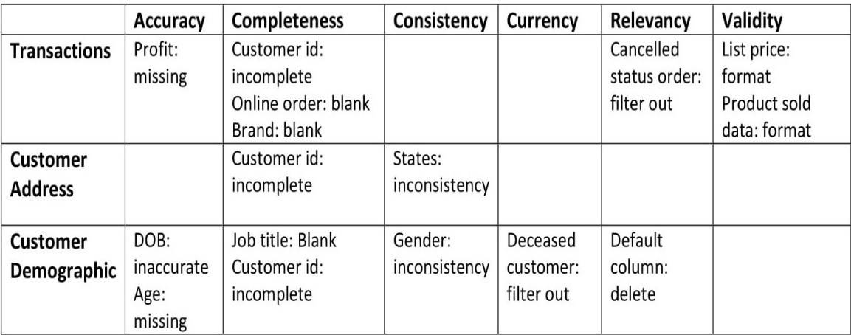
Data Exploration
Data Quality Assessment and ‘Clean Up’
Key Issues for Data Quality Assessment
Accuracy: Correct Values
Completeness: Data Fields with Values
Consistency: Values Free from Contradiction
Currency: Values Up to Date
Relevancy: Data Items with Value Meta-data
Validity: Data containing Allowable Values
Uniqueness: Records that are Duplicated
An in-depth analysis has been sent via mail
Summary Table

Slide 5
Data Exploration
‘New’ and ‘Old’ customer Age Distributions
Most customers are aged between 40 to 49 in ‘New’ as well as in ‘Old’.
The lowest age group are under 20 and above 80 in both ‘New’ and ‘Old’ customer lists.
The ‘New’ customer list suggests the age groups 20- 29 and 40- 49 are most populated.
The ‘Old’ customer list suggests 20- 69.
There is a steep drop of customers in 30- 39 age group in ‘New’ customer list.

Slide 6
Data Exploration
Bike related Purchases over past 3 Years by Gender
Over the last three years about 51% of bike related purchases were made by females to 47% purchases made by males and 2% made by unknown gender.
Numerically, females purchased almost 5000 more than males.
Females make up majority of bike related sales.

Slide 7
Data Exploration
Job Industry Distribution
20% of ‘New’ customers are in Manufacturing and Finance Services.
The smallest number of customers are in Telecommunication and Agriculture at 2% and 3% respectively.
In ‘Old’ customers list, 31% of customers are from IT industry and 21% of customers from Retail.

Slide 8
Data Exploration
Wealth Segmentation by Age Category
In all age categories, the largest number of customers are classified as ‘Mass Customer’.
The next category is ‘ High Net Worth’ customers.
The ‘Affluent Customer’ can outperform ‘High Net Worth’ customer in the 40- 49 age group.

Slide 9
Data Exploration
Number of cars owned or not owned by states
NSW has the largest amount of customers who do not own a car. NSW seems to have a higher number of people from which data was collected.
Victoria is also split quite evenly. But both numbers are significantly lower than those of NSW.
QLD has a relatively high number of customers that own a car.

Slide 10
Model Development
RFM Analysis and Customer Classification
RFM analysis is used to determine which customers a business should target to increase its revenue and value.
The RFM (Recency, Frequency and Monetary) model shows customers that have displayed high levels of engagement with the business in the three categories mentioned.

Slide 11
Model Development
Scatter- Plot based off RFM Analysis
The chart shows that customers who purchased more recently have generated more revenue, than customers who visited a while ago.
Customers from recent past(50 – 100 days) have also generated a moderate amount of revenue.
Those who visited more than 200 days ago have generated less revenue.
From very less customers, high profit is been gained.

Slide 12
Model Development
Customer title definition list with RFM values assigned
Rank | Customer Title | Description | RFM Value
1 | Platinum Customer | Most recent, buys often, most spent | 444
2 | Very Loyal | Most recent, buys often, spends most amount of money | 433
3 | Becoming Loyal | Relatively recent, bought more than once, spends large amount of money | 421
4 | Recent Customer | Bought recently, not very often, average money spent | 344
5 | Potential Customer | Bought recently, never bought before, spent small amount of money | 323
6 | Late Bloomer | No purchases recently, but RFM value is larger than average | 311
7 | Loosing Customer | Purchases were a while ago, below RFM value | 224
8 | High risk Customer | Purchase was a long time ago, frequency is quite high, amount of money spent is high | 212
9 | Almost Lost Customer | Very low recency, low frequency, but high amount spent | 124
10 | Evasive Customer | Very low recency, very low frequency, small amount spent | 112
11 | Lost Customer | Very low RFM | 111

Slide 13
Model Development
Customer Title Distribution in Dataset

Slide 14
Interpretation
Summary Table of Top 1000 Customers to Target
Rank | Customer Title | Description | Number of Customers | Cumulative | Customer Selection
1 | Platinum Customer | Most recent, buys often, most spent | 176 | 176 | 176
2 | Very Loyal | Most recent, buys often, spends most amount of money | 186 | 362 | 186
3 | Becoming Loyal | Relatively recent, bought more than once, spends large amount of money | 346 | 708 | 346
4 | Recent Customer | Bought recently, not very often, average money spent | 369 | 1077 | 292
5 | Potential Customer | Bought recently, never bought before, spent small amount of money | 355 | 1432 | 0
6 | Late Bloomer | No purchases recently, but RFM value is larger than average | 334 | 1766 | 0
7 | Loosing Customer | Purchases were a while ago, below RFM value | 356 | 2122 | 0
8 | High risk Customer | Purchase was a long time ago, frequency is quite high, amount of money spent is high | 361 | 2483 | 0
9 | Almost Lost Customer | Very low recency, low frequency, but high amount spent | 323 | 2806 | 0
10 | Evasive Customer | Very low recency, very low frequency, small amount spent | 397 | 3203 | 0
11 | Lost Customer | Very low RFM | 290 | 3493 | 0

Slide 15
Interpretation
Customer Target and Methodology
Rank | Customer Title | Description | Number of Customers | Cumulative | Customer Selection
1 | Platinum Customer | Most recent, buys often, most spent | 176 | 176 | 176
2 | Very Loyal | Most recent, buys often, spends most amount of money | 473 | 649 | 186
3 | Becoming Loyal | Relatively recent, bought more than once, spends large amount of money | 250 | 899 | 346
4 | Recent Customer | Bought recently, not very often, average money spent | 177 | 1076 | 292
Filter through the top 1000 customers by assigning the conditions discussed in the table above.
The 1000 customers discovered would have bought very frequently in the past and tend to spend more than other customers.

Slide 16
Appendix

