Slide 1

Introduction to Data Structures
Introduction to Data Structures
Concept of ADT
Types of Data Structures Linear and Nonlinear
Operations on Data Structure

Slide 2
Introduction to data Structure
In computer science, a data structure is a particular way of organizing data in a computer so that it can be used efficiently.
The idea is to reduce the space and time complexities of different tasks.
Data structures serve as building blocks of a program.
A program built using improper data structures may not work as expected. So as a programmer it is mandatory to choose most appropriate data structures for a program.
Every significant program will use one/some data structure(s) explicitly. For eg. A stack is implicitly used in a program, whether or not you declared it.
Some common examples of data structures are arrays, linked lists, queues, stacks, binary trees, and hash tables.

Slide 3
The data structure is not any programming language like C, C++, java, etc. It is a set of algorithms that we can use in any programming language to structure the data in the memory.
To structure the data in memory, 'n' number of algorithms were proposed, and all these algorithms are known as Abstract data types. These abstract data types are the set of rules.

Slide 4
Abstract Data Type
An Abstract Data Type in data structure is a kind of a data type whose behaviour is defined with the help of some attributes and some functions.
Generally, we write these attributes and functions inside a class or a structure so that we can use an object of the class to use that particular abstract data type.
Examples of Abstract Data Type in Data Structure are list, stack, queue etc.

Slide 5
Types of Data Structures
There are two types of data structures:
1. Primitive data structure
2. Non-primitive data structure
1. Primitive Data structure
The primitive data structures are primitive data types. The int, char, float, double, and pointer are the primitive data structures that can hold a single value.
2. Non-Primitive Data structure
The non-primitive data structure is divided into two types:
- Linear data structure
- Non-linear data structure

Slide 6
Linear & Non-Linear Data Structure
Linear Data Structure :
The arrangement of data in a sequential manner is known as a linear data structure.
The data structures used for this purpose are Arrays, Linked list, Stacks, and Queues.
In these data structures, one element is connected to only one another element in a linear form.
Non- Linear Data Structure :
When one element is connected to the 'n' number of elements known as a non-linear data structure.
The best example is trees and graphs.
In this case, the elements are arranged in a random manner.

Slide 7
Data structures can also be classified as:
Static data structure:
It is a type of data structure where the size is allocated at the compile time.
Therefore, the maximum size is fixed.
Dynamic data structure:
It is a type of data structure where the size is allocated at the run time.
Therefore, the maximum size is flexible.

Slide 8
Data Structure types
Homogeneous Data Structures:
Homogeneous indicates all the data elements are of same type. Eg. Array.
Non-Homogeneous Data Structures:
In Non-Homogeneous Data Structures, the elements may or may not be of the similar type.
Eg. Stuctures.

Slide 9
Linear Data Structure
A data structure is called linear if all of its elements are arranged in the linear order.
In linear data structures, the elements are stored in non-hierarchical way where each element has the successors and predecessors except the first and last element.
Types of Linear Data Structures are given below:
1. Arrays :
An array is a collection of similar type of data items and each data item is called an element of the array. The data type of the element may be any valid data type like char, int, float or double.
The elements of array share the same variable name but each one carries a different index number known as subscript. The array can be one dimensional, two dimensional or multidimensional.
The individual elements of the array age are:
age[0], age[1], age[2], age[3],......... age[98], age[99].

Slide 10
2. Linked List:
Linked list is a linear data structure which is used to maintain a list in the memory.
It can be seen as the collection of nodes stored at non-contiguous memory locations.
Each node of the list contains a pointer to its adjacent node.
3. Stack:
Stack is a linear list in which insertion and deletions are allowed only at one end, called top.
A stack is an abstract data type (ADT), can be implemented in most of the programming languages.
It is named as stack because it behaves like a real-world stack, for example: - piles of plates or deck of cards etc.
4. Queue:
Queue is a linear list in which elements can be inserted only at one end called rear and deleted only at the other end called front.
It is an abstract data structure, similar to stack. Queue is opened at both end therefore it follows First-In-First-Out (FIFO) methodology for storing the data items.

Slide 11
Non-Linear Data Structure
This data structure does not form a sequence i.e. each item or element is connected with two or more other items in a non-linear arrangement.
The data elements are not arranged in sequential structure.
Types of Non-Linear Data Structures are given below:
Trees:
Trees are multilevel data structures with a hierarchical relationship among its elements known as nodes.
The bottommost nodes in the hierarchy are called leaf node while the topmost node is called root node.
Each node contains pointers to point adjacent nodes.
Tree data structure is based on the parent-child relationship among the nodes.
Each node in the tree can have more than one children except the leaf nodes whereas each node can have atmost one parent except the root node.
Trees can be classfied into many categories.

Slide 12
2. Graphs:
Graphs can be defined as the pictorial representation of the set of elements (represented by vertices) connected by the links known as edges.
A graph is different from tree in the sense that a graph can have cycle while the tree can not have the one.

Slide 13
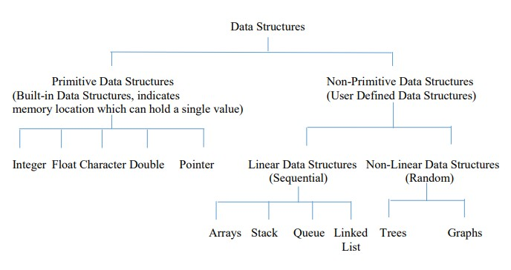

Slide 14
Operations on Data Structure:
1) Traversing: Every data structure contains the set of data elements. Traversing the data structure means visiting each element of the data structure in order to perform some specific operation like searching or sorting.
Example: If we need to calculate the average of the marks obtained by a student in 6 different subject, we need to traverse the complete array of marks and calculate the total sum, then we will divide that sum by the number of subjects i.e. 6, in order to find the average.
2) Insertion: Insertion can be defined as the process of adding the elements to the data structure at any location.
If the size of data structure is n then we can only insert n-1 data elements into it.

Slide 15
3) Deletion:The process of removing an element from the data structure is called Deletion. We can delete an element from the data structure at any random location.
If we try to delete an element from an empty data structure then underflow occurs.
4) Searching: The process of finding the location of an element within the data structure is called Searching. There are two algorithms to perform searching, Linear Search and Binary Search.
5) Sorting: The process of arranging the data structure in a specific order is known as Sorting. There are many algorithms that can be used to perform sorting, for example, insertion sort, selection sort, bubble sort, etc.
6) Merging: When two lists List A and List B of size M and N respectively, of similar type of elements, clubbed or joined to produce the third list, List C of size (M+N), then this process is called merging

Slide 16
Advantages of Data Structure
The following are the advantages of a data structure:
1. Efficiency: If the choice of a data structure for implementing a particular ADT is proper, it makes the program very efficient in terms of time and space.
2. Reusability: The data structure provides reusability means that multiple client programs can use the data structure.
3. Abstraction: The data structure specified by an ADT also provides the level of abstraction. The client cannot see the internal working of the data structure, so it does not have to worry about the implementation part. The client can only see the interface.

Slide 17
Application of Data Structure
Compiler design
Operating system
Data analytics
Database Management Systems
Numerical analysis
Simulation
Artificial intelligence
Graphics
Social Networking
Data Science

