Slide 1
Week7&8
File created on: 7/27/2023 11:35:20 AM

Slide 2
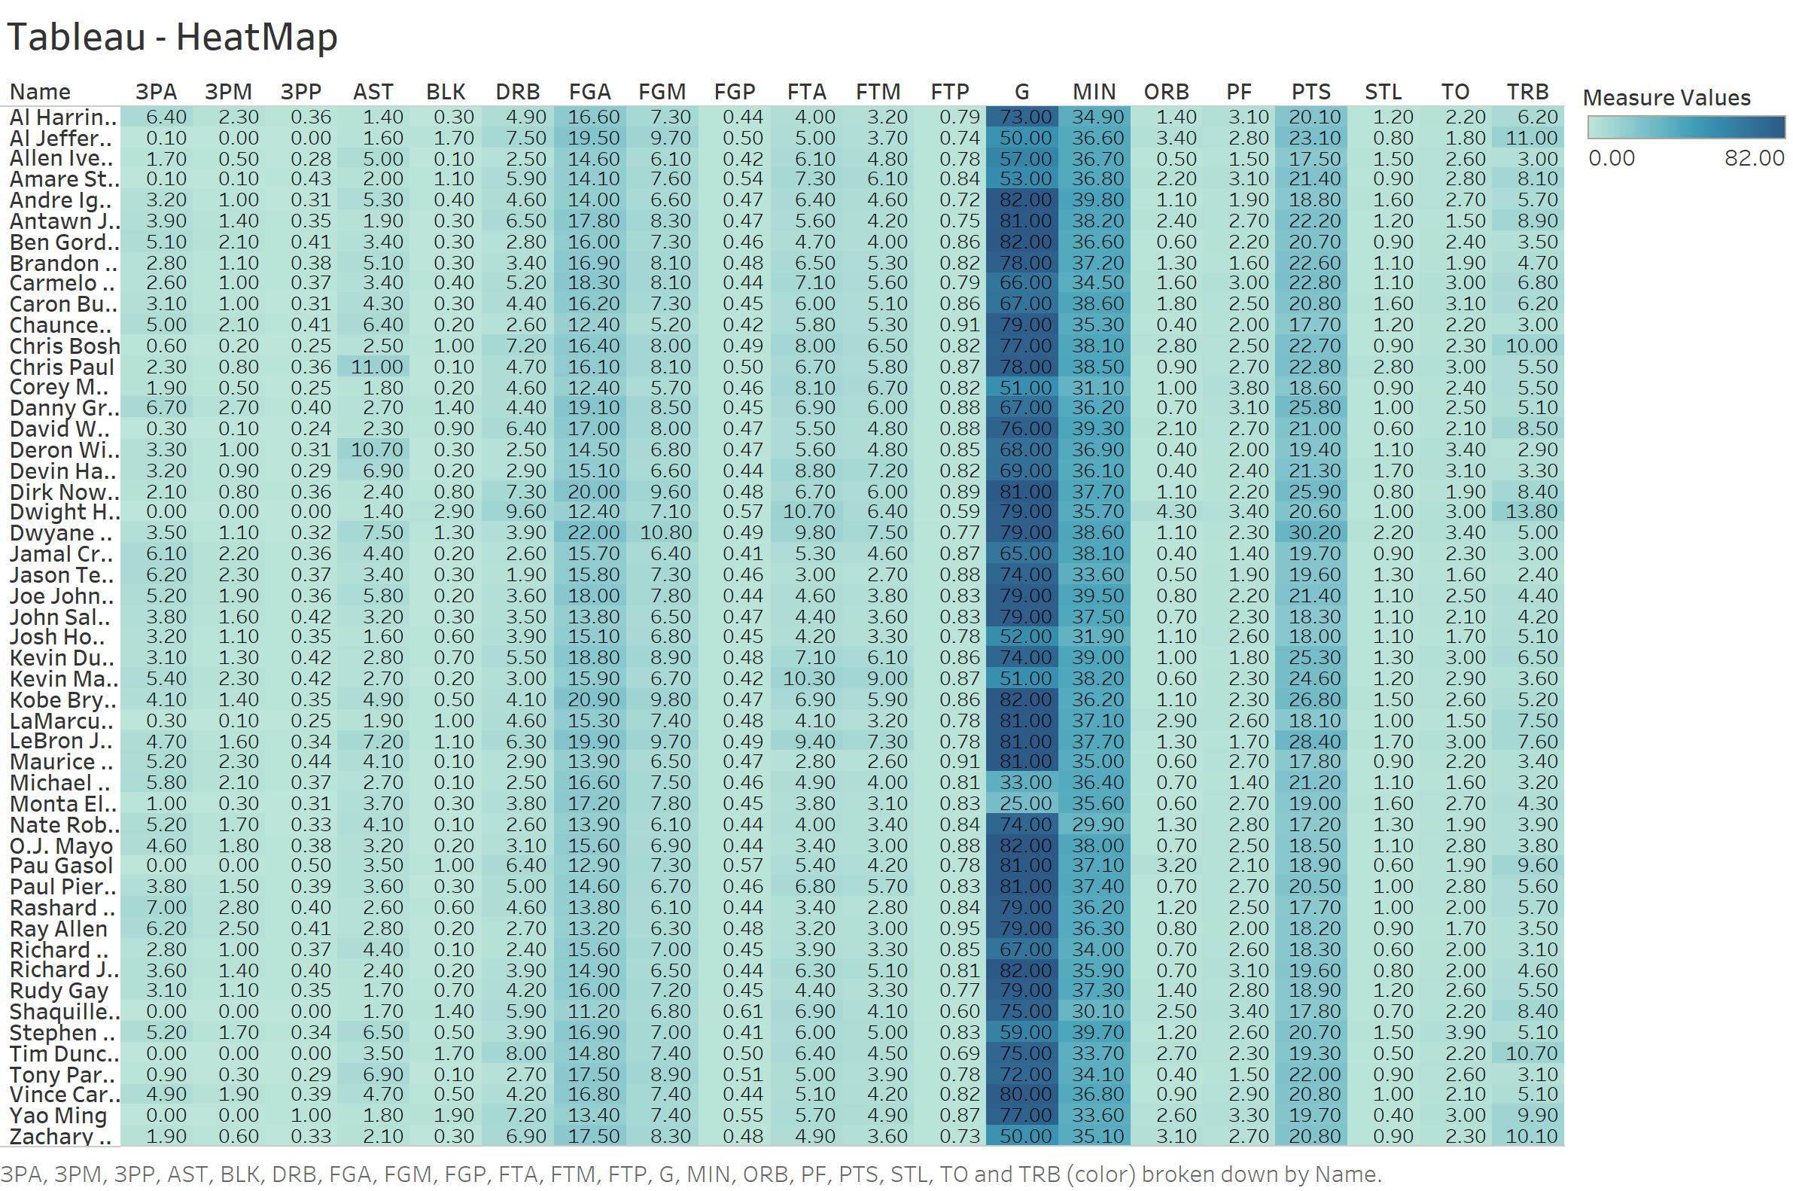

Slide 3
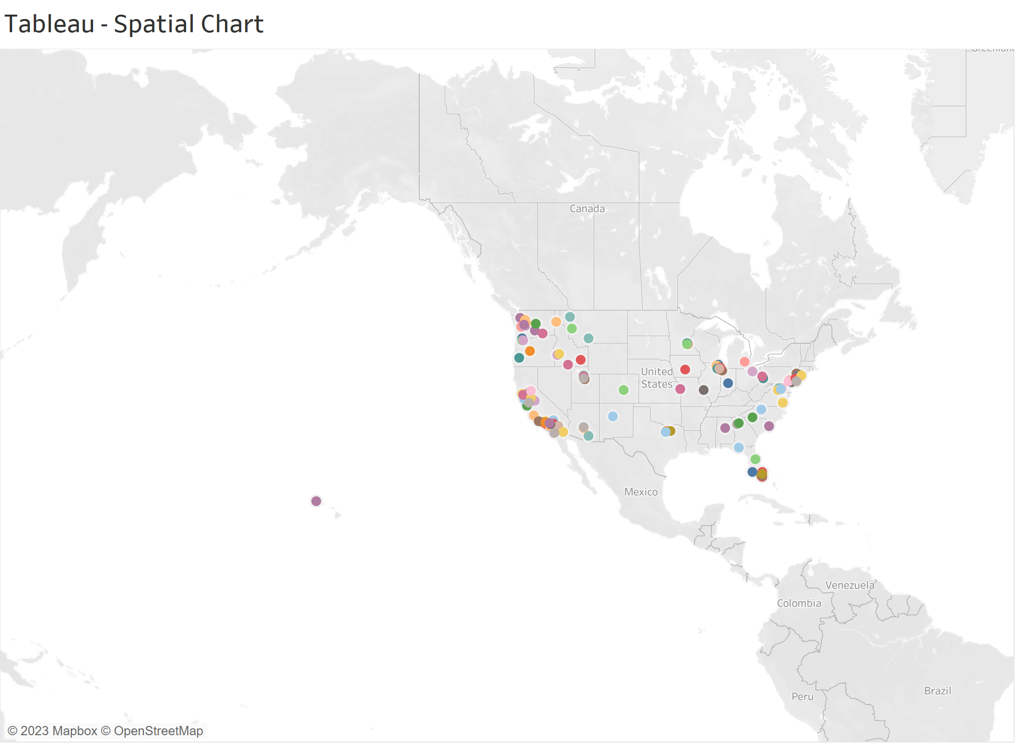

Slide 4
