Slide 1
Week5&6
File created on: 7/15/2023 11:59:29 AM

Slide 2
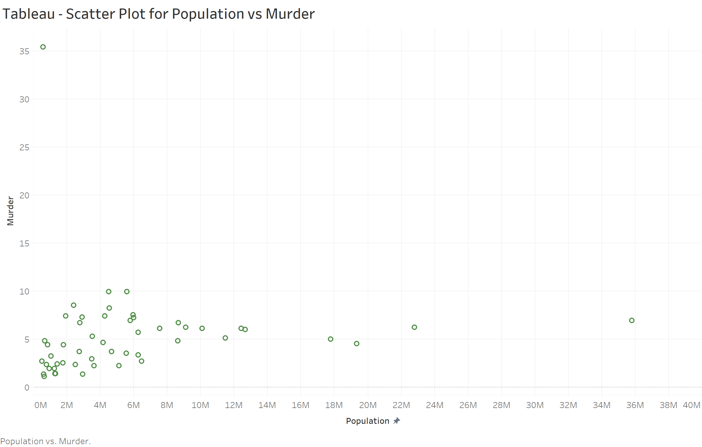

Slide 3
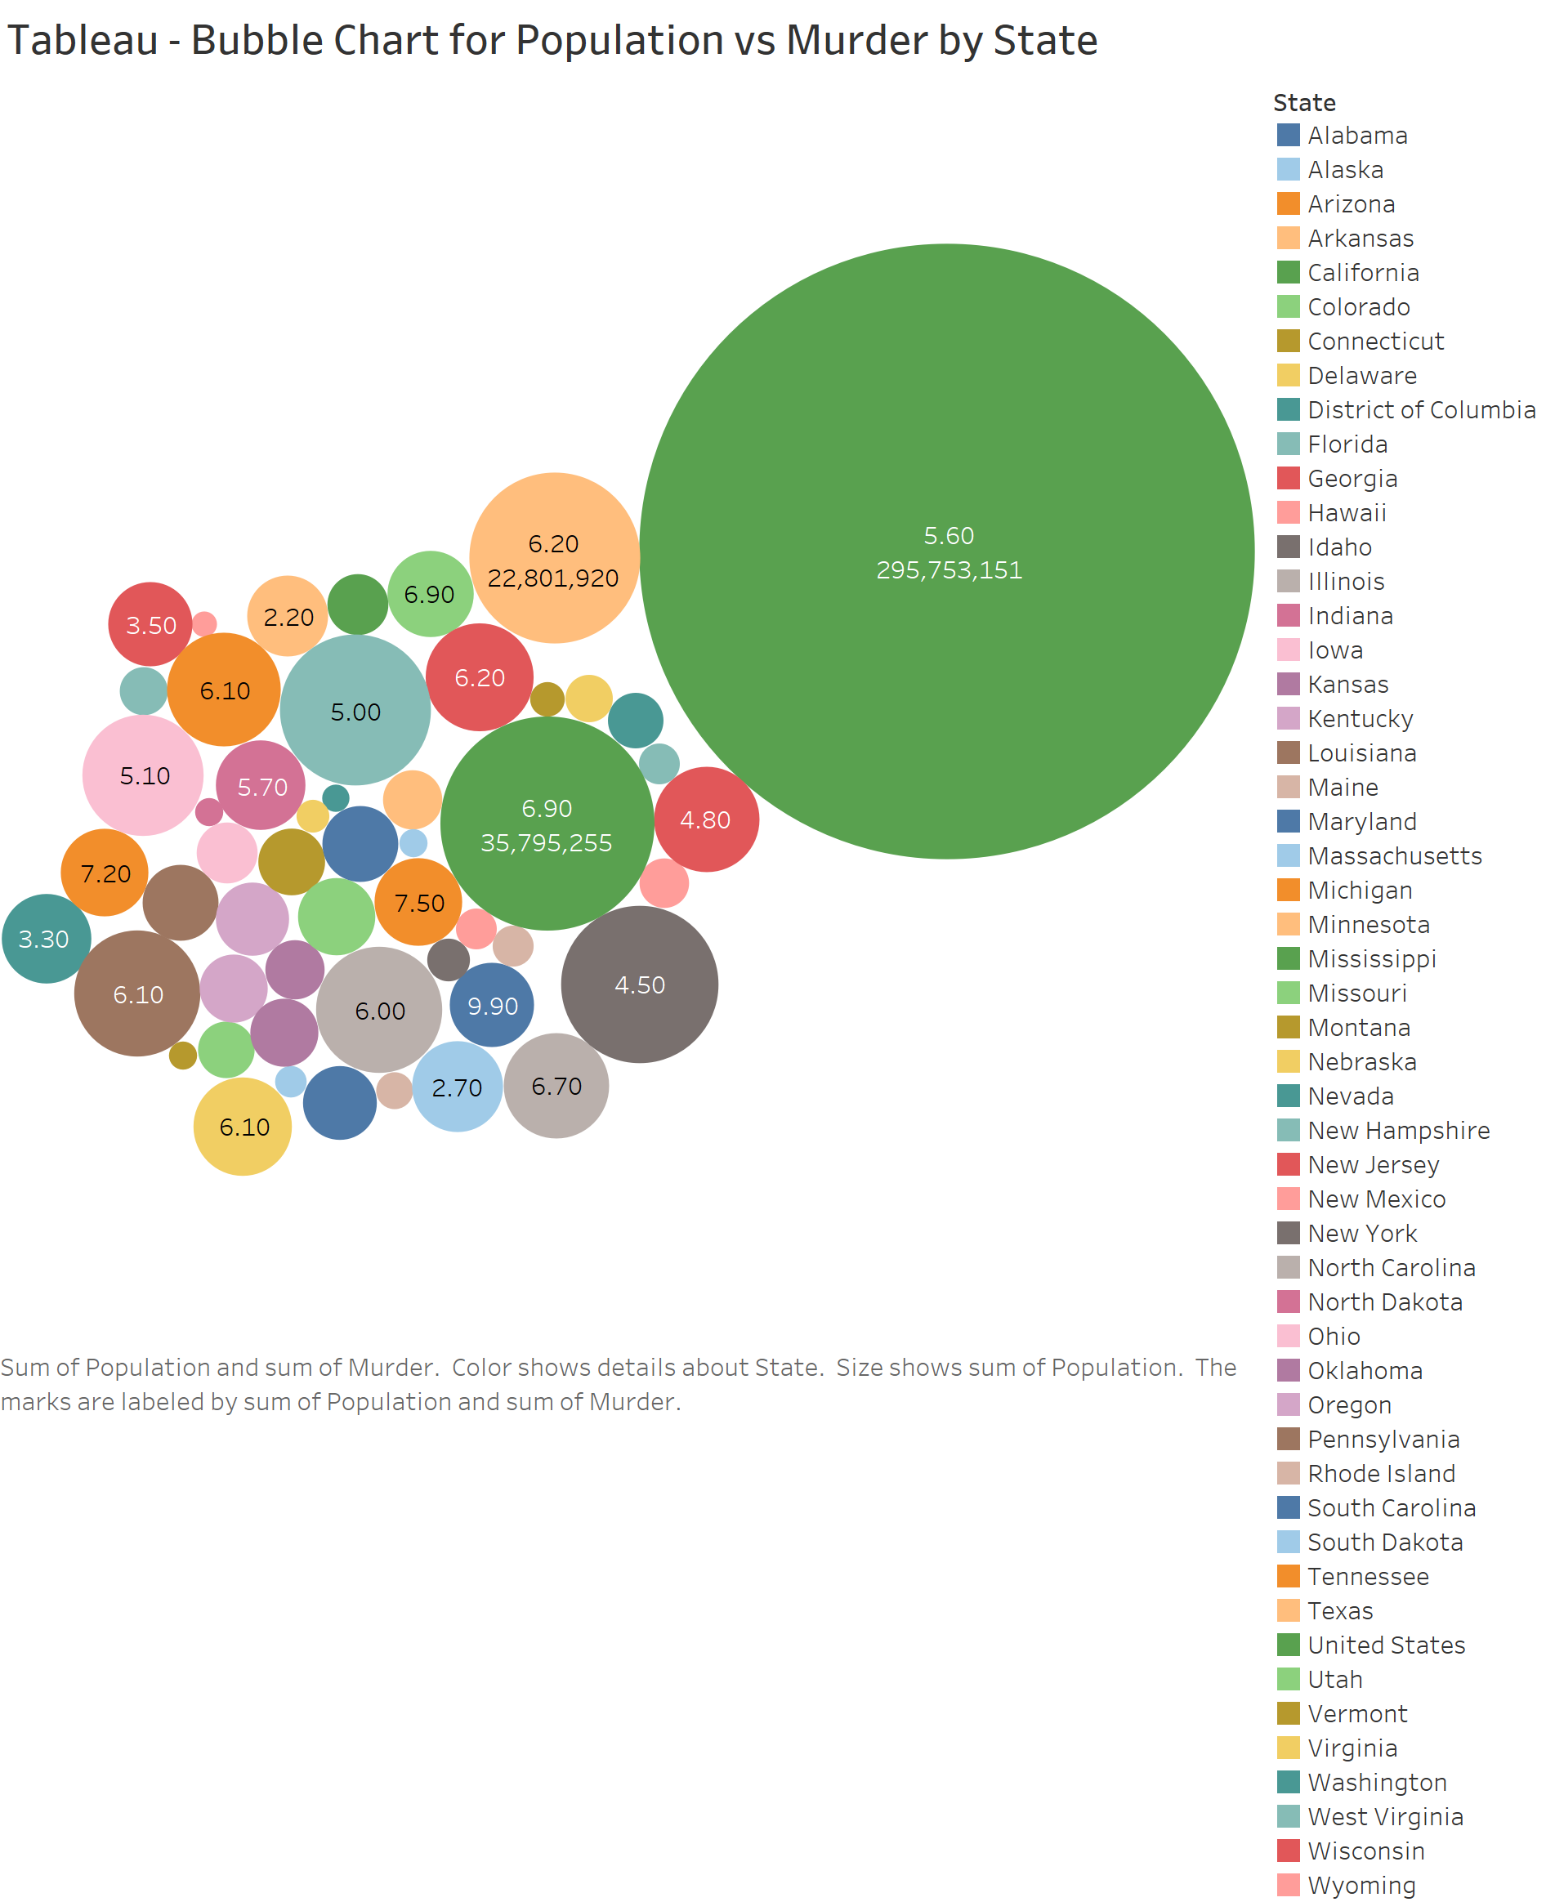

Slide 4
