Slide 1
Week3&4
File created on: 7/2/2023 12:34:08 AM

Slide 2
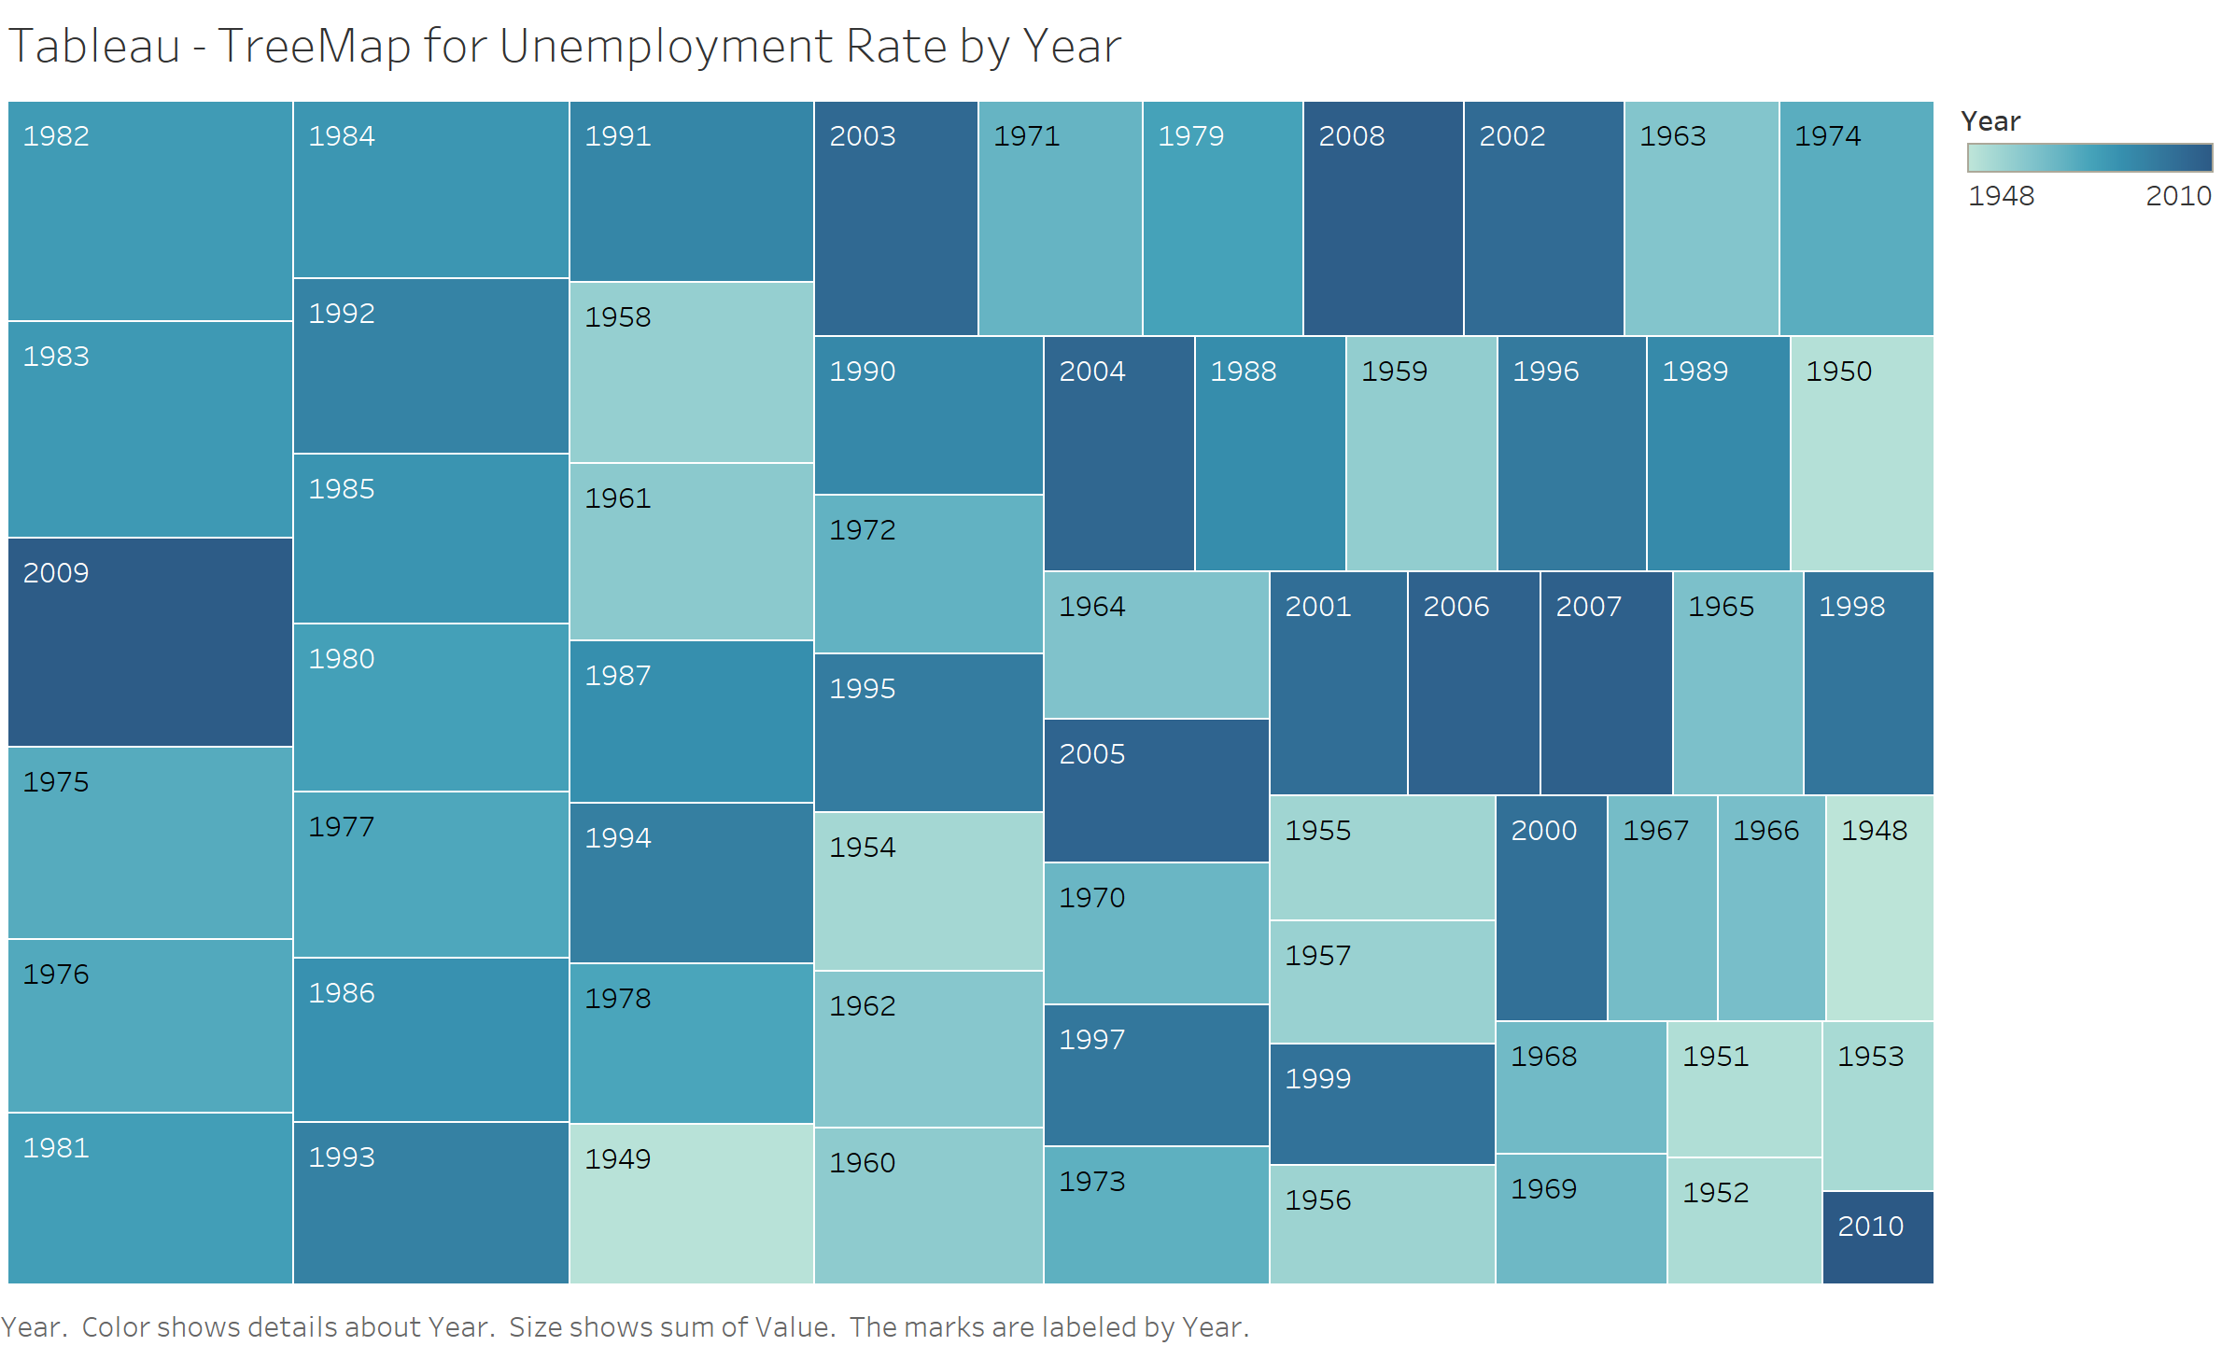

Slide 3
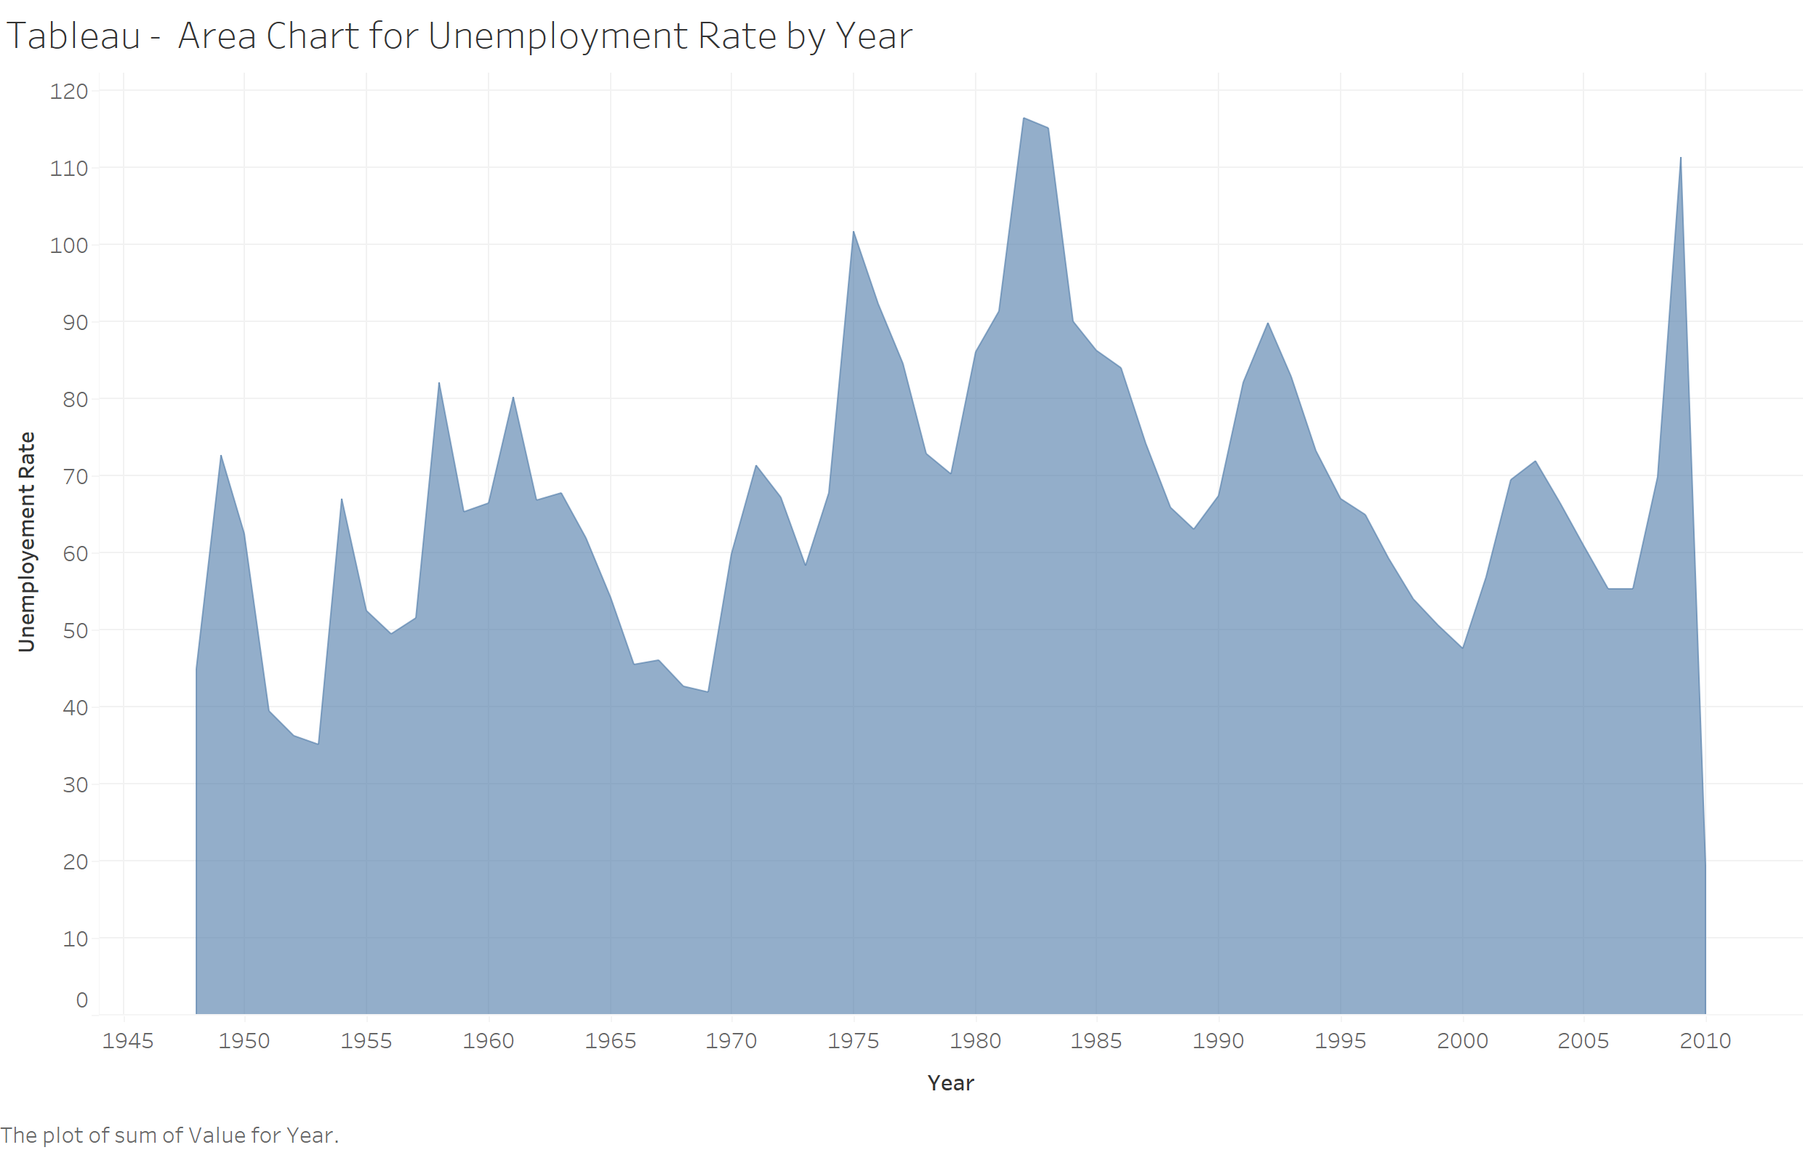

Slide 4
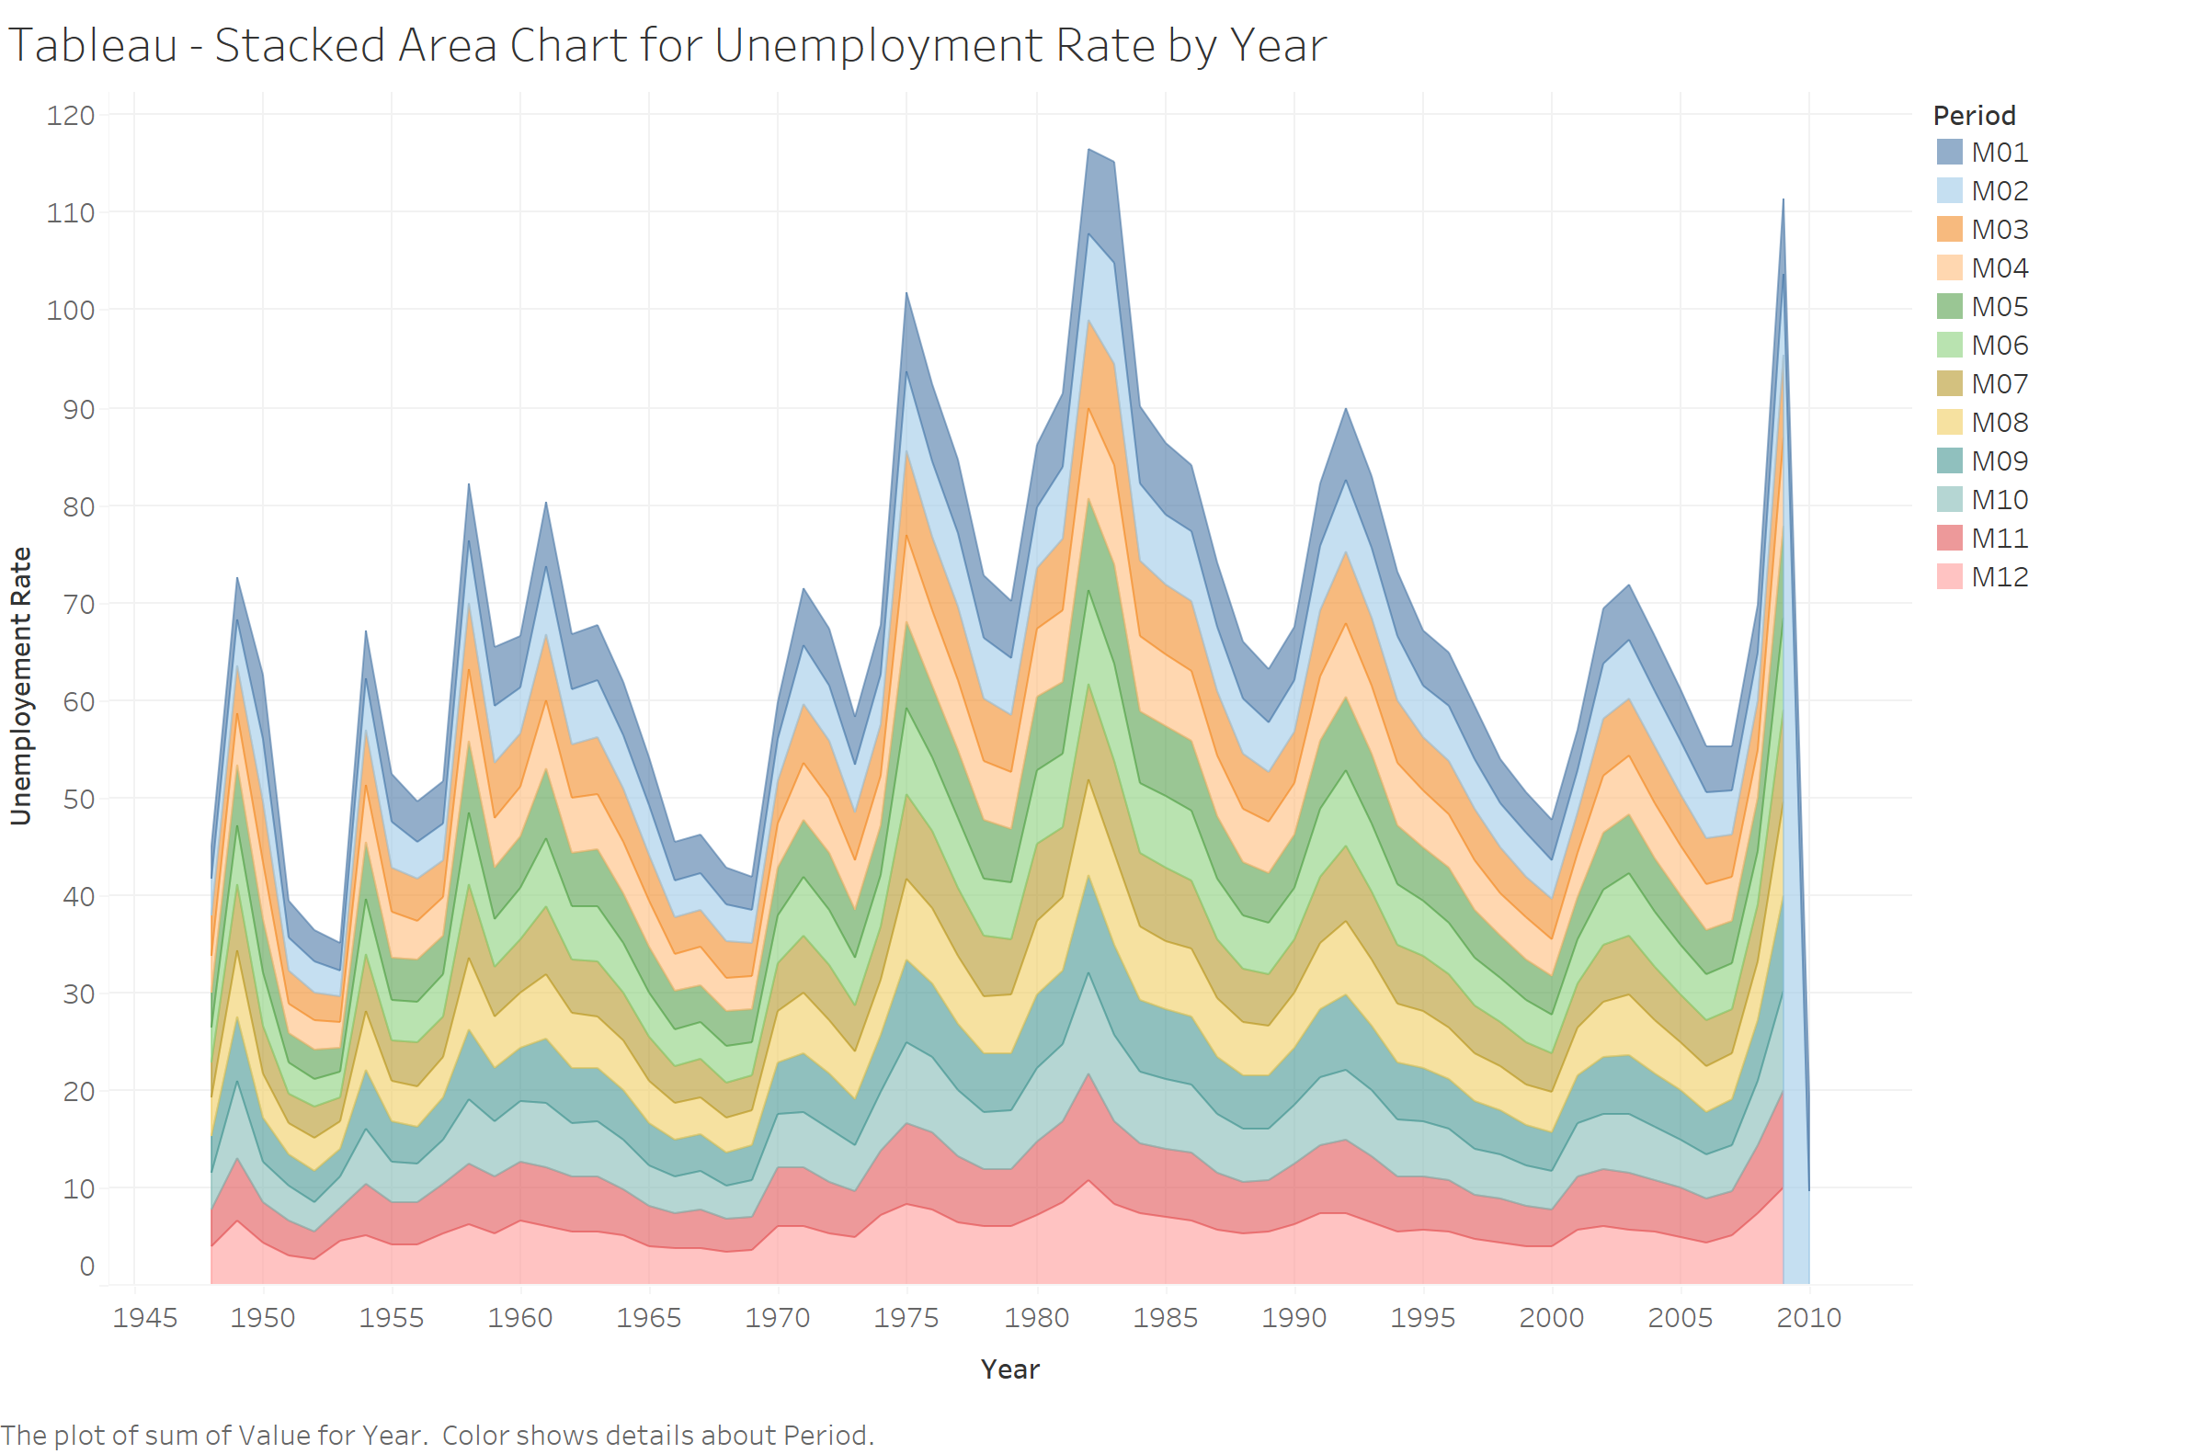

Slide 5
