Slide 1

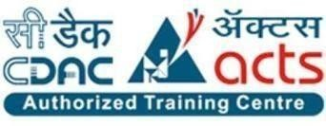
Dr. D.Y. Patil Pratishthan’s Institute for Advanced Computing and Software Development, Akurdi, Pune Project Title:- “DevSecOps MERN Stack Application Deployment on AWS EKS Cluster”
.
Guided by:-
Ms. Rutuja Kulkarni
Presented by:-
1. Aarti Lanke (248402)
2. Akanksha Patil (248432)

Slide 2
Index
Index
Problem statement
Introduction
Methodology
Application
Advantage and limitation
conclusion
Implementation step
Security tool
Requirement specifications
Security tool
Final word flow

Slide 3
PROBLEM STATEMENT
Traditional software deployment approaches often treat security as a separate phase, leading to vulnerabilities, inefficiencies, and scalability challenges. As applications grow in complexity, ensuring security, automation, and scalability becomes critical. This project addresses these challenges by integrating DevSecOps principles into the deployment of a MERN stack application on AWS EKS. The goal is to embed security within the CI/CD pipeline, enforce access controls, implement automated security compliance, and leverage Infrastructure as Code (IaC) for efficient, secure, and scalable deployments.

Slide 4
Introduction to DevSecOps and MERN Stack Deployment
In modern software development, security, scalability, and automation are critical for delivering high-performance applications. Traditional deployment methods often treat security as an afterthought, leading to vulnerabilities and inefficiencies. This project integrates DevSecOps principles to deploy a MERN stack application on AWS EKS, ensuring security is embedded throughout the Software Development Lifecycle (SDLC).
By leveraging an automated CI/CD pipeline with Jenkins and security tools like SonarQube, OWASP Dependency-Check, Trivy, and Kube-bench, the deployment is made secure, scalable, and efficient. This approach minimizes risks, enhances performance, and ensures continuous security compliance in a cloud-native environment.

Slide 5
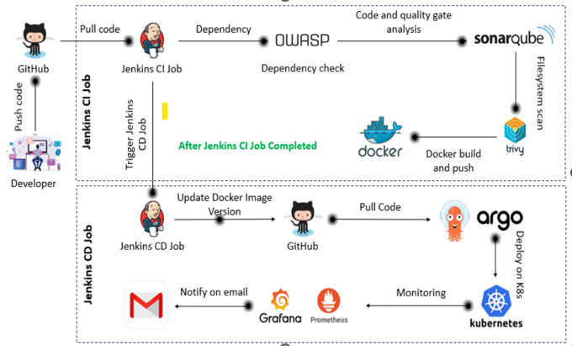
Methodology

Slide 6
REQUIREMENT SPECIFICATION:-
Hardware Requirements :-
RAM: 8GB Minimum, 16 GB Recommended
HDD: 100GB free space for virtual machines
Software Requirements :-
Operating System: ubuntu
Virtualization Tool: VMware Workstation Pro
Database: MariaDB
Check Code Quality : SonarQube
Managing Artifacts : Nexus
Version Control: Git
Scanning Tools: Nessus, Trivy

Slide 7
Security Tools and Measures
GitHub
Jenkins for CI/CD automation
Docker and Kubernetes
SonarQube for static code analysis
Trivy for container vulnerability scanning
OWASP Dependency-Check
Terraform for IaC
Grafana & Prometheus

Slide 8
Implementation Workflow:
Development & Version Control
Code is pushed to GitHub.
Shared Library used for CI/CD pipeline scripts.
Continuous Integration (CI) - Jenkins
OWASP Dependency-Check: Security scan for dependencies.
SonarQube: Static code analysis.
Trivy: Container vulnerability scanning.
Docker Build & Push: Image stored in Docker Hub/AWS ECR.
Infrastructure as Code (IaC) - Terraform
Provisions AWS EKS, IAM roles, Security Groups, and Key Pairs.
Continuous Deployment (CD) - GitOps with ArgoCD
ArgoCD pulls updated Kubernetes manifests from GitHub.
Deploys the latest application version to AWS EKS.
Monitoring & Alerts
Prometheus: Collects application & system metrics.
Grafana: Provides real-time monitoring dashboards.
Jenkins Notifications: Sends deployment success/failure emails.

Slide 9
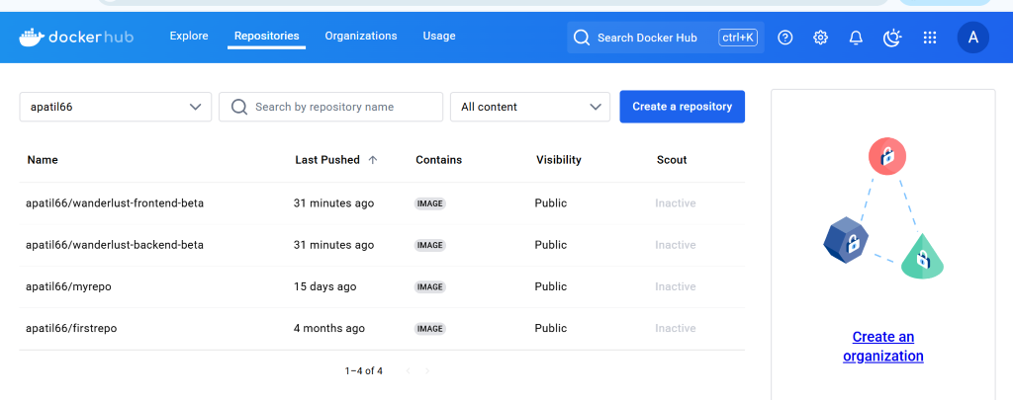
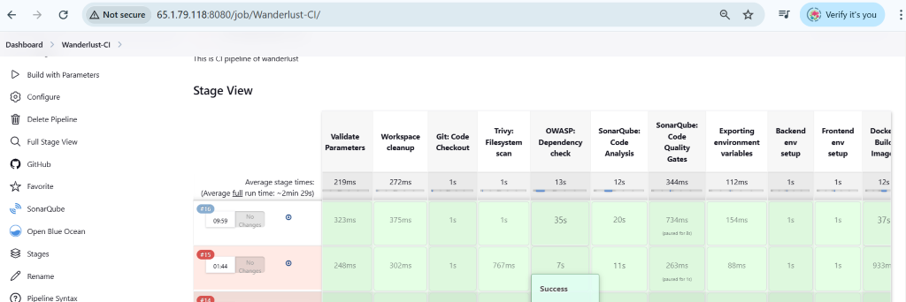
Application
1. Jenkins pipeline
2. Docker repository

Slide 10
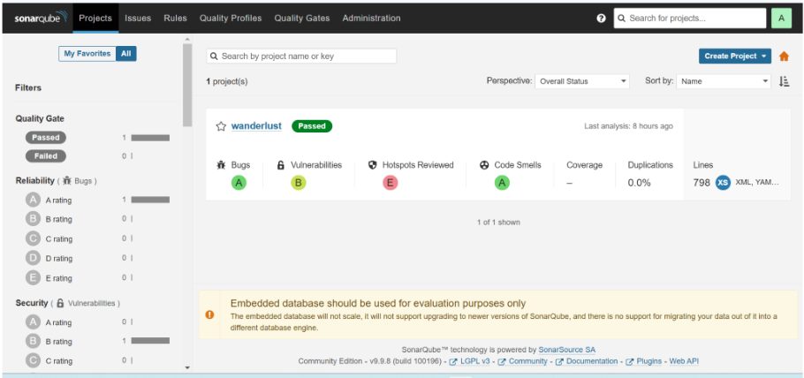
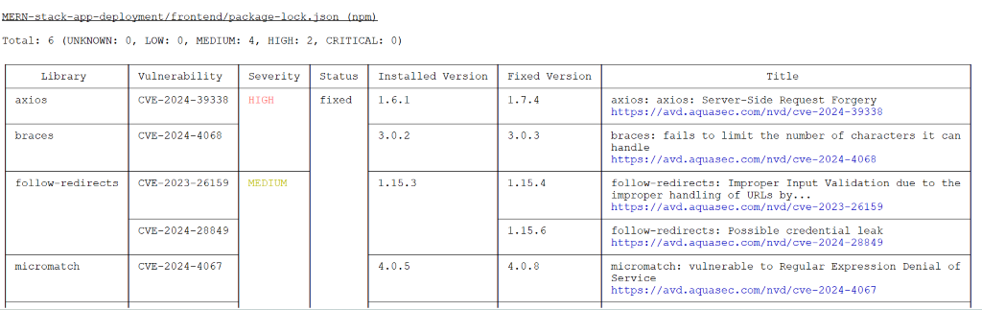
.
3. SonarQube
Trivy setup

Slide 11
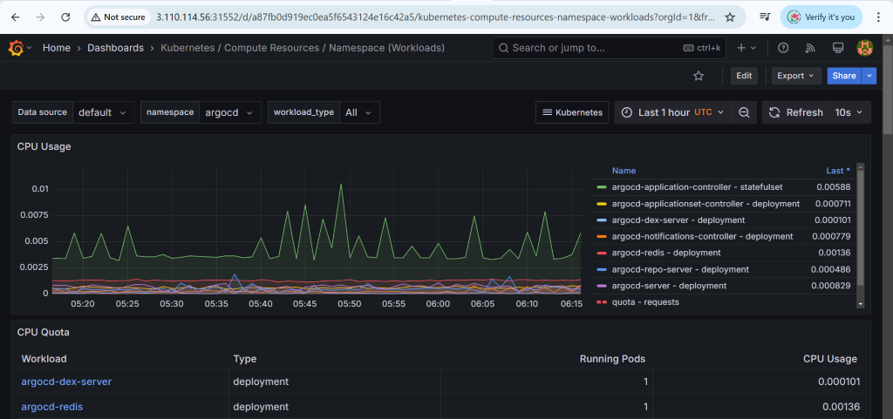
5. GRAFANA

Slide 12
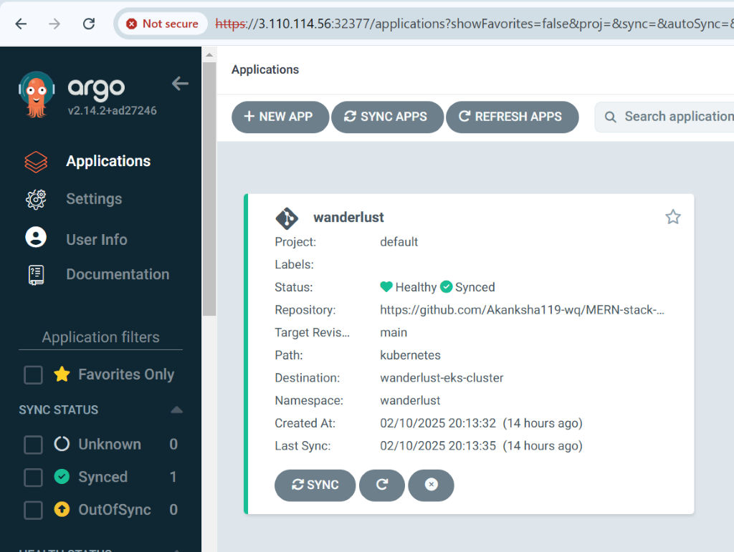
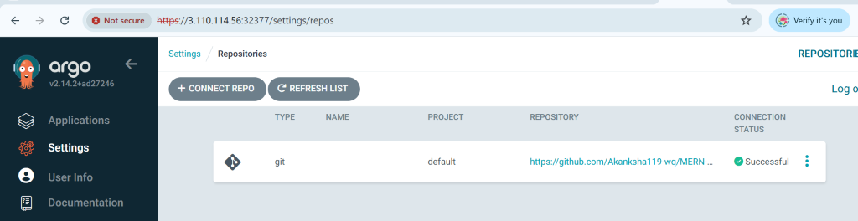
6.ArgoCD

Slide 13
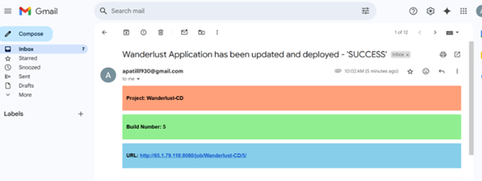
7 . Mail notification after build successful

Slide 14

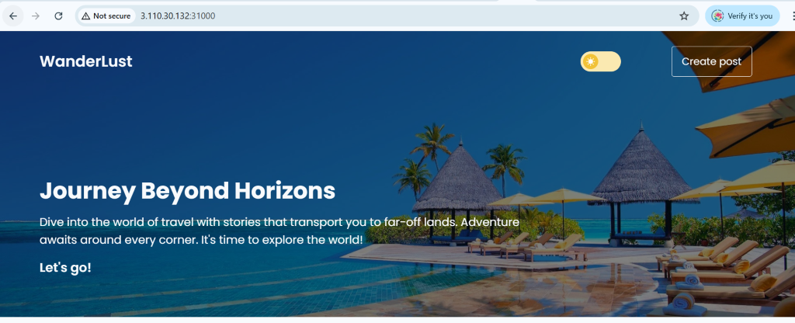
8. App deployment
Node 1
Node 2

Slide 15
Advantages
Secure deployment with automated security scanning.
Scalable and resilient infrastructure.
Reduced risk of security breaches.
Faster application delivery through CI/CD automation.

Slide 16
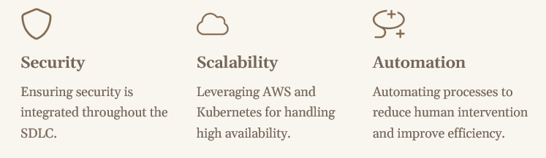
Benefits

Slide 17
Limitations
Requires expertise in DevSecOps tools and cloud services.
Initial setup and configuration are time-intensive.
Costs associated with AWS and security tools.
Complexity in Managing Security Policies and Compliance

Slide 18
Final Workflow Summary:
Developer pushes code → Jenkins CI pipeline starts.
Security & quality checks → Docker image build & push.
Jenkins updates GitHub → ArgoCD deploys to Kubernetes.
Prometheus & Grafana monitor → Notifications sent via email.

Slide 19
Conclusion
.
Enhanced Efficiency & Security
CI/CD automation ensures secure, reliable software deployment.
Key Integrations
Git, JenkinsMERN Stack, SonarQube, Trivy, Docker, Terraform, AWS, Prometheus, and Grafana.
Stronger Security
SonarQube & Trivy detect vulnerabilities early, reducing risks.
Scalable & Automated Deployment
Terraform enables reproducible cloud infrastructure.
Real-time Monitoring
Prometheus & Grafana provide observability and high availability.
Overall Impact
Faster release cycles, reduced errors, and improved system stability.
Future Scope
Continuous optimizations to enhance security and efficiency.

