Slide 1
Adult census Data
Board Infinity
Decode Hackathon 10.3
Aarti Thakur

Slide 2
Basic Statistics
The dataset has 32561 rows and 15 variables.
Age: continuous.
Workclass: Private, Self-emp-not-inc, Self-emp-inc, Federal-gov, Local-gov, State-gov, Without-pay, Never-worked.
Final Weight: continuous.
Education: Bachelors, Some-college, 11th, HS-grad, Prof-school, Assoc-acdm, Assoc-voc, 9th, 7th-8th, 12th, Masters, 1st-4th, 10th, Doctorate, 5th-6th, Preschool.
Education-num: continuous.
Marital-status: Married-civ-spouse, Divorced, Never-married, Separated, Widowed, Married-spouse-absent, Married-AF-spouse.
Occupation: Tech-support, Craft-repair, Other-service, Sales, Exec-managerial, Prof-specialty, Handlers-cleaners, Machine-op-inspct, Adm-clerical, Farming-fishing, Transport-moving, Priv-house-serv, Protective-serv, Armed-Forces.

Slide 3
Basic Statistics
Relationship: Wife, Own-child, Husband, Not-in-family, Other-relative, Unmarried.
Race: White, Asian-Pac-Islander, Amer-Indian-Eskimo, Other, Black.
Sex: Female, Male.
Capital-gain: continuous.
Capital-loss: continuous.
Hours-per-week: continuous.
Native-country: United-States, Cambodia, England, Puerto-Rico, Canada, Germany, Outlying-US(Guam-USVI-etc), India, Japan, Greece, South, China, Cuba, Iran, Honduras, Philippines, Italy, Poland, Jamaica, Vietnam, Mexico, Portugal, Ireland, France, Dominican-Republic, Laos, Ecuador, Taiwan, Haiti, Columbia, Hungary, Guatemala, Nicaragua, Scotland, Thailand, Yugoslavia, El-Salvador, Trinadad&Tobago, Peru, Hong, Holand-Netherlands.

Slide 4

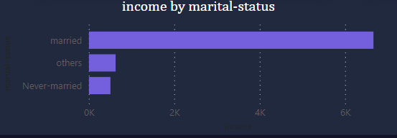
Income by Marital Status

Slide 5
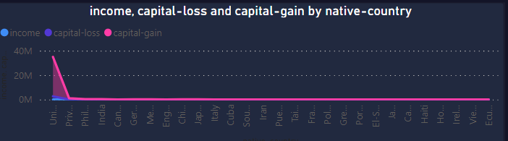
Capital Loss and Capital Gain countrywise

Slide 6
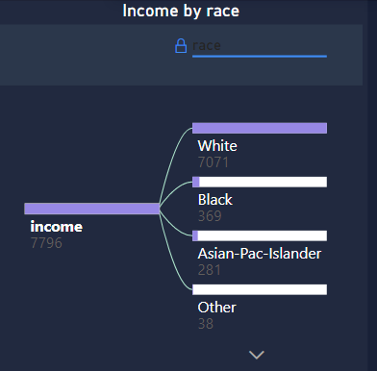
Income by Race

Slide 7
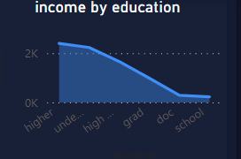
Income by education Crieteria

Slide 8
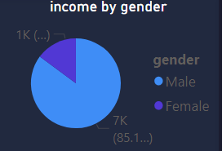
Income by gender

Slide 9
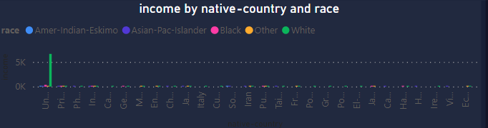
Income And Race by Country wise

Slide 10

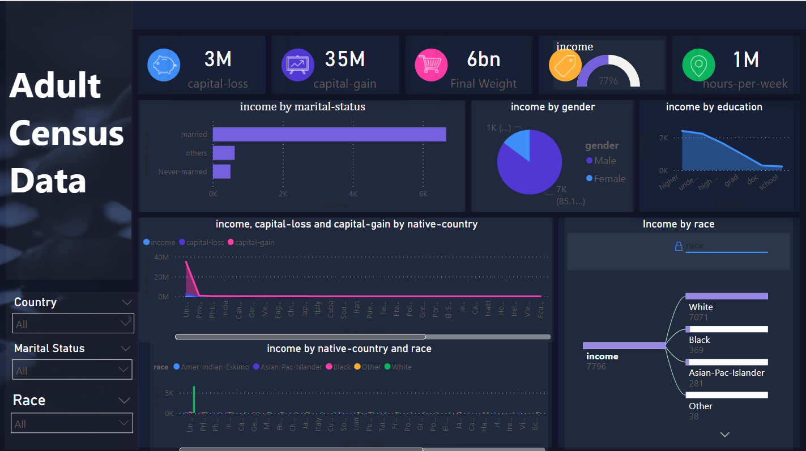





Thanks

