Slide 1
CUSTOMER BEHAVIOUR ANALYSIS
DAB-303 Marketing Analysis
By Group 10

Slide 2

Table of
CONTENTS
04
ABOUT PROJECT
Giive brief idea about what is project and what we are tring to archive
05
DATA AND MISSION
How is our data and wjat is our mission for the project
06
EXPLORATORY DATA ANALYSIS
Summarizing and visualizing data to understand its key characteristics and patterns.
13
OUR FINDINGS
Based on our EDA what are our findings
03
TABLE OF CONTENTS

Slide 3


ABOUT PROJECT
To gain insights into customer behavior patterns.
To identify factors influencing customer churn or retention.
To inform data-driven marketing strategies for customer engagement and retention.
The aim of this project is to comprehensively analyze customer behavior data with the primary goal of gaining actionable insights that will drive data-informed marketing strategies and enhance customer experiences.
Through this analysis, we aim to better understand the factors that influence customer retention or churn and use these insights to optimize our marketing efforts, ultimately improving customer satisfaction, loyalty, and business growth.
CUSTOMER BEHAVIOUR ANALYSIS
ABOUT US
04

Slide 4

DATA
The dataset comprises various customer attributes and behavioral data, providing a valuable resource for understanding customer interactions.
This data will be leveraged to uncover patterns and trends that inform marketing strategies and enhance customer engagement.
MISSION
Our mission is to harness the power of data to decode customer behavior, empower data-driven marketing decisions, and cultivate lasting relationships with our customers by delivering personalized experiences and valuable solutions that exceed their expectations.
CUSTOMER BEHAVIOUR ANALYSIS
DATA AND MISSION
05

Slide 5
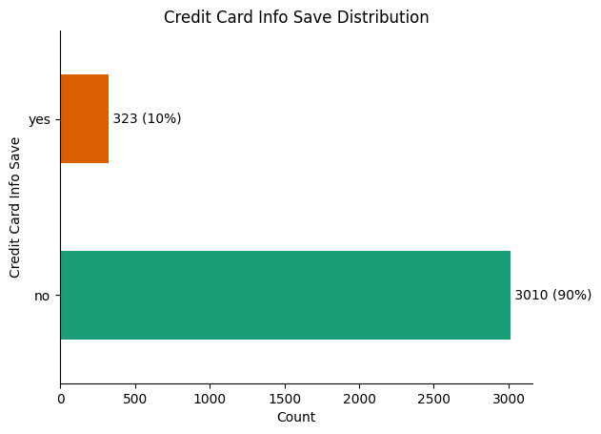
EXPLORATORY DATA ANALYSIS
SUMMARY
90% of customers choose not to save credit card info, while 10% opt to save it, indicating
strong data privacy concerns.
RECOMMENDATION
Prioritize data security for the majority, enhance convenience and security for the minority, and offer flexible payment
options for all.
06
EXPLORATORY DATA ANALYSIS
Customer behaviour analysis

Slide 6
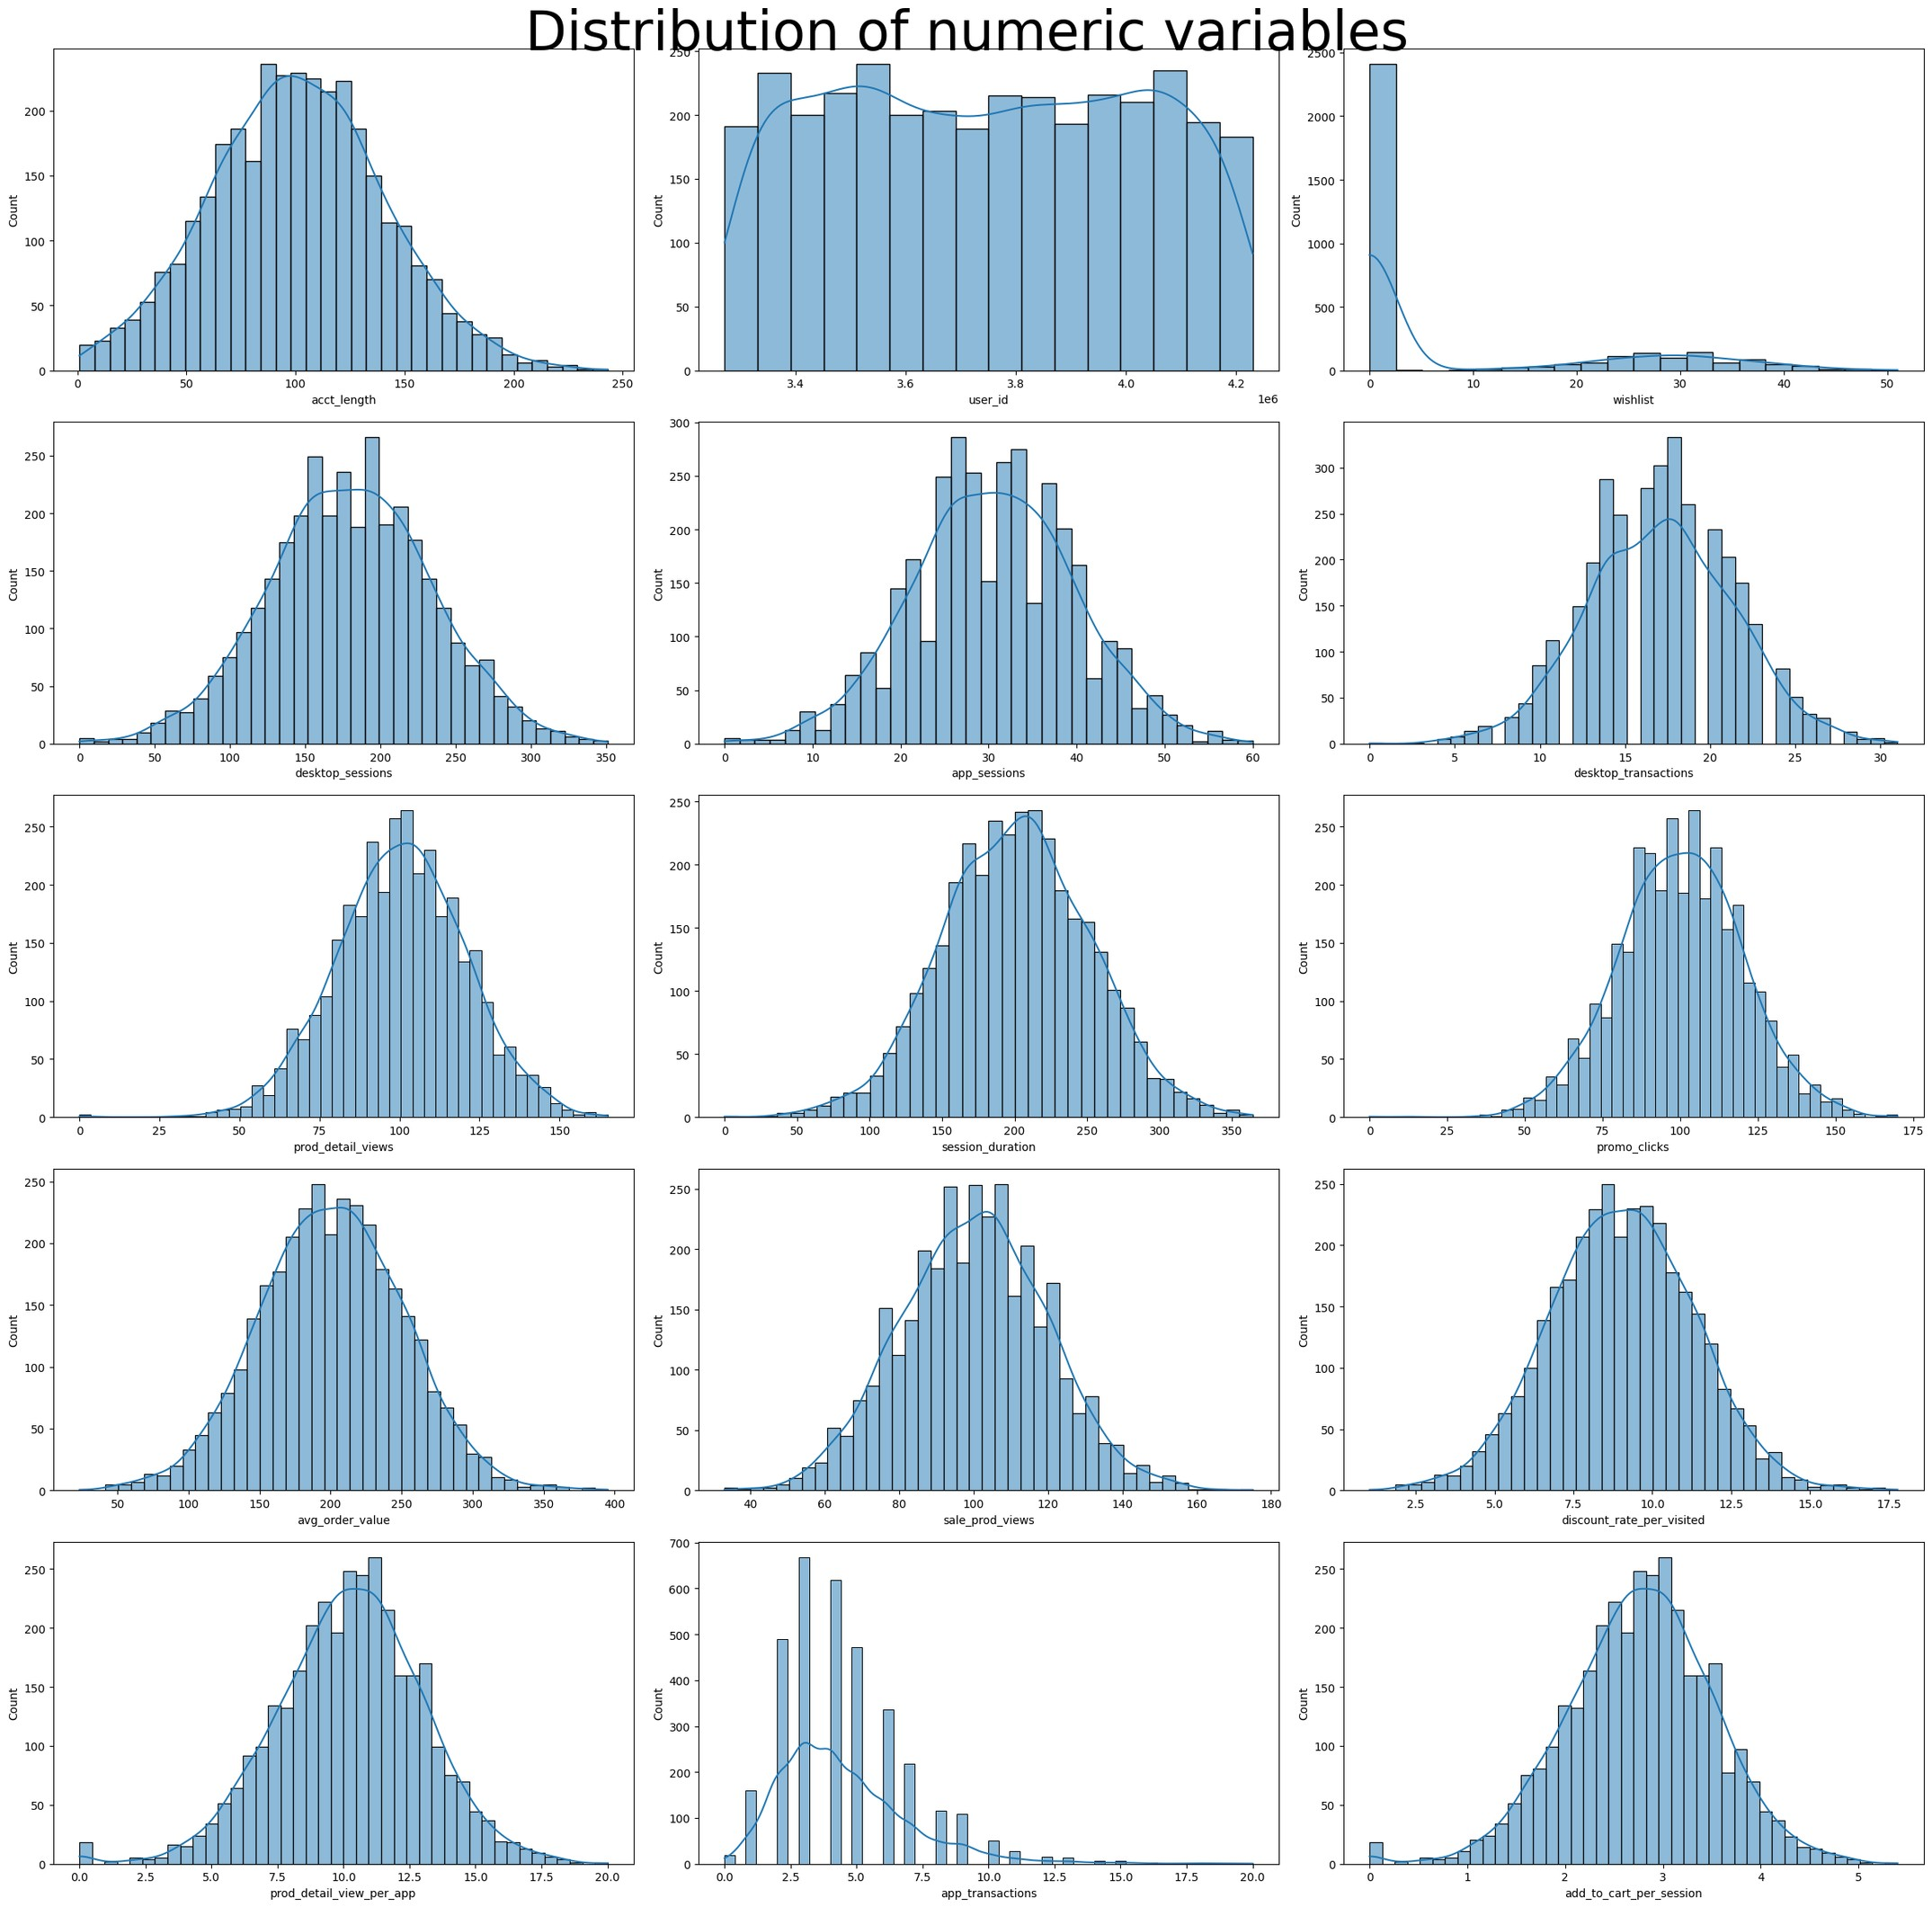
EXPLORATORY DATA ANALYSIS
SUMMARY
Customer behavior analysis highlights preferences for immediate purchases, desktop engagement, product information, modest mobile cart usage, and brief
website visits.
RECOMMENDATION
Streamlining checkout, optimizing desktop, enhancing product info, improving mobile app guidance, and capturing attention with engaging
content.
CUSTOMER BEHAVIOUR ANALYSIS
EDA
07

Slide 7
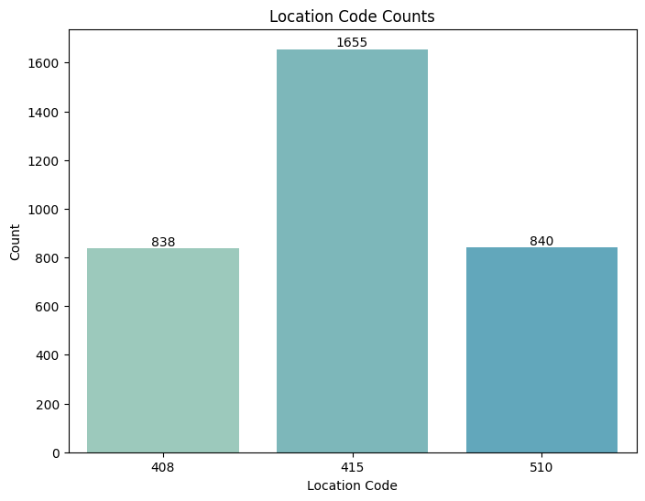
EXPLORATORY DATA ANALYSIS
SUMMARY
It's evident that the majority of customers are in Location Code 415, followed by Location Code 510 and Location Code 408. The analysis also needs to consider churn
behavior in these locations.
RECOMMENDATION
The analysis suggests that the business enjoys a relatively low churn rate, which is a positive indicator of customer retention.
08
EXPLORATORY DATA ANALYSIS
Customer behaviour analysis

Slide 8
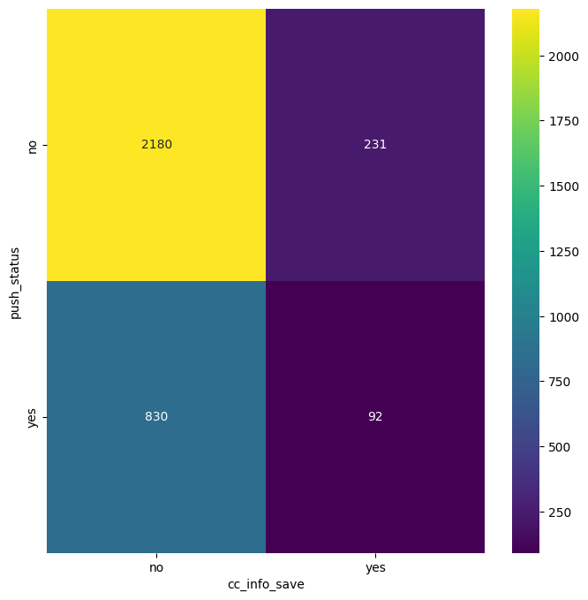
EXPLORATORY DATA ANALYSIS
SUMMARY
The heat map illustrates the relationship between the "push_status" and "credit card info save" variables. It shows that a majority of customers who haven't saved their credit card info have also opted not to receive push notifications, while a smaller number of customers who have saved their credit card info chose to receive push notifications.
RECOMMENDATION
To improve customer engagement, consider targeted strategies for encouraging customers to save their credit card info and opt for push notifications. This could involve promoting the benefits of both features and offering
incentives for their use.
CUSTOMER BEHAVIOUR ANALYSIS
EDA
09

Slide 9
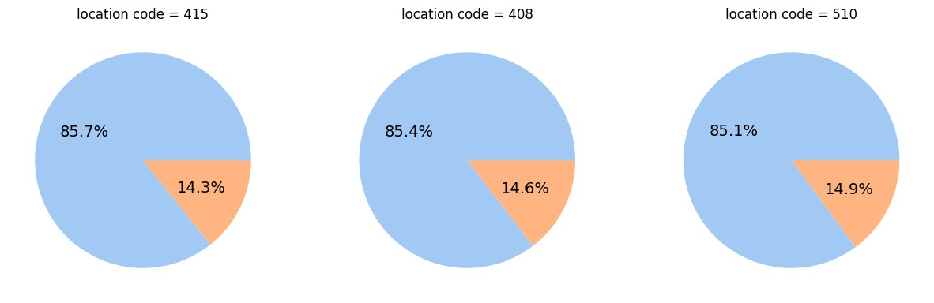
EXPLORATORY DATA ANALYSIS
SUMMARY
The analysis of location codes against churn indicates high percentages of customers in each location code who have not churned:
RECOMMENDATION
While the analysis shows positive retention rates for all location codes, it's advisable to explore the factors contributing to this high retention and identify best practices. Additionally, maintain consistent marketing efforts in these locations to sustain customer
loyalty.
Location Code 415: 85.7% not churn
Location Code 408: 85.4% not churn
Location Code 510: 85.1% not churn
This suggests that the majority of customers in each location code have remained with the business and have not churned.
10
EXPLORATORY DATA ANALYSIS
Customer behaviour analysis

Slide 10
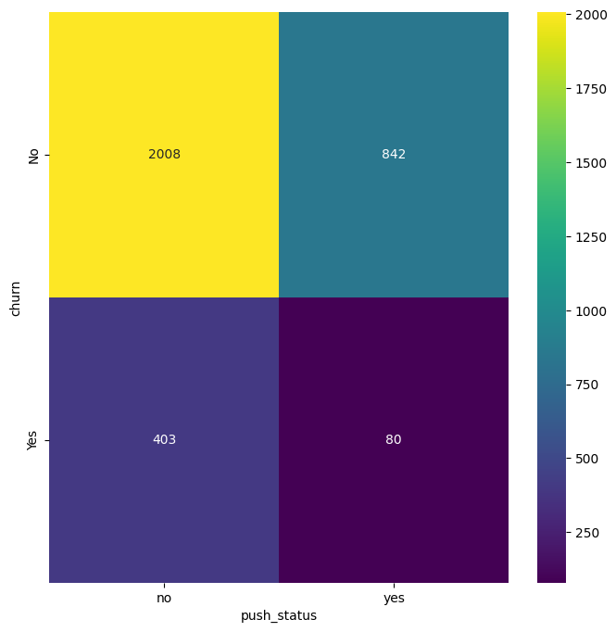
EXPLORATORY DATA ANALYSIS
SUMMARY
Customers who do not receive push notifications (No) have a higher proportion of not churning (No). Customers who receive push notifications (Yes) have a lower proportion of not churning (No).
RECOMMENDATION
To potentially reduce churn, consider emphasizing the benefits of push notifications to customers. Additionally, assess the effectiveness of push notification content and timing to ensure they align with customer preferences and needs, ultimately enhancing engagement
and retention.
CUSTOMER BEHAVIOUR ANALYSIS
EDA
11

Slide 11
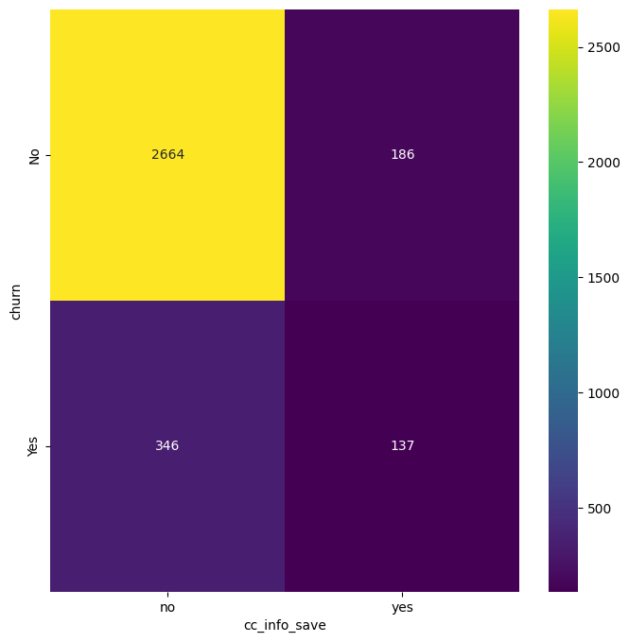
EXPLORATORY DATA ANALYSIS
SUMMARY
Customers who have not saved their credit card information (no) have a higher proportion of not churning (No). Customers who have saved their credit card information (yes) have a lower proportion of not churning (No).
RECOMMENDATION
To improve customer retention, consider encouraging more customers to save their credit card information. Highlight the convenience and security benefits of doing so, and explore ways to incentivize this behavior. This may help reduce churn and enhance customer engagement.
12
EXPLORATORY DATA ANALYSIS
Customer behaviour analysis

Slide 12


FINDINGS
The location codes have a similar percentage of churns, meaning that location might not be a strong indication for churn
Customers with push status activated are less likely to be churns, meaning that motivating customers to activate push status might help minimize churns Customers with their credit card information saved on the side are far less likely to be churns than customers without their credit card info saved. This means that if the shop motivates people to save their credit card info might minimize churns.
This makes sense since customers who trust their credit card info on a side indicate that they trust the brand. More trust less chances of customers leaving your business.
13
FINDINGS
Customer behaviour analysis

Slide 13
November 2023
Group 10

