Slide 1




DATA CHALLENGE
ST.CLAIR COLLEGE

Slide 2


TABLE OF CONTENTS
ABOUT US
03
INTRODUCTION
04
DATA FLOW
05
VISUALIZATION
06
KEY INSIGHTS
07
ST.CLAIR COLLEGE
ROCKET BLASTER

Slide 3




ABOUT US
Rocket Blaster
Aarti Anil Zikre
I'm a data wizard during the day, using Python to uncover insights, and at night, I work magic on Drupal to create captivating websites. My unique mix of technical skills and creativity allows me to make data exciting and websites stunning, setting me apart from the rest.
Bhavita Bhatt
A Data Enthusiast with keen interest in Tableau and Power BI, Python, Excel and Web application Development
ST.CLAIR COLLEGE
ROCKET BLASTER

Slide 4


INTRODUCTION
We present the client demographics dashboard and asset storyboard meticulously crafted for Rocket Mortgage Canada's data challenge.
These tools provide stakeholders with invaluable insights derived from real-world data.
Through diligent data cleaning, robust modeling, and insightful mining, we've meticulously organized and analyzed information from various sources, including credit reports, borrower details, incomes, liabilities, assets, and property information.
.
ST.CLAIR COLLEGE
ROCKET BLASTER

Slide 5





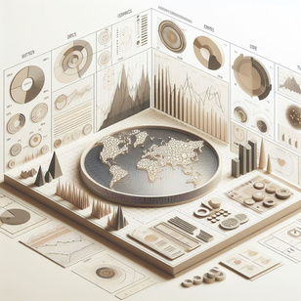

DATA FLOW
Our data flow process encompasses four essential stages: data cleaning, data modeling, data mining, and visualization.
Data Cleaning
Data Modeling
Data Mining
Visualization
Python-based cleaning ensured accuracy by addressing errors and inconsistencies.
Structured modeling organized data for efficient analysis.
Advanced techniques identified patterns and trends for deeper insights.
Tableau visualizations presented findings clearly for informed decisions.
ST.CLAIR COLLEGE
ROCKET BLASTER

Slide 6
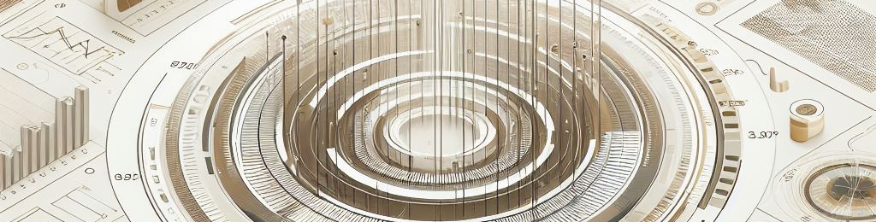

VISUALIZATION
Let’s move to tableau !!!!
ST.CLAIR COLLEGE
ROCKET BLASTER

Slide 7



KEY INSIGHTS
Imagine sorting through a mountain of data and finding 60,147 unique mortgage applications! These applicants carry an average ongoing debt of $41.95k and maintain a solid average credit score of 744.9. It's a testament to the diversity of those seeking mortgages.
In the working world, we see a clear divide. Professionals and managers typically bring in the big bucks, earning between $80k and $160k. On the flip side, clerical and labor/tradesperson roles tend to fall within lower income brackets. It's a tale of two earning spectrums.
Love seems to play a significant role in mortgage applications, with 59% of applicants being married. Most often, these couples either have no dependents or two. It's heartwarming to see families taking these financial steps together.
Jobs paint a fascinating picture of our applicants' lives. Many work in sectors like other and service, with only a small fraction employed in high tech. Interestingly, those not applying directly often have a spouse linked to the application. It's a reminder of the importance of support networks in big decisions.
ST.CLAIR COLLEGE
ROCKET BLASTER

Slide 8
CONTINUE
The highest earners in our dataset are the ones bringing home the bacon. On average, employed individuals make around $84.15k, a significant sum that speaks to their financial stability.
Let's talk investments! Our analysis uncovered some intriguing patterns. While stocks and bonds are the norm, there's a surprising $119.23k invested in the "Other" category. It's a reminder that financial planning is as diverse as our applicants.
Finally, when it comes to investments, managers stand out from the crowd. Their preferences lean towards unconventional options, contributing a whopping $92.3k to the "Other" category. It seems they're not afraid to take risks in the pursuit of financial growth.
ST.CLAIR COLLEGE
ROCKET BLASTER

Slide 9
THANK YOU

